Slide 1

ANUMAAN
Team Name: QWERTY
Team members: Amisha Joshi, Kshitij Jaiswal & Bandi Gayatri
Institute: IIT (BHU), Varanasi

Slide 2
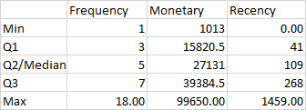
1.RFM ANALYSIS
Number of unique IDs: 4873
RFM analysis was performed to categorise and understand the customers, with each score in the range of 1-4 (1 being least desirable) using method of quartiles.
RFM scores:
4(Recency), 4(Frequency), 4(Monetary): Loyal customers-456 people
1(Recency), 1(Frequency), 1(Monetary): Extremely fickle customers-510 people
Highest sales: DK-130901 - 99.65k
Lowest sales: JE-57451- 1013
These two extreme groups of people are analysed in terms of sales.

Slide 3
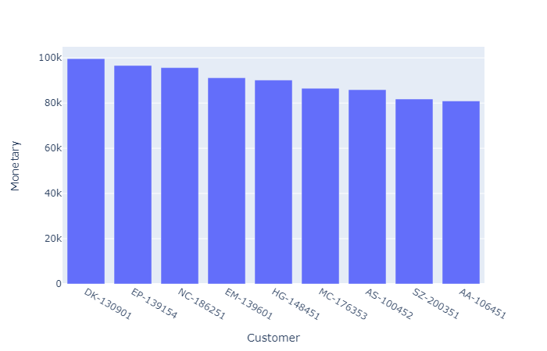
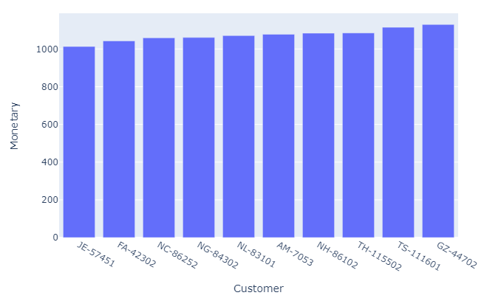
Header of RFM tabulated data:
Sales vs Top 10 IDs
Loyal customers(4,4,4 RFM): Unloyal customers(1,1,1 RFM):
Customer | Recency | Frequency | Monetary | F-score | M-score | R-score
AA-103151 | 8.00 | 5 | 14822 | 3 | 1 | 4
AA-103152 | 13.00 | 7 | 45736 | 4 | 4 | 4

Slide 4
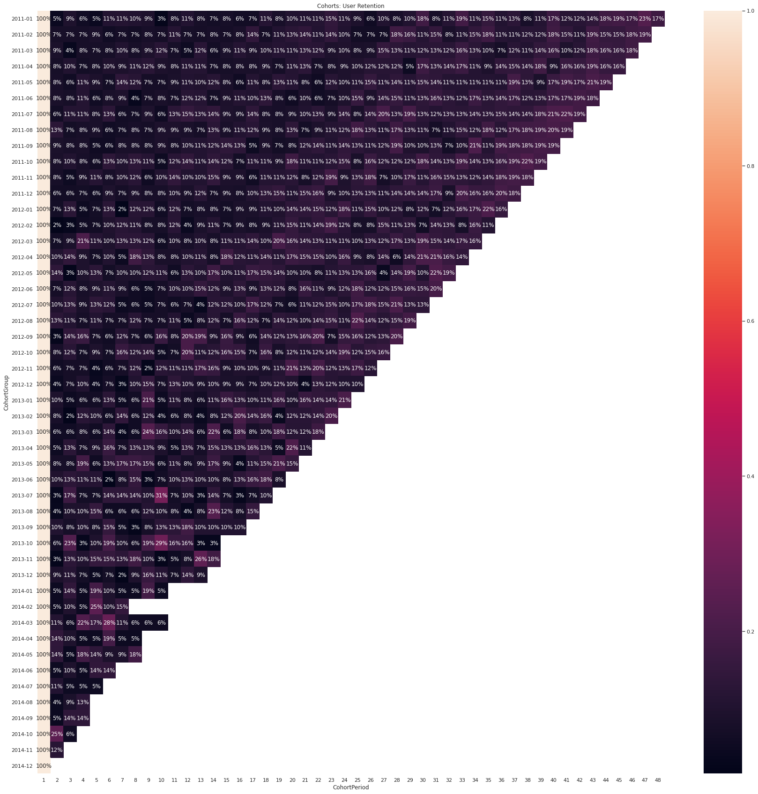
2.CUSTOMER LOYALTY & RETENTION
(Cohort Analysis)
48 Monthly cohorts were formed
Very low retention rates initially across each cohort suggests that old customers were not being retained. Thus efforts should be made to retain old customers.
Retention increased slightly (across the cohorts) implying that a better marketing strategy was adopted to retain older customers and not just acquire new ones.
Across the lifetime of sales, the retention increased only towards the end implying that only then some drastic measures were taken to retain customers.
Scope for further improvement for retention of customers.

Slide 5
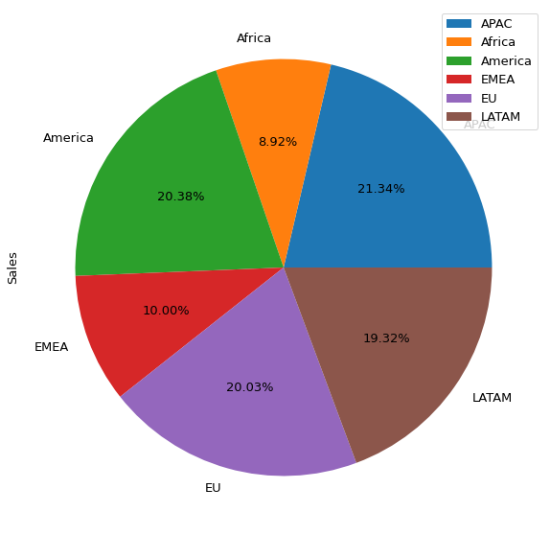
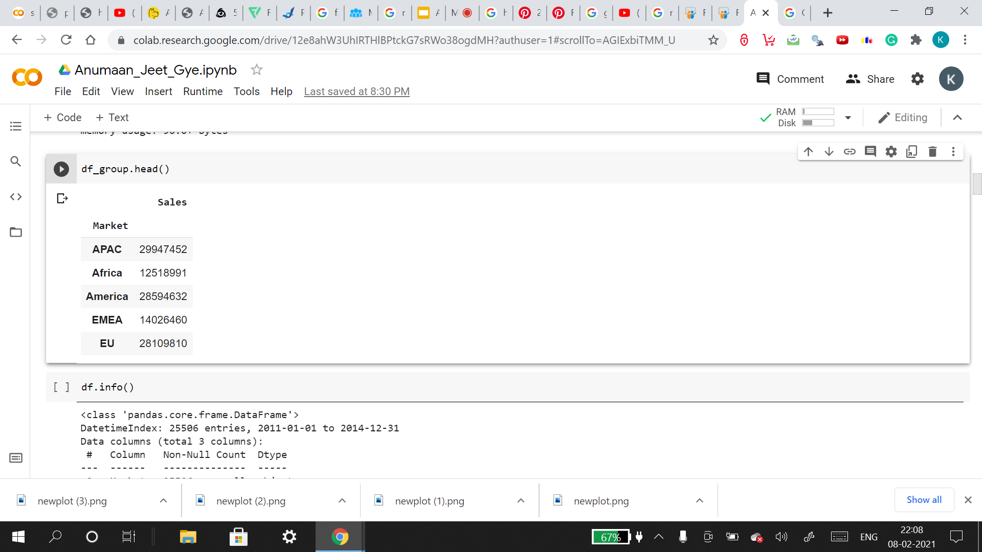
3. MARKET PERFORMANCE
Highest sales market-wise:
APAC (21.34%)
Lowest sales market-wise:
Africa (8.92%)
Each market was further analysed using decomposition models.

Slide 6
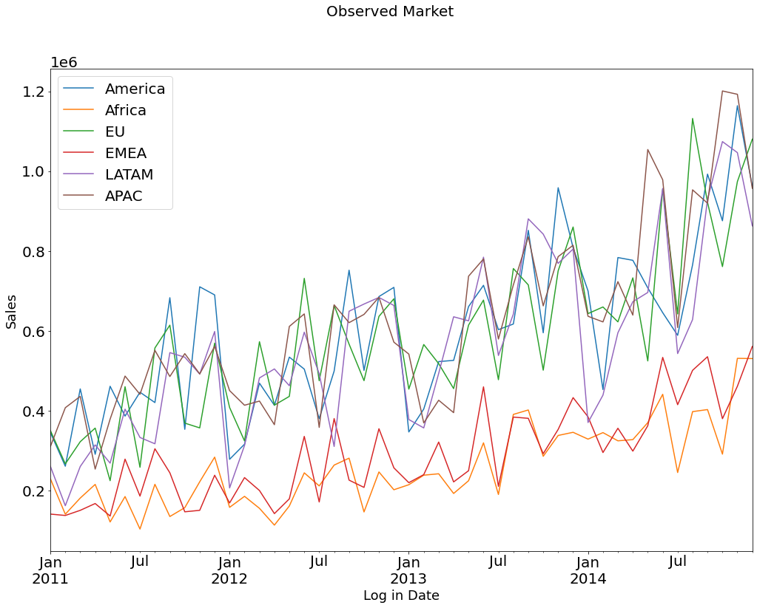
MARKET PERFORMANCE: Observed values (Market wise)
The lowest monthly sales over the 4 years is from Africa during July 2011.
Lowest sales in Africa might be due to economic conditions or reforms.
The highest monthly sales over the 4 years is from APAC during Oct 2014. Can be due to the high population density of the region.
EMEA has low sales probably due to presence of competitors.

Slide 7
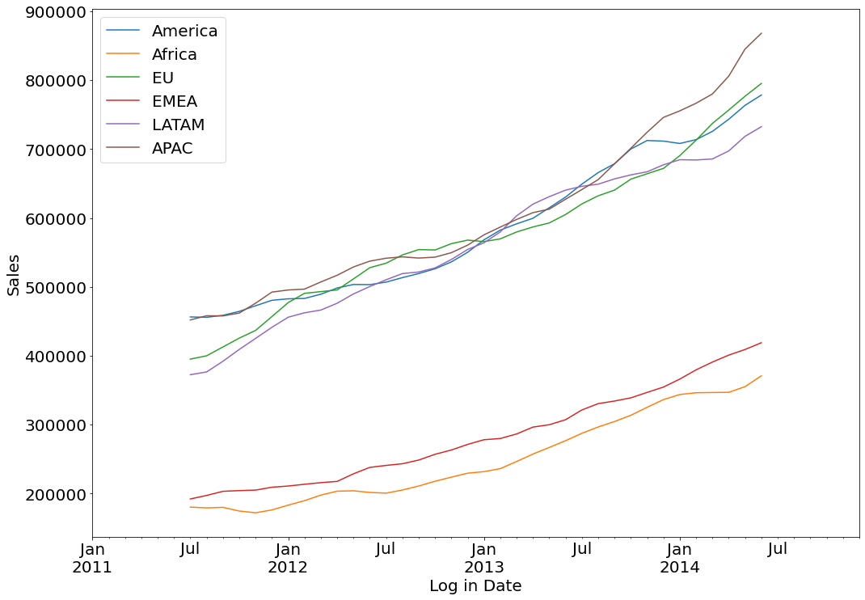
MARKET PERFORMANCE: Trend (Market wise)
All trends are linearly increasing indicating good growth in sales.
EMEA & Africa have relatively less steeper increasing trend of all regions. Strategies must be changed in EMEA and Africa or focus should be shifted to regions whose potential can be tapped.
Linear trend in APAC region is strongest. APAC can be a potentially bigger market.

Slide 8
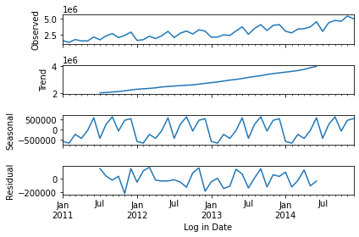
4. SEASONALITY IN SALES
Decomposition model was applied on the monthly sales data.
A linear increasing trend is observed indicating that sales were improving.
Seasonality is yearly with Feb having least sales. Possible reasons need to be looked into.
Highest sales in September.
December and June have significant amount of sales. Sales can be further increased in these months using aggressive marketing to beat competitors & to cash in on the festive spirit in December.

Slide 9
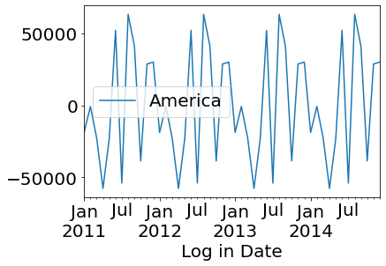
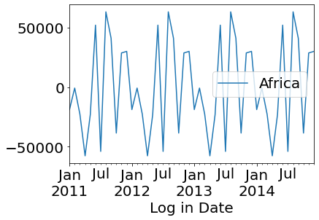
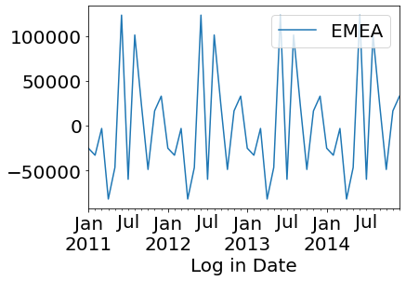
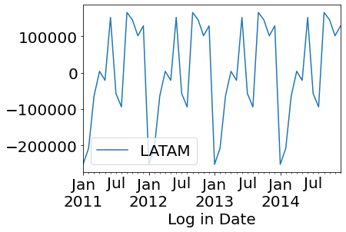
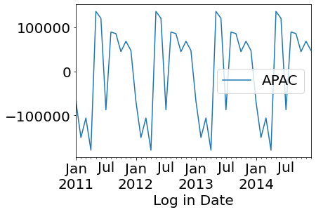
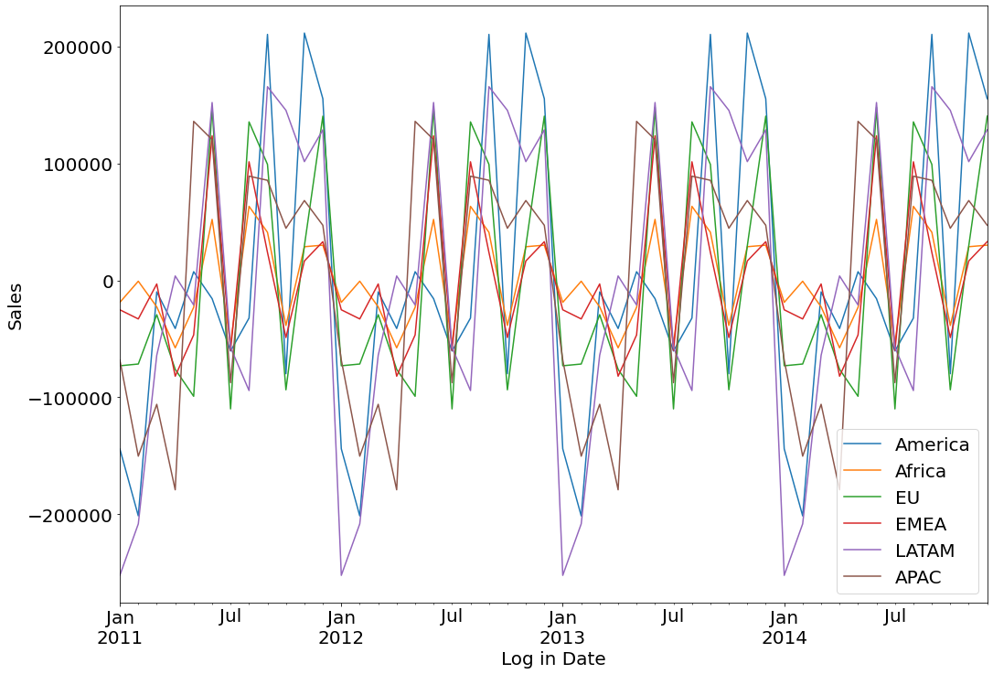
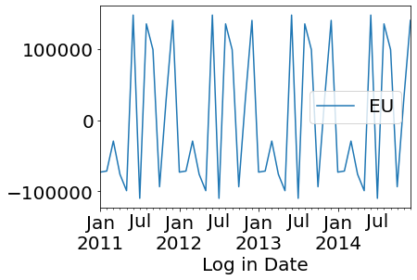
MARKET SEASONALITY
Seasonality in all ṭhe markets is clearly observed.
Additive seasonality in all markets.
(This implies presence of
same pattern every year)

Slide 10
THANK YOU

