Slide 1

CST1510 Programming for data communication and networks
Week 7

Slide 2
Objectives:
Programming paradigms
OOP overview & principles
Object
Class UML
A simple class
Creating Object of a class
Encapsulation
Superclass and subclass: Inheritance
The object Class
Polymorphism and Dynamic Binding
The isinstance Function
Class Relationships: association, aggregation, composition

Slide 3
Programming paradigms
Imperative: Programming with an explicit sequence of commands that update state.
Declarative: Programming by specifying the result you want, not how to get it.
Structured: Programming with clean, goto-free, nested control structures.
Procedural: Imperative programming with procedure calls.
Functional (Applicative): Programming with function calls that avoid any global state.
Function-Level (Combinator): Programming with no variables at all.
Object-Oriented: Programming by defining objects that send messages to each other.
Event-Driven: Programming with emitters and listeners of asynchronous actions.
Flow-Driven: Programming processes communicating with each other over predefined channels.
Logic (Rule-based): Programming by specifying a set of facts and rules. An engine infers the answers to questions.
Constraint: Programming by specifying a set of constraints. An engine finds the values that meet the constraints.
Aspect-Oriented: Programming cross-cutting concerns applied transparently.
Reflective: Programming by manipulating the program elements themselves.
Array: Programming with powerful array operators that usually make loops unnecessary.
Paradigms are not meant to be mutually exclusive; a single program can feature multiple paradigms!
Notes:
Just for information not necessarily to cover in great details to know for students to read later and be aware that we have large variety of programming paradigms

Slide 4
OOP
Object-oriented programming (OOP) is a computer programming model (style of designing software) that organizes software design around data, or objects, rather than functions and logic.
An object can be defined as a data field that has unique attributes and behavior.
OOP focuses on the objects that developers want to manipulate rather than the logic required to manipulate them.
This approach to programming is well-suited for programs that are large, complex and actively updated or maintained.
The organization of an object-oriented program also makes the method beneficial to collaborative development, where projects are divided into groups.
Notes:
Focus on what the developers want to manipulate writer the how. This approach is well suited for program that are large, complex and actively updated and maintain. Object can be anything from a physical ententi lika a human being down to a small computer program.

Slide 5
OOP - principles
Encapsulation. Data hiding provides greater program security and avoids unintended data corruption.
Abstraction. hiding any unnecessary implementation code which helps developers more easily make changes and additions over time.
Inheritance. Relationships and subclasses between objects which reduces development time and ensures a higher level of accuracy.
Polymorphism. Many forms which allowed cutting down the need to duplicate code.
Notes:
This week we will be just looking at Encapsulation. The implementation and state of each object are privately held inside a defined boundary, or class. Other objects do not have access to this class or the authority to make changes but are only able to call a list of public functions, or methods. This characteristic of data hiding provides greater program security and avoids unintended data corruption.
The remaining will be looked at in wee 10
Abstraction. Objects only reveal internal mechanisms that are relevant for the use of other objects, hiding any unnecessary implementation code. This concept helps developers more easily make changes and additions over time.
Inheritance. Relationships and subclasses between objects can be assigned, allowing developers to reuse a common logic while still maintaining a unique hierarchy. This property of OOP forces a more thorough data analysis, reduces development time and ensures a higher level of accuracy.
Polymorphism. Objects can take on more than one form depending on the context. The program will determine which meaning or usage is necessary for each execution of that object, cutting down the need to duplicate code.

Slide 6
Entry point:
Every module in Python has a special attribute called __name__.
The value of __name__ attribute is set to '__main__' when module run as main program.
Otherwise, the value of __name__ is set to contain the name of the module.
It makes a module both executable and importable
if __name__ == '__main__': main()

Slide 7

Object
State:
Name
Age
Address
Behavior:
Walk:
Talk
Breath
Programme is compose of lots of individual objects. (Bundle of data) Entity of things usually define as a noun
Example of object could be a person

Slide 8
Class UML
Blueprint of an object
Examples:
Identity
state
behavior

Slide 9


Define Object using class
Class is:
definition of an abject. (blueprint/template of an object)
used to create object.
Object is an instance of that class
Instances of a class Person
Class:
Person
Object:
Barry
Object:
Anna
Object:
Bob

Slide 10
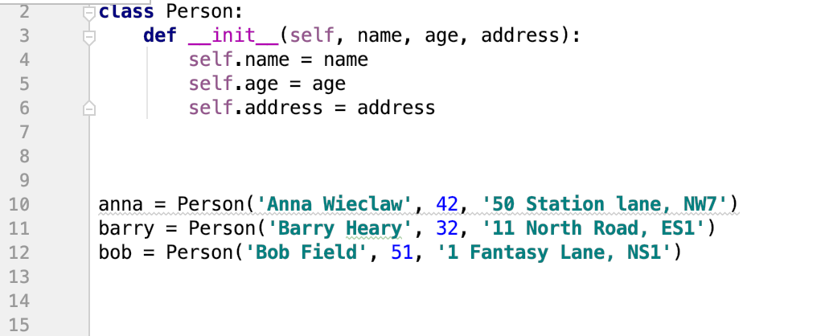
Class and Object code Example:

Slide 11




Define Object using class
Class:
Dog
Object:
Bart
Object:
Vuk
Object:
Princess

Slide 12
A simple class
name
class key word
class Dog: pass
pass key words

Slide 13
Creating object of a class
vuk = Dog()

Slide 14
Defining method
A method is a function defined in class scope and with first parameter self:
The self variable is explicit. It references the current object, that is the object whose method is currently executing.
class Dog: def bark(self, sound): return f' bark: {sound}'

Slide 15
Calling methods using the dot operator
vuk = Dog()
vuk.bark('Woof woof ...')

Slide 16
constructor/initializer
The constructor/initializer is a method named __init__.
Include in member variables are created with assignment.
class Dog: def __init__(self, name, age): self.name = name self.age = age
constructor / initializer
Notes:
Yhe role of Initialiser is to provide its initialize value

Slide 17
Instantiated object (initialize constructor)
vuk = Dog('Vuk', 4)

Slide 18
Class variables
A class variable is shared by instances of the class. Also called static data.
Define at class level with assignment.
class Dog: species = "Canis" def __init__(self, name, age): self.name = name self.age =age def bark(self, sound): return f' bark: {sound}' def __str__ (self): return f'the Dog name is: {self.name} and he is: {self.age} years old'
class variable

Slide 19
Using __repr__ method to represent an object
class Dog: species = "Canis" def __init__(self, name, age): self.name = name self.age =age def bark(self, sound): return f' bark: {sound}' def __repr__(self): return f'the Dog name is: {self.name} and he is: {self.age} years old'
string representation
of object

Slide 20
Using __str__ method to represent an object
class Dog: species = "Canis" def __init__(self, name, age): self.name = name self.age =age def bark(self, sound): return f' bark: {sound}' def __str__ (self): return f'the Dog name is: {self.name} and he is: {self.age} years old'
string representation
of object

Slide 21
Hiding Data Fields
Making data fields private protects data and makes the class easy to maintain.
class Dog: species = "Canis" def __init__(self, name, age): self.__name = name self.age =age def get_name(self): return self.__name def bark(self, sound): return f' bark: {sound}' def __str__(self): return f'the Dog name is: {self.__name} and he is: {self.age} years old'
private date
fields
accessor
method

Slide 22




Activity
Create a Class of a Car as the UML diagram below and three object of the class.
Object:
Audi
Object:
Volvo
Object:
Volvo
Class:
car
Change the make year, model, and fuel type into private attributes and create accessor methods to be able to get the data

Slide 23
Underscores in Python
Double underscores (“dunder”)
Single Leading Underscore: _var (naming preferences for variables, in functions however it would not allow import such function from the method )
Single Trailing Underscore: var_ (to break the naming conflict: in a variable is already defined)
Double Leading Underscore: __var (create private data field)
Double Leading and Trailing Underscore: __var__

Slide 24
Inheritance:
Object-oriented programming (OOP) allows you to define new classes from existing classes.
Inheritance enables you to define a general class (a superclass) and later extend it to more specialized classes (subclasses).
A subclass inherits accessible data fields and methods from its superclass, but it can also have other data fields and methods.

Slide 25
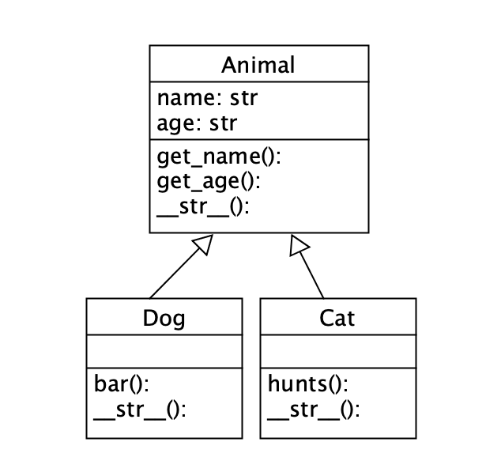
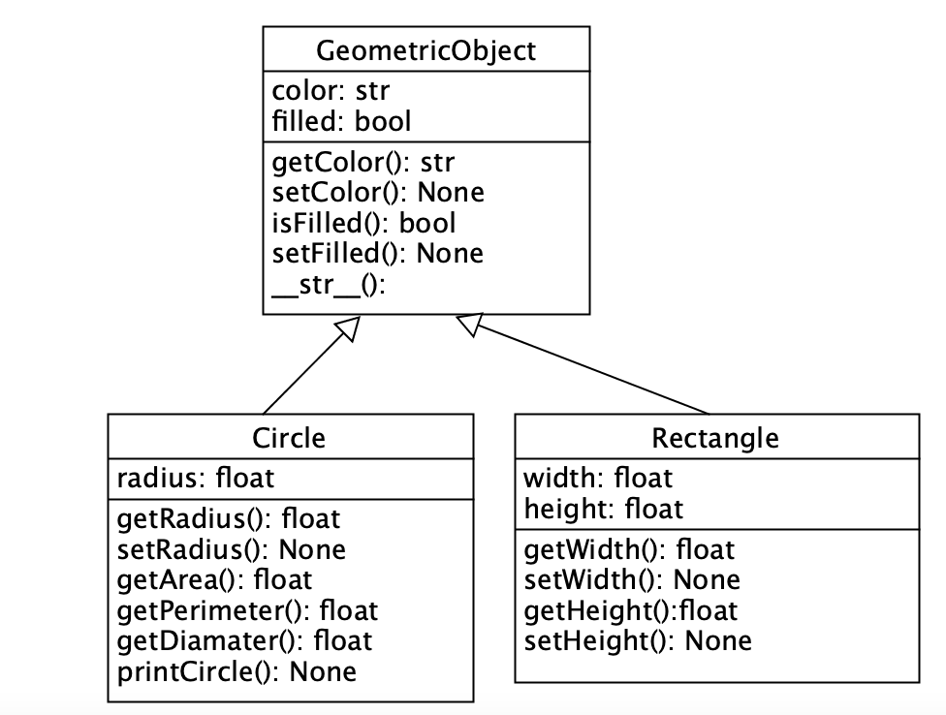
Example of Inheritance
Example 1
Example 2
superclass
subclass
subclass
superclass
class Dog(Animal):
class Circle(GeometricObject):
Liang book p.401

Slide 26
superclass and subclass constructor
class Animal: def __init__(self, name, age): self.__name = name self.__age = age
class Dog(Animal):
def __init__(self, name, age), id: super().__init__(name, age)
self.__id = id
super ()
calls constructor from the superclass

Slide 27
Code example of Inheritance
subclass
superclass
class Dog(Animal): def __init__(self, name, age, id): super().__init__(name, age)
self.__id = id def bark(self, sound): return f' bark: {sound}' def __str__(self): return super().__str__() + self.bark('woof woof')
class Animal: def __init__(self, name, age): self.__name = name self.__age = age
def get_name(self): return self.__name def get_age(self): return self.__age def __str__(self): return f'the Animal name is: {self.__name} and he is: {self.__age} years old'
subclass
superclass
class Cat(Animal):
def __init__(self, name, age, id): super().__init__(name, age)
self.__id = id def hunts(self): return f' it is: {True} cuts are hunting ' def __str__(self): return super().__str__() + self.hunts()
super ()
calls constructor or functions from the superclass

Slide 28
Overriding Methods
To override a method, the method must be defined in the subclass using the same header as in its superclass.
class Animal: def __init__(self, name, age): self.__name = name self.__age = age
def get_name(self): return self.__name def get_age(self): return self.__age def __str__(self): return f'the Animal name is: {self.__name} and he is: {self.__age} years old'
class Cat(Animal):
def __init__(self, name, age, id): super().__init__(name, age)
self.__id = id def hunts(self): return f' it is: {True} cuts are hunting ' def __str__(self): return super().__str__() + self.hunts()

Slide 29
The object Class
Every class in Python is descended from the object class.
The object class is defined in the Python library. If no inheritance is specified when a class is defined, its superclass is object by default.
The __new__() method is automatically invoked when an object is constructed.
This method then invokes the __init__() method to initialize the object. Normally we only override the __init__() method to initialize the data fields defined in the new class.
The __str__() method returns a string description/representation for the object

Slide 30
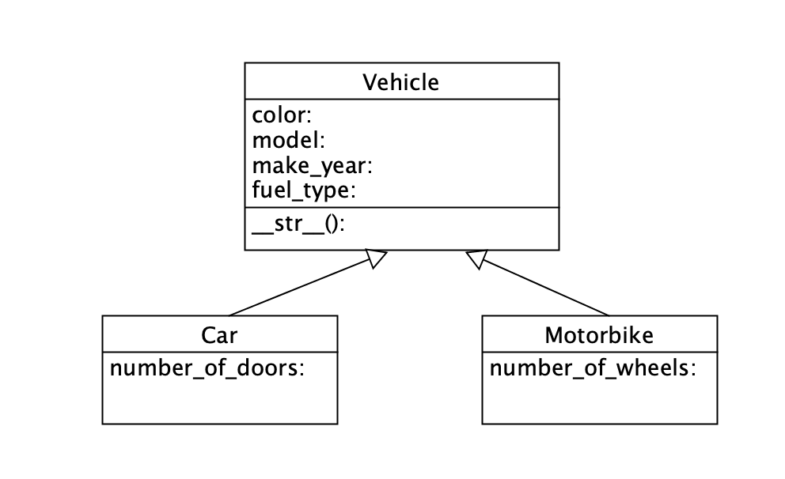
Activity
Create a superclass name of Vehicle and two subclasses names of:
Car and Bus as the UML diagram
Override the __str__ methods in both of the subclasses

Slide 31
Check for equality
The __eq__(other) method returns True if two objects are the same.
You can override this method to return True if two objects have the same contents.
The __eq__ method is overridden in many Python built-in classes such as int , float , bool , string , and list to return True if two objects have the same contents.
Example:
def __eq__(self, c): if super().get_ID() == c.get_ID(): return True
full code example on GitHub

Slide 32
Polymorphism
Polymorphism is the ability of an object to take on many forms.
def main(): vuk = Dog('Vuk', 5,'D01') princess = Dog('Princess', 2, 'D04') rex = Dog(‘Rark', 4, 'D05') lily = Cat(‘Lily',2,'C01') kitty = Cat(Kitty',1, 'C02’)
dogs_list = [vuk, princess, bark] cats_list = [lily, kitty] animals = dogs_list + cats_list for i in animals: print(i) if __name__=='__main__’: main()
Polymorphic call
#Vuk
#Princess
#Rex
#Lily
#Kitty

Slide 33
The isinstance Function
The isinstance function can be used to determine whether an object is an instance of a class.
def main(): vuk = Dog('Vuk', 5,'D01') princess = Dog('Princess', 2, 'D04') bark = Dog('Bark', 4, 'D05') piko = Cat('Piko',2,'C01') poko = Cat('Poko',1, 'C02’)
dogs_list = [vuk, princess, bark] cats_list = [piko, poko] animals = dogs_list +cats_list for i in animals: if isinstance(i, Cat): print(i.hunts()) if __name__=='__main__': main()
Is instance
Check if instance for the specific class

Slide 34
Activity
Create a main methods in which:
Create 3 car objects and 2 motorcycle objects
Create a lists: cars and motorcycles with the objects above objects as an elements
Join the lists into one vehicles list
Loop through the vehicle list and call the __str__ methods on all the objects

Slide 35
Class Relationships
To design classes , you need to explore the relationships among classes.
The common relationships among classes are
association
aggregation
composition
Inheritance (is a)
(has a)

Slide 36
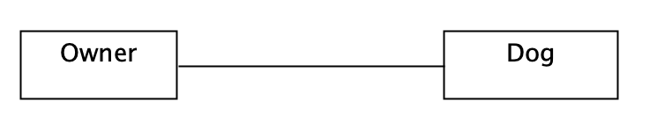
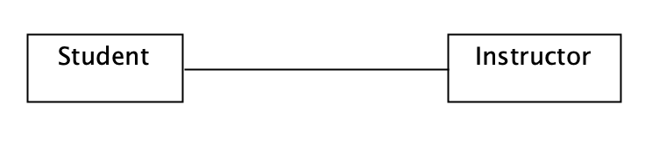
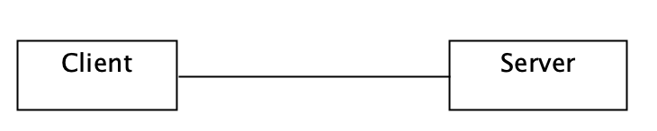
association
If two classes in a model need to communicate with each other, there must be a link between them, and that can be represented by an association (connector).
Examples:
owner association with dog
student associate with instructor
client associate with server etc

Slide 37
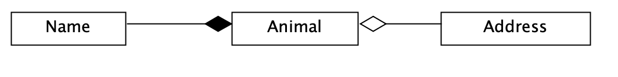
aggregation / composition
Composition and aggregation is a concept that models a has a relationship. It enables creating complex types by combining objects of other types.
Aggregation implies a relationship where the child can exist independently of the parent. Example: Class (parent) and Student (child). Delete the Class and the Students still exist.
Composition implies a relationship where the child cannot exist independent of the parent. Example: House (parent) and Room (child). Rooms don't exist separate to a House.
Example: a name is a part of both dogs and cats (composition)
composition aggregation

Slide 38
Composition
class Address: def __init__(self, number, street, postcode, country): self.number = number self.street = street self.postcode = postcode self.country = country def __str__(self): return f'The address is:\n{self.number} {self.street}
\n{self.postcode} \n{self.country}'
class Animal: def __init__(self, name, age, address): self.__name = name self.__age = age self.address= address def get_name(self): return self.__name def get_age(self): return self.__age def get_Address(self): return self. address def __str__(self): return f'the Animal name is: {self.__name} and he is: {self.__age} years old\n{self.address}'
def main(): vuk = Dog('Vuk', 5, Address(1, 'Station Road', ‘ES4', 'UK')) princess = Dog('Princess', 2, Address(2, 'Hendon Lane', 'N4', 'UK')) poko = Cat('Poko',1, Address(1, ‘Dog lane', ‘NW1', 'UK')) animals = [vuk, princess, poko] for i in animals: print(i) print('----------------------') if __name__=='__main__': main()

Slide 39
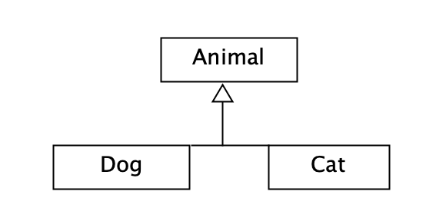
inheritance
Inheritance models what is called an is a relationship. This means that when you have a Derived class that inherits from a Base class, you created a relationship where Derived is a specialized version of Base.
Example: a cat is a animal (inheritance / generalization)

