Slide 1

CST1510 Programming for data communication and networks
Week 8

Slide 2
Objectives:
Overview of socket
Socket in python
Client and Server application
Pickle

Slide 3
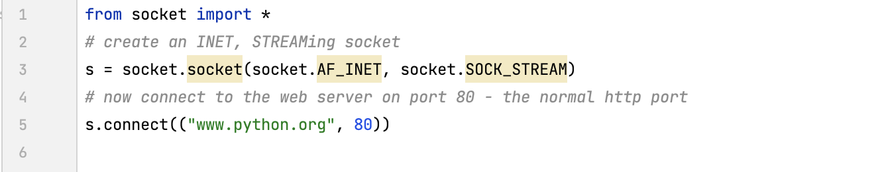
History
Of the various forms of IPC, sockets are by far the most popular.
They were invented in Berkeley as part of the BSD flavour of Unix.
Example; when we click on a link to the to the www.python.org page, our browser did something like the following:
Notes:
IPC is a leading provider of secure, compliant communications and multi-cloud connectivity solutions for the global financial markets.
What Are IPC Standards? IPC is the official name of the association which produces PCB-related standards. The association was formerly called the Institute for Printed Circuits (hence the acronym "IPC"), but is presently called the Association Connecting Electronics

Slide 4
Background
Socket programming - abstract principle by which two programs can share data stream by using an Application Programming Interface (API) for different protocols available in the internet typically supported by the operating systems.
Socket – point to point channel of communication between a client and a server
Socket is specified by the machine’s IP address, the port it is listening on and protocol it uses.

Slide 5
Types of Protocols
TCP (Transmission Control Protocol )
Connection oriented
Reliable delivery
Can managed out of order message or retransition
UDP (User Datagram Protocol)
Connectionless connection
Unreliable
No reordering of data

Slide 6
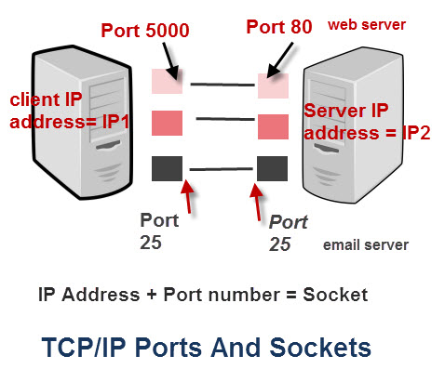
Ip-address & Ports
The IP address identifies the device e.g. computer.
The network port identifies the application or service running on the computer.
Ip and port creates an address
(Ports available between 0 and 65535
Excluding the reserve port numbers and
choose anything between 1024 - 65535)
Notes:
House or Apartment block analogy
IP address corresponds to the street address
All of the apartments share the same street address.
However, each apartment also has an apartment number, which corresponds to the port number.

Slide 7
The socket python module
socket module documentation : https://docs.python.org/3/library/socket.html
The module socket provides all of the required functionalities to quickly write TCP and UDP socket connection
We need to create two applications/files, one acting as a server and the other as a client, and where both communicate through message protocols

Slide 8
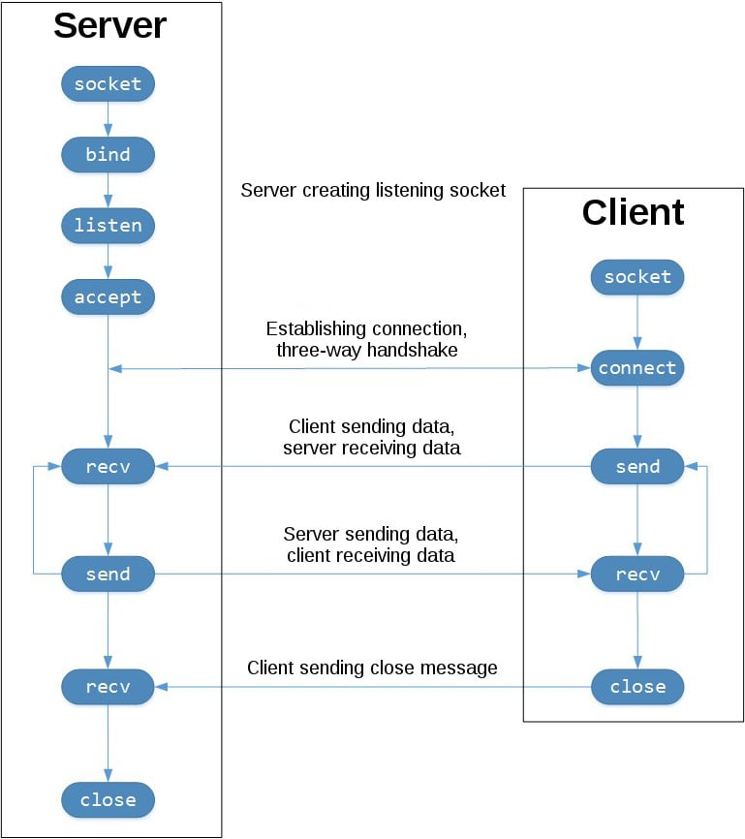
TCP connection flow of data diagram

Slide 9
Address
Tuple, comprise of two elements:
HOST:
Host variable assign into the string ‘localhost’ itself
gethostbyname('localhost’): which will provide the equivalent in a form of string : ‘127.0.0.1’
gethostname(): return the IP name of the host computer running the Python interpreter.
PORT:
Integer number between 1024 - 65535

Slide 10
Python socket module
Creating a socket in Python is done through the socket.socket() method.
s = socket.socket(socket_family, socket_type)
Socket family:
socket.AF_INET socket for working with the IPv4 protocol
Socket.AF_INET6 socket for working with the IPv6 protocol
Communication type:
TCP sockets ( socket.SOCK_STREAM) TCP- connection oriented
UDP sockets ( socket.SOCK_DGRAM) UDP - is not connection oriented

Slide 11
Server socket method
socket.bind (address): allows to connect the address with the socket, with the requirement that the socket must be open before establishing the connection with the address
socket.listen (count): accepts as a parameter (count) the maximum number of connections from clients and starts the TCP listener for incoming connections.
socket.accept (): enables us to accept client connections and returns a tuple with two values that represent client_address . You need to call the socket.listen () client_socket socket.bind () methods before using this method.

Slide 12
Client socket method
socket.connect(address): connects the client to the sever
socket.connect_ext(address): has the same functionality as the connect() method and also offers the possibility of returning an error in the event of not being able to connect with that address.

Slide 13
Socket method used in both: client and server
socket.send(bytes): sends bytes of data to the specified target.
socket.recv(bufsize): receives data from the socket. The method argument indicates the maximum amount of data it can receive. Usually buff-size is set to 1024
socket.close(): releases the memory and finishes the connection.

Slide 14
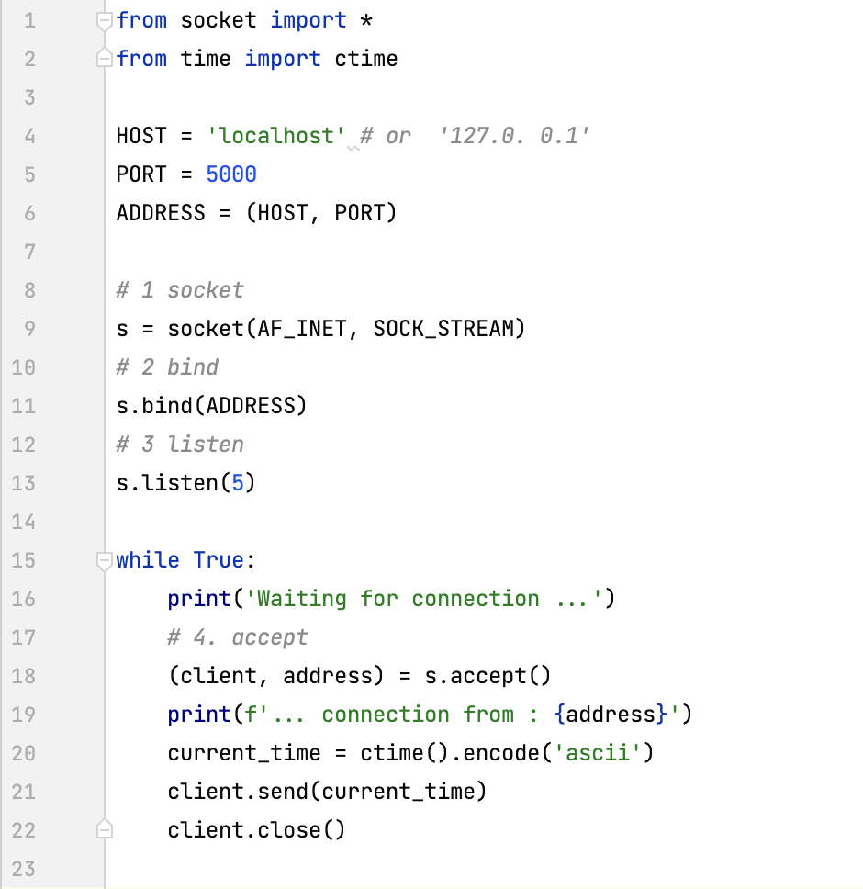
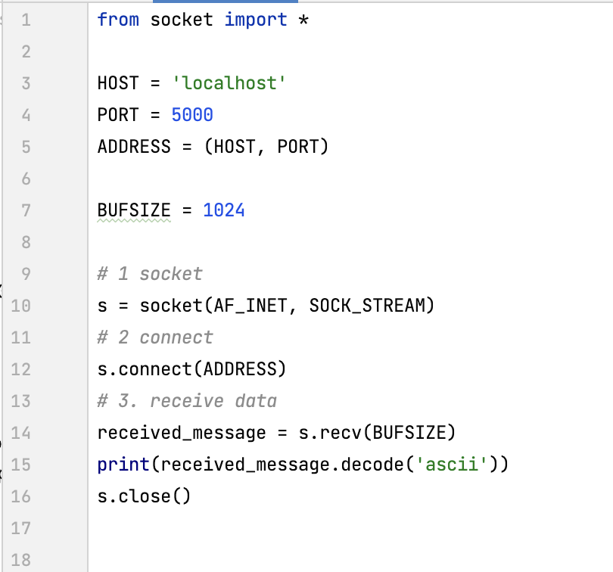
Sending current-time from server
server.py
client.py

Slide 15
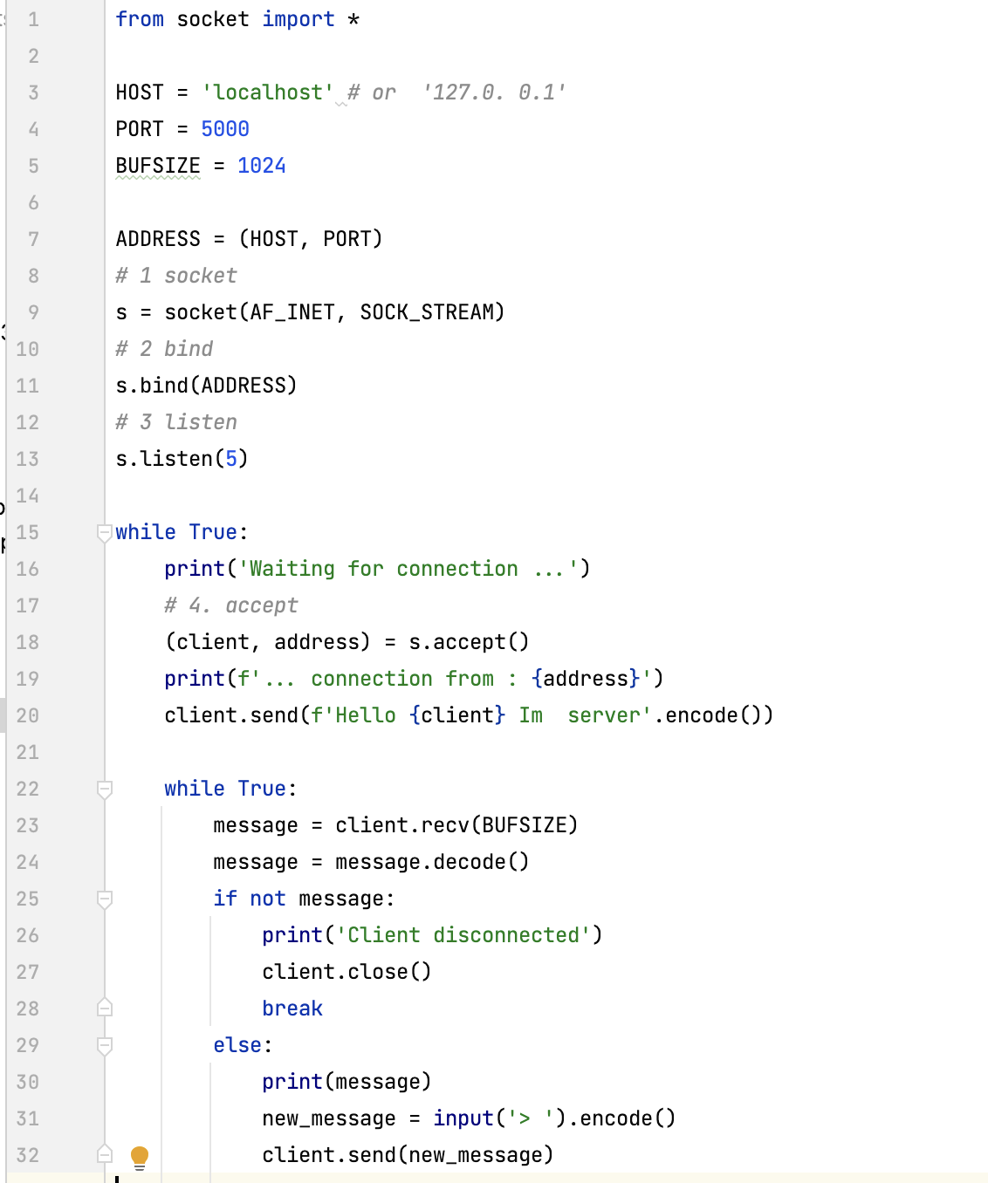
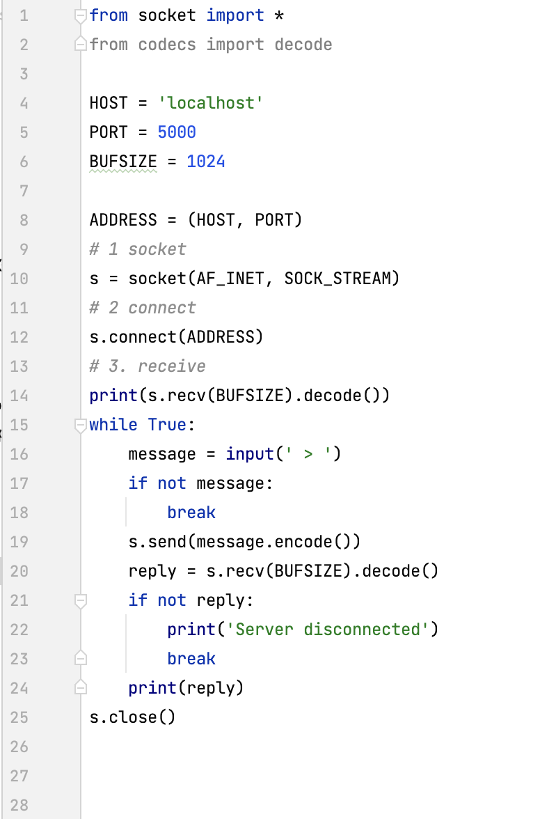
Echo string back
SERVER
CLIENT

Slide 16
Serialize data
In serialization, an object is transformed into a format that can be stored, so as to be able to deserialize it later and recreate the original object from the serialized format.
Pickle
Pickling is the process whereby a Python object is converted into a byte stream (usually not human readable) to be written to a file, this is also known as Serialization.
Unpickling is the reverse operation, whereby a byte stream is converted back into a working Python object hierarchy.
Pickle is operationally simplest way to store the object. The Python Pickle module is a way to store objects directly in a special storage format.

Slide 17
Pickle python module
Pickle documentation:
https://docs.python.org/3/library/pickle.html
The pickle interface provides four different methods.
pickle.dump() serialize to an open file (file-like object)
pickle.load() desterilizes from an open –like object
pickle.dumps() serializes to a string
pickle.loads() desterilizes from a string

Slide 18
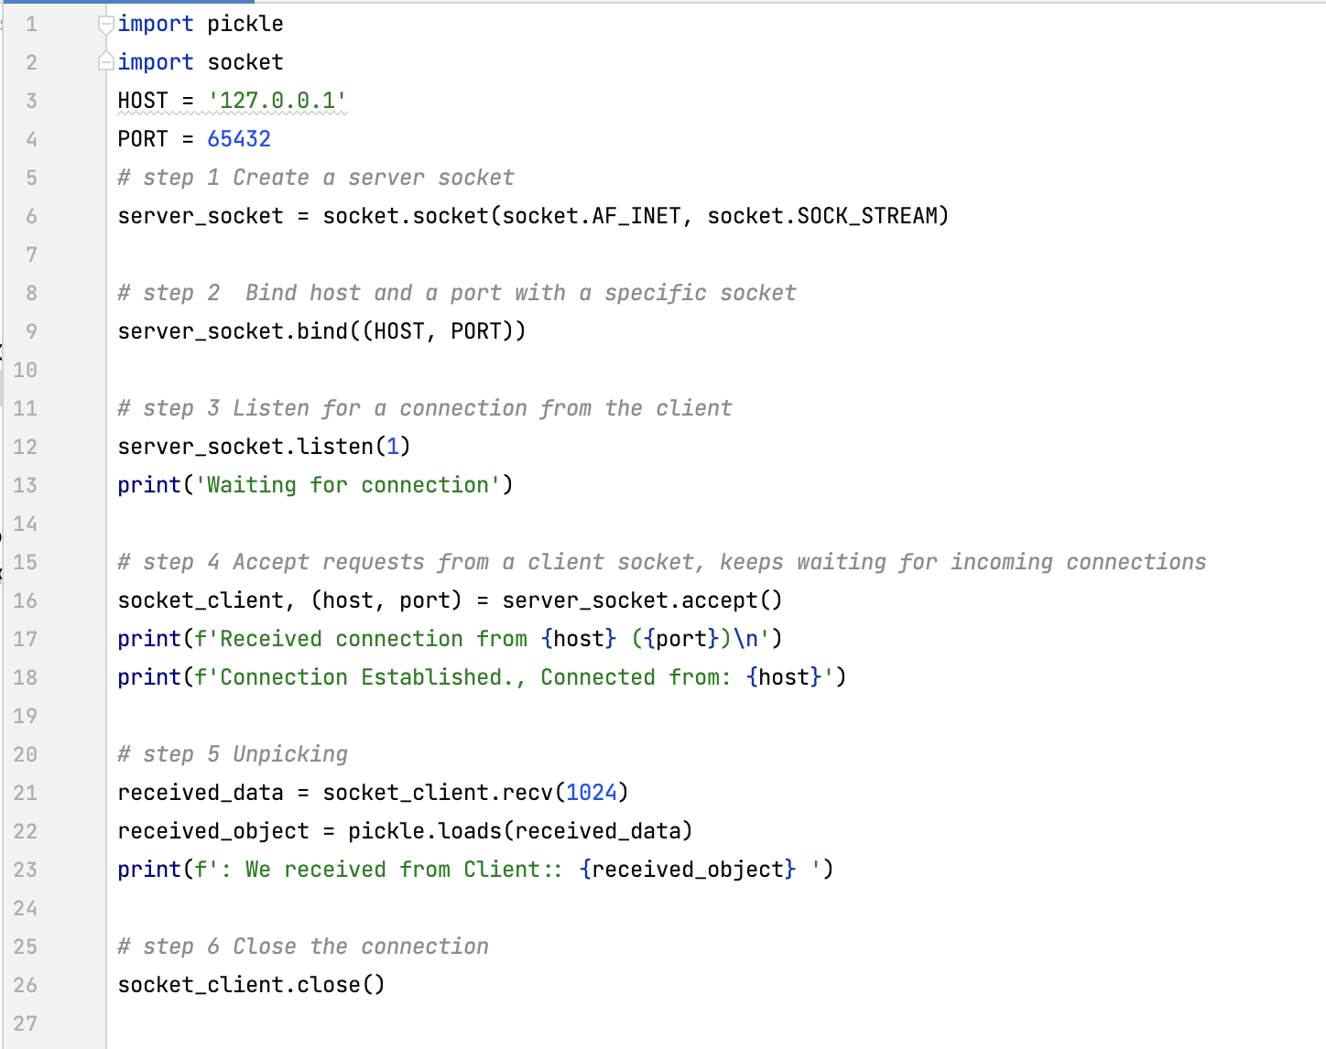
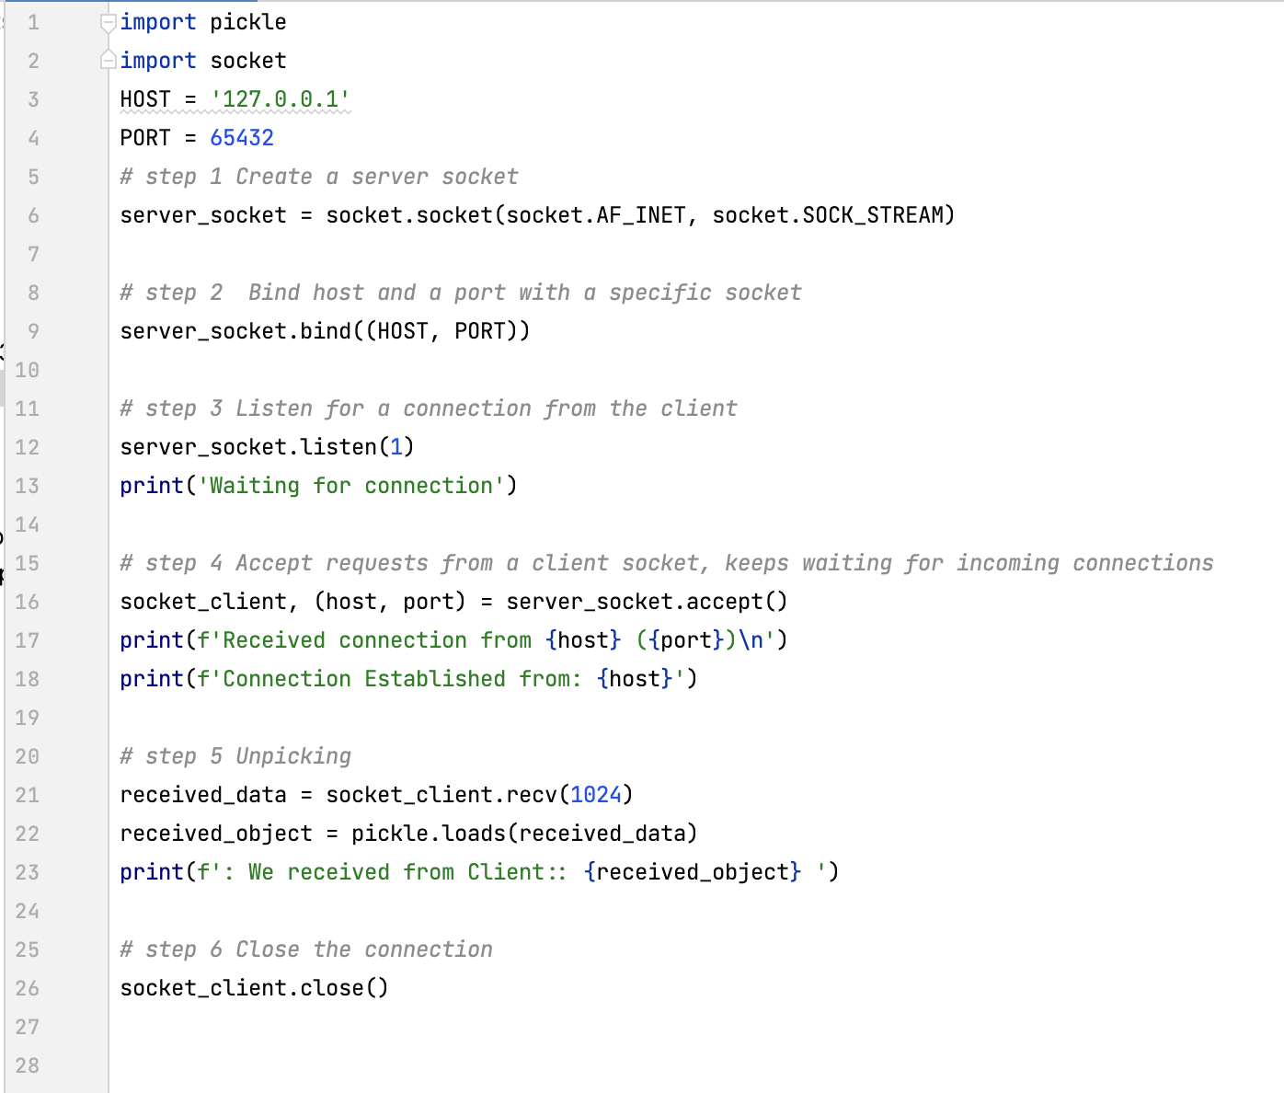
Pickle example sending object
SERVER:
CLIENT:

Slide 19
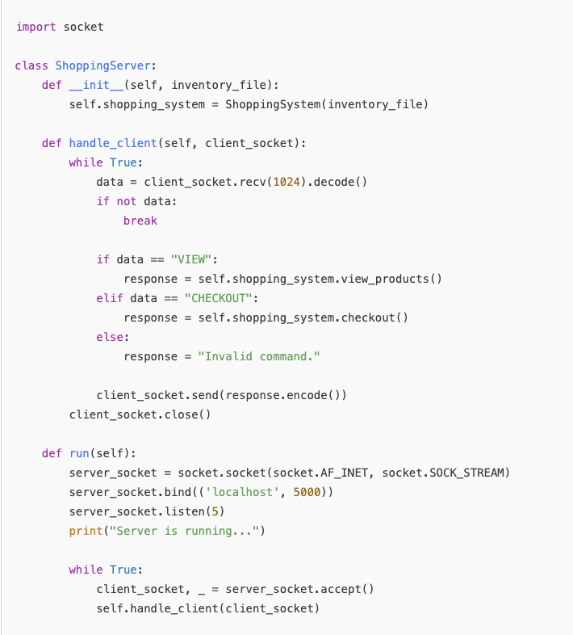
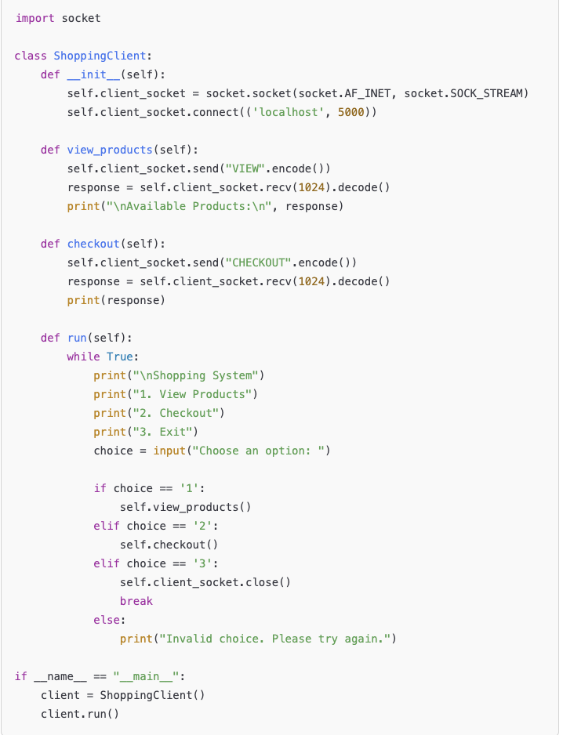
Sample of Client Server for Shopping System
server.py
client.py

Slide 20
Summary
Overview of socket
Socket in python
Client and Server application
Pickle

