Slide 1

CST1510 Programming for data communication and networks
Week 10

Slide 2
Objectives:
Web scraping using:
What, Why and How
Your browser, requests vs selenium, and Beautiful Soup
Inspect your data source
Scrape HTML content from a page
Parse HTML code with Beautiful Soup

Slide 3
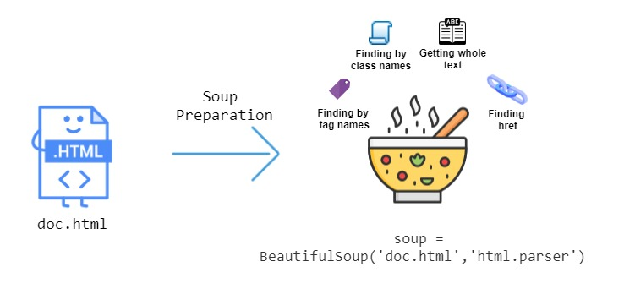
What is web scraping?
Notes:
Extracting data from website !
While web scraping can be done manually we use code to create an automate process (knows as bot or web crawler) to obtain such data
Tow parts to web scraping:
Fetching – downloading of a page (which browser does when view a page)
Extraction – when content of a page is parse, searched or reformed to obtain pieces of data
We will be fetching the HTML of webpage and using BeautifulSoup to extract data from it.

Slide 4
Legality related to web scraping
Scraping is not prohibited by law. There is no law that explicitly addresses web scraping.
However it is essential to review the website's terms and conditions
The Computer Fraud and Abuse Act (CFAA) does not explicitly mention web scraping, however it does prohibit the unauthorized access of a computer or network.
Interesting blog about it: https://blog.apify.com/is-web-scraping-legal/
Notes:
The CFAA does not explicitly mention web scraping or other specific activities related to data extraction. However, the CFAA does define what activities are considered a violation of federal law. The CFAA defines a violation as "intentionally accessing a computer without authorization or exceeding authorized access, and thereby obtaining information from any protected computer." This would include web scraping if the access is unauthorized. Additionally, the CFAA makes it a crime to "intentionally access a computer without authorization or exceeding authorized access, and thereby obtain anything of value." Therefore, if the web scraping activity is unauthorized and the data that is obtained has value, it could be considered a violation of the CFAA.

Slide 5
Packages:
Beautiful Soup - Python library for pulling data out of HTML and XML files
Documentation: https://beautiful-soup-4.readthedocs.io/en/latest/
Requests – Piton library for making simple HTTP requests, as well as more complex requests such as POST, PUT, and DELETE.
Documentation: https://requests.readthedocs.io/en/latest/

Slide 6
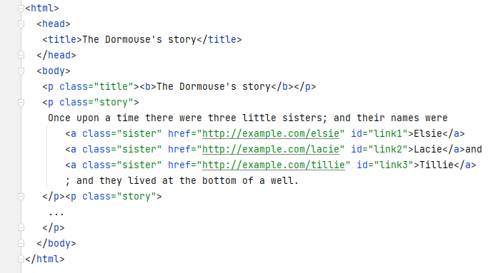
HTML structure
Head-
Is the invisible part of
the page; title,
meta tags, etc.,
Body –
the main section of the page
Html – is the root tag encapsulating the page

Slide 7
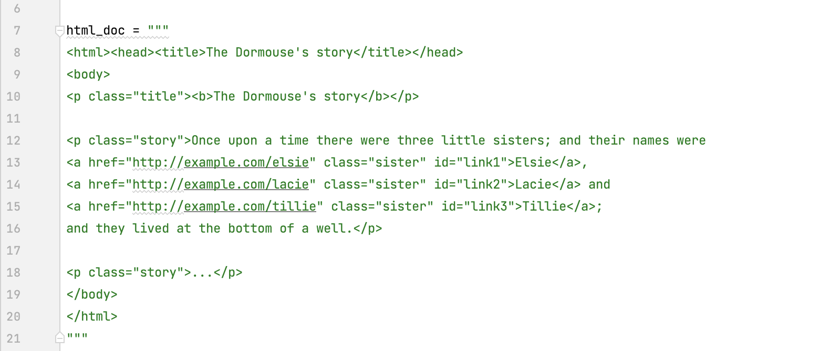
The HTML as a string

Slide 8
Making the soup
from bs4 import Beautiful Soup
soup = BeautifulSoup(html_doc, 'html.parser’)
print(soup.prettify())
HTML as string
Parser
Beautiful Soup transforms a complex HTML document into a complex tree of Python objects.
“Beautiful Soup Documentation” as a .pdf
Beautiful Soup Documentation (beautiful-soup-4.readthedocs.io)

Slide 9
Beautiful Soup parsers
There are other parsers available
Different parsers will give different results
Some needs to be explicitly install
Example:
“html.parser” (support html)
“lxml” (support xml)
“html5lib” (creates valid HTML5 )

Slide 10
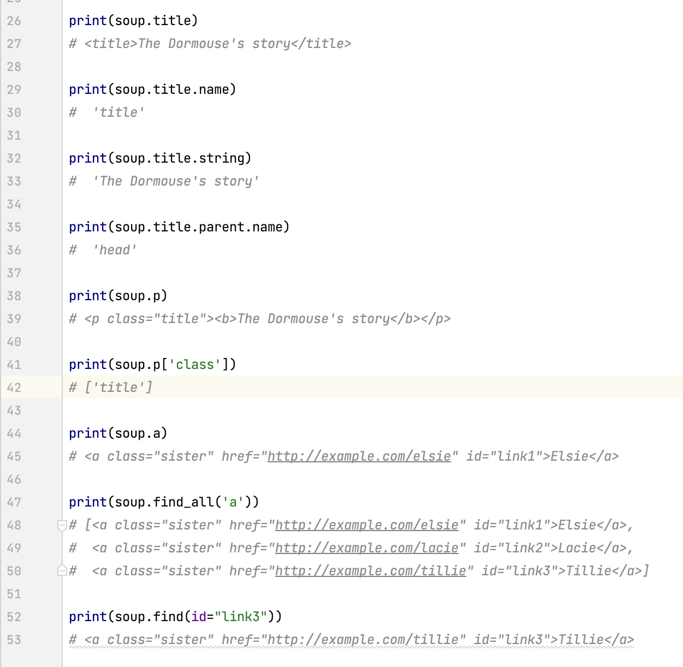
A simple ways to navigate html tree:
soup
HTML

Slide 11
Beautiful-Soup objects
We can only ever have four kinds of objects:
soup = BeautifulSoup('<b class="boldest">Extremely bold</b>', 'html.parser’)
Tag
Beautiful soup functions
Comments
Navigating string
Corresponds to an XML or HTML tag.
A tag may have any number of attributes.
<b id="boldest">
- tag ‘b’
- attribute “id”
- value “boldest”.
You can access a tag’s attributes by treating the tag like a dictionary:
tag['id’]
Text with in the tag:
tag = soup.b, tag.string
Beautiful Soup defines a lot of methods for searching the parse tree:
find()
find_all()
find_text()
An HTML comment begins with
<! –– and the comment closes with ––>

Slide 12
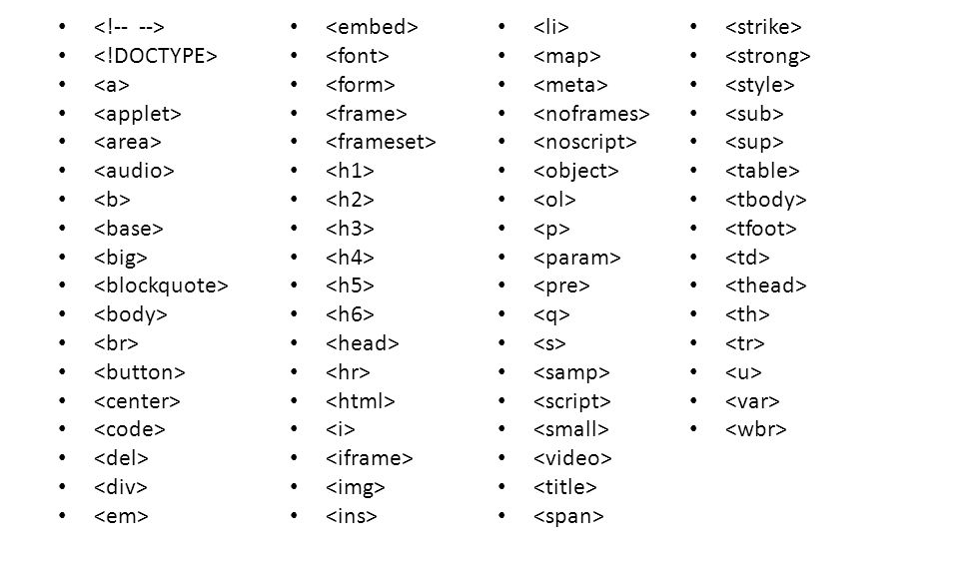
List of HTML tags

Slide 13
HTML tag
Attribute Attribute Attribute Text
<a href="http://example.com/tillie" class="sister" id="link3">Tillie</a>
Tag
Name Value Name Value Name Value

Slide 14
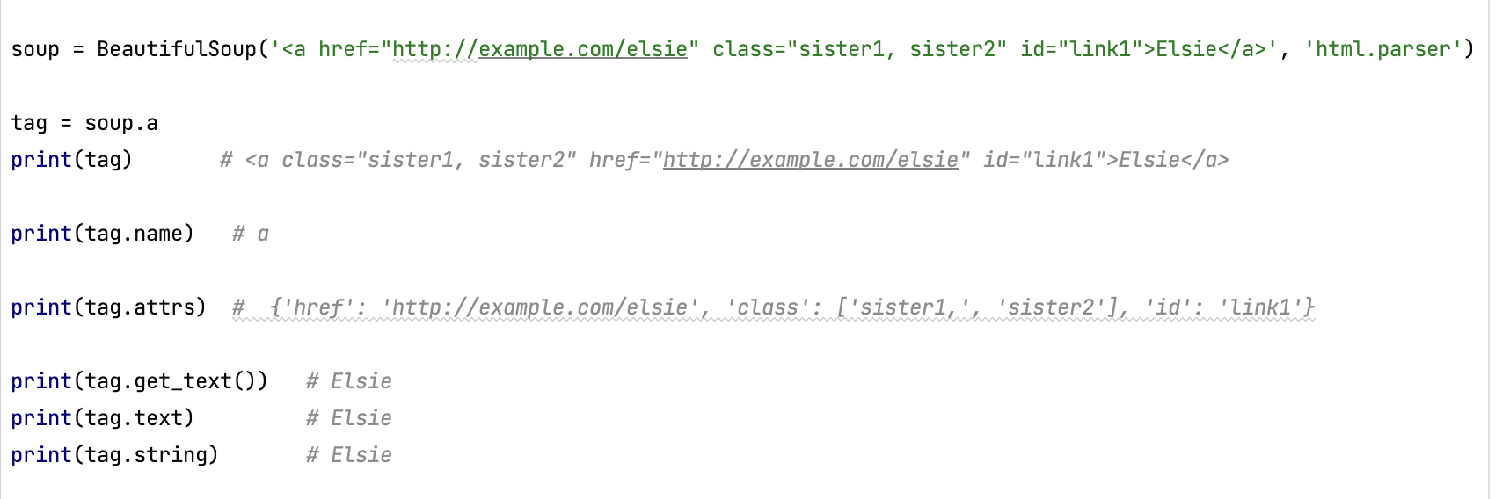
Tag, attributes, text
Tag
Attributes
Text

Slide 15
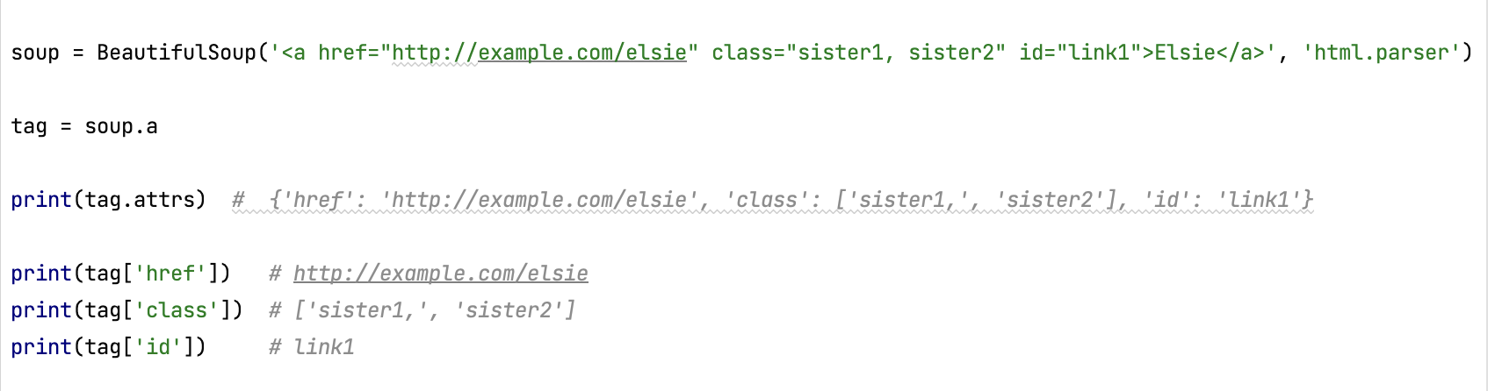
Attribute: name and value
You can get, add, remove, and modify a tag’s attributes.
It is done by treating the tag as a dictionary

Slide 16
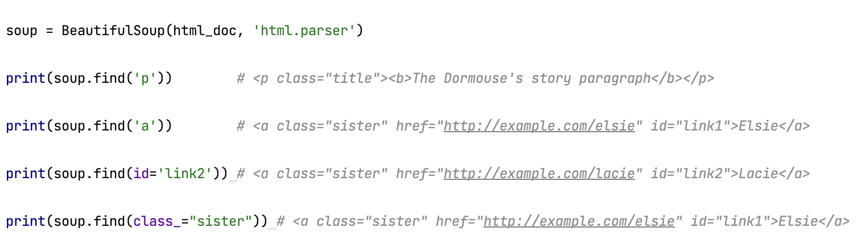
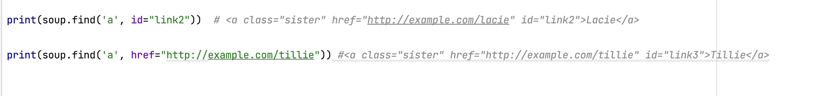
Find
You can find content using the find() function.
It could also be used to find content from attribute and value that are in sub section of the tree structure

Slide 17
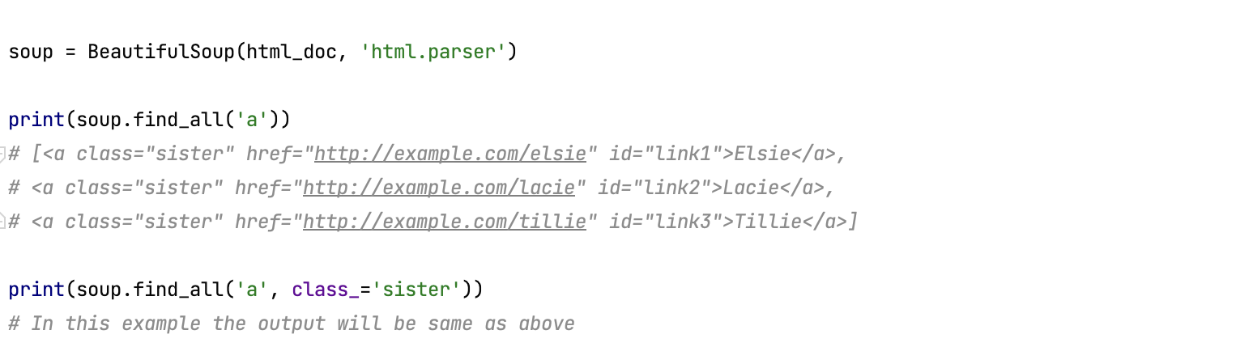
Find all …
Find all tags or specific attribute and values

Slide 18
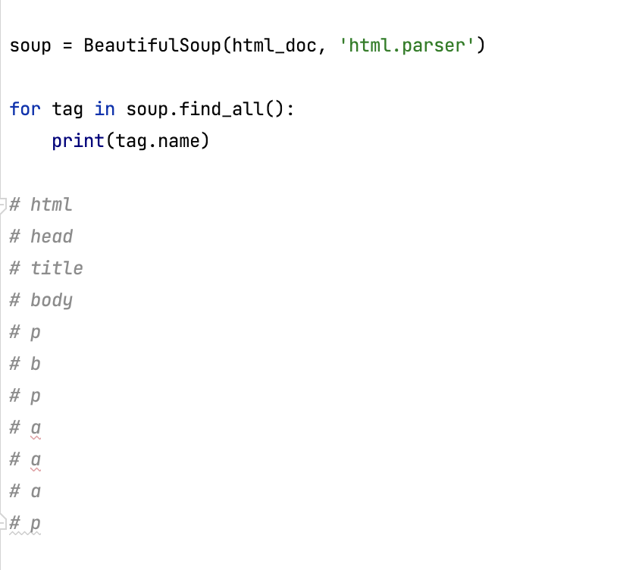
Get all tags
Print all tags

Slide 19
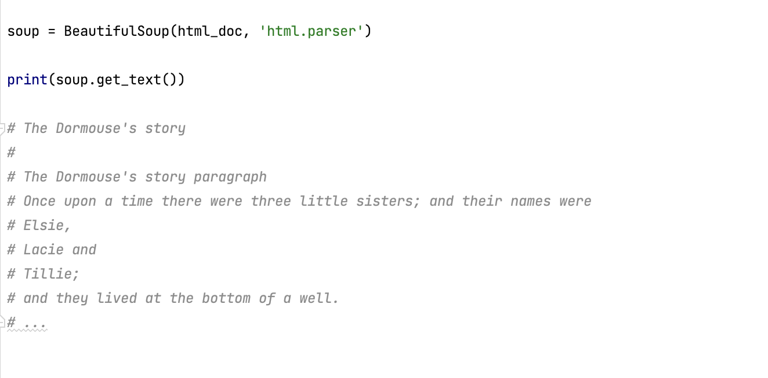
Get all text
Get all text from the HTML

Slide 20
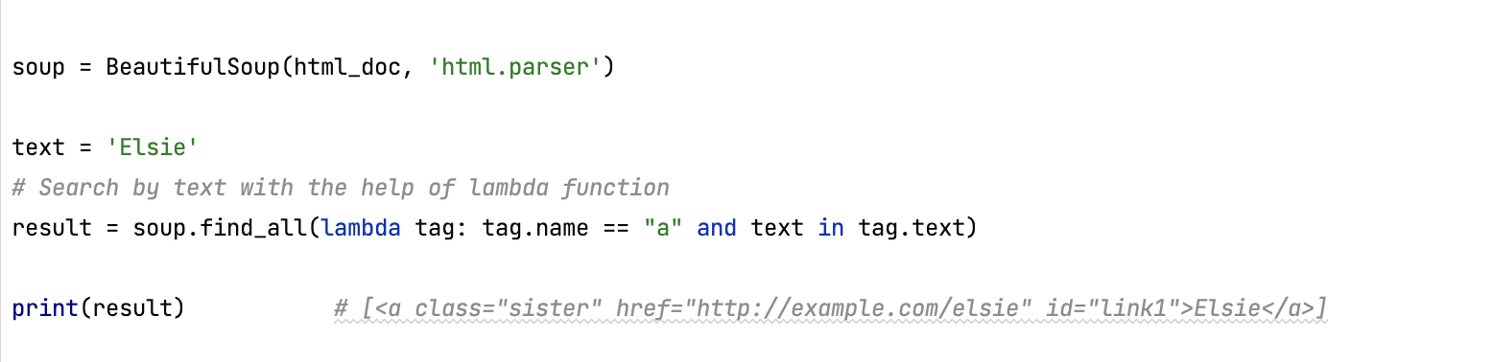
Find text
Find specific text:

Slide 21
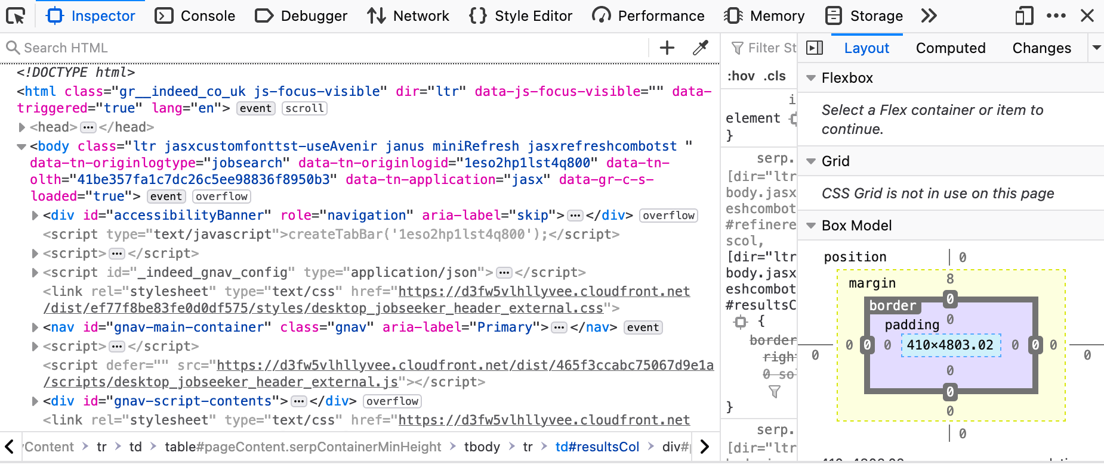
Web exploring tool
Right click anywhere on the page and choose ‘inspect element’ or ‘inspect’

Slide 22
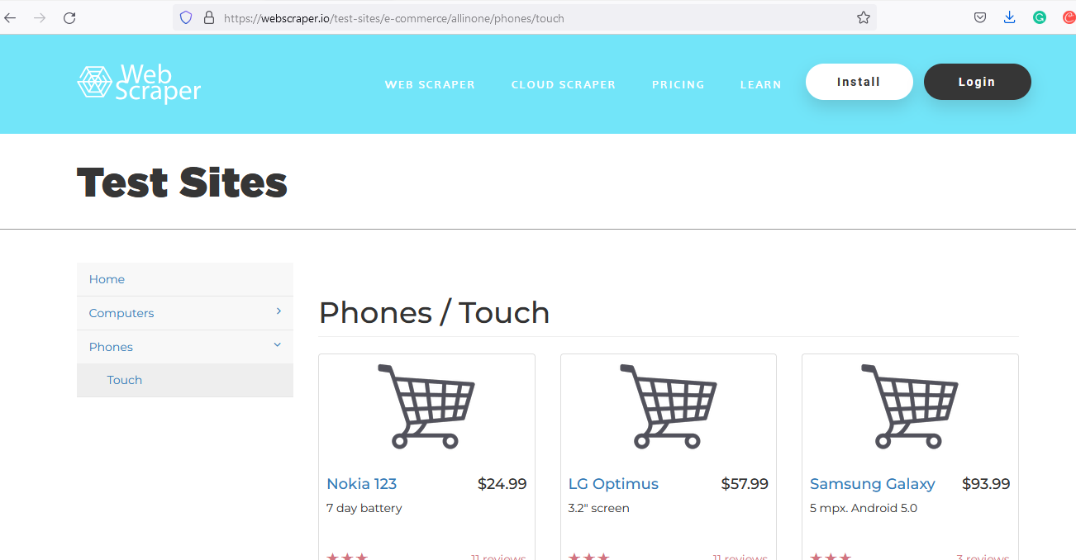
Web scraping test side
https://webscraper.io/test-sites/e-commerce/allinone

Slide 23
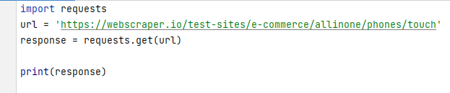

Using requests to get the website URL
Returns status code
Example:
<Response [200]>
Possible status codes:
200 (OK, request succeeded)
404 (Not found; requested resource cannot be found)
500 (Internal server error)
204 (No content to be sent)
401 (Unauthorized request was made to the server)

Slide 24
Making the soup
import requests from bs4 import Beautiful Soup urn = ‘https://webscraper.io/test-sites/e-commerce/allinone/phones/touch’
response = requests.get(url) soup = BeautifulSoup(response.content, features="html.parser") print(soup.prettify())
Beautiful Soup transforms a complex HTML document into a complex tree of Python objects.

Slide 25
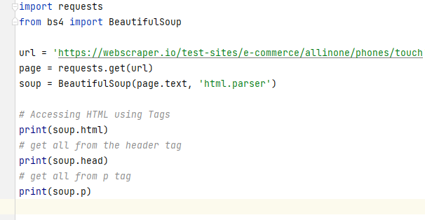
Tags example

Slide 26
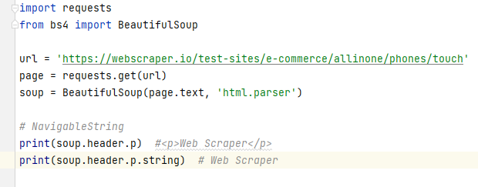
Getting text from header ‘p’ tag

Slide 27
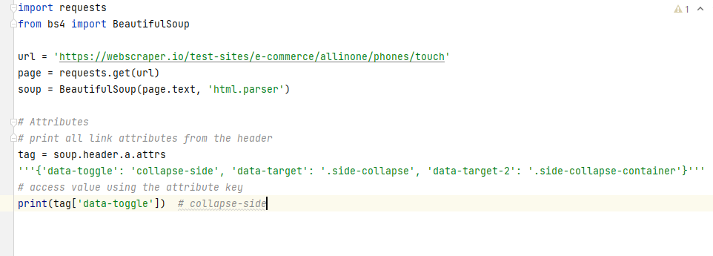
Getting Attributes from ‘a’ tag

Slide 28
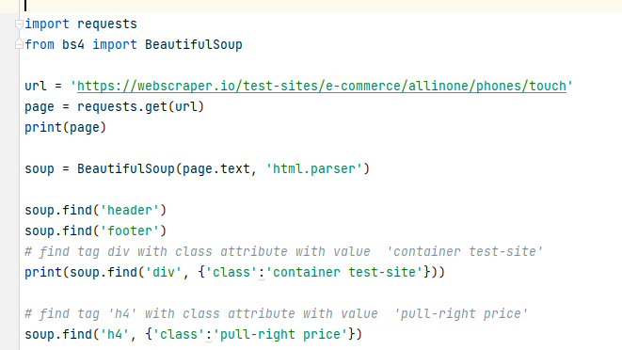
find() function to get all prices

Slide 29
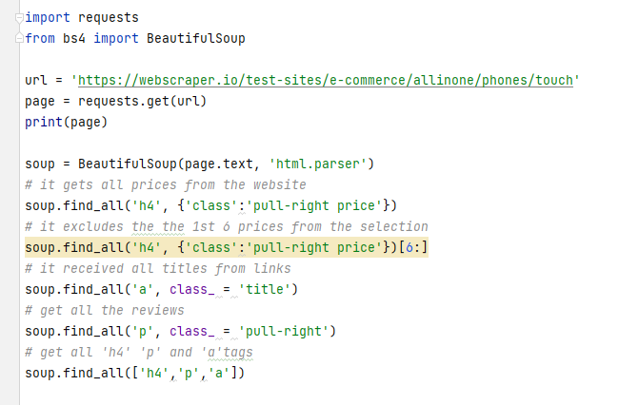
find_all() functions example

Slide 30
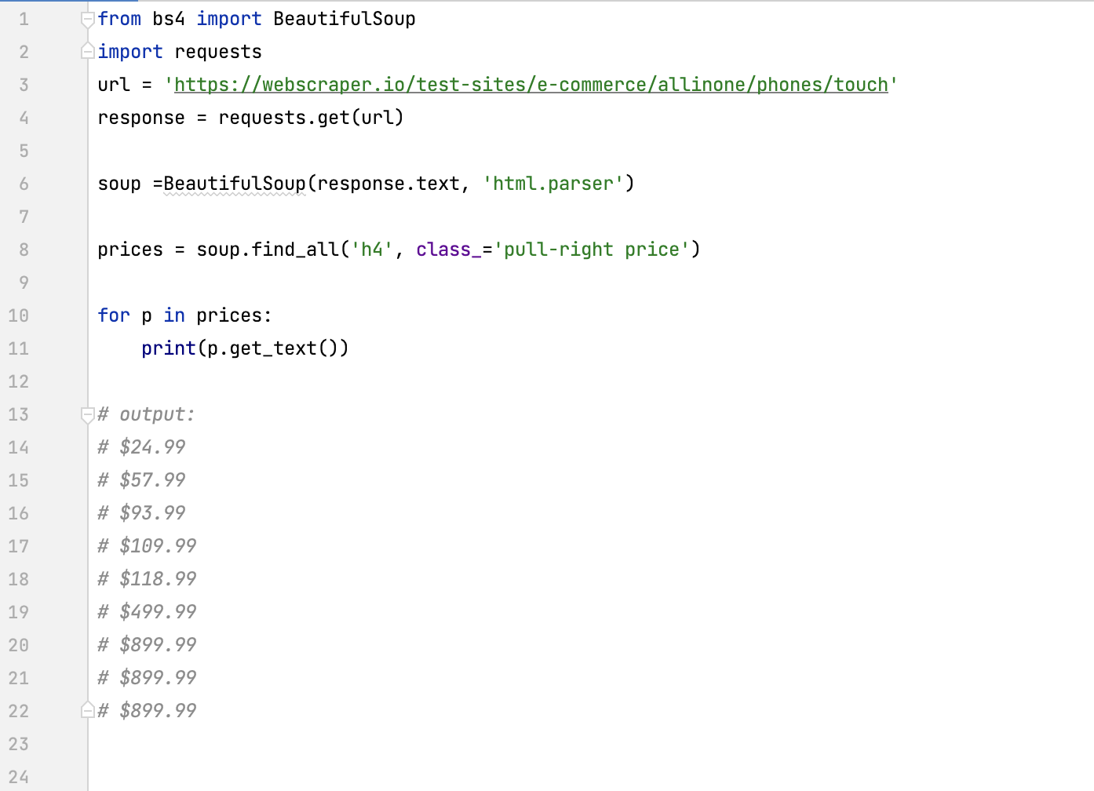
Find all prices

Slide 31
Summary
Inspect data source
Scrape HTML content From a page
Parse HTML code with Beautiful Soup
Moving forward explore modele called selenium (https://www.selenium.dev/selenium/docs/api/py/ ) module

