Slide 1

Machine Learning Hackathon CG 2022
Team Name- OneWomanEXOL
Team Leader Name- Kshitija Shirsekar
Team Leader Email Address- kshirsekar0@gmail.com

Slide 2
Brief description of the problem at hand:
Given a dataset with information about multiple websites, categorize them as phishing sites vs legitimate sites.

Slide 3
Solution proposed and description:
As the result can have just two values(-1 or 1) it can be treated as a Binary Classification problem.

Slide 4
Technology/Tool Stack Used:
Google Colab python notebook created with use of following libraries:
Pandas
Numpy
Sklearn
Statsmodels
Matplotlib

Slide 5
Approach:
We start by reading the CSV files into our python notebook
For columns with more than two categories(1,0,-1) one-hot encoding is done
From the overall features, sklearn’s inbuilt feature selection is used for choosing the best features
Logistic regression for binary classification is used
Final output is stored to a CSV file

Slide 6
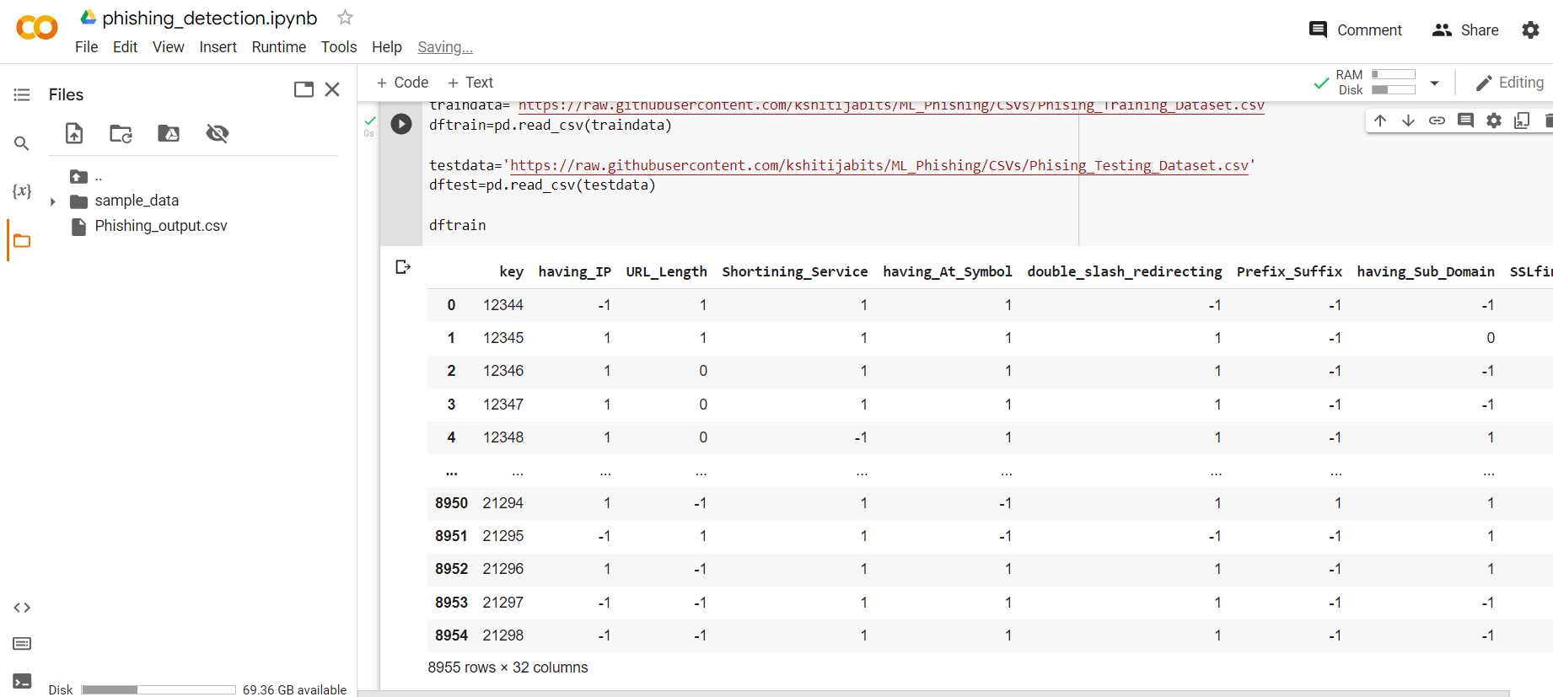
Execution Demo(Video/Screenshots) of the solution:

Slide 7
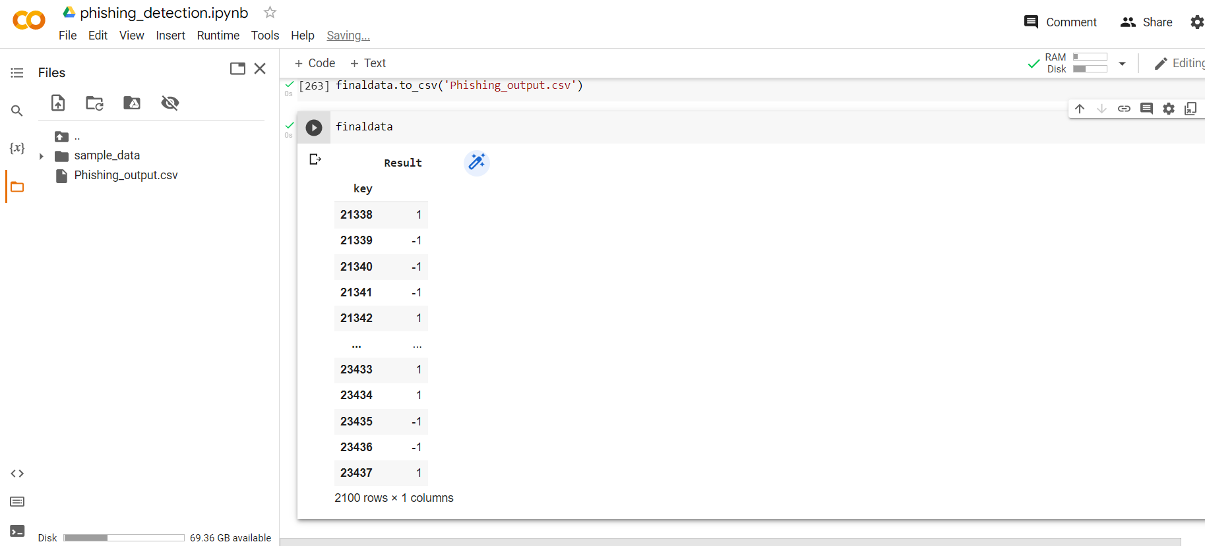
Execution Demo(Video/Screenshots) of the solution:

Slide 8
Source code as ZIP or Github URL:
https://github.com/kshitijabits/ML_Phishing

Slide 9
Additional comments (optional):

Slide 10
THANK YOU

