Slide 1
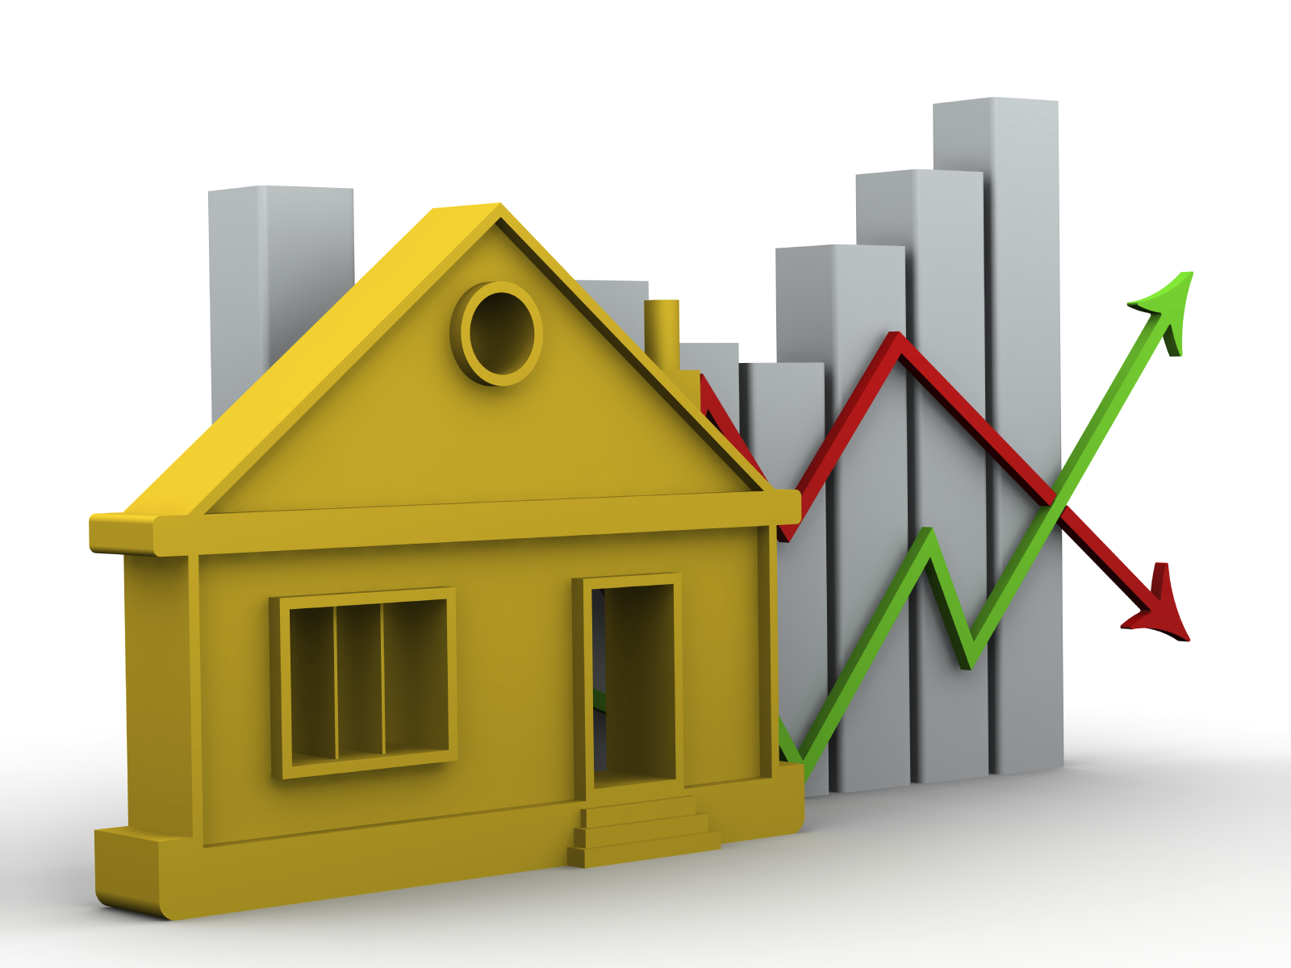
House Price Prediction based on factors like Eir code, number of bedrooms, year of constructions and other parameters
Agenda
Presenting the insights found after analysing the data.
Visualization and discussion about the model and accuracy
Conclusion and next steps for improvement
Kshitija Shelar

Slide 2
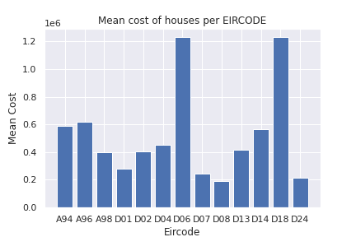
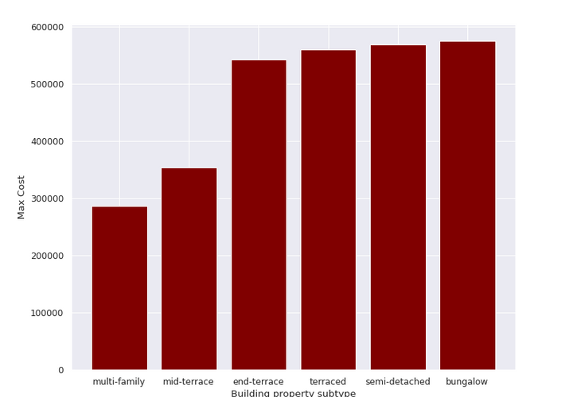
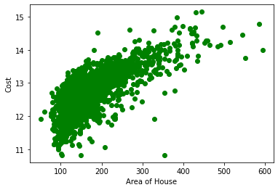
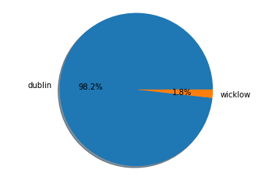
Insights
Bungalow subtype has the highest priced houses sold followed by semidetached type.
Around 98% houses sold are in Dublin, rest being in County Wicklow
D06 and D18 are the expensive regions. Both these areas have highly priced houses.
The larger the total area of house, the higher is the cost of the house.

Slide 3
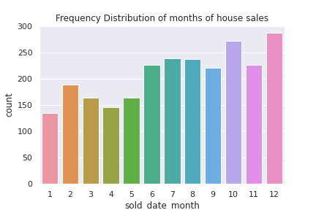
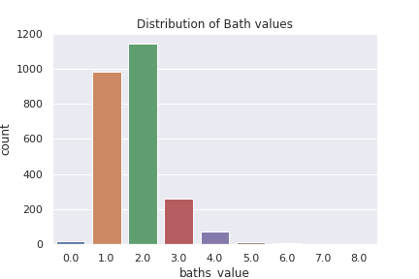
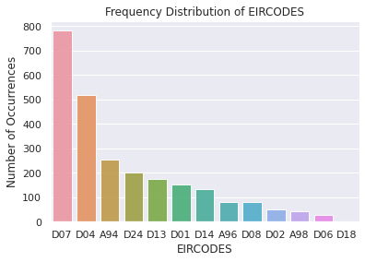
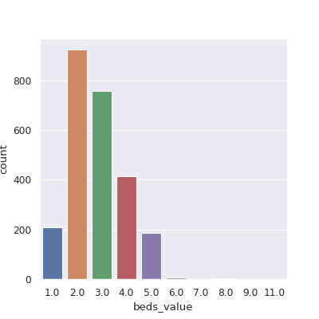
High number of houses are sold in the second half of the year.
It is possible there might be few offers involved during this time which drops price slightly.
D07 is the area where most number of houses were sold.
New home indicator is mostly 0 in the data i.e most of the houses sold are not new.
Houses with larger shape area value tend to have higher cost.
2 and 3 bed room apartments are more frequently sold.
Along with 1-2 bathroom per apartment being the most common.
Sales consistently increased till 2015 and we can see the maximum sale in the year 2017.

Slide 4
Next Steps / Conclusion
From the analysis it is clear that Bungalow type of houses are sold for the highest prices. So to increase sales, houses with bungalows can be targeted.
We can also see that EIR code D07 has the highest number of houses sold for moderate price. So, to increase sales we can focus on this area as it will give the highest outcome in terms of houses sold.
Houses with 2-3 Bedrooms and 1-2 Bath rooms are generally preferred by people. So houses with the specific numbers can be aimed to increase the sale.
If we find out more information from the latitude and longitude of the area we can see how the following places affect the house prices if they are nearby:
1. Schools 2. Grocery Stores 3. Bus stations/Dart/Luas accessibility 4. Hospitals 5. Corporate offices
6. Lakes/parks/beach/monuments like castles or structures of historic significance. 7. Airports/ seaports
If we could fetch the crime rate of that neighborhood we can also analyse the safety parameter and see how it affects the house rates.
Comparing this analysis wrt to a manual process we can see that data analysis has more advantages than a broker since a broker will not be able to give such accurate predictions and might be harder for a broker to see the patterns like we observed about performing EDA.

Slide 5
Details about the model and feature engineering
The model performs basic pre-processing steps and learns patterns to predict the sold prices of house using features given in dataset.
Following are the steps performed before training the model and details about what model was used.
Converted date column into dayofweek, month and year column
There were around 80% missing bath_values and around 50% missing beds_value hence used KNN Imputer to fill these missing values
Cleaned building property subtype since some had the same name in different format.
Dropped columns census2016_small_area_geogi,thoroughfare_id, id, postal_address, lat, lon as they were not contributing to the model
Introduced a new feature called ageOfHouse which is calculated as year_of_construction – sold_year
Introduced another feature total_area which is calculated as building_shape_area + sqm_value
Used minmax scaler to normalize the data’s numeric features
Used pandas get dummies to convert categorical features into numeric form.
Implemented Light GradientBoosting Machine and eXtreme GraidentBoosting algorithm in stacked layer along with RandomForest regressor to predict the house prices.
This model gives a Median Absolute percentage error as 1.44.
In terms of model and accuracy, we could try to implement more powerful neural network models or deep learning models

Slide 6
`
Thank you

