Slide 1
Implementing Secure Mobile Solutions
Lesson 13
Notes:
This lesson follows on from host security by looking specifically at mobile devices. While there are a lot of content examples to cover, this subject area is well-established at A+ level, so you may be able to move quite quickly through this section.
Topics:
Implement mobile device management.
Implement secure mobile device connections.

Slide 2
Syllabus Objectives Covered
3.5 Given a scenario, implement secure mobile solutions

Slide 3
Mobile Device Deployment Models
Bring your own device (BYOD)
(the mobile device is owned by the employee. The mobile will have to meet whatever profile is required by the company and the employee will have to agree on the installation of corporate apps and to some level of oversight and auditing.)
Corporate owned, business only (COBO)
—the device is the property of the company and may only be used for company business
Corporate owned, personally-enabled (COPE)
-- the device is chosen and supplied by the company. The employee may use it to access personal email and social media accounts and for personal web browsing
Choose your own device (CYOD)
-employee is given a choice of device from a list.

Slide 4
Enterprise Mobility Management
Enterprise mobility management (EMM) is a class of management software designed to apply security policies to the use of mobile devices and apps in the enterprise.
The challenge of identifying and managing attached devices is often referred to as visibility. EMM software can be used to manage enterprise-owned devices as well as BYOD.Two main functions:
Mobile device management (MDM) —sets device policies for authentication, feature use (camera and microphone), and connectivity
Mobile application management (MAM) —sets policies for apps that can process corporate data, and prevents data transfer to personal apps
Install and monitor corporate apps and data
Notes:
At this point, MDM and MAM are probably best thought of as functionality within products, rather than product classes.
Note the trend towards unified endpoint management, including IoT devices.
Encourage students to browse the vendor sites referenced in the text to get a better idea of the features and capabilities of EMM/UEM suites.

Slide 5
Distinguishing whether client endpoints are mobile or fixed is not really a critical factor for many of these management tasks, with the consequence that the latest suites aim for visibility across PC, laptop, smartphone, tablet, and even IoT devices. These suites are called unified endpoint management (UEM)
When the device is enrolled with the management software, it can be configured with policies to allow or restrict use of apps, corporate data, and built-in functions, such as a video camera or microphone.

Slide 6
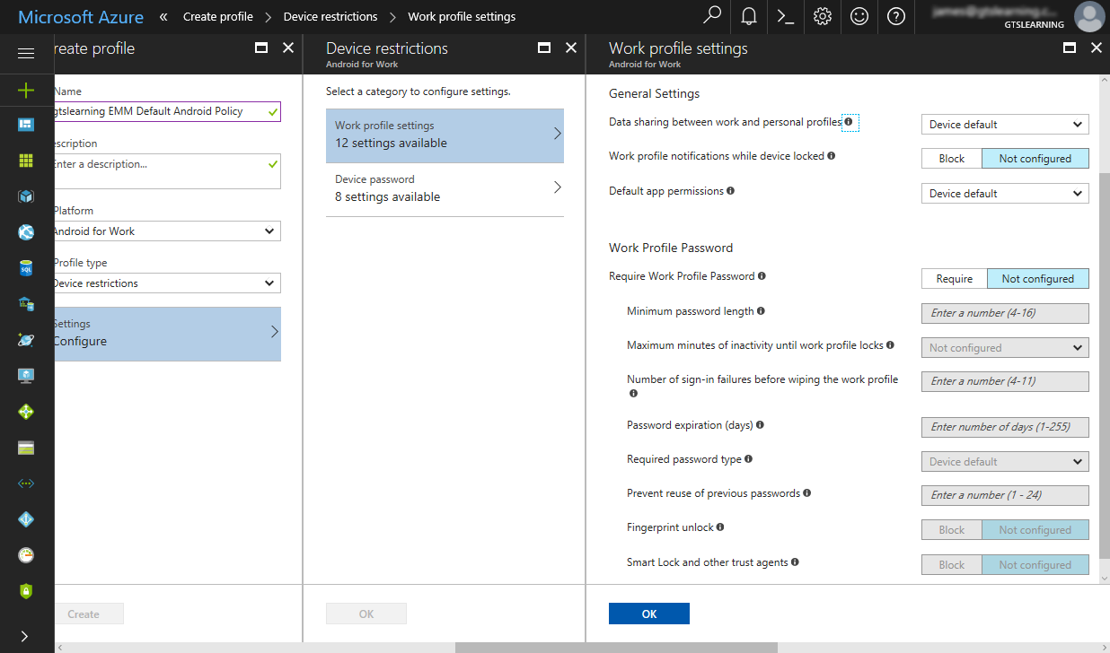
Mobile Access Control Systems
Smartphone authentication
The majority of smartphones and tablets are single-user devices.
Password
PIN
Swipe pattern
Biometric
Screen lock- incorrect attempts locks device
Screenshot used with permission from Microsoft.
Notes:
For students who have taken A+, this subject matter should be familiar. Just note the way that EMM can be used to enforce authentication types.

Slide 7
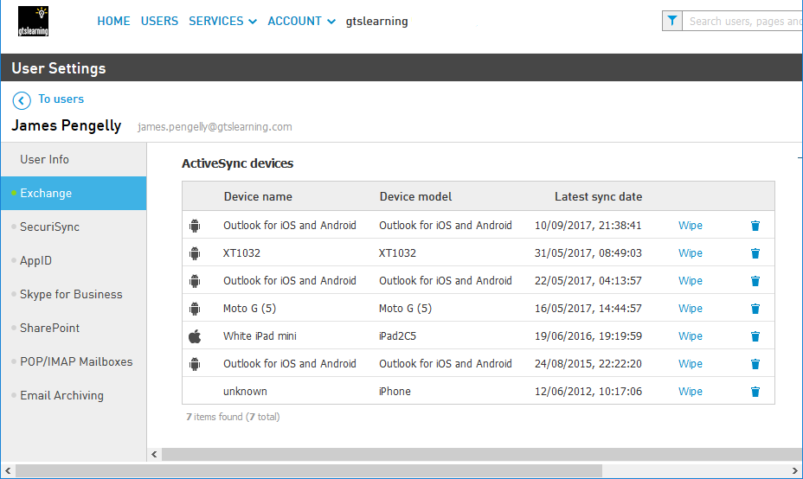
Remote Wipe
Initiated from enterprise management software
or kill switch means that if the handset is stolen it can be set to the factory defaults or cleared of any personal data (sanitization). Some utilities may also be able to wipe any plug-in memory cards too.
could be triggered by several incorrect passcode attempts
Context-Aware Authentication
newer authentication models.
For example, smartphones now allow users to disable screen locks when the device detects that it is in a trusted location
Screenshot used with permission from Intermedia.

Slide 8
Full Device Encryption and External Media
In iOS, there are various levels of encryption
Secure erase encryption
All user data on the device is always encrypted but the key is stored on the device. This is primarily used as a means of wiping the device. The OS just needs to delete the key to make the data inaccessible rather than wiping each storage location.
Data protection
Email data and any apps using the "Data Protection" option are subject to a second round of encryption using a key derived from and protected by the user's credential.
Android device encryption - allow encryption of the removable storage, such as a plug-in Micro SecureDigital (SD) card slot
MicroSD HSM is a small form factor hardware security module designed to store cryptographic keys securely.
Notes:
Note that full disk encryption makes a handset less usable as a phone, so encryption is applied to user data areas rather than the whole device.

Slide 9
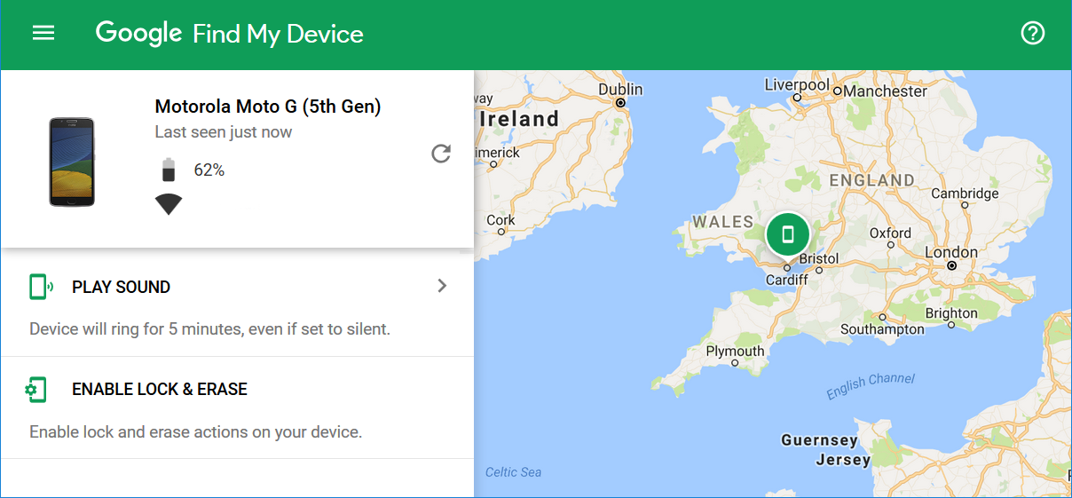
Location Services
Geolocation is the use of network attributes to identify the physical position of a device.
Location Services
Global Positioning System (GPS)
determining the device's latitude and longitude
Indoor Positioning Systems (IPS)
device's location by triangulating its proximity to other radio sources like cell towers, APs
Geofencing to apply location-based policies automatically
GPS tagging
process of adding geographical identification metadata
Track movements
Geofencing is the practice of creating a virtual boundary based on real-world geography. Geofencing can be a useful tool with respect to controlling the use of camera or video functions or applying context-aware authentication. An organization may use geofencing to create a perimeter around its office property
Notes:
Make sure students can distinguish the various geo-something technologies.

Slide 10
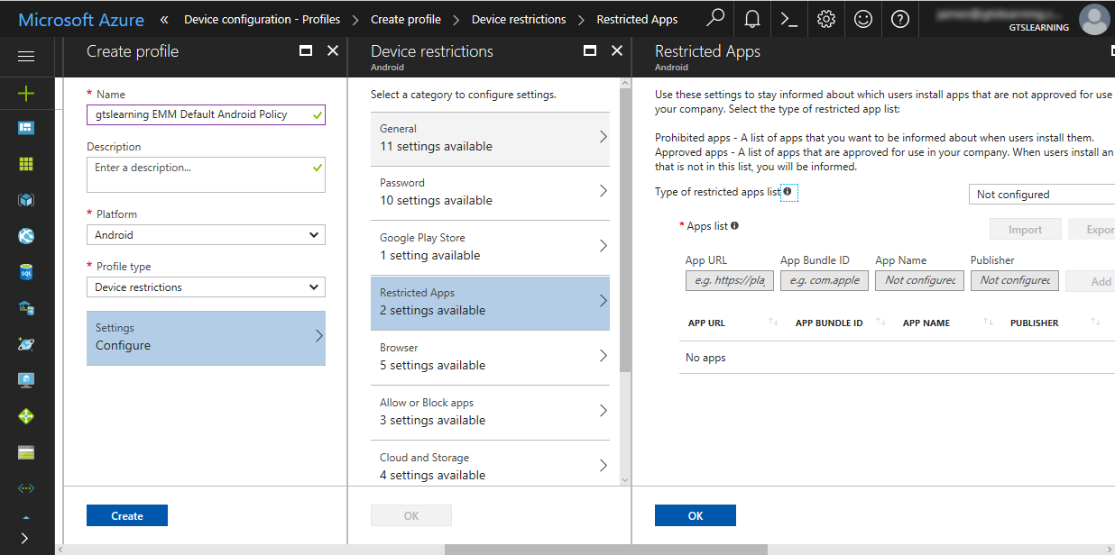
Application Management
When a device is joined to the corporate network through enrollment with management software, it can be configured into an enterprise workspace mode in which only a certain number of authorized applications can run.
Restricting third-party app stores
Enterprise app development and fulfillment
Sideloading- With unknown sources enabled, untrusted apps can be downloaded from a website and installed using the .apk file format. This is referred to as sideloading. Eg Android allows, iOS doesn’t.
Screenshot used with permission from Microsoft.
Notes:
Note that sideloading is both a way of adding enterprise apps and an undesirable behavior that needs to be prevented on corporate-owned devices.

Slide 11
Content Management
Containerization allows the employer to manage and maintain the portion of the device that interfaces with the corporate network. An enterprise workspace with a defined selection of apps and a separate container is created. This container isolates corporate apps from the rest of the device. There may be a requirement for additional authentication to access the workspace.
Containerization also assists content management and data loss prevention. A content management system tags corporate or confidential data and prevents it from being shared or copied to unauthorized external media or channels

Slide 12
Rooting and Jailbreaking
Rooting
this term is associated with Android devices. Some vendors provide authorized mechanisms for users to access the root account on their device.
Custom firmware/ROM (Custom firmware is essentially a new Android OS image applied to the device)
Jailbreaking
Principally iOS
(exploits that enabled the user to obtain root privileges, sideload apps, change or add carriers, and customize the interface. iOS jailbreaking is accomplished by booting the device with a patched kernel.)
Risks to enterprise management
Devices equipped with the A12 chip or newer (iPhone XR, XS/XS Max or newer) can jailbreak iOS & iPadOS 14.0-14.3 with Taurine and unc0ver.
Notes:
Detecting whether a device has been rooted is not straightforward. You might want to point students to Google's attestation API documentation for more information on root detection (developer.android.com/training/safetynet/attestation).

Slide 13
Implement Secure Mobile Device Connections
Topic 13B
Notes:
This topic completes the coverage of objective 3.5 by looking at connection methods. We also cover the Bluetooth, NFC, and RFID attacks from 1.4

Slide 14
Wi-Fi and Tethering Connection Methods
Risks from Wi-Fi
Open access points
Rogue access points
Personal Area Network (PAN) technologies
Ad Hoc networks and Wi-Fi Direct
Tethering and hotspots
(Where the connection is shared by connecting the smartphone to a PC over a USB cable or with a single PC via Bluetooth, it can be referred to as tethering)

Slide 15
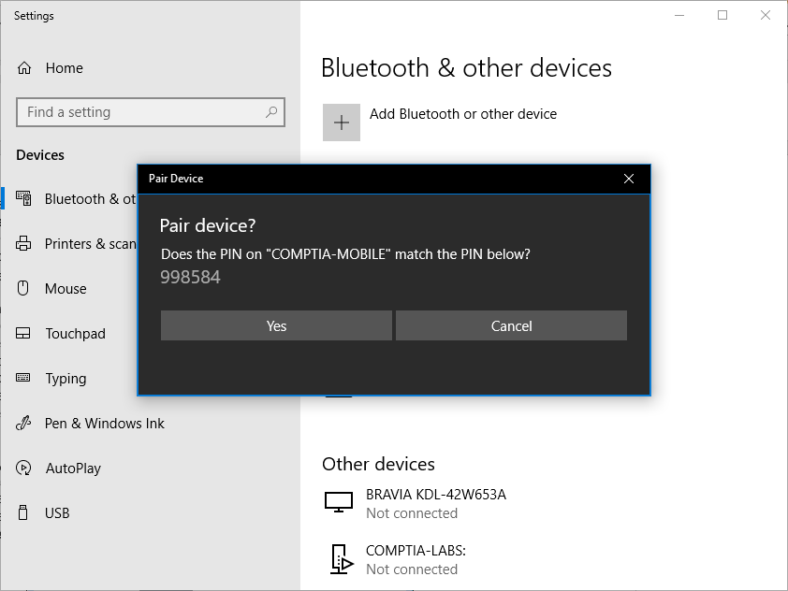
Bluetooth Connection Methods
Security issues:
Device discovery
Authentication and authorization
Pairing mechanism- simple passkeys
Malware and exploits- Bluetooth worms and application exploits, BlueBorne exploits
Bluejacking
Unless some sort of authentication is configured, a discoverable device is vulnerable to bluejacking, a sort of spam where someone sends you an unsolicited text (or picture/ video) message or vCard (contact details)
Bluesnarfing
refers to using an exploit in Bluetooth to steal information from someone else's phone.
Screenshot used with permission from Microsoft.

Slide 16
Infrared and RFID Connection Methods
Infrared
IR blaster - this allows the device to interact with an IR receiver and operate a device such as a TV or HVAC monitor as though it were the remote control handset.
IR sensor -these are used as proximity sensors and to measure health information (such as heart rate and blood oxygen levels).
Radio Frequency ID (RFID) - ) is a means of encoding information into passive tags, which can be easily attached to devices, structures, clothing etc
Transmit when in range of reader- produces an electromagnetic wave that powers up the tag and allows the reader to collect information
Encrypt sensitive information

Slide 17
Near Field Communications and Mobile Payment Services
Near Field Communications (NFC)-NFC is based on a particular type of radio frequency ID (RFID)
Connection configuration/bump (An NFC transaction) - Android Beam
Mobile wallet apps - The widest application of NFC is to make payments.
wallet apps: Apple Pay, Google Pay (formerly Android Pay), and Samsung Pay
Eavesdropping
Notes:
Sophos Security has produced a video about NFC card skimming (facebook.com/SophosSecurity/videos/10155345347100017). They also evaluate card and wallet protectors designed to block NFC transmissions.

Slide 18
USB Connection Methods
USB on the Go (OTG) allows a port to function as a device or hub
USB with malicious firmware might be able to perform an exploit
Spread malware between computers using the device as a vector
Install or run malware to try to compromise the smartphone itself
Notes:
This attack vector doesn't seem to have many actual exploits associated with it, but you could refer students to Wall of Sheep's Juice Jacking page (wallofsheep.com/pages/juice).

Slide 19
SMS/MMS/RCS and Push Notifications
Short message service (SMS)
Multimedia message service (MMS)
Rich communication services (RCS)
Exploits against handling of attachments or rich formatting
Push notifications

Slide 20
Microwave Radio Connection Methods
Point-to-point (P2P) microwave
High gain directional antenna
Point-to-multipoint (P2M) microwave
Smaller sectoral antennas

