Slide 1
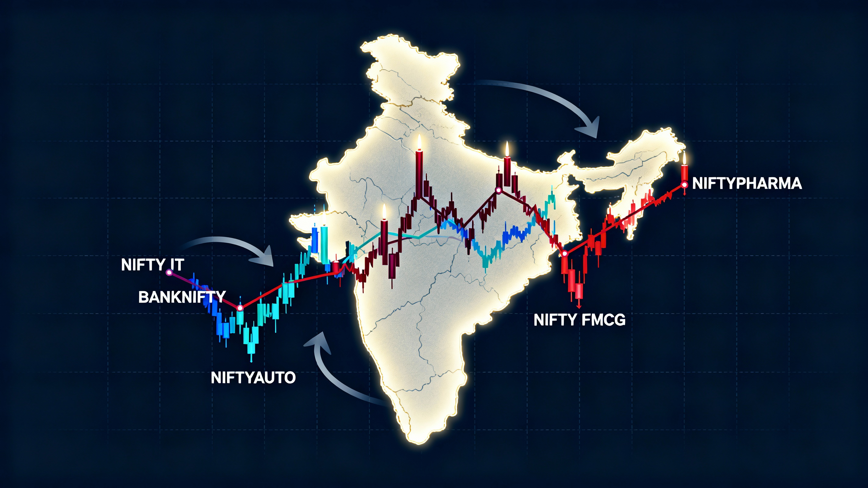
VOLATILITY FORECASTING AND SECTORAL RISK PROPOGATION IN INDIAN MARKETS : A GARCH PERSPECTIVE

Slide 2
Agenda
Introduction & Motivation
Data Description & Return Construction
Stationarity Diagnostics
ARIMA Mean Behavior
Rolling Volatility Patterns
GARCH / EGARCH Modeling
Volatility Forecasting Results

Slide 3
Introduction
Study of volatility patterns across five key NIFTY sectors (Bank, IT, Pharma, Auto, FMCG)
Focus on how market volatility behaves in calm vs crisis periods
Goal to estimate future volatility levels
Understanding how risk spreads across sectors during shocks

Slide 4

Data Description
Five NIFTY sector indices (Bank, IT, Pharma, Auto, FMCG)
Daily price data converted to log returns – log returns are additive and statistically magneable
Data Range (2000 – 2021)
Train–test split: last one year treated as test period
Train data : 5102 observations, Test data: 251 observations

Slide 5
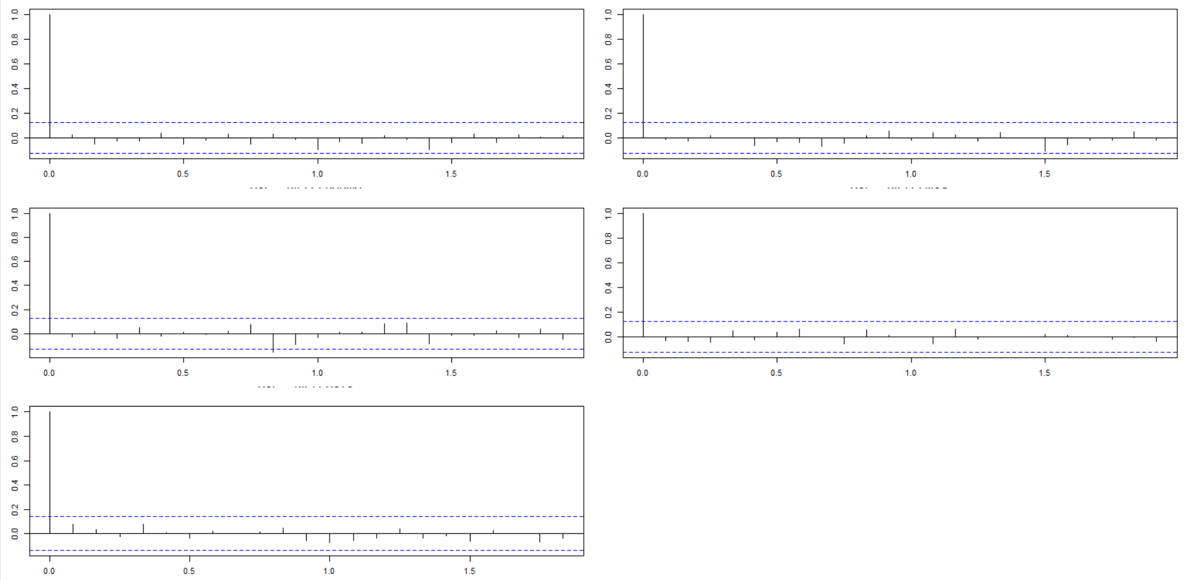
Stationarity
All sectors show negligible correlation
No predictable structure in returns
Supports weak-form market efficiency
returns behave like white noise across
sectors

Slide 6
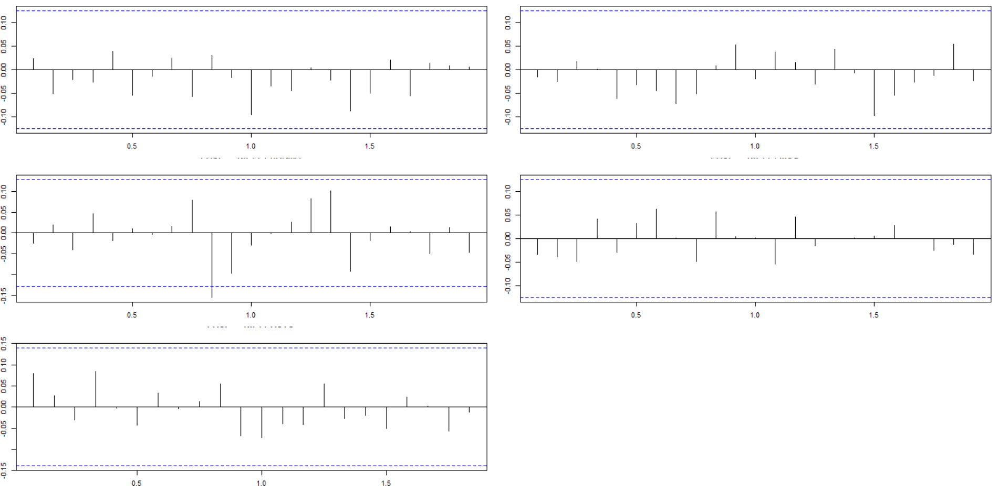
No significant partial autotocorrelation at any lag
All spikes remain within the 95% confidence
No hidden lag-driven predictability
Returns do not have meaningful AR
structure
Supports weak form: no exploitable
return timing
Need to model volatility instead

Slide 7
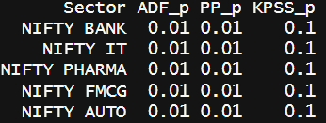
Stationarity Tests
ADF and PP p-values are below 0.05
we reject the null of non-stationarity
KPSS fails to reject the null of stationarity
Results fluctuate around constant mean and no drift
return dynamics are white noise like, not
trend-driven

Slide 8
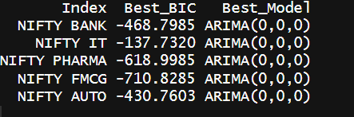
ARIMA
ARIMA search across (0,0,0), (1,0,0), (0,0,1), (1,0,1) using BIC
ARIMA(0,0,0) gives the lowest BIC for all 5 sectors
no autoregressive or moving-average structure
Consistent with flat ACF/PACF and weak-form market efficiency

Slide 9
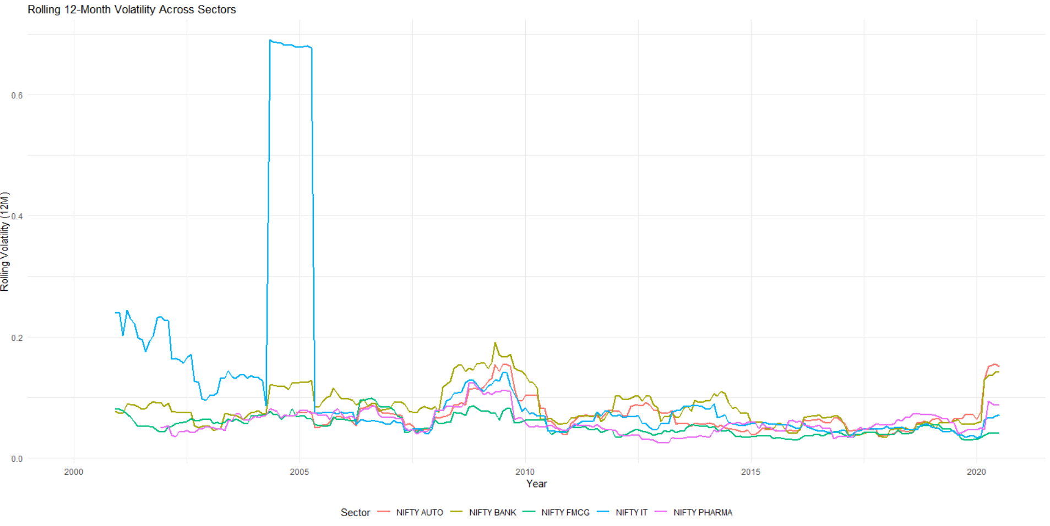
Rolling Volatility
Volatility is time varying and clustered across sectors
Volatility has good persistence (quiet to sudden) and shows regime shifts
Banking and Auto show sharp spikes
FMCG and Pharma are relatively stable
Returns behave like white noise, but volatility not

Slide 10
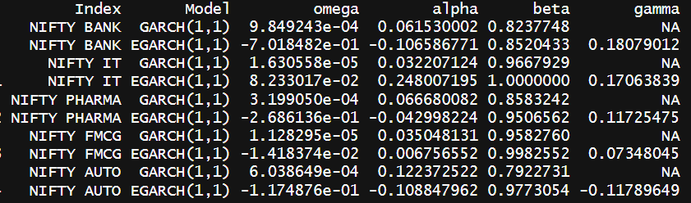
GARCH
GARCH(1,1)
Volatility today = baseline + reaction to shocks (α) + persistence (β)
α + β close to 1 → long‐lasting volatility
Captures clustering but assumes symmetric shock impact
EGARCH(1,1)
asymmetric reaction: bad news vs good news
Uses log‐variance, ensures positive volatility without constraints
Better suited for crisis regimes

Slide 11
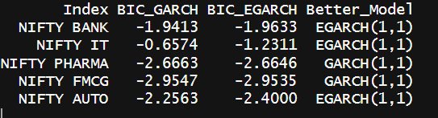
GARCH persistence α+β =0.88 – 0.99 : volatility stays too long
EGARCH persistence drops to = 0.74–0.90 : more realistic shock decay
EGARCH captures asymmetry (γ present); GARCH has no γ term
γ > 0 (Bank 0.18, IT 0.17, Pharma 0.12) → bad news causes larger volatility jumps
GARCH: persistence driver (α+β) vs EGARCH: shock response driver (γ)
GARCH assumes volatility never dies. EGARCH shows it decays not instantly
EGARCH better reflects real risk behavior

Slide 12
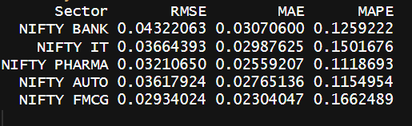
Volatility Forecast Accuracy
log returns used for volatility forecasting
EGARCH model trained on full series minus test window
One-step-ahead rolling forecasts generated for test period
Realized volatility computed using rolling window standard deviation (window size = 20 days)
Both expressed as annualized volatility
Accuracy measured using RMSE, MAE, MAPE
errors remain consistently low across all sectors
FMCG & Pharma show lowest MAE – more stable

Slide 13
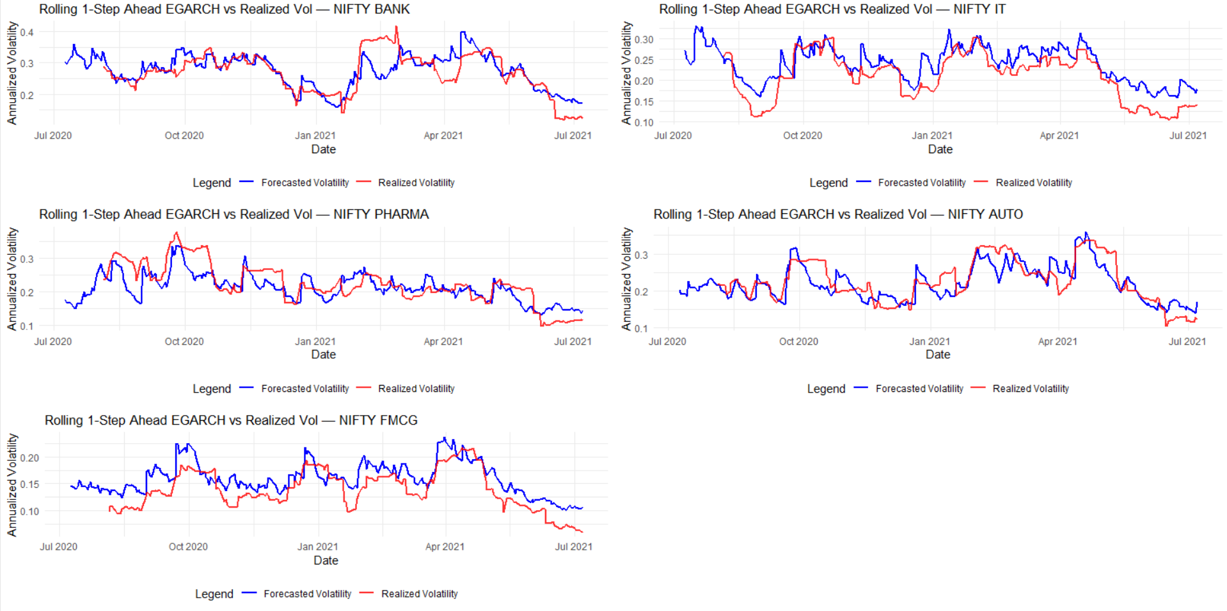

Slide 14
THANK YOU

