Slide 1
CRIME IN INDIA
ANALYSIS
FINAL PROJECT
DATS-6101
Ben Schmidt, James Rullo, Kshitij Bhat, Srilatha Lakka, Sam SR

Slide 2
Project Overview
Crime Data can highlight areas of concern for many regions
India’s crime rate has come under international focus in recent years
Efforts to predictively understand driving factors of crime allows a chance to decrease the harm done by criminal activity

Slide 3
Dataset:
2012-2013 Indian National Crime Report
Our dataset contains information pertaining to various crimes committed in India between 2012-2013
The data lists number of crimes committed by ten different demographics, in each state / Union Territory:
Gender: Male or Female
Age: Less than 18, 18-30, 30-45, 45-60, Greater than 60
Crimes range from various kinds of theft, murder, or sexual assault, to financial crimes, environmental, and civil

Slide 4
Data Processing
In order to perform some of our analysis, we had to process the data as follows:
Broke down the many different crimes into 8 categories:
Civil, Contraband, Human Trafficking, Immigration, Kidnapping, Theft, Violent, Other
Where a crime might fall into more than one category the more severe category was chosen (armed robbery is violent crime, not theft)
In order to obtain numeric and more granular data about the age for crimes committed, we assigned ages based on a random distribution for each of the ten demographics. This allowed the analysis to run numerically

Slide 5
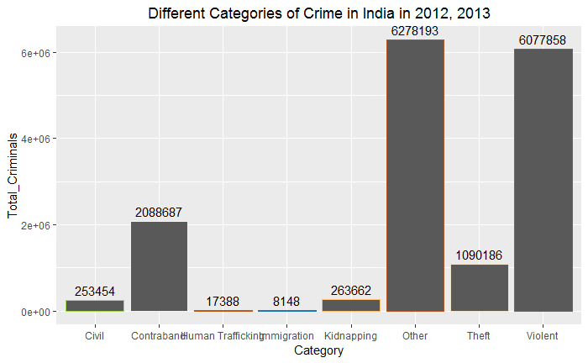
EDA : Overview of categories of crimes

Slide 6
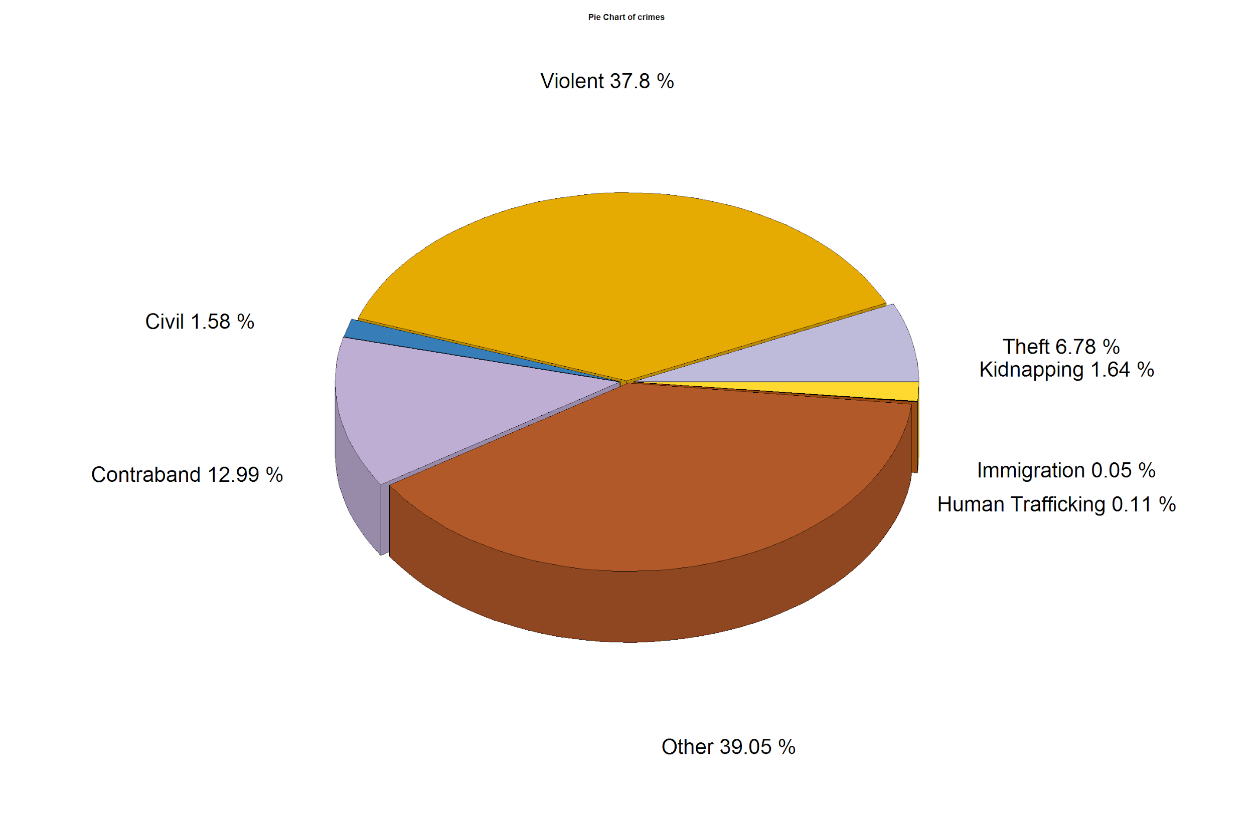

Slide 7
S.M.A.R.T Question
Can demographic data be used to predict particular crimes or locations?
This question is specific to the dataset
The dataset contains the required information to measure this, and is thus achievable
Relevant to the data points
Bounded by the years of crime data provided

Slide 8
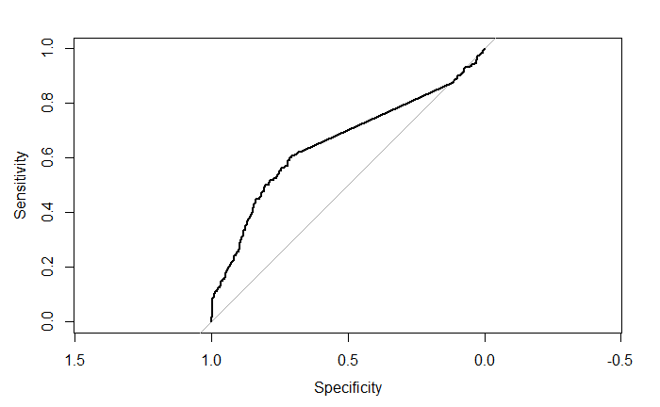
Linear Regression and Model ROC #1
Our first general linear model is based on the 3 middle age groups
Category ~ (Total crimes committed for 18 to 30) +
(Total crimes committed for 30 to 45) +
(Total crimes committed for 45 to 60)
ROC curve indicates that the model could be better but demonstrates a positive trend
AUC = .6546, not great
McFadden = 3.14e-02, also not great

Slide 9
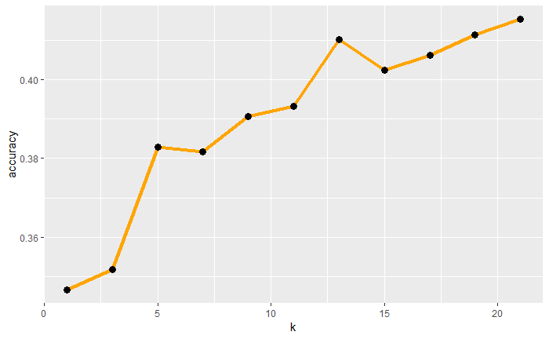
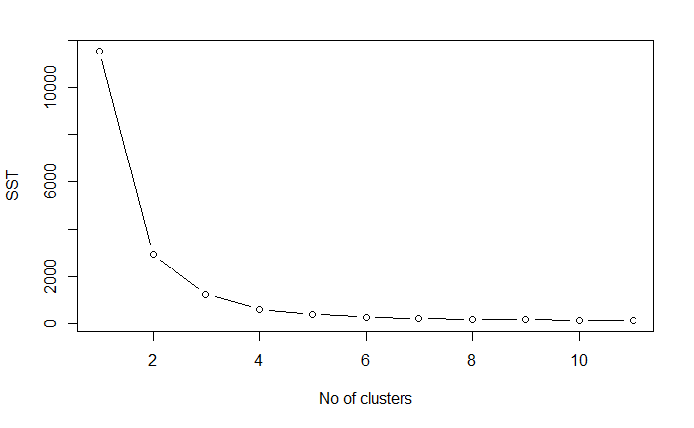
Accuracy of KNN and K-Means (Model 1)
Running a simulation of the KNN analysis shows us that a k value of around 10-15 will be the most optimal, so we chose 14
The elbow curve of our K-Means plot shows diminishing returns start at around 5 clusters (each additional cluster after provides less than 1% increase in accuracy)

Slide 10
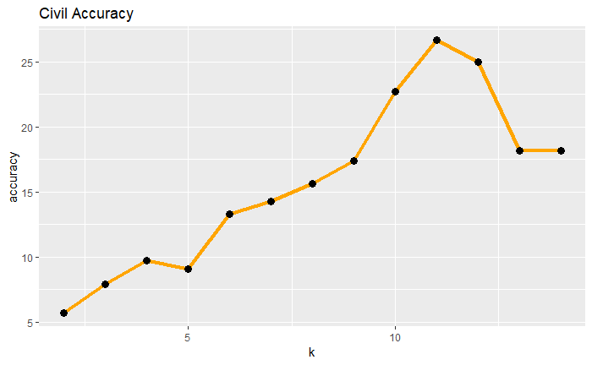
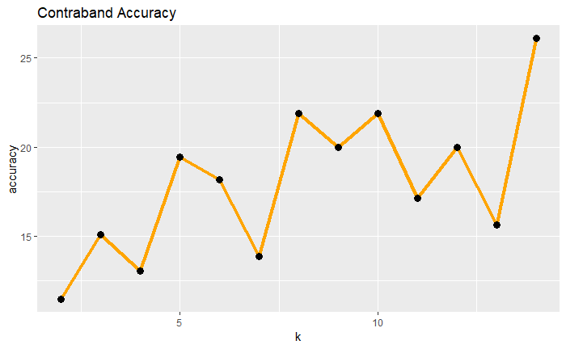
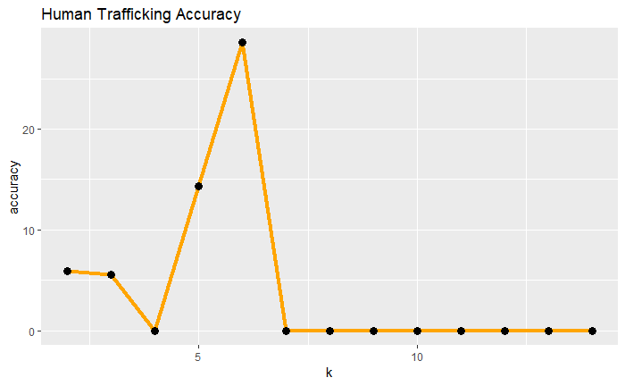
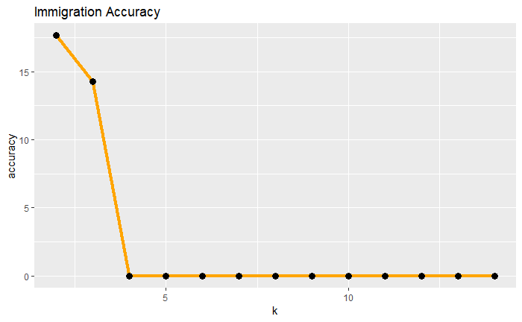
Accuracy of 1st KNN model as a function of K

Slide 11
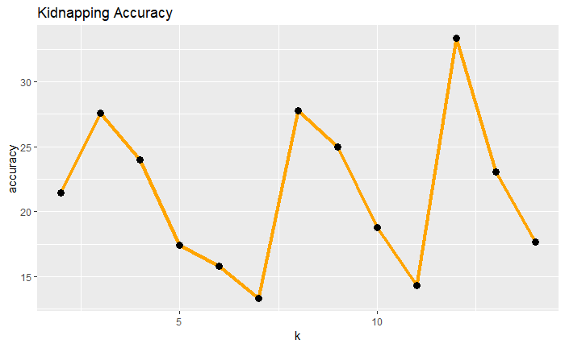
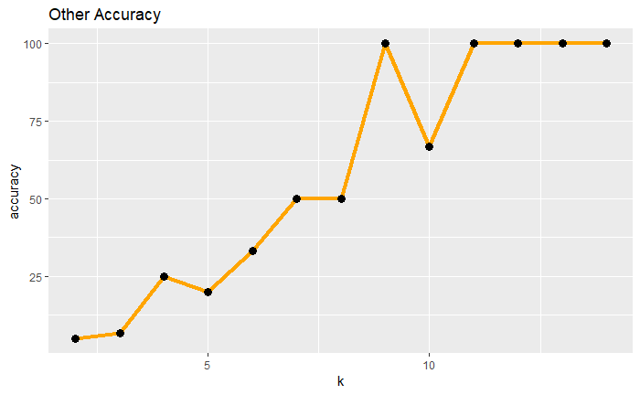
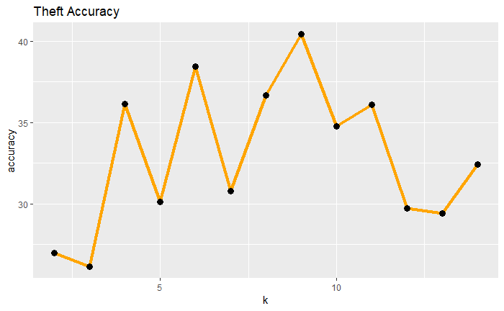
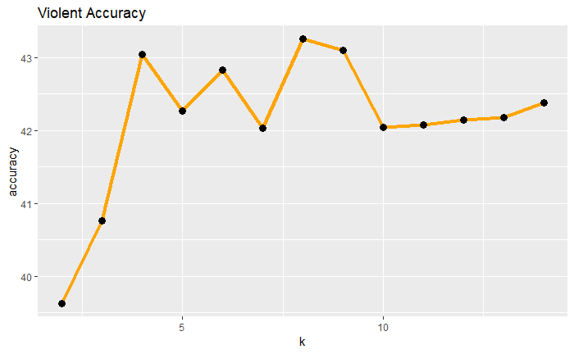
Accuracy of 1st KNN model as a function of K

Slide 12
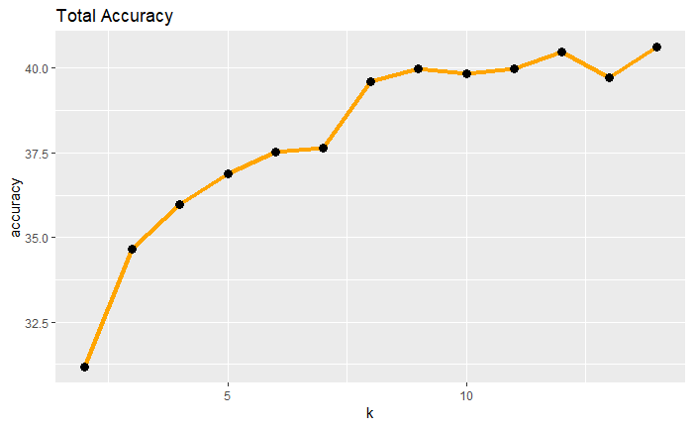
Conclusion about Model 1
Because our data is aggregated and at the start lacked enough granularity, it doesn’t lend itself well to this modeling analysis, our accuracy is low
between 32.5% for low k
Plateauing out (diminishing returns for computation required) at around 8-10 k at 40%
Individual accuracies for classifying crime categories are can be accurate, but the overall model was not.

Slide 13
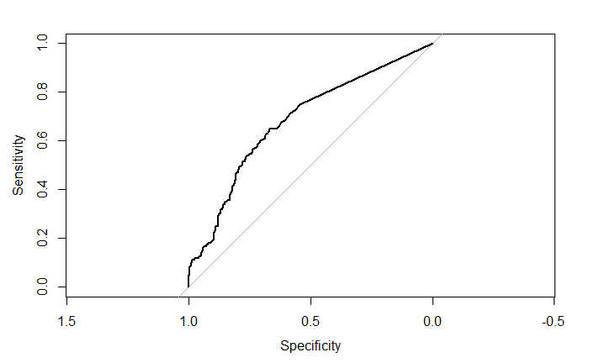
Linear Regression and Model ROC #2
Our second general linear model is based on the two gender demographics
Category ~ (Total crimes committed for Males) +
(Total crimes committed for Females)
ROC curve indicates that the model could be better but demonstrates a positive trend
AUC = .6828, slightly better than previous model, but negligibly different
McFadden = 1.72e-02, slightly worse than previous model

Slide 14
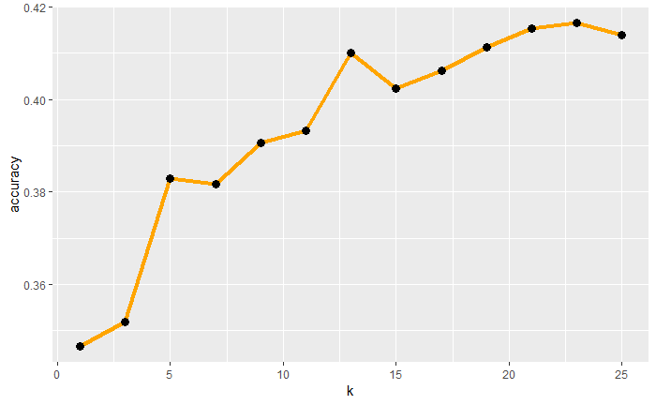
Accuracy of KNN and K-Means (Model 2)
Running a simulation of the KNN analysis shows us that a k value of around 10-15 will be the most optimal, so we chose to try up to 14, again
The elbow curve of our K-Means plot shows diminishing returns start at around 5 clusters (each additional cluster after provides less than 1% increase in accuracy)

Slide 15
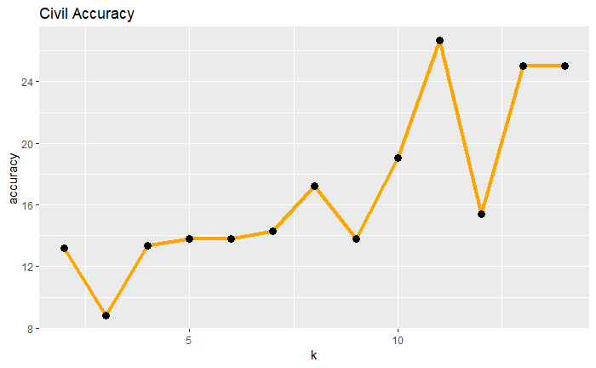
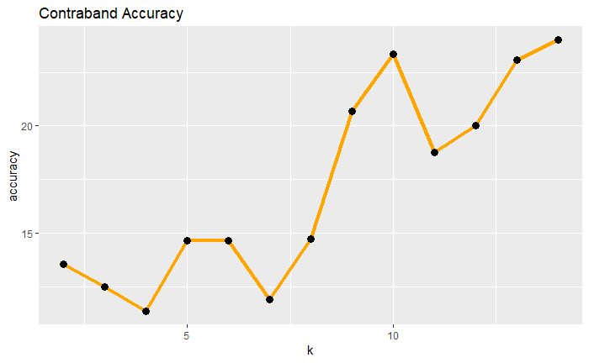
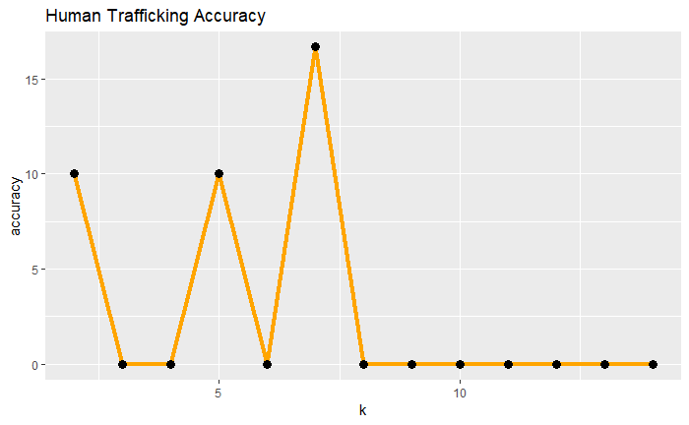
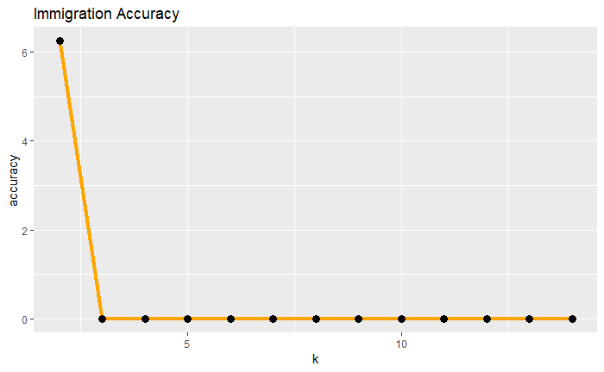
Accuracy of 2nd KNN model as a function of K

Slide 16
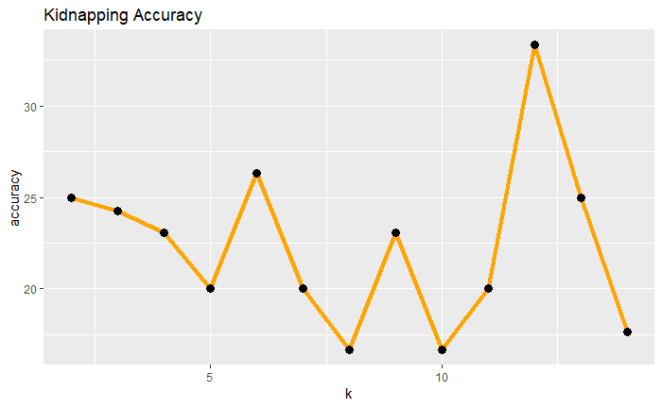
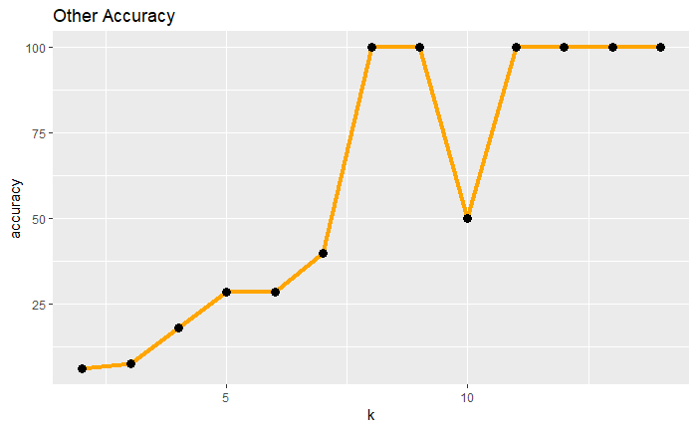
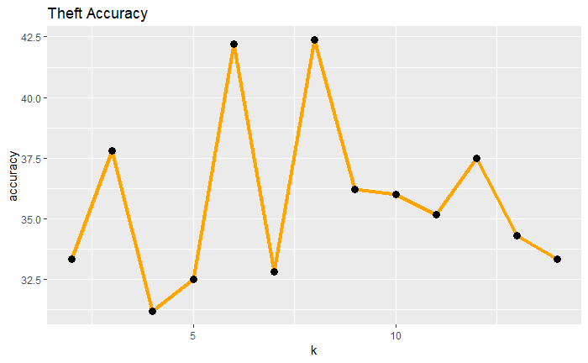
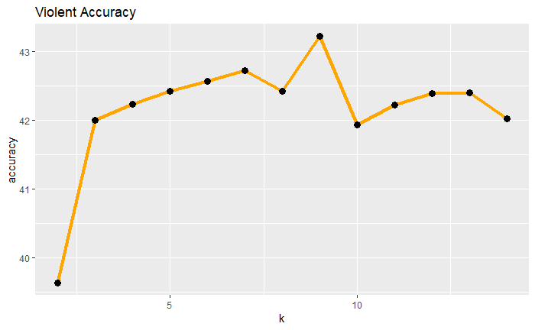
Accuracy of 2nd KNN model as a function of K

Slide 17
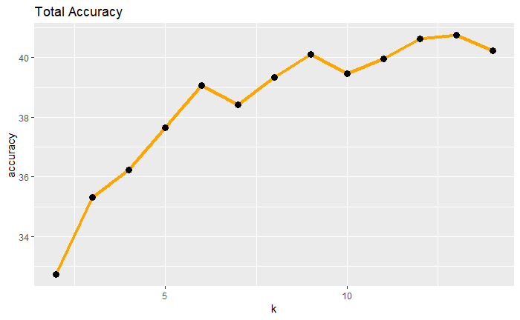
Conclusion about Model 2
Because our data is aggregated and at the start lacked enough granularity, it doesn’t lend itself well to this modeling analysis, our accuracy is low
between 32.5% for low k
Plateauing out (diminishing returns for computation required) at around 8-10 k at 40%
Individual accuracies for classifying crime categories are can be accurate, but the overall model was not.

Slide 18
Model Comparison
Very similar results in the individual classification accuracies and total accuracies
No clear superior model
odel 1 (Age) Model 2 (

Slide 19
Conclusion
Can demographic data be used to predict particular crimes or locations?
Yes, but it isn’t terribly accurate, around 40% at best
Future improvements to the model could include:
Different breakdown of categories. Few crime statistics for immigration crime and human trafficking led to inaccurate predictions for those classifications
Different combinations of demographics than the ones we chose
Also possible that this data set is just hard to build models from

Slide 20
Sources
Ansari, S., Verma, A., & Dadkhah, K. (2015). Crime Rates in India: A Trend Analysis. International Criminal Justice Review, 25(4), 318–336. https://doi.org/10.1177/1057567715596047
Chaudhuri, K., Chowdhury, P., & Kumbhakar, S. (2015). Crime in India: specification and estimation of violent crime index. Journal of Productivity Analysis, 43(1), 13–28. https://doi.org/10.1007/s11123-014-0398-7
Crime in India. (1954). New Delhi: Intelligence Bureau, Ministry of Home Affairs, Govt. of India.
Mittal, M., Goyal, L., Sethi, J., & Hemanth, D. (2018). Monitoring the Impact of Economic Crisis on Crime in India Using Machine Learning. Computational Economics, 1–19. https://doi.org/10.1007/s10614-018-9821-x
Sahu, J., & Mohanty, C. (2016). Is there a natural rate of crime in India? Contemporary Social Science, 11(4), 334–346. https://doi.org/10.1080/21582041.2016.1249937
Sharma, D. (2013). Growing overlap between terrorism and organized crime in India: a case study.(Case study). Security Journal, 26(1), 60–79. https://doi.org/10.1057/sj.2011.33

