Slide 1
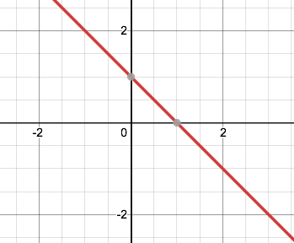

Distance between two parallel lines =
$\frac{b+1}{|\left|w\right||}−\frac{b}{|\left|w\right||}$= $\frac{1}{|\left|w\right||}$

Slide 2



y = +1
$$w∙x+b=1$$
$$w∙x+b=0$$
$$w∙x+b=−1$$
Margin
Support Vectors
y = -1

Slide 3
Hard-Margin SVM
Soft-Margin SVM
Hard-Margin SVM decision boundary is narrow and unstable to new data points.
Soft-Margin SVM achieves a wider margin by allowing for wrong classification.

Slide 4

Misclassified Point
$ξ$ = slack

