Slide 1

JavaScript Applications Website
Satish Narayan Gupta ( 181500626 )
Kshitij Gupta (181500337)
GLA University Mathura- 281406, INDIA

Slide 2
INTRODUCTION
○
■
I have developed a website where users can learn while playing games. So basically I am promoting the idea of fun with learning.
The Applications which I have made on my website are:
Todo List
Typing Speed Game
Simon Game
These applications not only relax the users mind but also boost their skills.

Slide 3
OBJECTIVE
The aim of my project is to target thousands of users to use and engage with my website. I have decided to work on this project because most of the people face the same problem when they want to relax their mind but don't want to waste their time on any game which has no use.
So, to overcome this problem I have build a website where users can improve their skills with fun and also manage their work.

Slide 4
Requirements
Hardware
Language and Frameworks
Software
Laptop/Desktop
1.8Ghz or faster processor.
4GB of RAM and core i3 processor.
Hard disk space: Minimum of 500MB
HTML
CSS
Bootstrap
JavaScript
Jquery
Windows 8.1 and
above.
Visual Studio Code.
Web Browser.
Github Desktop.

Slide 5
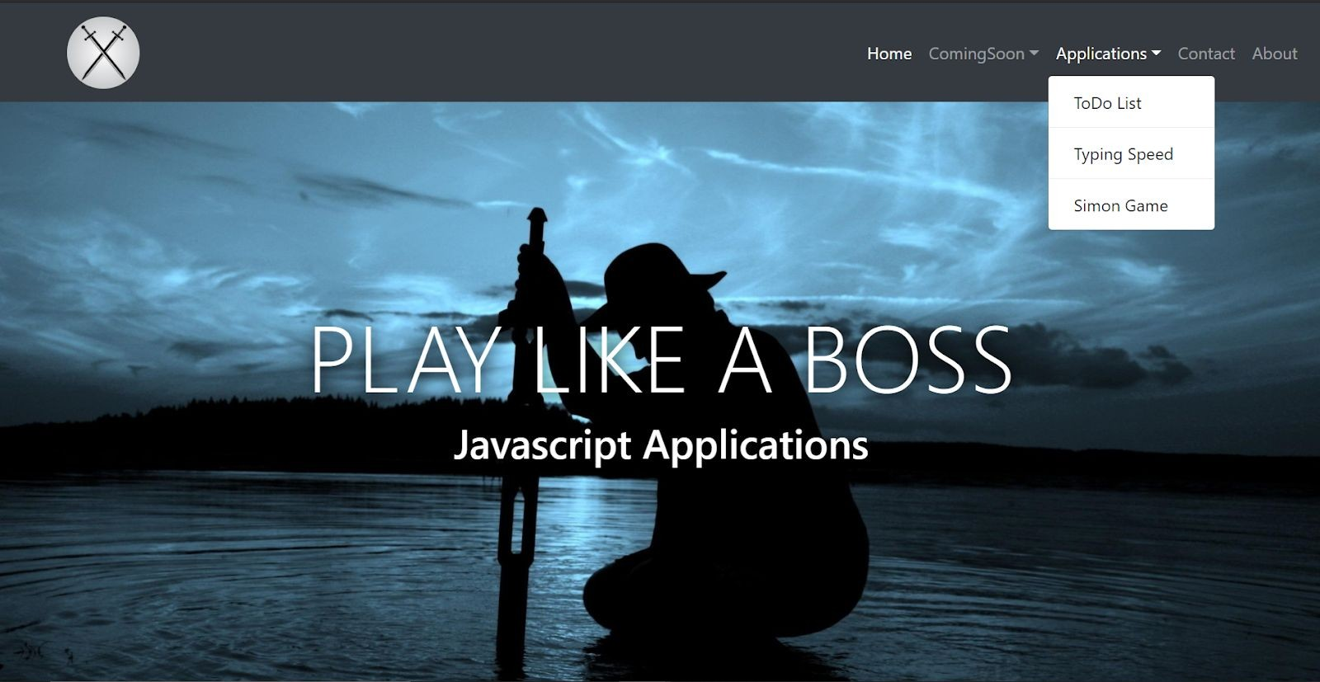
Some Screenshots
Home Page: Navigation Bar

Slide 6

TODO LIST Section:

Slide 7
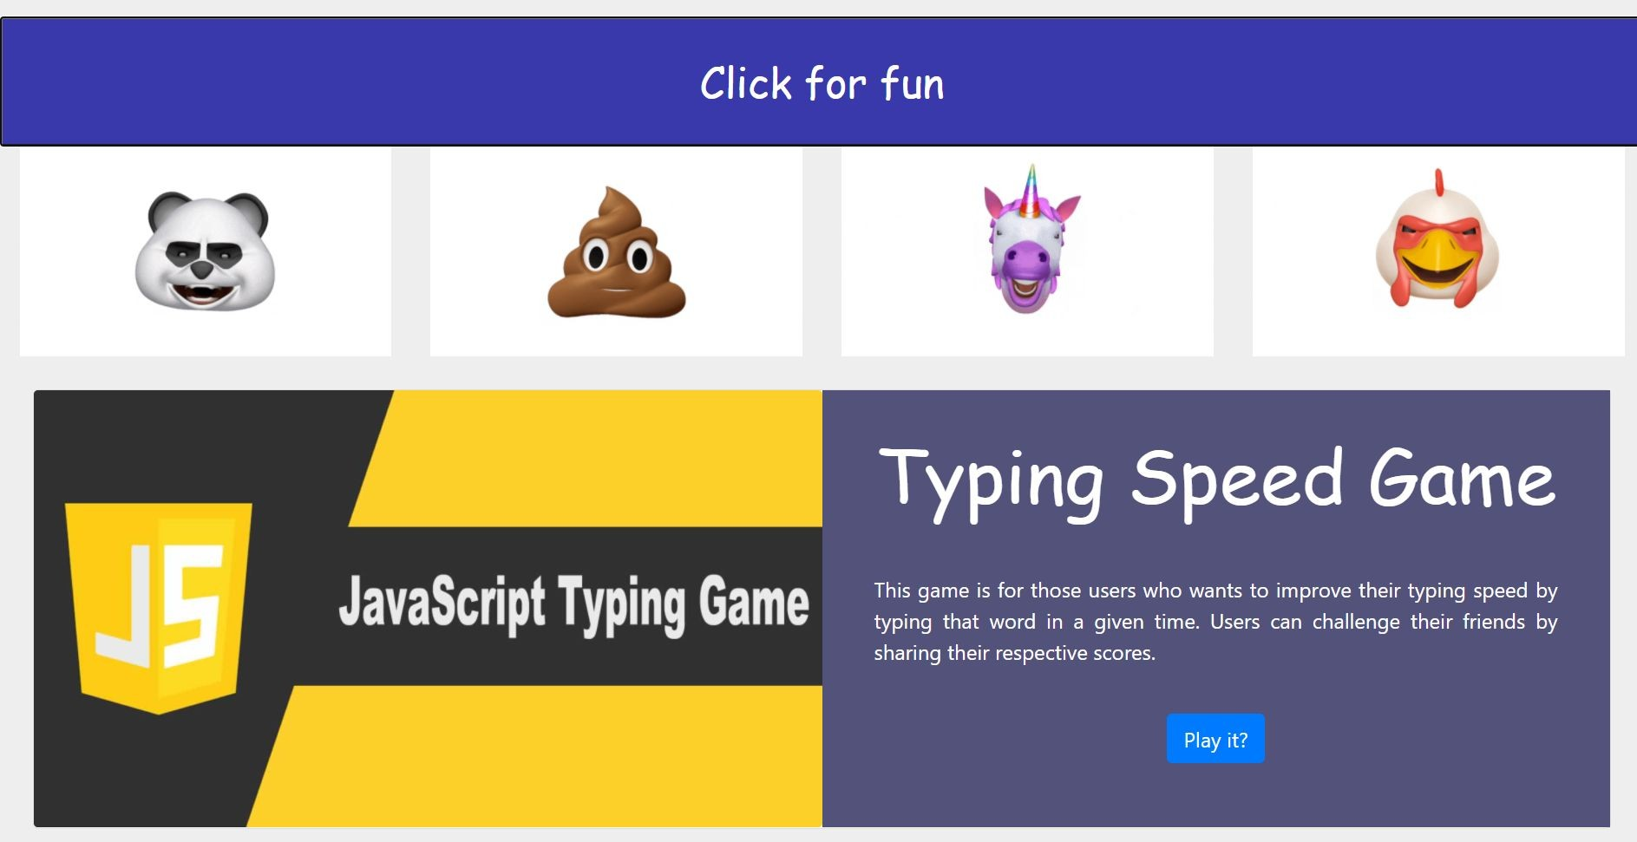
TYPING SPEED GAME Section:

Slide 8
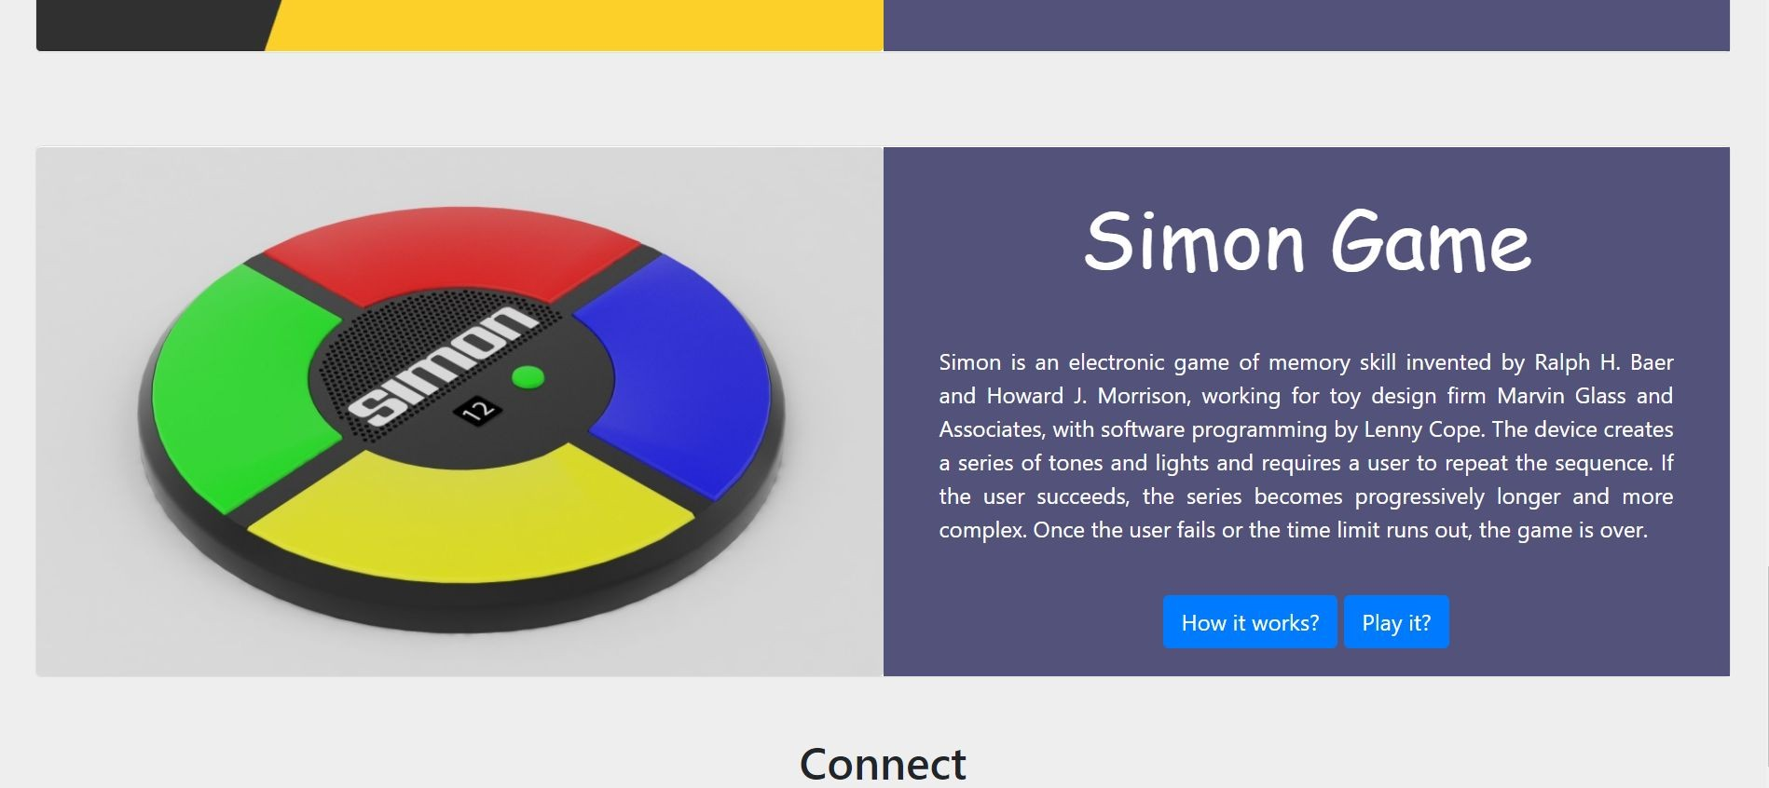
SIMON GAME Section:

Slide 9
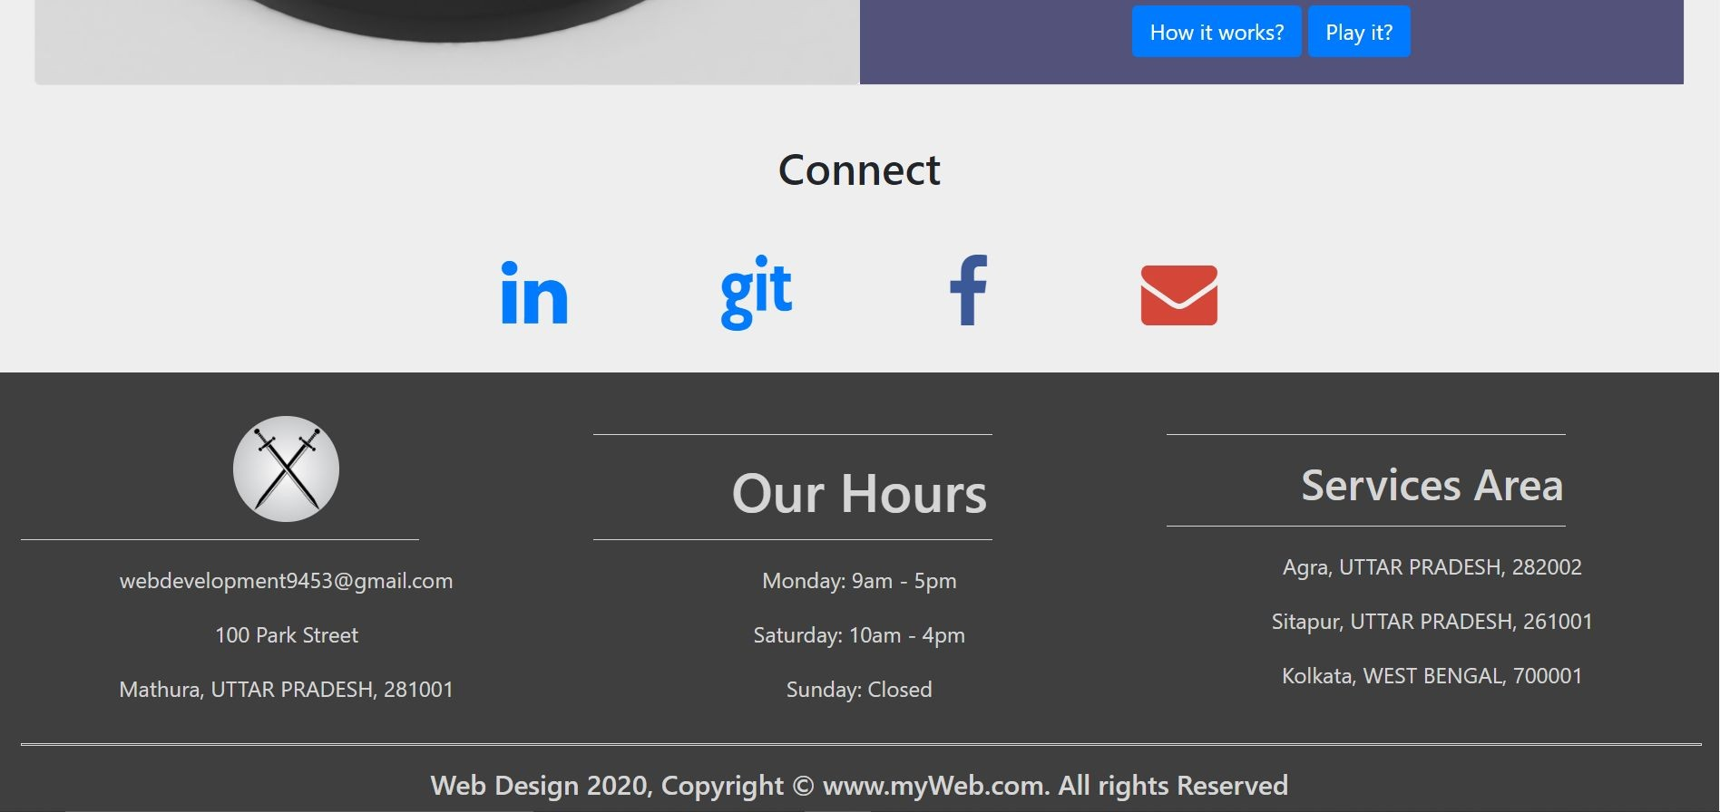
Contact and About Section:

Slide 10
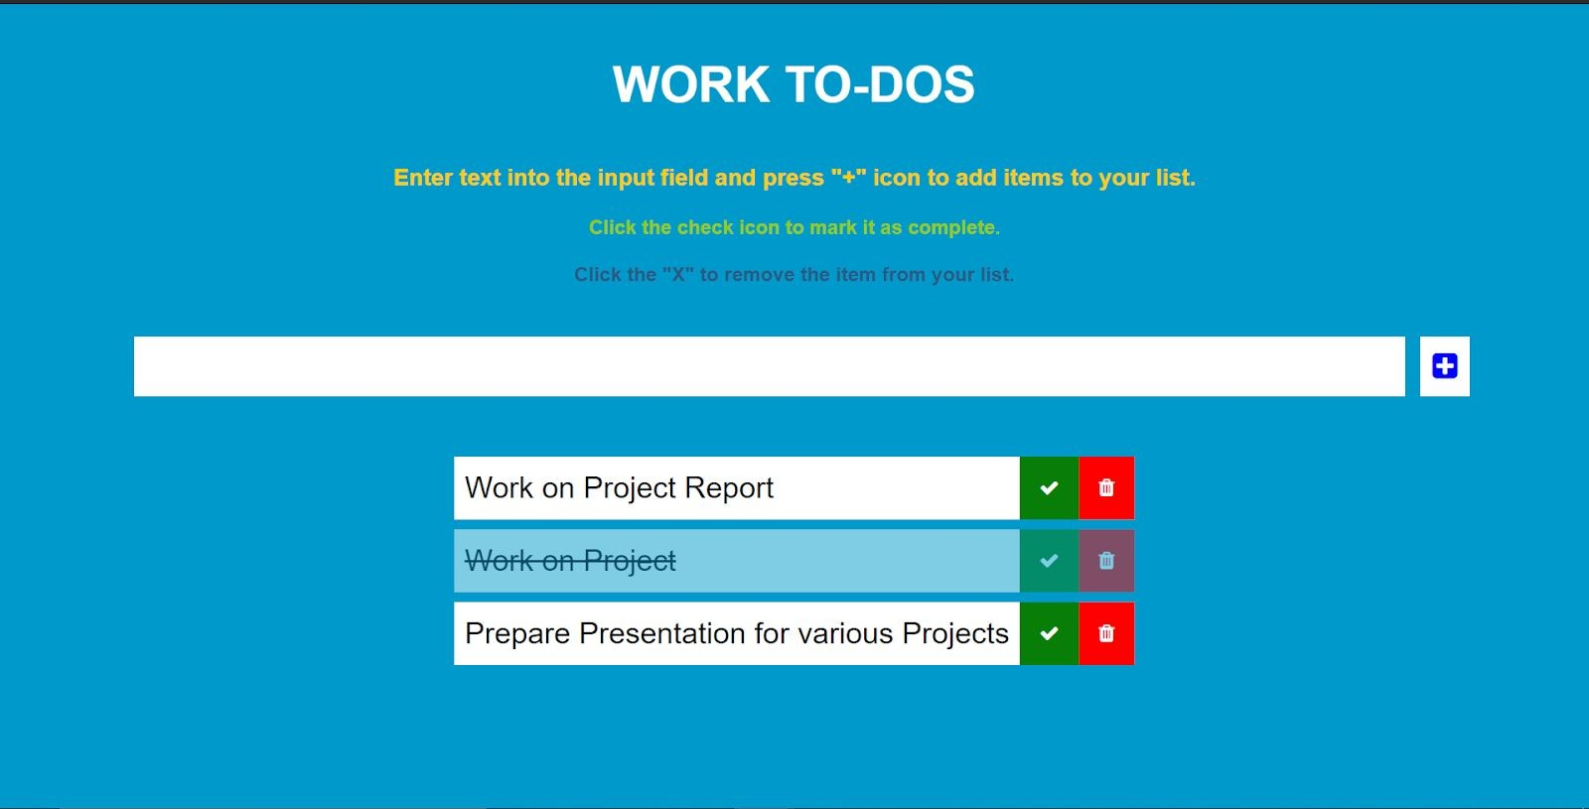
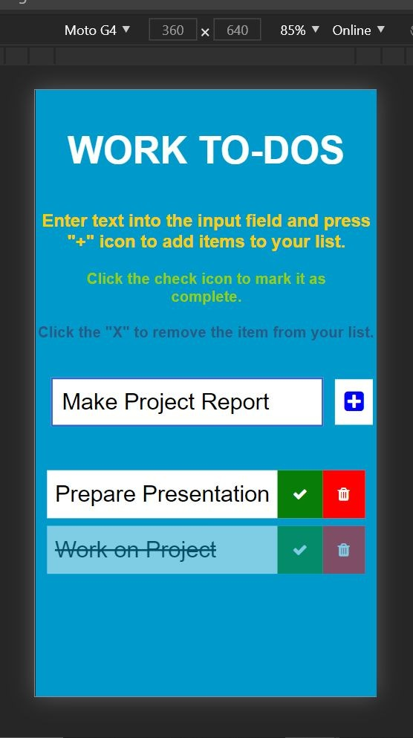
TODO LIST: Desktop and Mobile Screen

Slide 11
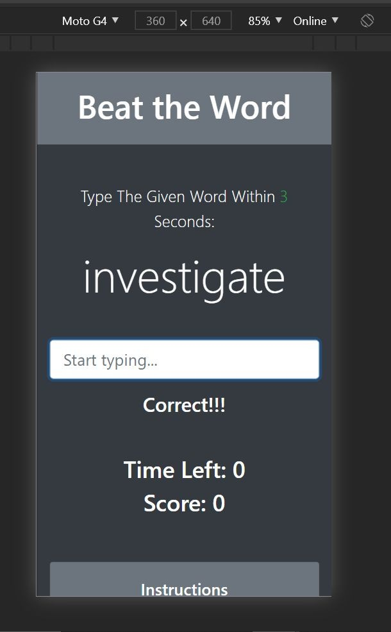
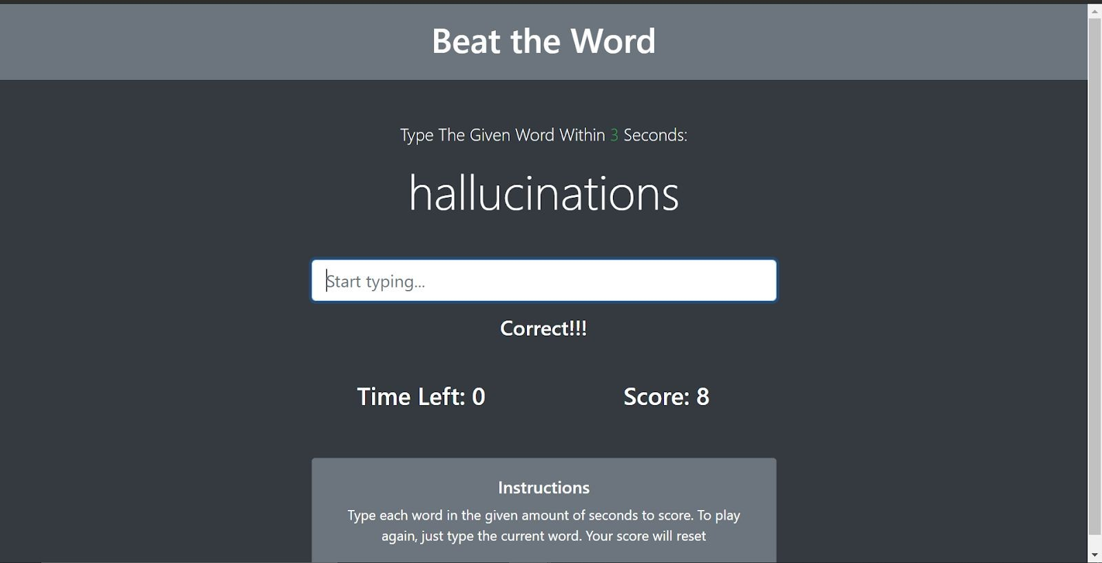
Typing Speed Game: Desktop and Mobile Screen

Slide 12
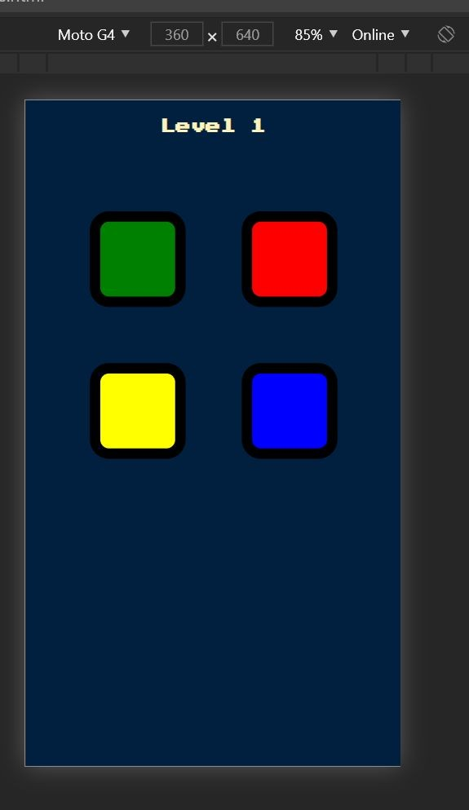
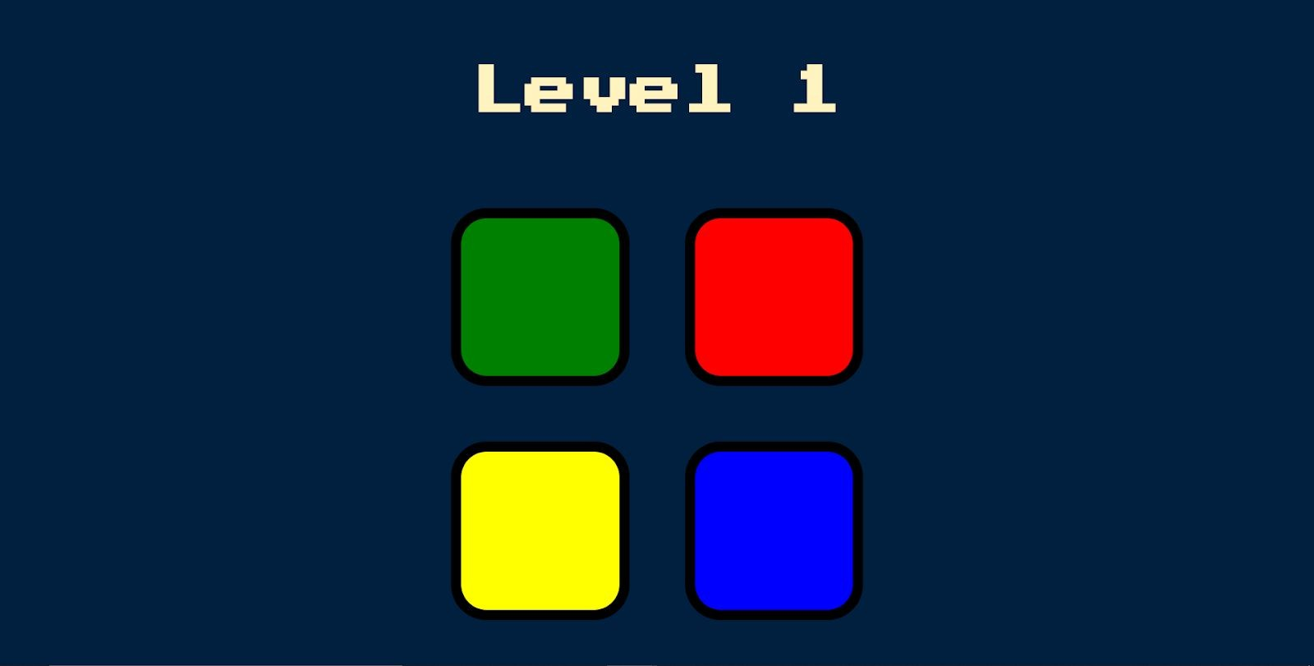
Simon Game: Desktop and Mobile Screen

Slide 13
...Thanks

