Slide 1

UNITED AIRLINES HACKATHON
TEAM : THE MINIMALISTS
DATA
ANALYSIS
OF AIRLINES DATA
TEAM
THE MINIMALISTS

Slide 2

UNITED AIRLINES HACKATHON
TEAM : THE MINIMALISTS
1
Data Cleaning and Preprocessing
Identify Tentative factors influencing high AHT and AST
2
Analyze the impact of identified factors on AHT and AST.
3
Create charts to illustrate the impact of each factor.
WORK FLOW
4
Examine call reasons and transcripts for potential solutions.
5

Slide 3
UNITED AIRLINES HACKATHON
TEAM : THE MINIMALISTS
TENTATIVE FACTORS BEHIND HIGH
AST AND AHT
01
02
03
04
05
Elite Level
Code
Calling
Time
and Day
Customer
tone & Agent
tone
Sentiments
&
Silence Percentage
Reason
of Calling

Slide 4
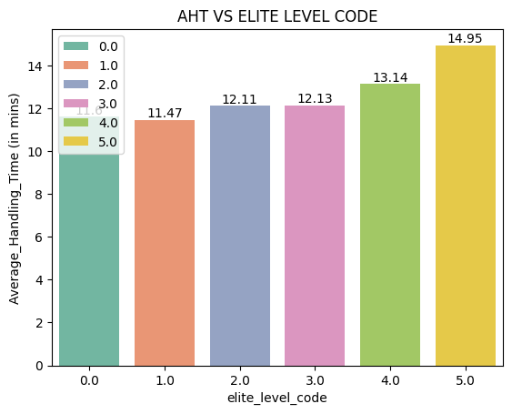
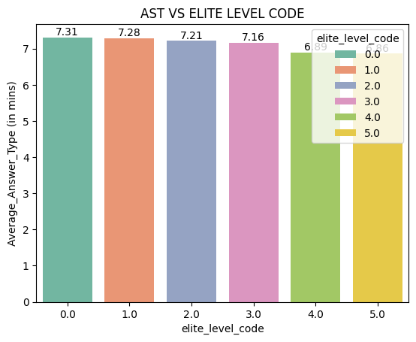
UNITED AIRLINES HACKATHON
TEAM : THE MINIMALISTS
1
The graph shows that higher membership levels lead to longer handling times, indicating more complex inquiries or requests from elite customers.
AST
The graph shows that higher membership levels lead to faster response times, indicating prioritized service for elite customers.
AHT
ELITE LEVEL
CODE

Slide 5
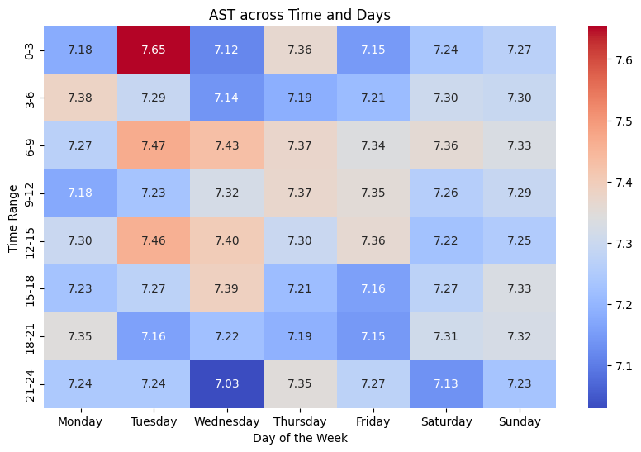
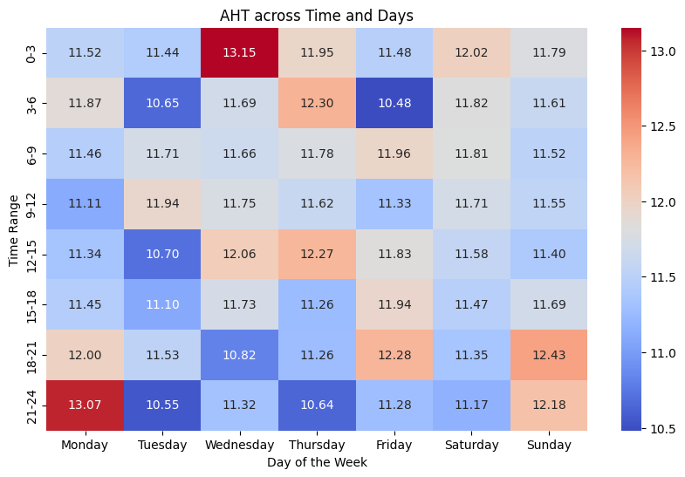
UNITED AIRLINES HACKATHON
TEAM : THE MINIMALISTS
2
AST
AHT
Average Speed to Answer (AST): Remains stable throughout the day and across the week, indicating no significant dependence on time or day.
CALLING TIME AND DAY
Average Handling Time (AHT): Also shows similar stability, suggesting performance is consistent regardless of morning, afternoon, evening, or weekdays vs. weekends.

Slide 6
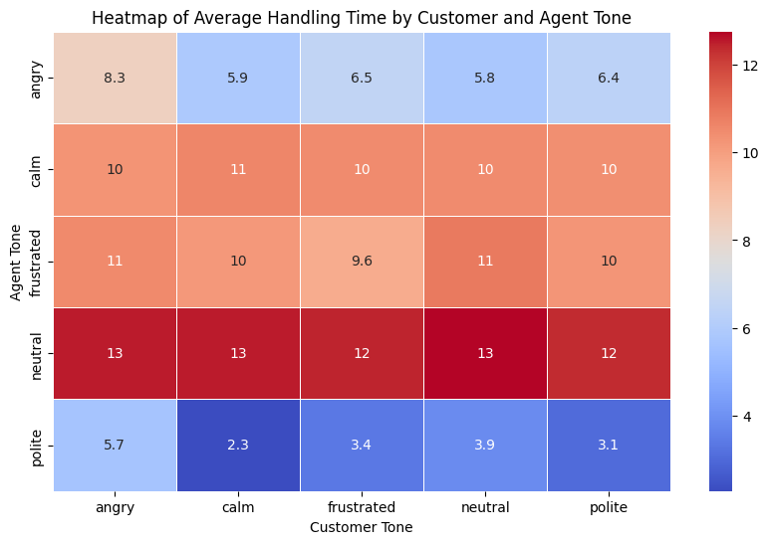
UNITED AIRLINES HACKATHON
TEAM : THE MINIMALISTS
CUSTOMER &
AGENT TONE
3
AHT
The heatmap shows that handling times vary by agent tone:
- Neutral Tone: Peaks at 13 minutes, indicating inefficiency.
- Polite Tone: Shortest times, as low as 2.3 minutes with calm customers, reflecting effectiveness.
- Frustrated Tone: Consistent handling times around 10-11 minutes, showing inefficiency.
- Calm Tone: Moderately high times (10-11 minutes), needing improvement.
In summary, maintaining a calm and polite tone can reduce handling times and enhance customer satisfaction, underscoring the role of emotional intelligence in service interactions.

Slide 7
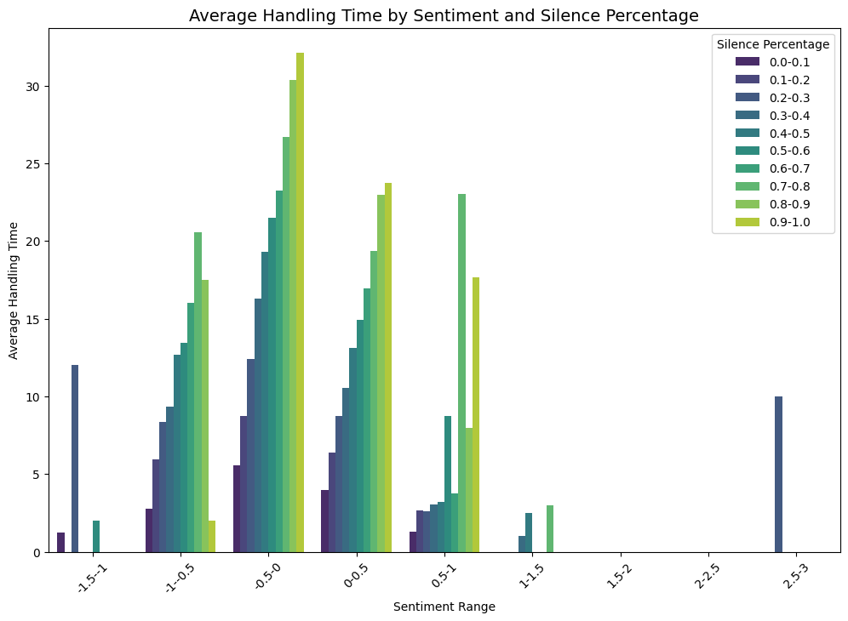
UNITED AIRLINES HACKATHON
TEAM : THE MINIMALISTS
SENTIMENTS &
SILENCE
PERCENTAGE
4
AHT
The graph shows that higher silence percentages (0.8-1.0) lead to longer handling times, exceeding 30 minutes, likely due to miscommunication. Lower silence percentages (0.0-0.1) result in quicker resolutions under 10 minutes. Mid-range silence (0.4-0.6) has mixed effects, while sentiment likely influences AHT, with negative tones correlating with higher silence and longer call durations. Reducing silence can help decrease AHT.

Slide 8
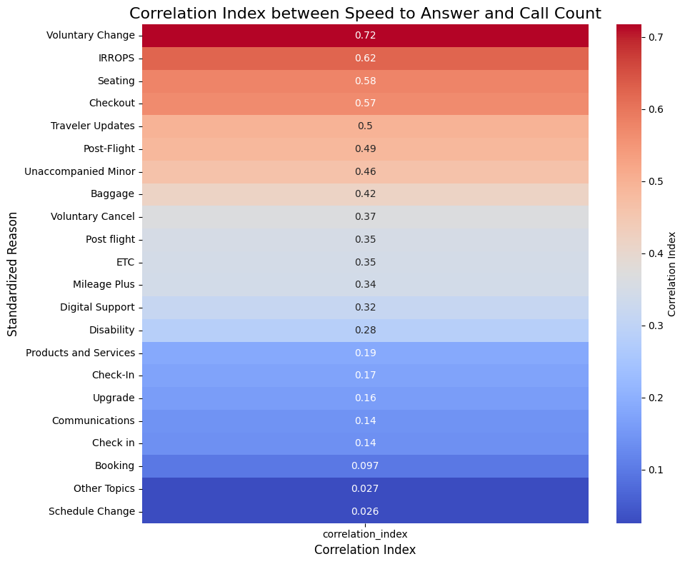
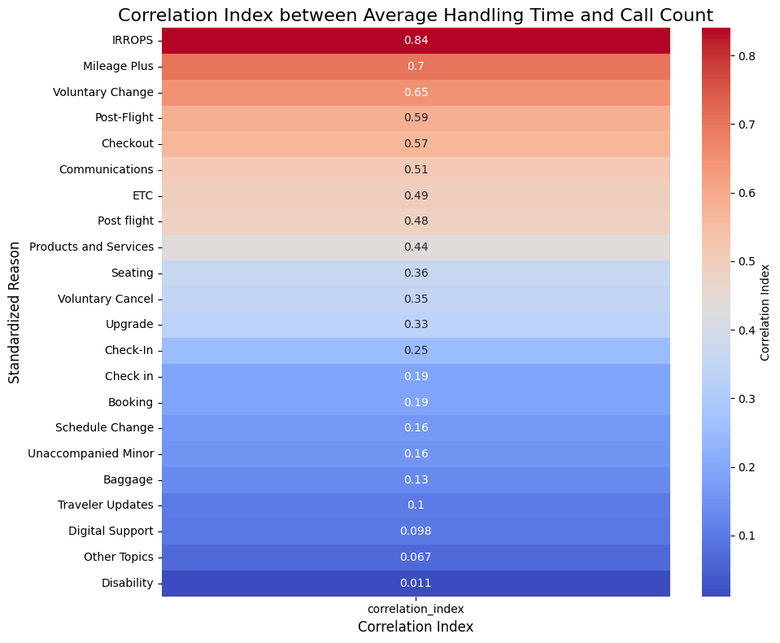
UNITED AIRLINES HACKATHON
TEAM : THE MINIMALISTS
IRROPS (0.84), Mileage Plus (0.70), and Voluntary Change (0.65) strongly correlate with longer handling times, while Booking (0.19) reflects quicker resolutions. Prioritizing high-correlation areas can boost efficiency
5
Voluntary Change (0.72) and IRROPS (0.62) correlate with faster response times, while Booking (0.097) shows slower responses. Focusing on high-correlation areas can improve customer experience and performance
AST
AHT
CALLING REASONS

Slide 9
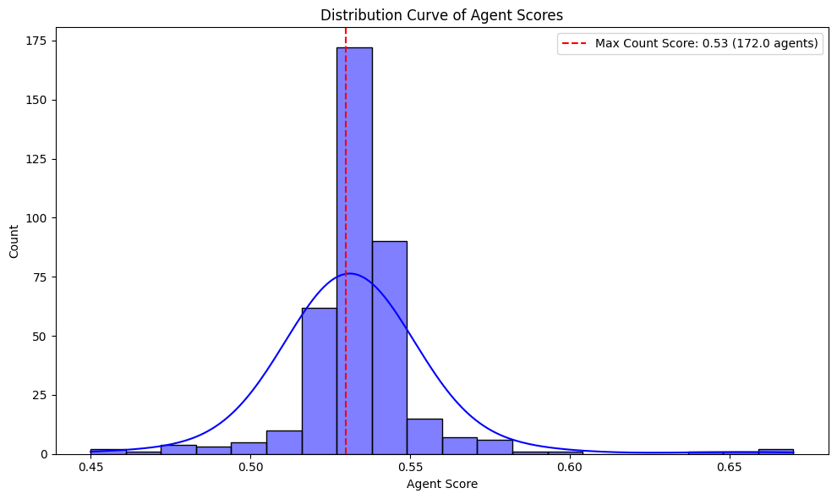
UNITED AIRLINES HACKATHON
TEAM : THE MINIMALISTS
OPTIMIZE AGENT
ALLOCATION
FOR CALL REASONS
Agent Score Analysis: Agent score used here is based on factors like agent tone, silence percentage, and sentiment score.
Agent Allocation: Agents with higher scores can be assigned to handle call reasons with a high correlation index for better performance.

Slide 10

UNITED AIRLINES HACKATHON
TEAM : THE MINIMALISTS
OVERALL OPTIMIZATION OF
CUSTOMER SERVICE
Prioritized Service for Elite Members: Implement tiered service strategies and train agents to handle complex inquiries effectively for elite customers.
Enhanced Communication Techniques: Provide training on effective communication to minimize silence and improve resolution times.
Emotional Intelligence Training: Encourage agents to adopt calm and polite tones during interactions to enhance efficiency and customer satisfaction.

