Slide 1


MATRIX
MULTIPLICATION
Fundamentals, Rules, Examples, and Applications
Row × Column → Cell
Mathematics / Design and Analysis of Algorithms
Notes:
Welcome. Today we break down matrix multiplication from core rules and dimension compatibility to implementation, a complete step-by-step example, and runtime complexity.

Slide 2
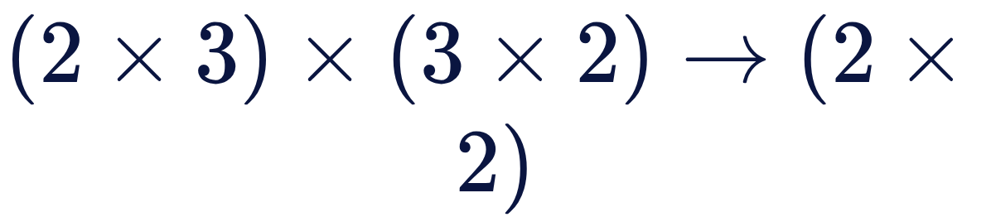
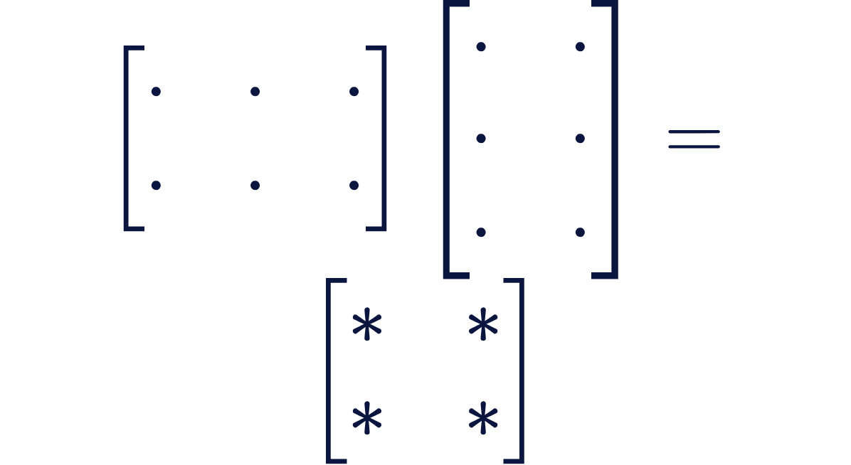



FOUNDATIONS
WHAT IS MATRIX MULTIPLICATION?
Row-by-column composition
COMPATIBLE PAIR
Combines each row of the first matrix with each column of the second using pairwise dot products.
Strict inner-dimension constraint
Multiplication is possible only when the number of columns in equals the number of rows in .
Non-commutative operation
Generally not commutative: . Changing factor order changes dimensions or yields entirely different values.
Inner dimensions (3 and 3) match
Notes:
Emphasize that this is not element-wise multiplication. We sweep rows against columns, meaning inner dimensions must align exactly before any calculation can begin.

Slide 3









DIMENSIONAL COMPATIBILITY & DEFINITION
RULES AND DIMENSIONS
The Dimension Law
✓ Compatible
Multiplying an matrix by an matrix always produces an output matrix.
The Row-by-Column Rule
Shared inner dimension matches.
To calculate position , multiply corresponding elements of row and column , then sum all products.
✗ Incompatible
Columns of first (3) rows of second (2).
Notes:
Walk through the index summation formula. Highlight how index k steps simultaneously across row i of A and down column j of B.

Slide 4




IMPLEMENTATION
ALGORITHM: THREE NESTED LOOPS
1
Row index: loop i
MatrixMultiply(A, B, m, n, p):
create matrix C of size m × p
for i = 0 to m-1:
for j = 0 to p-1:
C[i][j] = 0
for k = 0 to n-1:
C[i][j] += A[i][k] * B[k][j]
return C
picks a row of .
2
Column index: loop j
picks a column of .
3
Summation: loop k
walks along that row and column, summing the products. Each is one row-by-column dot product.
Notes:
Show the role of each loop variable. The outer two loops address each cell in the result matrix, while the innermost loop accumulates the sum of products.

Slide 5
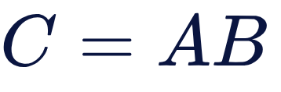
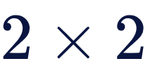


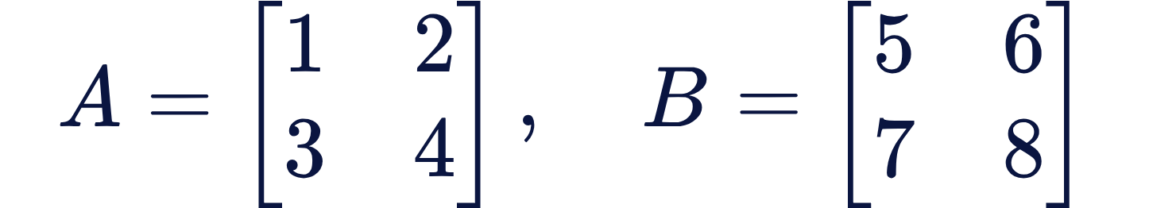




WORKED PROBLEM
EXAMPLE: MULTIPLY TWO MATRICES
Compute the matrix product for two square matrices of dimension :
[Dimension: 2 × 2]
Target output structure
Since is and is , product has 4 elements: .
Mechanics
Each entry is the dot product of row of and column of .
Notes:
Set up the exact values for the worked exercise. Point out that both matrices are 2x2, meaning the result will also be a 2x2 matrix with four distinct cells to evaluate.

Slide 6



STEP-BY-STEP CALCULATION
SOLUTION: STEP BY STEP
Entry | Row of A × Col of B | Arithmetic Calculation | Result
C₁₁ | Row 1 [1, 2] × Col 1 [5, 7] | (1 \times 5) + (2 \times 7) = 5 + 14 | 19
C₁₂ | Row 1 [1, 2] × Col 2 [6, 8] | (1 \times 6) + (2 \times 8) = 6 + 16 | 22
C₂₁ | Row 2 [3, 4] × Col 1 [5, 7] | (3 \times 5) + (4 \times 7) = 15 + 28 | 43
C₂₂ | Row 2 [3, 4] × Col 2 [6, 8] | (3 \times 6) + (4 \times 8) = 18 + 32 | 50
Key takeaway: Each row of pairs with each column of independently to yield one coordinate in .
Notes:
Guide students through each entry sequentially. Emphasize row 1 producing the top row of C, and row 2 producing the bottom row.

Slide 7



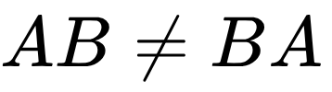
NON-COMMUTATIVITY
FINAL RESULT: AB IS NOT BA
FORWARD PRODUCT: AB
REVERSED ORDER: BA
The four calculated values placed into matrix .
Computed by reversing the order of operands.
THEOREM
. Matrix multiplication is generally non-commutative, even when both matrices are square and of identical dimensions.
Notes:
Point to the side-by-side matrices. Even though both A and B are 2x2, reversing the order yields completely different values: [19, 22; 43, 50] versus [23, 34; 31, 46].

Slide 8





EFFICIENCY & REAL-WORLD IMPACT
COMPLEXITY AND APPLICATIONS
O(MNP)
O(N³)
O(MP)
Standard time complexity
Square matrix cost ( )
Auxiliary memory for output
Computer Graphics
Machine Learning
Scientific Computing
Image Processing
Graph Algorithms
3D rotations, scaling, translations, and perspective projections.
Layer activations and weight transformations in deep neural networks.
Differential equations, finite element analysis, and physical simulations.
Kernel convolutions, spatial filtering, and compression algorithms.
Adjacency matrix powers for path counts and random walk analysis.
Notes:
Conclude with theoretical cost and practical value. The O(n³) cost makes hardware acceleration like GPUs essential for neural nets and real-time graphics.

Slide 9

THANK YOU!
Any Questions?
Fundamentals of Matrix Multiplication · Q&A Session
Ready for Discussion
Notes:
Open the floor for questions regarding dimension validation, inner loop optimizations, or the non-commutative property.

