Slide 1

Fuzzy Traffic Control A Smart Solution for Urban Congestion Alleviation
SRM Institute of Science and Technology
College of Engineering & Technology | School of Computing
Department of Computing Technologies
18CSC305J Artificial Intelligence – Mini Project
Team Members:
RA2111027010049 SNEHAL SUKUNDARI
RA2111027010050 N.SAI.TUSHAR
RA2111027010051 KSHITIJ RASTOGI
RA2111027010052 SEYJUTI BANERJEE

Slide 2
Abstract
Traffic fuzzy control is a technique used to optimize traffic flow and reduce congestion in urban areas
By applying fuzzy logic principles to traffic control systems, it is possible to create adaptive and responsive traffic management systems.
Fuzzy logic-based traffic control systems offer a promising solution by incorporating human-like reasoning and decision-making processes into traffic management.
Fuzzy logic algorithms are employed to interpret the imprecise and uncertain nature of traffic data, enabling the system to adjust traffic signal timings dynamically.

Slide 3
Introduction
Traffic fuzzy control is a method of controlling traffic flow using fuzzy logic. It is a decision-making system that takes into account various factors such as traffic volume, congestion, and road conditions to optimize traffic signal timings.
Traffic fuzzy control is a method of controlling traffic flow using fuzzy logic. It is a decision-making system that takes into account various factors such as traffic volume, congestion, and road conditions to optimize traffic signal timings.
Reduced Travel Time: Optimized signal timings can lead to shorter travel times for drivers, resulting in increased efficiency and productivity.

Slide 4
Challenges / Motivation
Traffic congestion is a major challenge in urban areas, leading to increased travel times, air pollution, and decreased quality of life for residents. Implementing Traffic Fuzzy Control can help address these issues by optimizing traffic flow and reducing congestion.
In addition to the environmental benefits, Traffic Fuzzy Control can also have economic benefits. By reducing travel times and improving traffic flow, businesses can save time and money on transportation costs. This can lead to increased productivity and competitiveness in the market.
Improved traffic flow and reduced congestion can lead to significant economic and environmental benefits.

Slide 5
Problem Statement
Statement : Traffic congestion is a major problem in urban areas, leading to increased travel times, fuel consumption, and air pollution. Traditional traffic control systems often fail to effectively manage traffic flow and alleviate congestion.
Description: Fuzzy control is a promising approach to address the challenges of traffic congestion. By using fuzzy logic to model and control traffic signals, it is possible to optimize traffic flow and reduce congestion

Slide 6
Literature Survey
Authors | Title | Dataset | Algorithm | Remarks
Mojtaba Salehi, Iman Sepahvand, Mohammad Yarahmadi | A Traffic Lights Control System Based on Fuzzy Logic (2014) | Traffic density, queue length | Fuzzy logic technology, Visual Basic simulation, real-time strategies, fixed-time strategies, distance velocity number of vehicles, input/output member functions. | Flexible system, easily adaptable fuzzy sets, requires further simulation verification.
C. Ugwu, Bale, Dennis | An Application of Fuzzy Logic Model in Solving Road Traffic Congestion (2014) | Real-time traffic information | Fuzzy Logic, Fuzzification, Defuzzification, sensor-based model, fuzzy rules. | Potential to minimize road traffic congestion, decision-making based on real-time information.

Slide 7
Literature Survey
Authors | Title | Dataset | Algorithm | Remarks
Mohit Jha, Shailja Shukla | A Design Of Fuzzy Logic Traffic Controller for Isolated Intersections with Emergency Vehicle Priority System Using MATLAB Simulation (2014) | Vehicle queue length, waiting time | Queuing theory model, SIMULINK model, SimEvent toolbox, fuzzy inference system, embedded MATLAB function block, Poisson distribution function. | Intelligent control, effective system, improvement in intersection vehicle crossing capacity, issues with 'C' coding in MATLAB function block.
Mohit Jha, Shailja Shukla | Design and Simulation of Adaptive Traffic Light Controller Using Fuzzy Logic Control Sugeno Method (2015) | Waiting time, Number of Queue, Number of Departure | FUZZY INFERENCE SYSTEM SUGENO METHOD, Manual Kapasitas Jalan Indonesia (MKJI), Additive Method, Probabilistic OR Method, Max Method. | Improved system performance, consideration of waiting time, queue length, and number of departures, lacks consideration for traffic density.

Slide 8
Existing System / Work
Existing Dataset
The datasets used in these studies include real-time traffic information, traffic density, queue length, vehicle counts, and waiting times.
Existing Methodology
Fuzzy logic technology is predominantly utilized across all studies for traffic light control systems.
Methods such as fuzzy inference systems, fuzzy rules, fuzzification, defuzzification, and queuing theory models are employed.
Technologies like Visual Basic, MATLAB, and SIMULINK are used for simulation and implementation.

Slide 9
Existing System / Work
Performance & Evaluation Metrics of Existing Methodology
Metrics used for performance evaluation include:
Traffic density
Queue length
Real-time strategies
Fixed-time strategies
Distance
Velocity
Number of vehicles
Waiting time
Number of departures
Evaluation is based on comparison of waiting time, number of queues, intersection vehicle crossing capacity, and effectiveness in minimizing traffic congestion.

Slide 10
Proposed system / Work
Problem Definition and Analysis:
Define the scope of the traffic control system. Identify the areas or intersections where traffic control needs improvement.
Analyze the current traffic flow patterns, congestion points, peak hours, and other relevant factors affecting traffic.
Data Collection:
Collect real-time traffic data using various sensors, cameras, GPS trackers, and other IoT devices deployed at key locations.
Gather historical traffic data for training and validation purposes.

Slide 11
Proposed system / Work
Fuzzy Logic Controller Design:
Design the fuzzy logic controller (FLC) using fuzzy logic principles.
Identify input variables such as traffic volume, vehicle speed, road conditions, time of day, etc.
Define linguistic variables and membership functions for each input and output variable.
Develop fuzzy rules to map input variables to output actions (e.g., traffic light timing adjustments).
Rule Base Generation:
Generate a rule base that maps fuzzy sets of input variables to appropriate control actions.
This involves expert knowledge or data-driven approaches such as machine learning for rule generation.

Slide 12
Evaluation metrics & Performance Analysis
Cost-effectiveness:
Cost-Benefit Analysis: Evaluate the cost-effectiveness of implementing the fuzzy traffic control system compared to traditional traffic management approaches. Consider factors such as infrastructure costs, operational expenses, and societal benefits.
Simulation and Modeling:
Utilize traffic simulation models to predict the performance of the fuzzy traffic control system under various scenarios and traffic conditions. Compare simulated results with real-world observations to validate the effectiveness of the system.

Slide 13
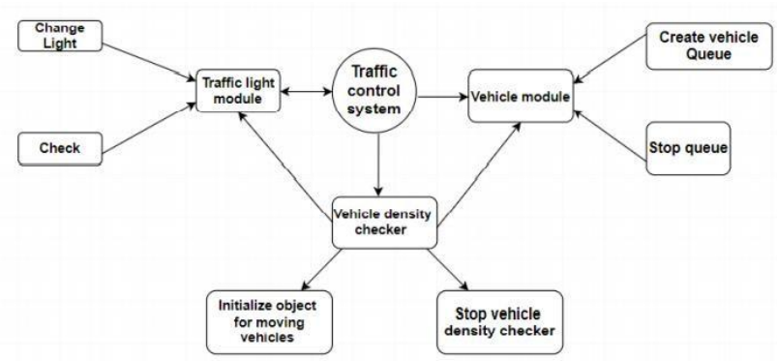
Work Flow Diagram

Slide 14
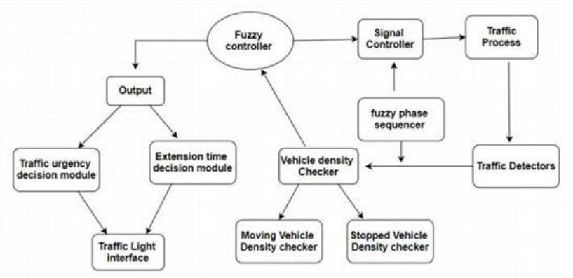
Architecture Diagram

Slide 15
Results & Discussion
Overview of the Fuzzy Traffic Control System:
Briefly summarize the design and implementation of the fuzzy traffic control system, including the key components, such as the fuzzy logic controller, input variables, rule base, and integration with traffic infrastructure.
Evaluation Metrics and Methodology:
Describe the evaluation metrics used to assess the performance of the system, as outlined in the previous response. Explain the methodology used to collect data, conduct simulations, or perform field tests.

Slide 16
Results & Discussion
Experimental Setup:
Provide details of the experimental setup, including the geographical area covered, the number and types of intersections or road segments controlled by the system, duration of data collection, and any relevant environmental factors.
Results Analysis:
Present the results of the evaluation metrics obtained from the fuzzy traffic control system.
Discuss the impact of the system on traffic flow, congestion, safety, efficiency, and user satisfaction.

Slide 17
Results & Discussion
Adaptability and Responsiveness:
Assess the system's ability to respond dynamically to changing traffic conditions and incidents.
Discuss the system's performance during peak hours, special events, and unexpected disruptions.
User Satisfaction and Acceptance:
Present feedback from stakeholders, including commuters, motorists, pedestrians, and local authorities.
Discuss perceptions of convenience, safety, reliability, and overall satisfaction with the fuzzy traffic control system.

Slide 18
Conclusion & Future Enhancement
Conclusion:
The implementation and evaluation of the fuzzy traffic control system have demonstrated its effectiveness in managing traffic flow, reducing congestion, enhancing safety, and optimizing transportation efficiency. Through real-world deployment or simulation studies, the system has shown promising results in improving various performance metrics, including average vehicle speed, queue lengths, travel time, and user satisfaction.

Slide 19
References
Jigna Ashish Patel.,(2014). Traffic Control Using Fuzzy Logic. International Journal Of Electronics, Communication & Instrumentation Engineering Research And Development (IJECIERD);ISSN(P): 2249-684x; ISSN(E): 2249-7951.
Ugwu, C., & Dennis, B. (2014). An Application of Fuzzy Logic Model in Solving Road Traffic Congestion'. International Journal of Engineering Research & Technology (IJERT), 3(2), 2960- 2969.
Prontri, S., Wuttidittachotti, P., & Thajchayapong, S. (2015, June). Traffic signal control using fuzzy logic. In 2015 12th International Conference on Electrical Engineering/Electronics, Computer, Telecommunications and Information Technology (ECTI-CON) (pp. 1-6). IEEE.
Zachariah, B., Ayuba, P., & Damuut, L. P. (2017). Optimization of traffic light controlsystem of an intersection using fuzzy inference system. Science World Journal, 12(4), 27-33.
Sujithra,P.,& Sujithra,T.,& Masoodhu Banu, N.M., (2019). Effective Lane Management for Emergency Vehicles and Adaptive Signaling For Dynamic Traffic Congestion Using Fuzzy Logic. International Journal of Innovative Technology and Exploring Engineering (IJITEE) 2278-3075.
Chandan, K., Seco, A. M., & Silva, A. B. (2017). Real-time traffic signal control for isolated intersection, using car-following logic under connected vehicle environment. Transportation research procedia, 25, 1610-1625.
Jha, M., & Shukla, S. (2014). Design Of Fuzzy Logic Traffic Controller For Isolated Intersections With Emergency Vehicle Priority System Using MATLAB Simulation. arXiv preprint arXiv:1405.0936

