Slide 1
Text mining
Song Lyrics
Jieqing Hu
Sumeet Santani
Kshitij Sankesara

Slide 2
Quick Overview of Dataset
The dataset has 57650 rows and 4 columns
Source: Kaggle(https://www.kaggle.com/mousehead/songlyrics)
A song lyrics dataset
The dataset has 4 columns (3 independent variables and 1 target variable
Independent variables: Song, Link, Text
Target Variable: Artist

Slide 3
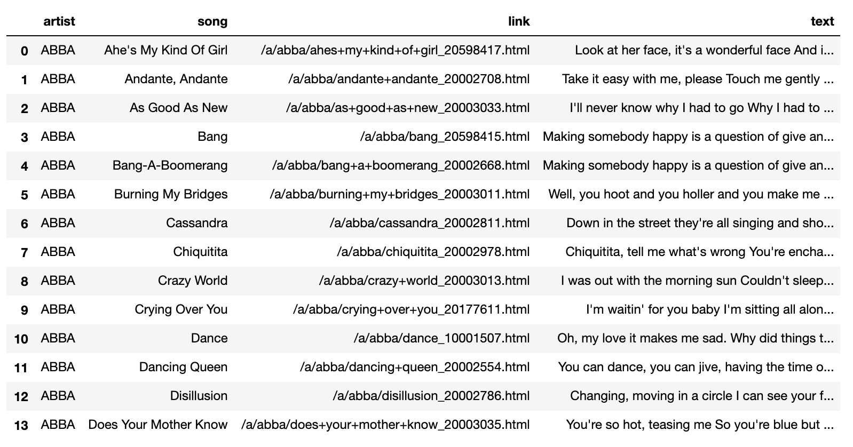
First Few Rows of the Data Frame

Slide 4
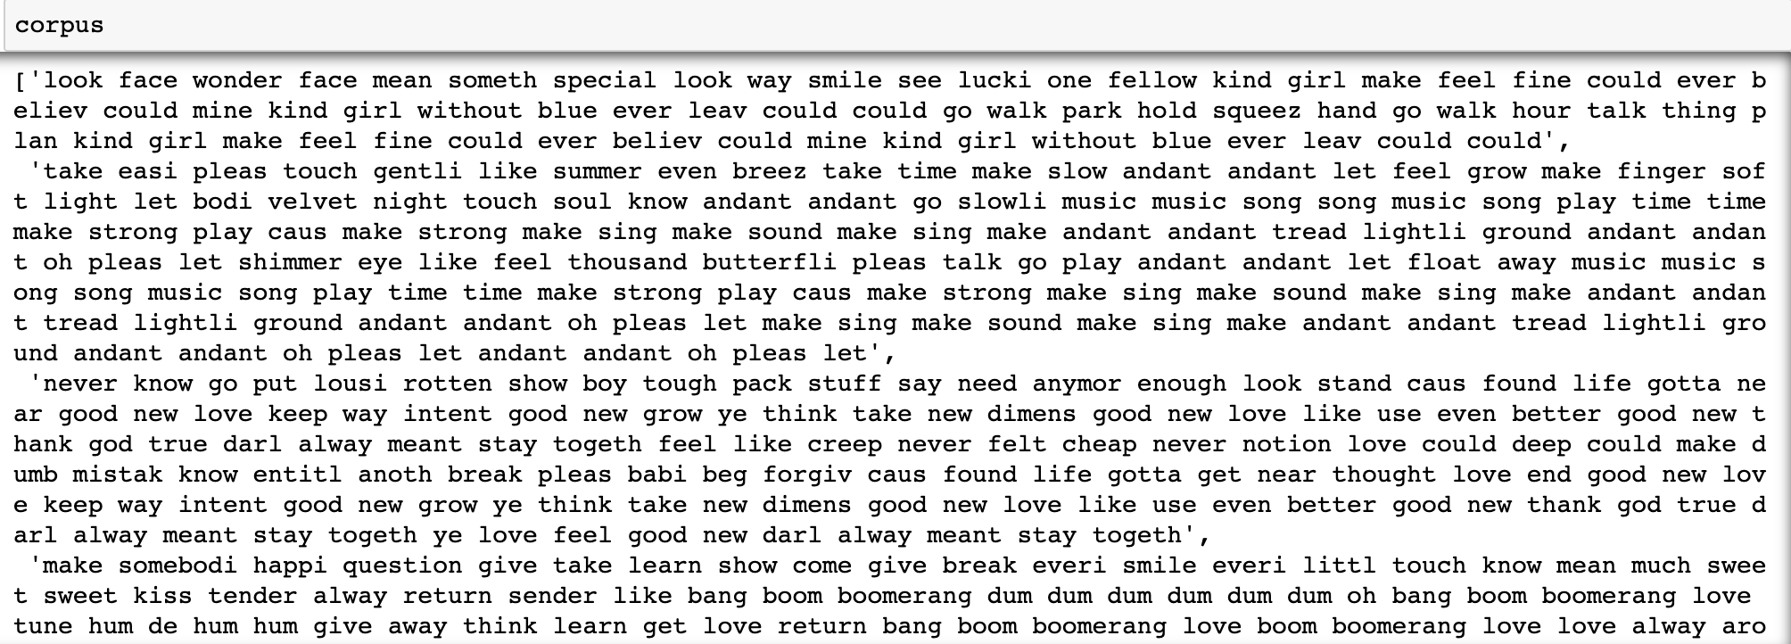
Data Cleaning and Preparation
Removed stopwords
Stemming
All words to lowercase
Bag of words

Slide 5
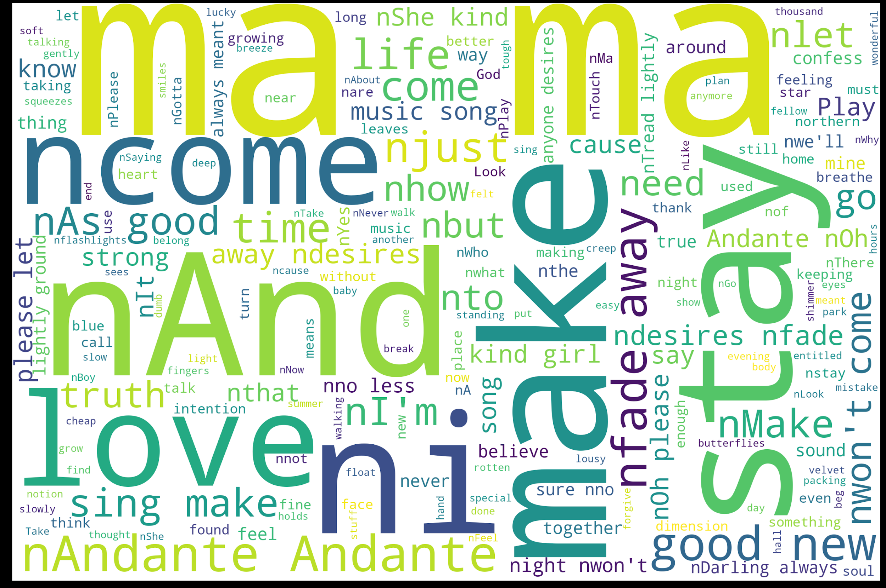
Descriptive Analysis
Wordcloud
(frequently featuring
words in the data)

Slide 6
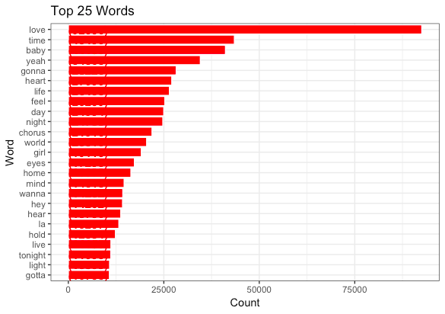
Top Words
The top 25 words are shown based on their frequency.
Words like love, time, baby, heart are most commonly used.

Slide 7
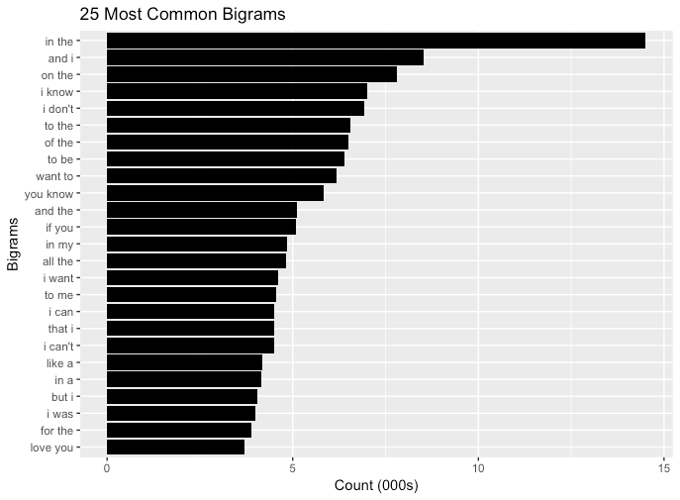
Top 25 Bigrams:

Slide 8
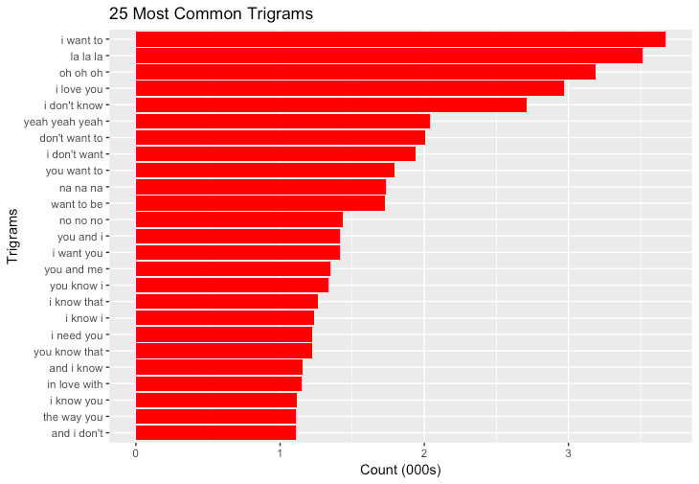
Top 25 Trigrams:

Slide 9
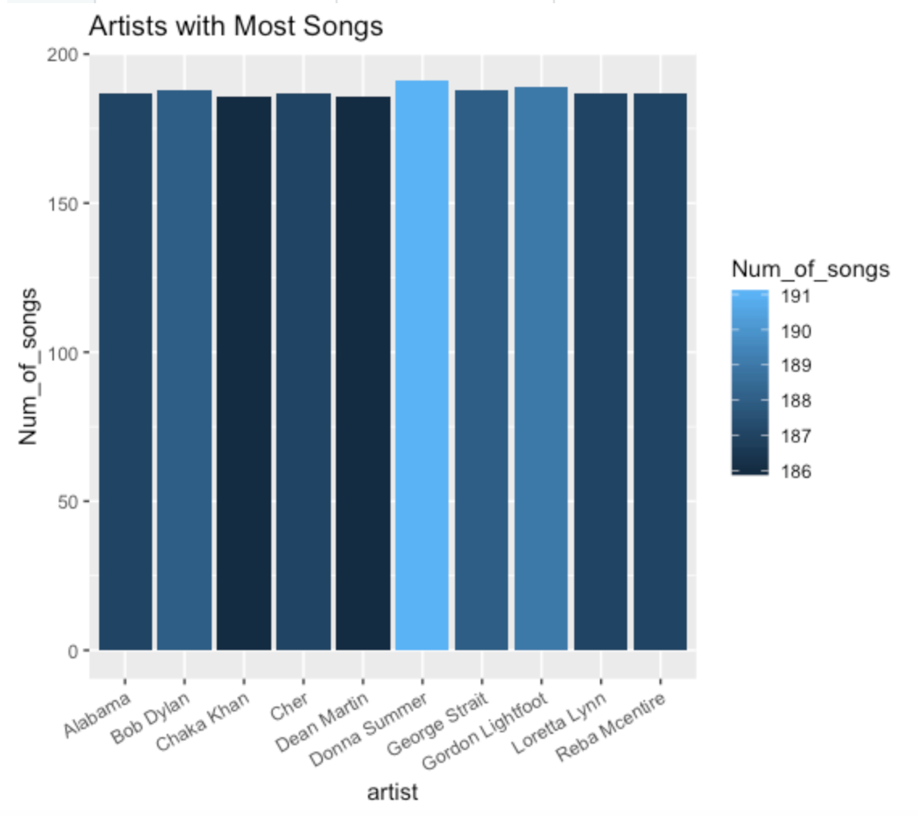
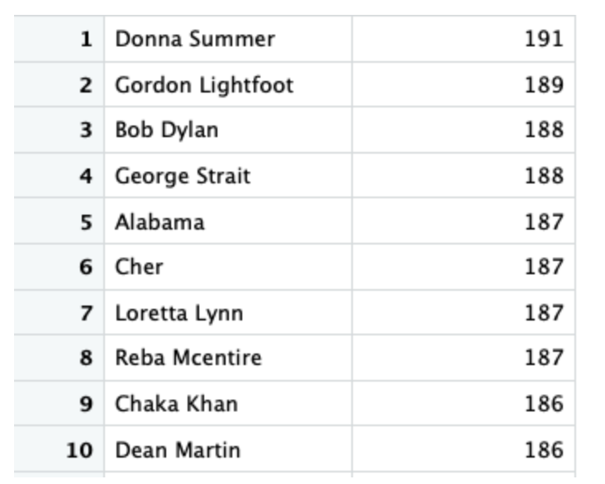
Top 10 artists with most songs

Slide 10
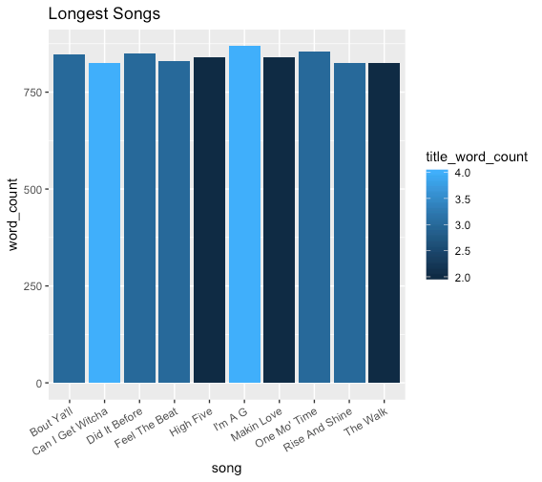
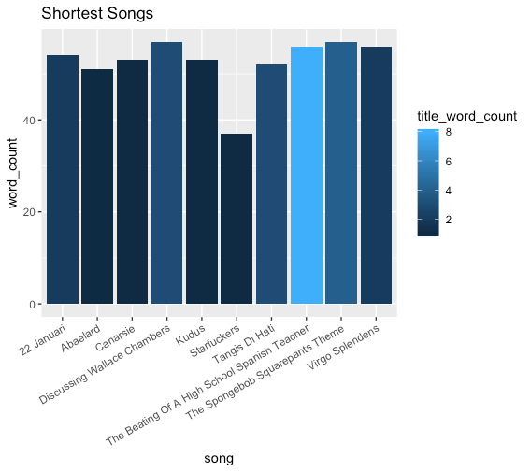
Longest and Shortest Songs

Slide 11
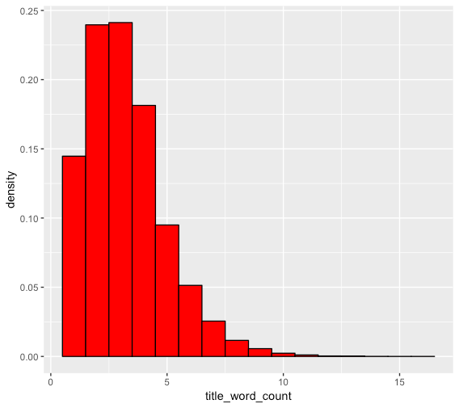
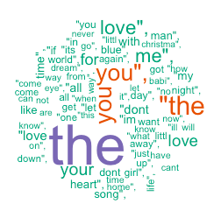
Song Titles:

Slide 12
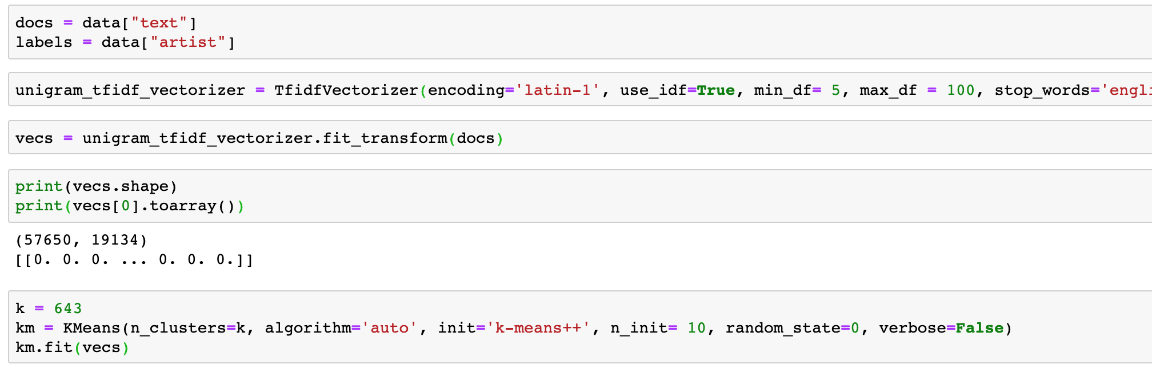
K-Means document clustering
Notes:
First, we’d like to predict the artist for each song. We used Kmeans clustering. We selected ‘artist’ column as label and got 643 labels. To speed up convergence, we set initial cluster centers for k-means clustering = k-mean++ and max iteration number to 300. But it still take some time to run the code. We haven’t got the result yet. We will add the result and confusion matrix to the report later.

Slide 13
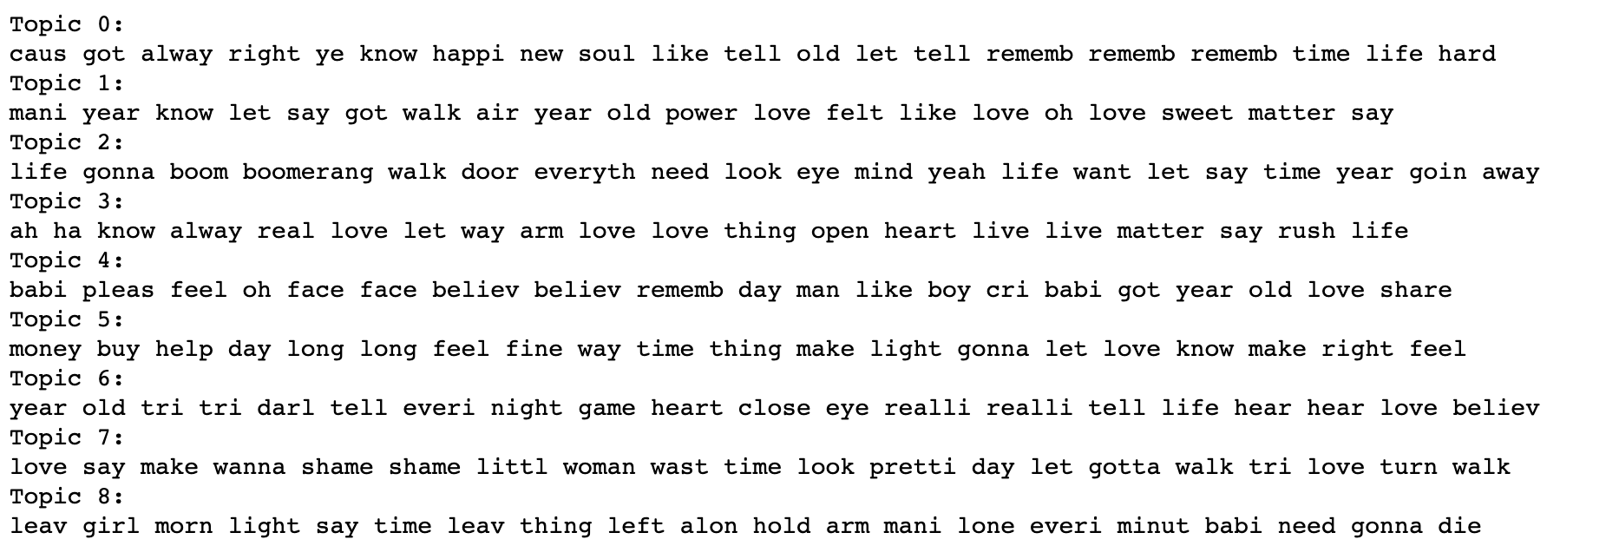
Topic Modeling
Notes:
Thencall the LDA algorithm to fit a topic model, and transform all documents to their topic distributions
no_topics = 9, no_top_words = 10
Love, power, man, woman, game, life

Slide 14
Next steps:
We have planned to use the NRC sentiment lexicon as it had large number of words and sentiments compared to others.
Sentiments which we are using are Joy, Trust, Fear, Sadness and Anger.
Top words which depicts these Sentiments
Positive vs Negative Words
Then, based on the top words used by the Artist we can get to know the genre and the sentiment of any particular song.
Also, we can know the genre preferred by any particular Artist based on the top words used by him/her in all their songs.

