Slide 1
MEDICAL IMAGE ANALYSIS · COURSE PROJECT
Automated Choroid Vascularity Index (CVI) on OCT
Reproducing Arian et al. (Photonics 2023) and Fine-Tuning on OIMHS
Paper reproduction
OIMHS domain shift
Fine-tuning
Teammates :
P. Sharmi (23bcs090)
Kshitij Shende (23bcs075)
C Pothan Sai Reddy (23bds017)
Saisha Bore (23bcs116)
Under the guidance of:
Dr. Girish G.N Sir
A course project — not a clinical product.

Slide 2
Agenda
OVERVIEW
PART A · THE PAPER · slides 3–8
PART B · OUR WORK · slides 9–16
Clinical motivation: choroid, CVI, low-contrast SCJ
Problem statement: manual vs automatic
Pipeline overview and U-Net architecture
Loss function and CVI mathematics
What the authors trained and released
OIMHS dataset and our code
Experiment 1: zero-shot
Experiment 2: patient-level fine-tune
Qualitative cases
Limitations and conclusions

Slide 3
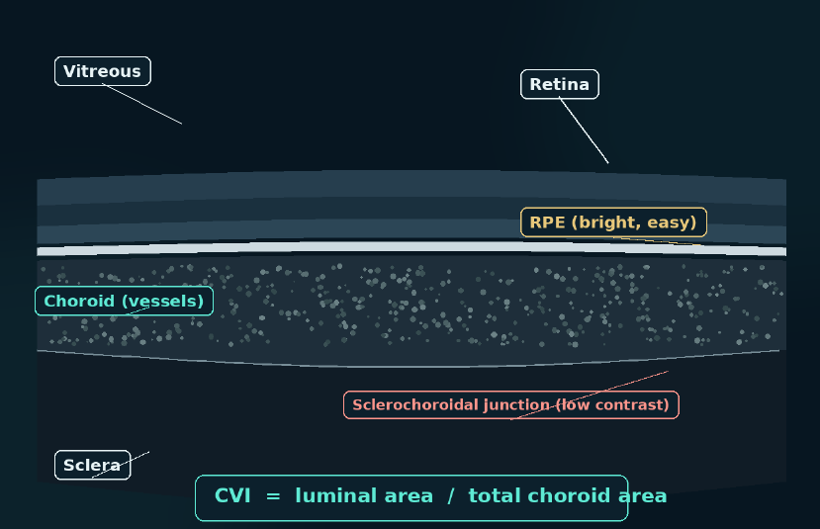
Why CVI? Clinical motivation
PART A · THE PAPER · ARIAN ET AL., PHOTONICS 2023
The choroid is the vascular layer between the retina and the sclera.
CVI = luminal area ÷ total choroid area, a proportion of vessel lumen.
Outlining the choroid needs the sclerochoroidal junction (SCJ), which has low contrast in OCT.
CVI is a research biomarker, not a deployed clinical tool.
Schematic: stylized OCT, not patient data. CVI is a research biomarker; we did not deploy it in a clinic.
Source: Arian et al., Photonics 2023

Slide 4
The paper's problem statement
PART A · THE PAPER · ARIAN ET AL., PHOTONICS 2023
The problem
The goal
The data
Manual choroid segmentation is tedious and rater-dependent.
The SCJ is low-contrast, so boundaries are ambiguous.
Automatic choroid mask.
Automatic CVI from that mask.
Diabetic retinopathy (DR) raster scans.
Pachychoroid EDI scans.
Source: Arian et al., Photonics 2023

Slide 5
Paper pipeline overview
PART A · THE PAPER · ARIAN ET AL., PHOTONICS 2023
STEP 1
STEP 2
STEP 3
STEP 4
STEP 5
OCT B-scan
U-Net mask
Largest component
NLM + Niblack
CVI
→
→
→
→
Input image
3 classes: above / choroid / below
Keep the main choroid region
Denoise, then threshold lumen
Luminal ÷ total choroid area
CVI = luminal area ÷ total choroid area
Niblack window 15, k = 0.001. Pipeline as described in Arian et al. (2023); our code follows the same steps.

Slide 6
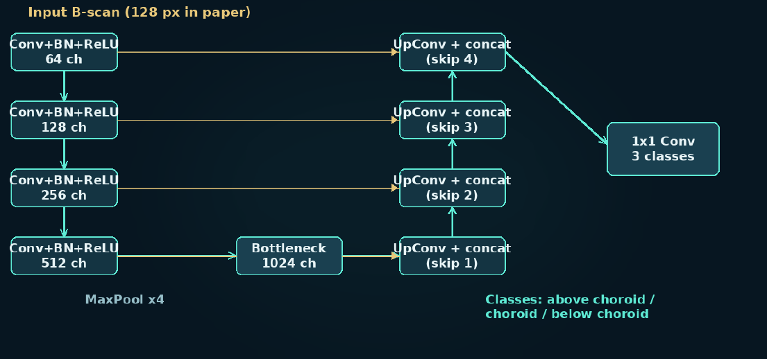
Lightweight U-Net for 3-Class Segmentation
PAPER · NETWORK
3 classes: above / choroid / below
One Conv+BN+ReLU per stage
4 encoder + bottleneck + 4 decoder
Skip connections restore detail
~23 weighted layers only
Input 128 px in the paper
We ran it at 256 px zero-shot
Architecture as described in Arian et al. 2023; sketch is ours.

Slide 7
Loss function and CVI mathematics
PART A · THE PAPER · ARIAN ET AL., PHOTONICS 2023
Combined loss
CVI and lumen threshold
Loss = WCCE + Dice + Tversky
CVI = LA / TCA
LA = luminal area, TCA = total choroid area
WCCE: weighted categorical cross-entropy
Dice: region overlap
Tversky: trades off false positives and negatives
Niblack: T = m + k·s
m = local mean, s = local std. dev., k = 0.001, window = 15
Same formula in our code. Source: Arian et al., Photonics 2023

Slide 8
Starting Point: The Authors’ Public Weights
PAPER · WHAT WAS RELEASED
AUTHORS TRAINED & RELEASED
WHAT WE DO WITH IT
Two trained models: raster + EDI (.h5)
Authors’ repo with inference code
Code released with the paper
Load their released raster .h5 weights
Run zero-shot on a new disease domain
Fine-tune only on OIMHS (next part)
Their internal Dice / CVI numbers: see the paper tables — we did not copy unverified digits.
We did not retrain their original DR / pachychoroid cohorts from scratch — out of scope for a course project.
Arian et al. 2023: code & weights public; we use them as the paper-intended starting point.

Slide 9
From the paper to our course implementation
TRANSITION
Same architecture, loss, and CVI formula — we keep the paper’s pipeline
New disease domain: macular hole (OIMHS), not DR / pachychoroid
Two experiments: zero-shot transfer, then patient-level fine-tuning
We start from the authors’ released .h5 weights, not from scratch.

Slide 10
OIMHS: A Different Disease Domain
OUR WORK · TEST DATASET
Optical Coherence Tomography Image Macular Hole Segmentation · Sci. Data 2023
125
3,859
119
MH
eyes
B-scans
patients
disease
WHY IT’S A HARD TEST
PATIENT-LEVEL HANDLING
Macular hole — not the paper’s diseases
Different OCT appearance & pathology
Choroid masks are project references
6 patients scanned in both eyes
demographics.csv keeps both eyes together
No patient ever crosses train / val / test
Otherwise metrics would be optimistic
OIMHS: DOI 10.1038/s41597-023-02675-1 · a domain-shift test, not a copy of the paper’s data.

Slide 11
Implementation Stack
OUR WORK · ENGINEERING
REPO / FILES
ENVIRONMENT
oimhs_cvi_pipeline.py — zero-shot CVI on all B-scans
finetune_oimhs_pipeline.py — training + eval
Authors’ code: OCT-CVI-DeepLearning-main
Colab notebooks for runs & plots
TensorFlow 2.16+ with tf_keras
Loads legacy .h5 without re-saving
Google Colab, Tesla T4 GPU
One-line takeaway:
their released model runs in our pipeline with only input-size and preprocessing alignment.

Slide 12
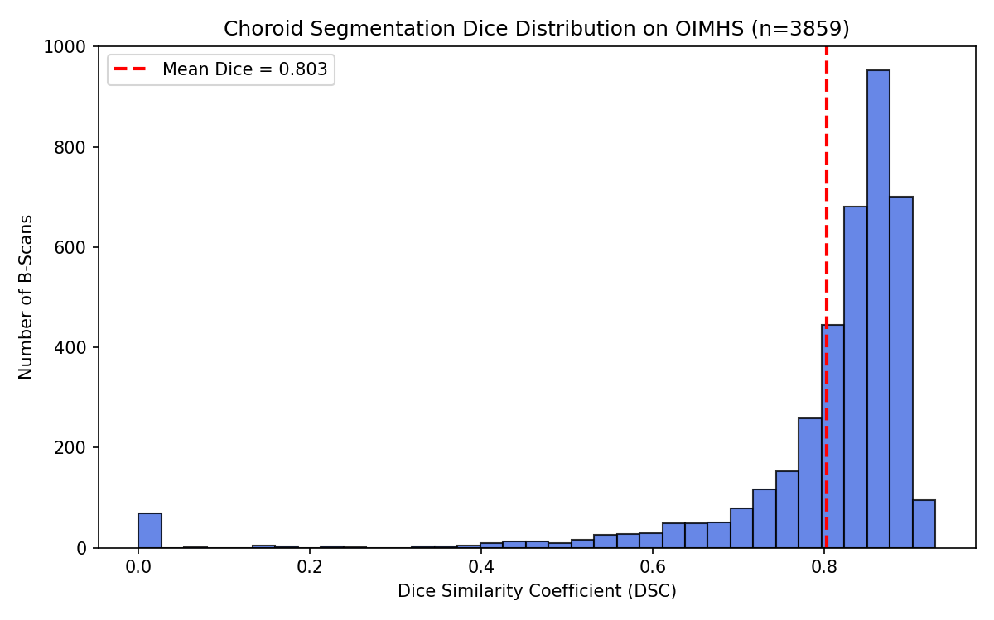
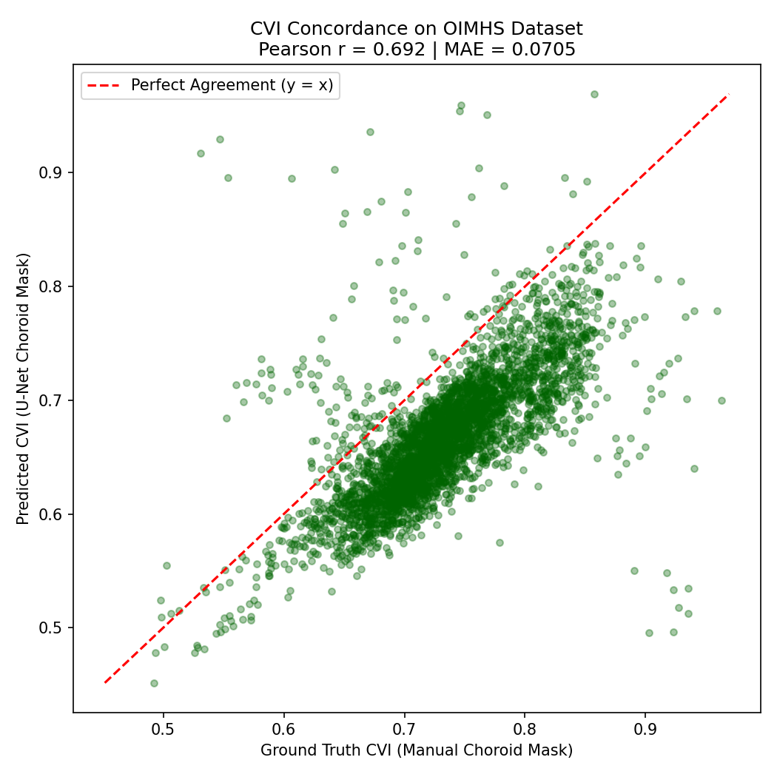
Experiment 1: zero-shot on OIMHS
PART B · OUR WORK · OUR COLAB RUN
n = 3,859 slices · our Colab run
Metric | Value
Mean Dice | 0.8032 ± 0.1415
Median Dice | 0.8448
Mean IoU | 0.6879 ± 0.1450
Mean CVI_gt | 0.7323 ± 0.0598
Mean CVI_pred | 0.6676 ± 0.0568
CVI MAE | 0.0705
Pearson r | 0.6917
BM error (px) | 12.07 ± 20.45
SCJ error (px) | 13.51 ± 25.99
Dice distribution, n = 3,859
CVI: reference vs predicted
Protocol: paper raster weights, all 3,859 B-scans, input 256, slice-level. Decent overlap (mean Dice ≈ 0.80) but CVI is biased low (0.67 vs 0.73) and Pearson r is only 0.69.

Slide 13
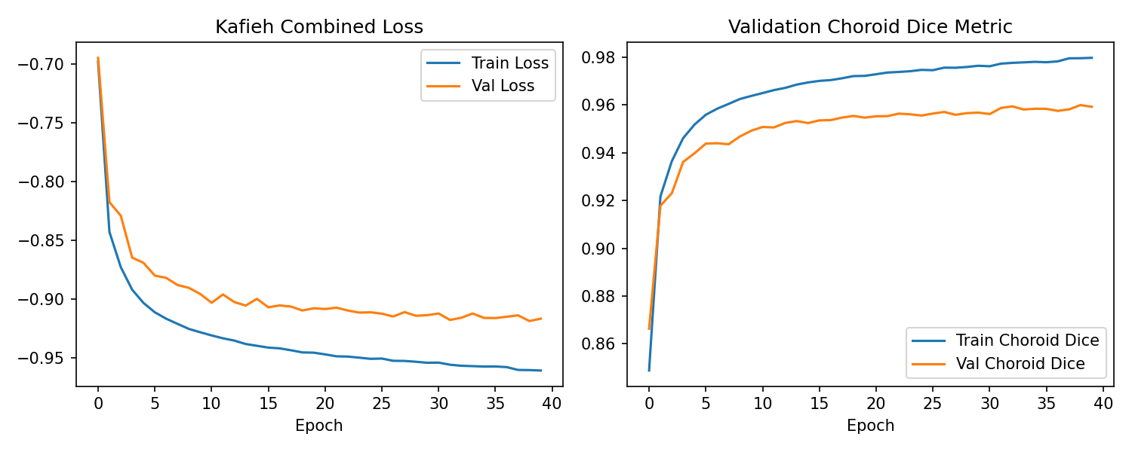
Experiment 2: patient-level fine-tuning
PART B · OUR WORK · OUR COLAB RUN
Split | Patients | Eyes | Slices
Train | 83 | 87 | 2023
Val | 17 | 18 | 428
Test | 19 | 20 | 479
n = 20 test eyes / 479 slices · 128×128 · our Colab run
Metric | Zero-shot | Fine-tuned
Dice | 0.6048 ± 0.1243 | 0.9531 ± 0.0159
IoU | 0.4482 ± 0.1191 | 0.9111 ± 0.0280
CVI (pred − ref) | −0.0392 ± 0.0491 | −0.0131 ± 0.0072
BM error (px) | 28.93 ± 8.99 | 1.56 ± 0.23
SCJ error (px) | 44.18 ± 32.00 | 3.02 ± 0.81
Failed slices/eye | 0.00 | 0.00
128×128, ≤30 slices/eye, seed 42
No patient leakage across splits
Adam 1e-4, batch 16, ≤40 epochs, early stopping, T4
Train vs validation loss and choroid Dice (our Colab run). Different protocol from slide 12.
Dice 0.60 → 0.95 on this test protocol

Slide 14
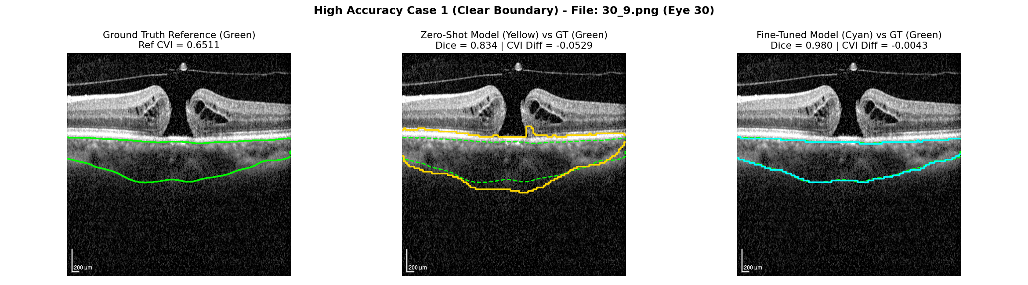
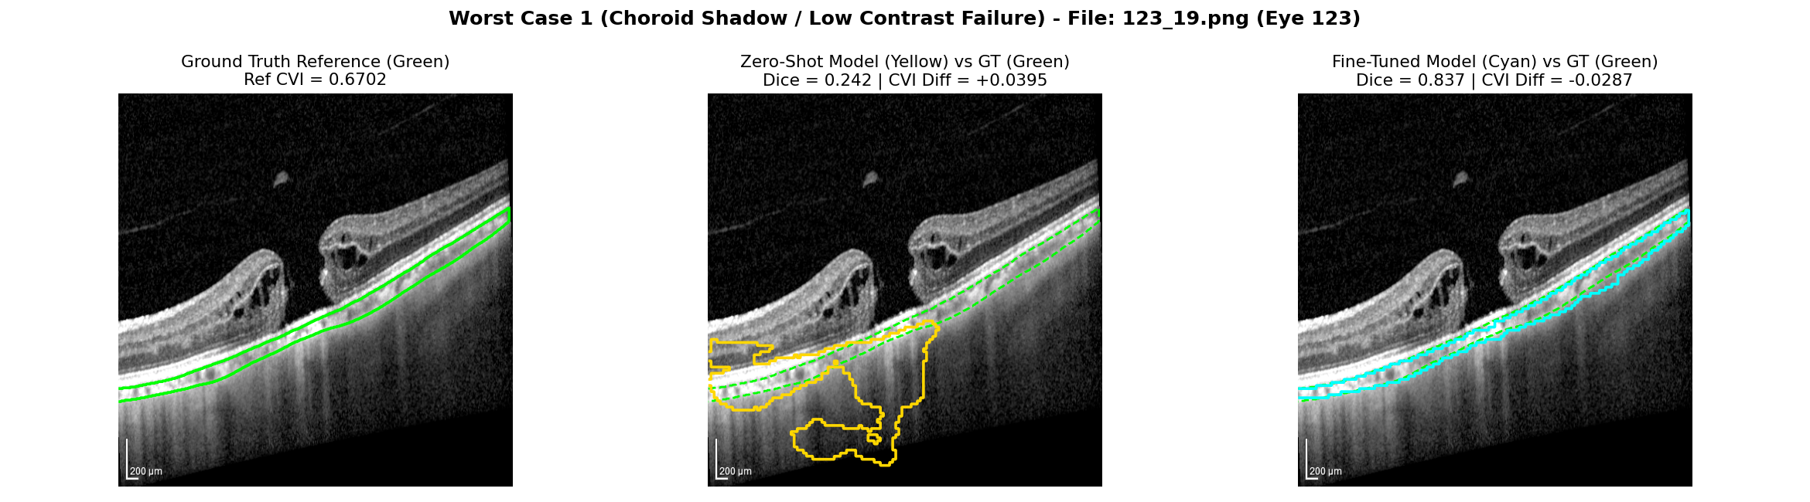
Qualitative: a good case and a failure case
PART B · OUR WORK · OUR COLAB RUN
Green: reference
Yellow: zero-shot
Cyan: fine-tuned
Good case (eye 30): Dice 0.834 → 0.980
Failure case (eye 123, low contrast): Dice 0.242 → 0.837
Selected examples, not random
Worst cases still exist
Test-eye slices, our Colab run

Slide 15
Major limitations
PART B · OUR WORK · OUR COLAB RUN
Not expert- or ophthalmologist-verified.
OIMHS is macular-hole data; which is significant shift in the domain.
Niblack lumens are not expert vessel maps.
Zero-shot CVI underestimates reference CVI.
One split, one seed, 128 fine-tune resolution, 30 slices/eye.
Not a diagnostic device.

Slide 16
What we can and cannot conclude
PART B · OUR WORK · OUR COLAB RUN
We can say
We cannot say
The paper pipeline is implementable.
OIMHS is a hard domain shift.
Patient-safe fine-tuning lifts choroid overlap and reduces CVI bias on our test eyes.
Clinical accuracy or expert-grade masks
Generalization to hospitals or other scanners
Anything about diagnosis or treatment

Slide 17
Summary
PART B · OUR WORK · OUR COLAB RUN
Paper pipeline reproduced from released weights.
Zero-shot on OIMHS: Dice ≈ 0.80, CVI biased low.
Fine-tuning on a patient-level split: Dice 0.60 → 0.95 on 20 test eyes.
References
1. Arian R, Mahmoudi T, Riazi-Esfahani H, et al. Photonics. 2023;10(3):234. DOI: 10.3390/photonics10030234
2. Ye X, et al. OIMHS dataset. Scientific Data. 2023. DOI: 10.1038/s41597-023-02675-1
Questions?

Slide 18
Backup: full metrics and details
BACKUP
A · zero-shot, n = 3,859
B · 20 test eyes, 128×128
Niblack and files
Metric | Value
Mean Dice | 0.8032 ± 0.1415
Median Dice | 0.8448
Mean IoU | 0.6879 ± 0.1450
CVI_gt | 0.7323 ± 0.0598
CVI_pred | 0.6676 ± 0.0568
CVI MAE | 0.0705
Pearson r | 0.6917
BM (px) | 12.07 ± 20.45
SCJ (px) | 13.51 ± 25.99
Metric | Zero-shot | Fine-tuned
Dice | 0.6048 ± 0.1243 | 0.9531 ± 0.0159
IoU | 0.4482 ± 0.1191 | 0.9111 ± 0.0280
CVI diff | −0.0392 ± 0.0491 | −0.0131 ± 0.0072
BM (px) | 28.93 ± 8.99 | 1.56 ± 0.23
SCJ (px) | 44.18 ± 32.00 | 3.02 ± 0.81
T = m + k·s, k = 0.001, window = 15. CVI = LA / TCA.
oimhs_cvi_pipeline.py
finetune_oimhs_pipeline.py
OCT-CVI-DeepLearning-main
Seed 42, ≤30 slices/eye
Split | Pat. | Eyes | Slices
Train | 83 | 87 | 2023
Val | 17 | 18 | 428
Test | 19 | 20 | 479

