Slide 1


FISABIO SUMMER SCHOOL 2026
Module 4 : Introduction to metabolic models of microbial communities
Kshitij Tandon, PhD
Vanessa R Marcelino, PhD

Slide 2
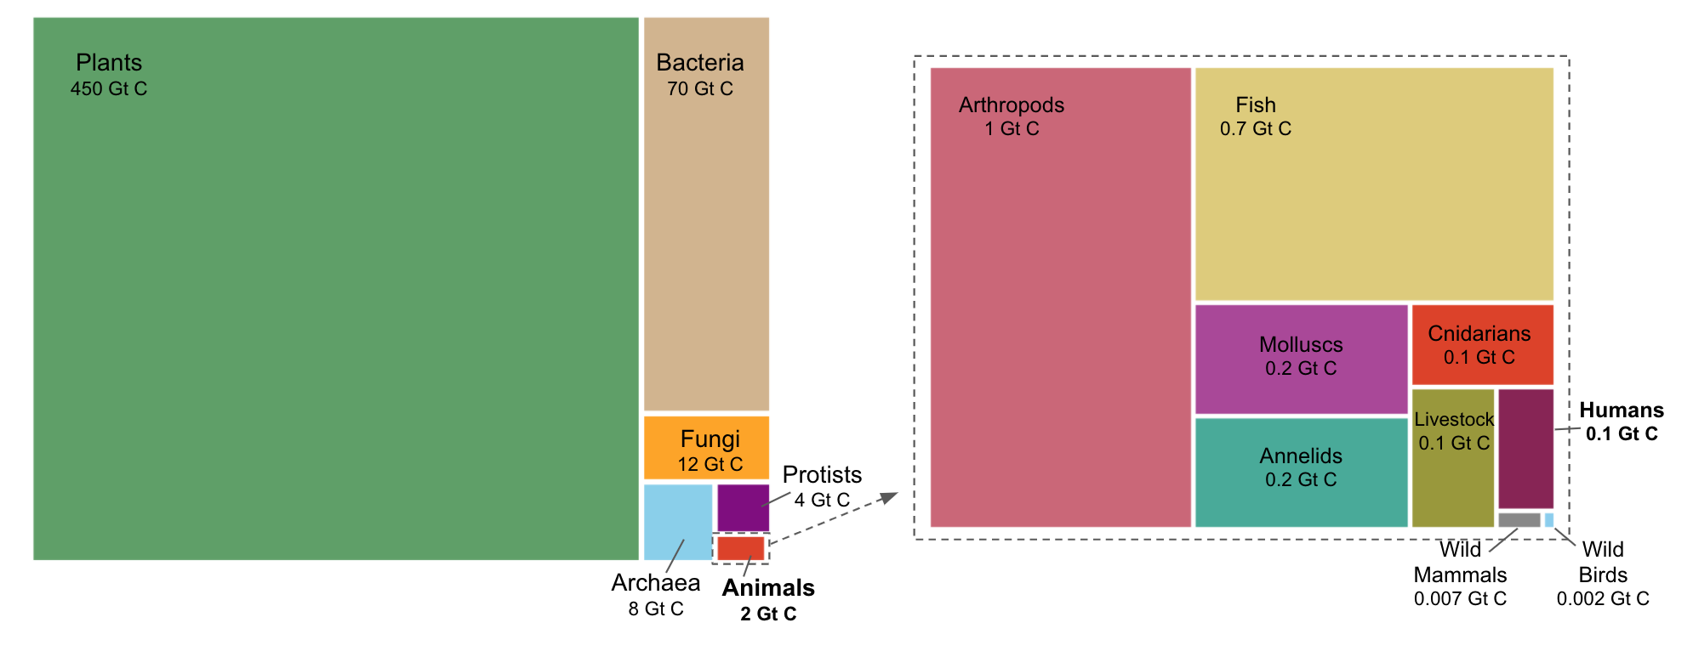
FISABIO Summer School
Bacteria are second largest contributors to Earth’s Biomass
Bacteria produces >1100 times more biomass than Humans
Adapted from Bar-On et al. 2018 PNAS
Units: Gt C Gigatons of Carbon
Notes:
Bacteria outweight humans by a n

Slide 3
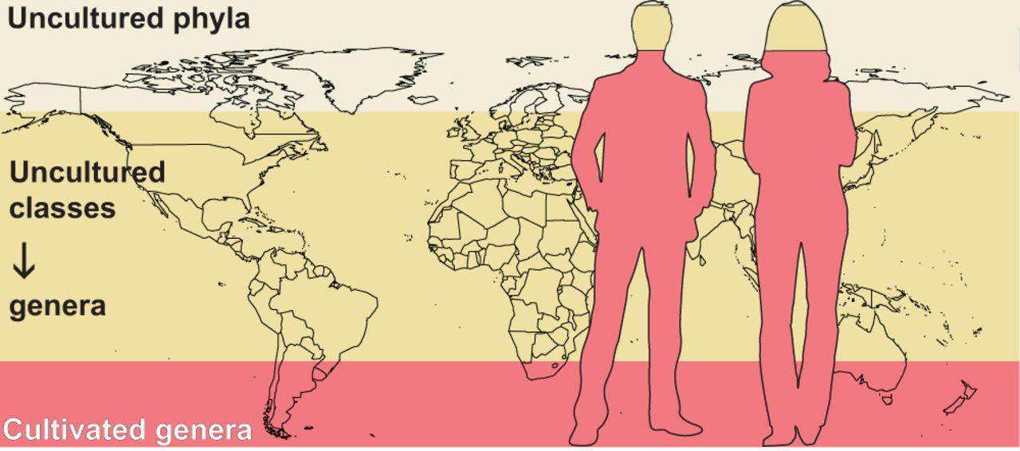
FISABIO Summer School
Cultured microbiome is limited
Adapted from Hug L. 2018 mSystems
Notes:
Graphical representation of data adapted from the work by Lloyd et al. (7) showing the proportion of uncultured cells from Earth’s habitats, with an inset demonstrating that culturability is highest for humans and human-associated environments. Based on the conservative simplification of a single 16S rRNA gene per genome, Lloyd and colleagues estimate that 19% of Earth’s microbial cells are from cultivated lineages (pink). The remaining 81% are cells from uncultured genera or higher levels of taxa, with 25% from uncultured phyla (cream). In contrast, microbial populations from humans are overwhelmingly from cultured genera,

Slide 4

FISABIO Summer School
Metagenomics
Metagenomics is an approach commonly used to study the structure and function of microbiomes, which are the communities of microorganisms present in specific environments without the need of culturing.
Adapted from www.ebi.ac.uk/training/what-is-metagenomics/
Notes:
Microbiomes are extremely diverse and very specific to the environment they are associated with.

Slide 5


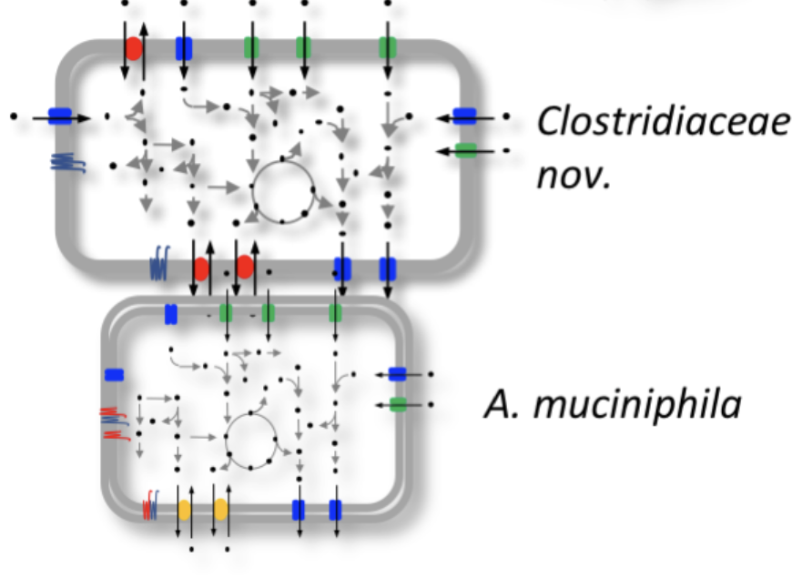
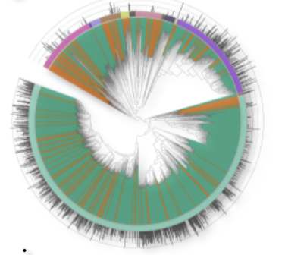
FISABIO Summer School
Metagenome assembled genomes
Quality Control and Assembly
Genome Binning/ Metagenom-assembled Genomes
Taxonomic and Function Annotation
Adapted from Metagenome-atlas 2.0

Slide 6
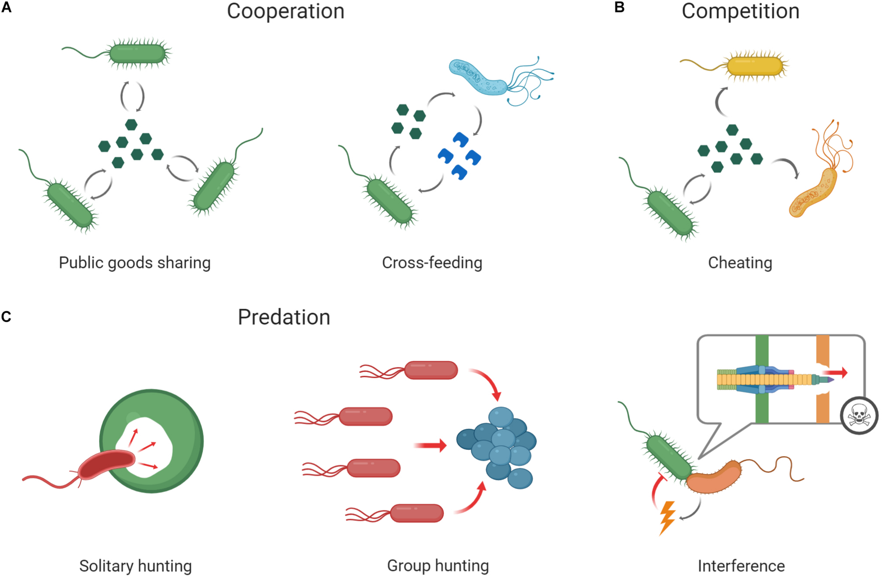
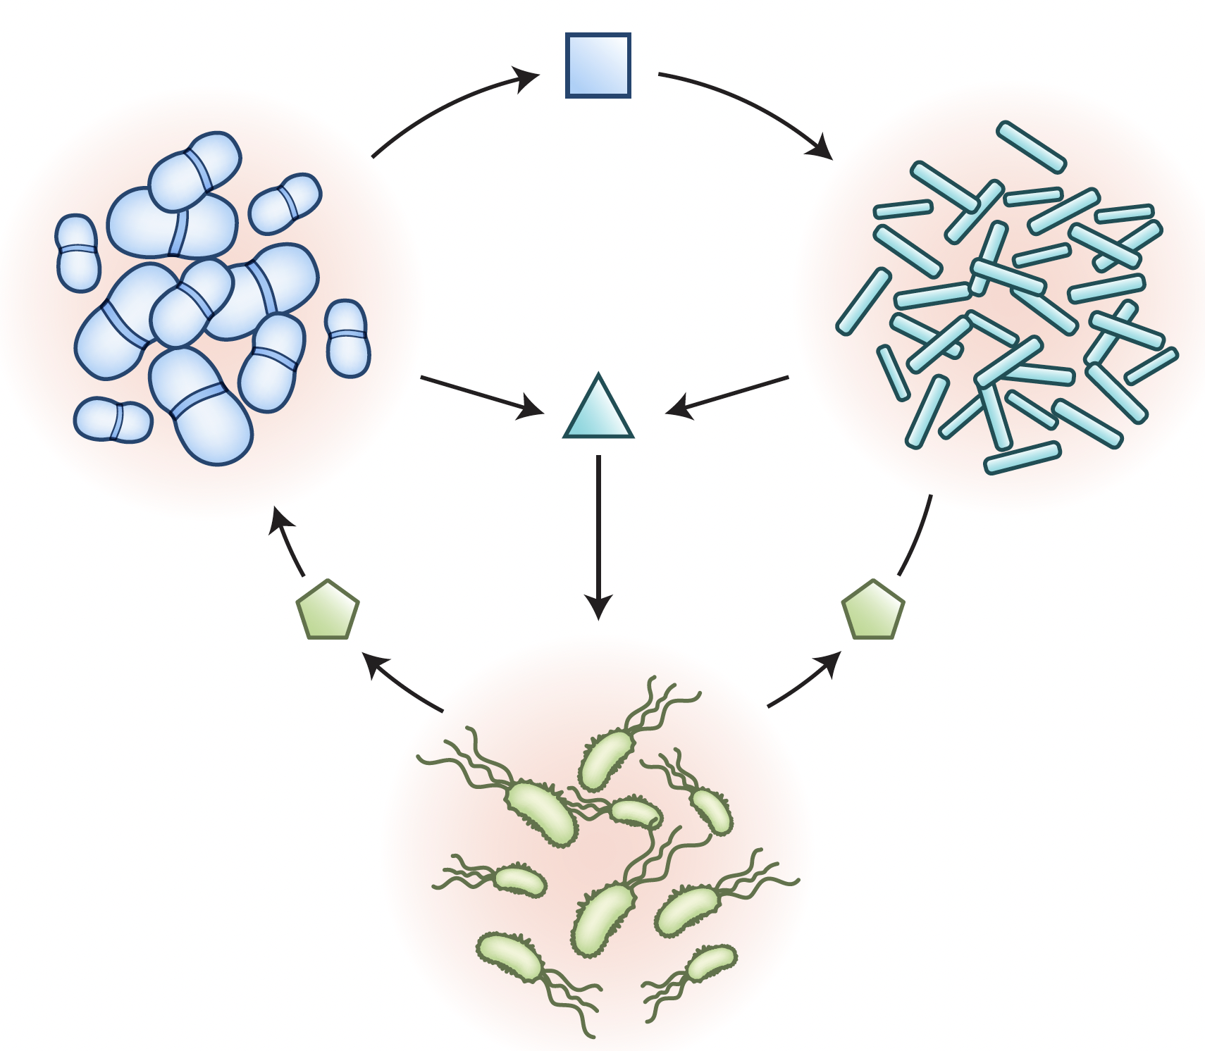
FISABIO Summer School
Microbes are social
Metabolites
Adapted from Lei Tang, Nature Methods, 2018 and Figueiredo and Kramer, Front. Eco Evo., 2020

Slide 7
FISABIO Summer School
From genotype to metabolic phenotype
DNA
Genome sequence / gene catalogue
Genome
Transcriptome
RNA
Condition-specific expression
Genome-scale metabolic model
Proteins
Enzymes and complexes
Proteome
Metabolites
Nutrients, intermediates, products
Metabolome
PHENOTYPE
Notes:
Naïve T cell + APC (MHCI) -> activated T cell
Activated T cell can acquire a spectrum of states with variable phenotypes and functions.
During initial response to infection, a large pool of short-lived effector cells (KLRG1) are generated. These cytotoxic cells deal with the immediate threat and then die during the subsequent contraction phase.
Another subset of T cells are programmed for longevity and plasticity. These are the CD127+ positive memory precursor effector cells which persist following an infection and confer immunological memory.

Slide 8
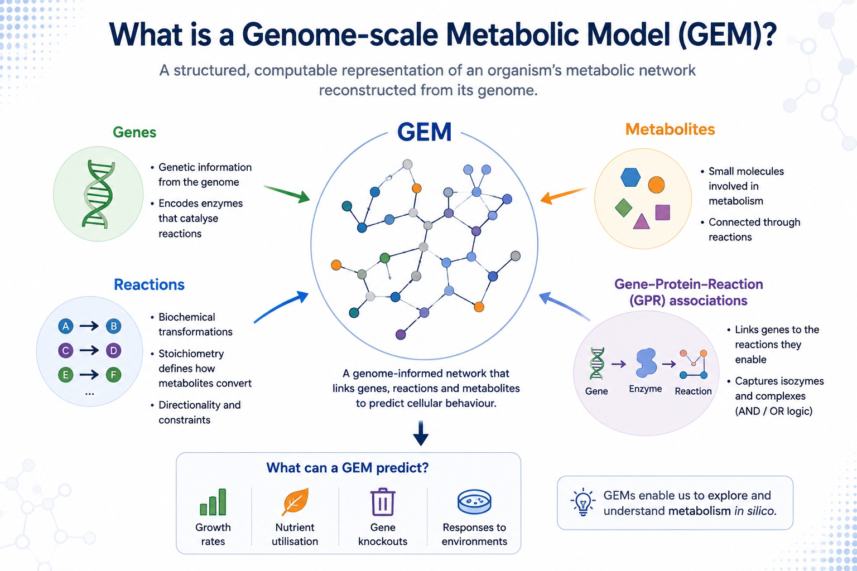
FISABIO Summer School
What is a Genome Scale metabolic model?
A structured, computable representation of an organism’s metabolism reconstructed using its genome
Links genes → proteins → reactions → metabolites to predict cellular behaviour.
Image created using Biorender

Slide 9
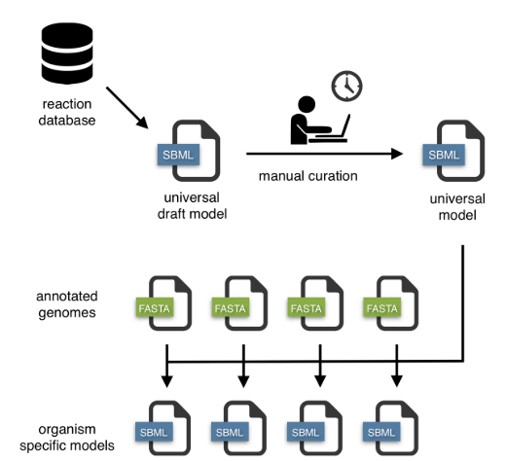
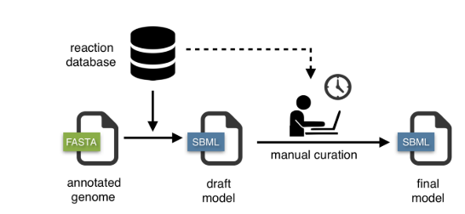
FISABIO Summer School
Approaches
Top-down approach
Bottom-up approach
Adapted from Macado D Nucleic Acids Research, 2018

Slide 10
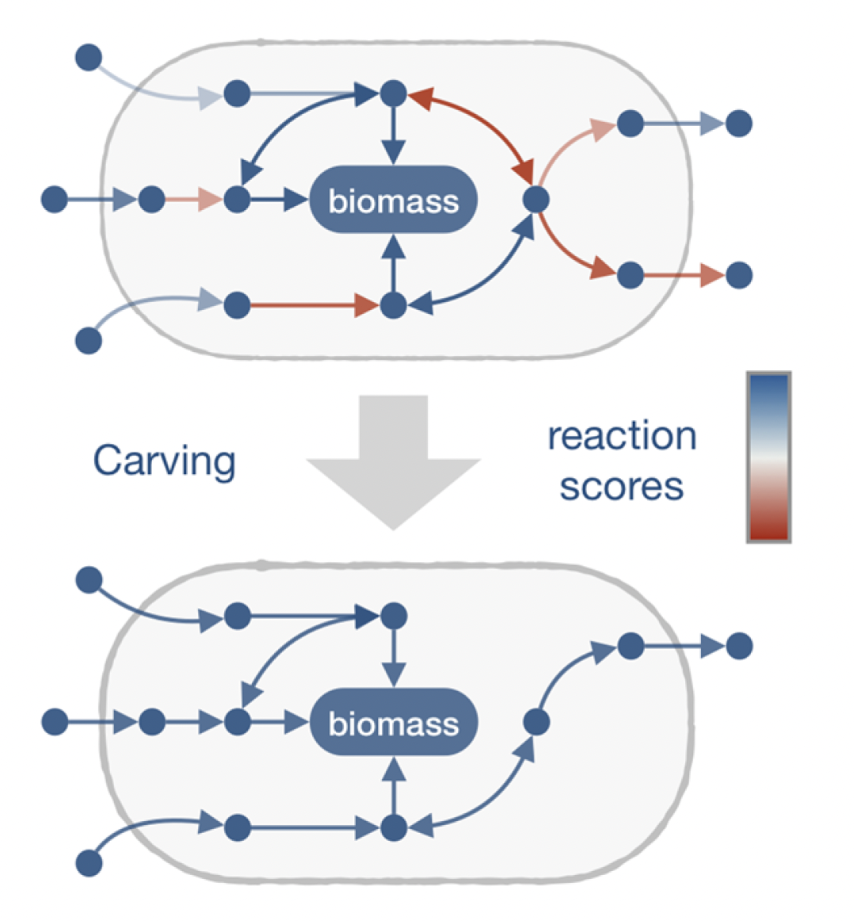
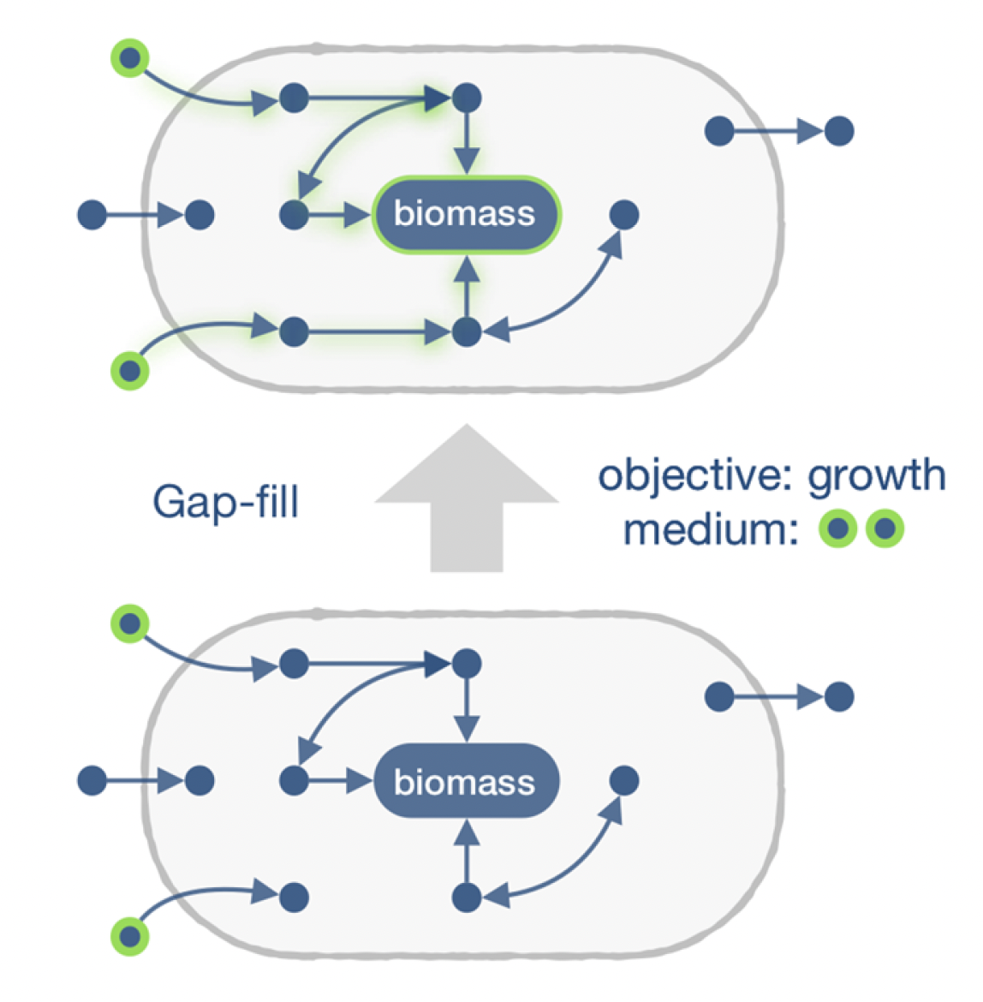
FISABIO Summer School
Approaches
Top-down approach
Bottom-up approach
Genetic evidence dependence on universal model
Iterative addition of reactions to fill gaps

Slide 11








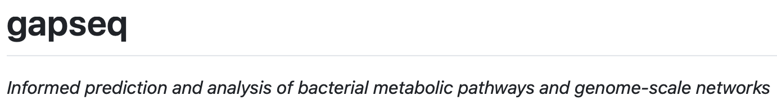
FISABIO Summer School
Tools

Slide 12
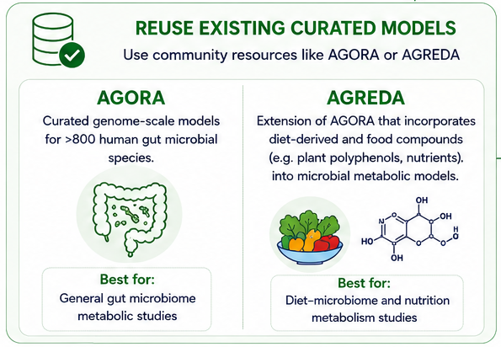
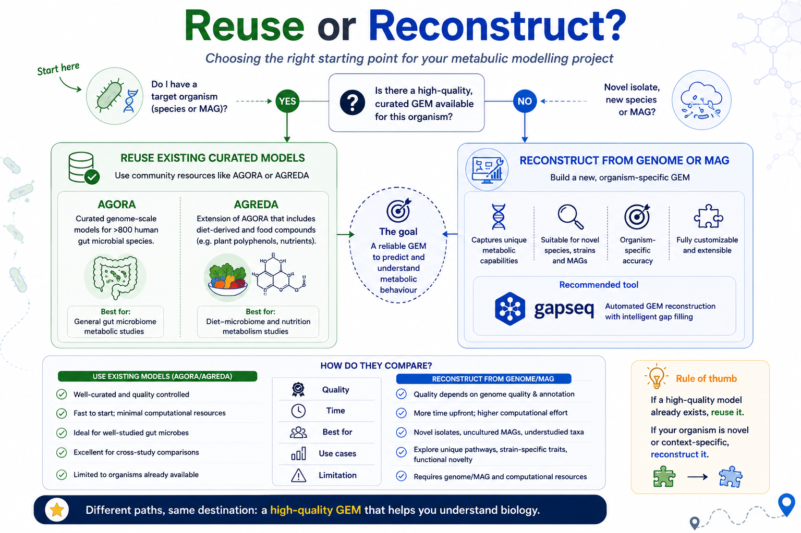
FISABIO Summer School
Reuse or Reconstruct?
✅
✅
AGORA: Magnúsdóttir, S. et al Nature Biotechnology, 2017; AGORA2: Heinken, A. et al Nature Biotechnology, 2023
AGREDA: Blasco, T. et al Nature Communications, 2021
Notes:
“Whether you reuse a curated model such as AGORA or AGREDA, or reconstruct a new one with gapseq, the end product is the same: a genome-scale metabolic model. But a GEM by itself is simply a network of reactions—it doesn’t tell us how metabolites flow through that network. To make biological predictions, we need a mathematical framework. That’s where Flux Balance Analysis, or FBA, comes in.”

Slide 13
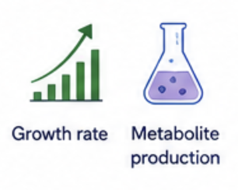
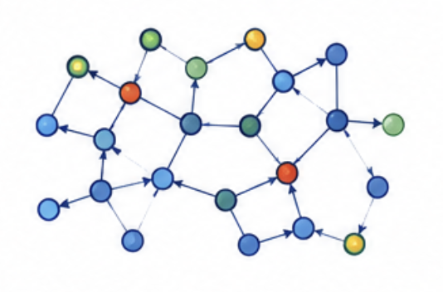

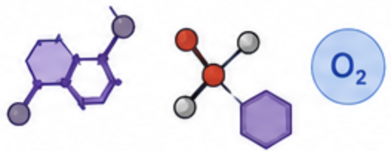
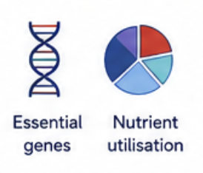
FISABIO Summer School
Flux Balance Analysis
From metabolic network to biological predictions
GEM
Constrains
(Nutrient availability
Optimization
(Mathematical solution)
Cellular behavior
FBA predicts how metabolites flow through a metabolic network under defined environmental conditions

Slide 14
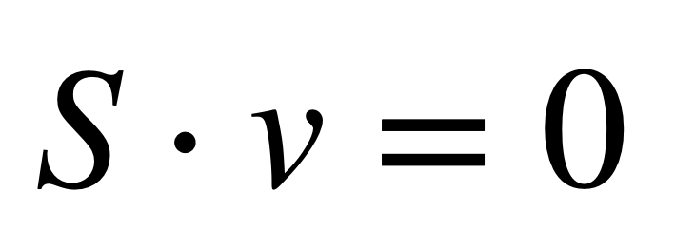
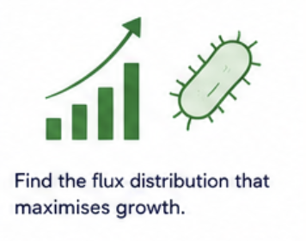
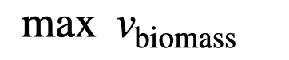
FISABIO Summer School
How does FBA work?
Optimization
(Mathematical solution)
Where,
S = Stoichiometric matrix (metabolites x reactions)
v = Reaction flux
Under steady state, what goes in, comes out

Slide 15
FISABIO workshop
What FBA can and cannot tell us?

