Slide 1
Netfield – Network Traffic Analyzer

Slide 2
Table of contents
01
02
03
04
05
06
Algorithm
Pseudo Code
Flow Chart
Modern Tool Usage
& Application of engineering principles
Code & Output
Social Relevance & consideration during the development of project

Slide 3

Introduction
We created network packet analyzer. It allows you to capture and analyze network packets in real-time, making it a valuable tool for network monitoring and debugging.
It's particularly useful for diagnosing network issues, monitoring traffic, and gaining a deeper understanding of network behavior.
We can also track the location of the packet .

Slide 4
Existing Work with limitations

Slide 5
Proposed Work
The code which we will be working on is a Python program for packet capture and analysis with a graphical user interface (GUI) using PyShark and tkinter. It allows users to capture and analyze network packets in real-time. It is different from tools like Wireshark and tcpdump in the following ways:
1. User Interface -
- The provided code has a graphical user interface (GUI) created with Tkinter, which allows users to interact with the application using buttons, text fields, and a tree view. Wireshark and tcpdump, on the other hand, are command-line tools without a graphical interface.
2. Ease of Use -
- The code is user-friendly and suitable for individuals who may not be comfortable with command-line tools. In contrast, Wireshark and tcpdump require users to have a certain level of expertise in working with command-line parameters.
3. Real-Time Capture:
- The code offers real-time packet capture and analysis. Users can start and stop packet capture at their convenience. Wireshark can also perform real-time capture, but tcpdump is primarily designed for static capture and post-capture analysis.

Slide 6
4. Packet Analysis -
- The code provides packet analysis features that allow users to view and inspect packet details in a structured format. Wireshark is a specialized packet analyzer that provides extensive capabilities for packet inspection and filtering.
5. Scriptability -
- The code is written in Python, making it scriptable and customizable. Users can extend its functionality or integrate it with other Python applications. Wireshark and tcpdump are standalone tools with limited scripting capabilities.
6. Limited Features -
- The code offers basic packet capture and display features. It lacks the advanced filtering, protocol decoding, and analysis capabilities provided by Wireshark. Wireshark, in particular, is a comprehensive packet analysis tool used for in-depth network troubleshooting and analysis.
7. Dependency -
- The provided code depends on external Python libraries like PyShark, tkinter, and tabulate. In contrast, Wireshark and tcpdump are standalone applications that don't rely on additional Python libraries.
8. Cross Platform Compatibility -
- While Wireshark and tcpdump are available for various platforms, the code's cross-platform compatibility may depend on the availability of the required Python libraries and modules.

Slide 7
Libraries used
tkinter is a built in python library for creating graphical user interface (GUIs) . It provides tools and widgets to design and build desktop applications with buttons , labels , text areas , and more .
pyshark is a python library that provides a simple interface to the wireshark network protocol analyser . It allows to capture and analyse network packets .
time is a built in Python library that provides functions related to time , timing and delays . In the code , the ‘time’ library can be used for tracking the duration of the packet capture . It records the start time and calculates the time elapsed .
socket is a built in Python library that provides functions to work with sockets and network communication . In the code , the ‘socket’ library is used to obtain the IP address in the GUI.

Slide 8
Algorithm used for the Project
Import the PyShark Library:
- The code will begin by importing the `PyShark` library. This library is used for capturing and analyzing network packets.
2. Define the `analyze_packet` Function:
- The `analyze_packet` function is defined to process and analyze each captured packet.
It takes one argument, `packet`, which represents a captured network packet.
It will simply print the source and destination IP addresses of each packet.
3. The Main() Function:
The `main` function is the entry point of the script.
Set the ‘interface’ variable to the name of the network interface you want to capture packets from (‘WI-FI’).
Set the ‘capture_filter’ variable to a capture filter to specify which packets to capture. {‘tcp’ for TCP packets}
Set the ‘time_limit’ variable to a maximum duration(in seconds) for capturing packets.

Slide 9
4. Creating a Live packet capture object:
Create a ‘pyshark.LiveCapture’ object named ‘capture’ with the specified ‘interface’, ‘display_filter’, and ‘timeout’ settings.
The ‘timeout’ settings will ensure that the packet capture will stop after specified duration (‘time_limit’).
5. Start capturing packets in a loop:
Use a ‘try’ block a capture packets continuously in a loop using ‘capture.sniff_continuously()’.
For each packet captured, call the ‘analyze_packet(packet)’ function to perform analysis on the packet.
If a ‘keyboard Interrupt’ (CTRL+C) is detected, print “Exiting…….” and exit the loop.
6. Execute the ‘main()’ function:
The ‘if__name__==__main__”:’ block ensures that the ‘main()’ function is executed when the script runs the main program.

Slide 10
Pseudo Code
Define a function analyze_packet(packet):
Print "Source IP: packet.ip.src, Destination IP: packet.ip.dst"
Define a function main():
Set interface to "Wi-Fi"
Set capture_filter to "tcp"
Set time_limit to 10
Create a capture object using pyshark.LiveCapture with the specified interface, capture_filter, and timeout settings
Try:
Start an infinite loop to continuously capture packets:
For each packet captured:
Call analyze_packet(packet) to analyze and print source and destination IP addresses
Except when a KeyboardInterrupt is raised:
Print "Exiting..."
If this script is executed as the main program, call main().

Slide 11
Flow Chart
START
Input Network Interface
Input Capture Filter (tcp , udp)
Input the time limit for network packets capture

Slide 12
Analyze Packet Function
Extract packet data
Return packet data
Exception handling for invalid packets
Get Wi-Fi IP Address Function | - Get the hostname | - Get the IP address of the host | - Handle socket errors
Packet Selected Function | - Handle the selection of a packet in the list | - Extract the packet and display details
Show Packet Details Function | - Create a new window for packet inspection | - Display packet details in a text area

Slide 13
Start Capture Function | - Initialize packet capture | - Continuously capture packets | - Analyze and store captured data | - Update the display with new packets | - Handle exceptions related to capture |
Clear and reset captured data and UI | | - Show "Stop the capture" message if running
Show Captured Data Function | - Get the Wi-Fi IP address | - Format captured data into a table | - Display data in the ScrolledText widget
After completing the time limit
If Refresh is clicked
Main Window (Root) | | - Create the main application window | | - Add UI elements (labels, buttons, etc.) | | - Initialize ScrolledText and Treeview
Else
Stop

Slide 14
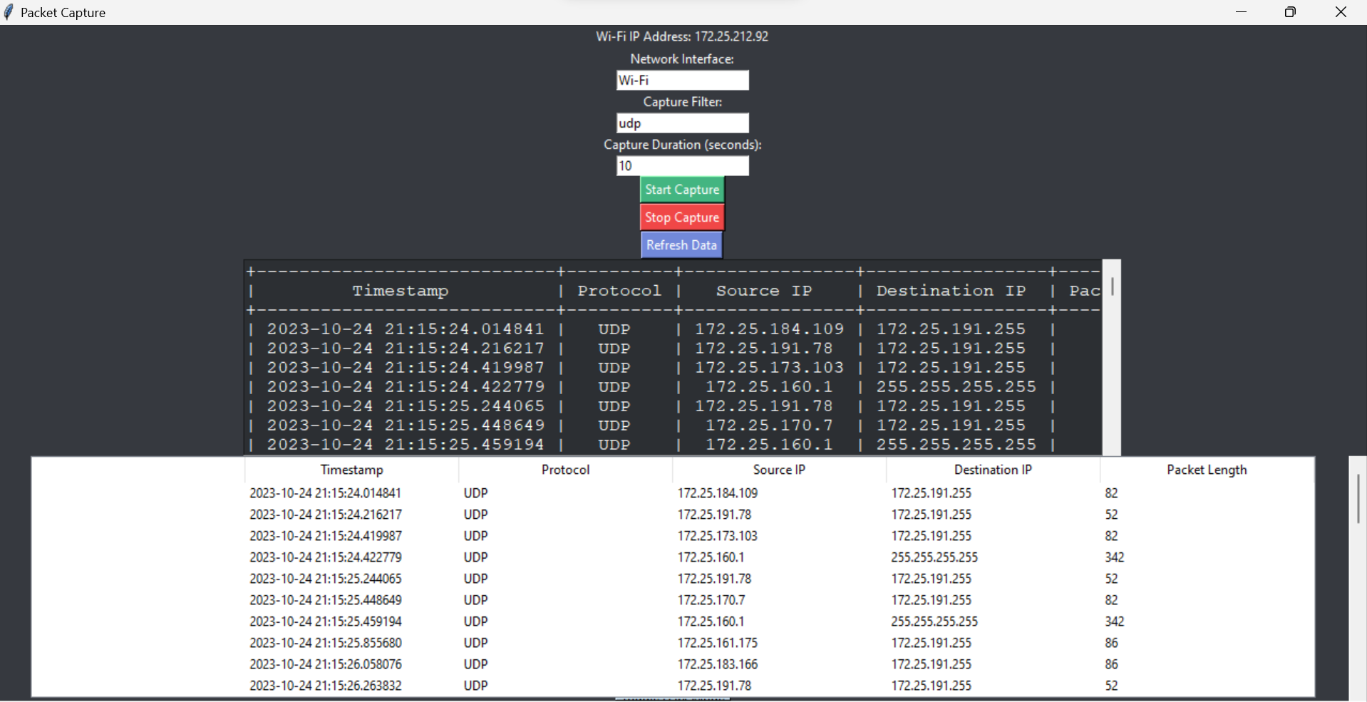
OUTPUT
The output of the provided code will display the source and destination IP addresses of network packets that match the specified capture filter (in this case, udp packets).

Slide 15
OUTPUT
In this output:
- "Source IP" corresponds to the source IP address of a captured packet.
- "Destination IP" corresponds to the destination IP address of the same packet.
- “Timestamp” tells the exact time when the network packet was captured.
- “Protocol” indicates the protocol of the network packet .
- “Packet Length” corresponds to the length of the packet .

Slide 16
Features
1. Networking Fundamentals: The code assumes a basic understanding of networking principles, including concepts like IP addresses, TCP/IP protocols, and network interfaces.
2. Software Engineering: This code follows software engineering best practices by defining functions (`analyze_packet` and `main`) for modularity, readability, and maintainability.
3. Network Capture: The `pyshark.LiveCapture` class from the PyShark library is used to capture network packets from a specified network interface. Engineering principles related to data capture and real-time monitoring of network traffic are applied here.
4. Packet Analysis: The `analyze_packet` function performs analysis on each captured packet. Engineers would typically apply various analysis techniques, such as protocol decoding, payload inspection, and anomaly detection, depending on the specific use case.
:

Slide 17
5. Error Handling: The code includes error handling using a try-except block to catch the `KeyboardInterrupt` exception (typically triggered by pressing Ctrl+C) to ensure a graceful exit. This demonstrates engineering principles related to robustness and reliability.
6. Configuration Management: Configuration parameters like the network interface (`interface`), capture filter (`capture_filter`), and time limit (`time_limit`) are defined as variables at the beginning of the script, making it easy to modify these parameters without changing the core logic of the code. This adheres to principles of configuration management and flexibility.
7. Security Considerations: When working with network traffic analysis, security principles and best practices are crucial. Engineers should ensure that the code and network monitoring activities are compliant with security policies and regulations.

Slide 18
Social Relevance & consideration during the development of project
Network Security and Privacy: It can be used for legitimate purposes such as network security monitoring, where organizations monitor their networks for security threats and anomalies.
Cybersecurity: In the context of cybersecurity, it can be used to detect and mitigate cyberattacks, helping organizations defend against threats like malware, ransomware, and unauthorized access. It contributes to the overall security of digital infrastructure, which is vital in today's interconnected world.
Network Performance Optimization: Network traffic analysis is essential for optimizing network performance. By identifying inefficient network traffic patterns, it can help organizations improve the speed and reliability of their networks.
Compliance and Regulation: Organizations in various industries are subject to data protection and privacy regulations (e.g., GDPR, HIPAA). Network traffic analysis tools can help ensure compliance by monitoring data flows and identifying potential violations.

Slide 19
Incident Response: In the event of a network breach or incident, this code can be a valuable tool for incident responders to quickly analyze network traffic and identify the scope and impact of the incident. It aids in the rapid mitigation of threats.
Network Infrastructure Monitoring: Beyond security, network traffic analysis is used to monitor the health and performance of critical infrastructure, such as telecommunications networks and data centers. It ensures the reliability of essential services.
Open Source and Community Contribution: The code's use of PyShark, an open-source library, demonstrates the importance of open-source tools in the field of network analysis. It encourages community collaboration and knowledge sharing.
It's essential to emphasize responsible and ethical use of network traffic analysis tools like the one demonstrated in the code. Social considerations, legal compliance, and respect for privacy should always be at the forefront when deploying such tools in any context

Slide 20
Members:
Kshitij Parag Ukey (22BCY10139)
Ansh Garg (22BCY10178)
Khushi Kumari (22BCY10275)
Kashinath R. (22BCY10094)
Nupur Shivani (22BCY10066)

Slide 21
References
Chatgpt

Slide 22
Thanks

Slide 25
Contents of this template

