Slide 1
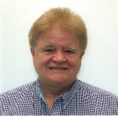
Institutional Repository Efficiencies via a Unique Partnership Now Extending to Others
Presented By: Robert Vernon Phillips, University of Florida (UF) George A. Smathers Libraries, Application Programmer II
With resources shared by:
Judy Russell – Dean of UF George A. Smathers Libraries
and Jean P. Shipman – Elsevier
Notes:
-See first page rules for er&L:
https://www.electroniclibrarian.org/conference-info/presenter-logistics/#SESSIONPR
-

Slide 2
Institutional Repository Efficiencies via a Unique Partnership Now Extending to Others
Presented By: Robert Vernon Phillips, University of Florida (UF) George A. Smathers Libraries, Application Programmer II
With resources shared by:
Judy Russell – Dean of UF George A. Smathers Libraries
Jean P. Shipman – Elsevier

Slide 3
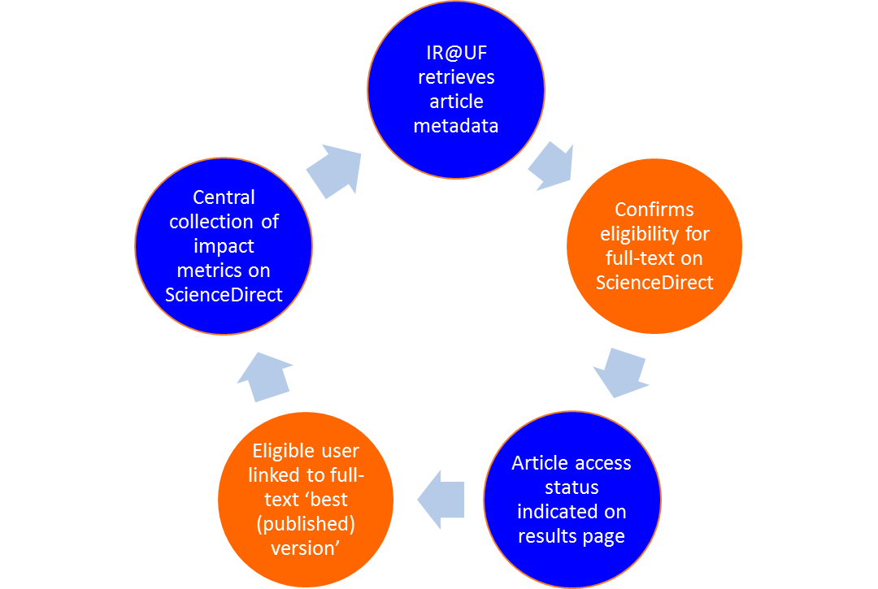
Elsevier APIs for Institutional Repositories

Slide 4
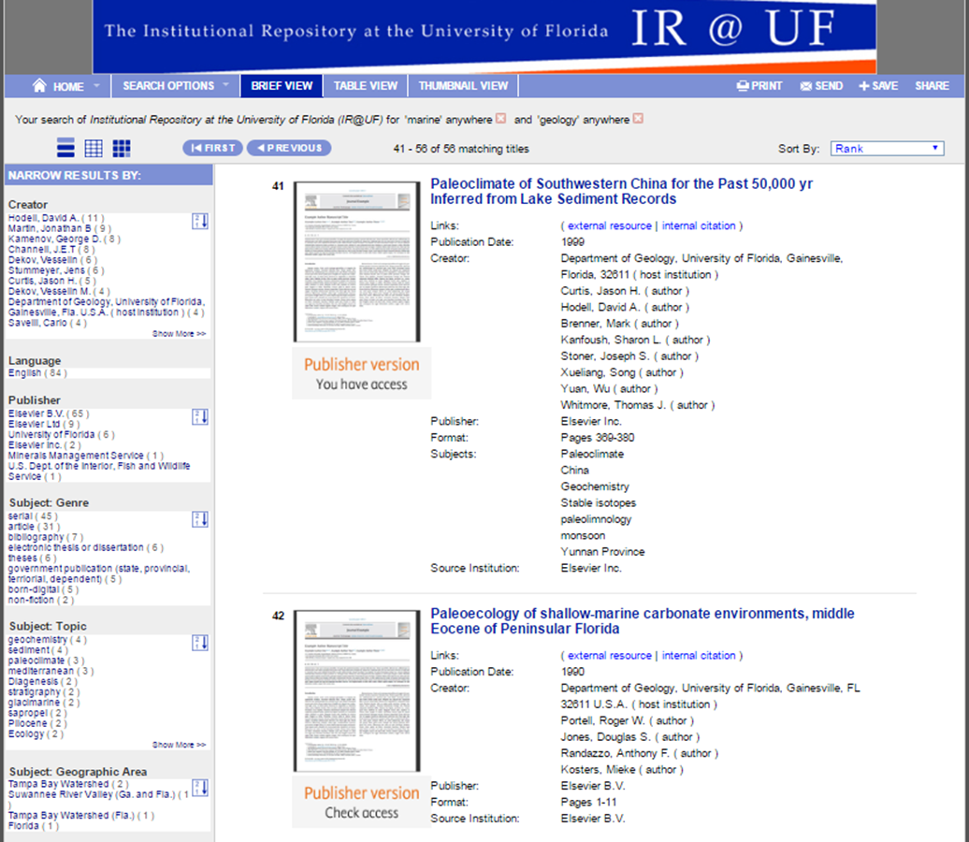
Search Results – Published Journal Articles (subscribed and unsubscribed articles)

Slide 5
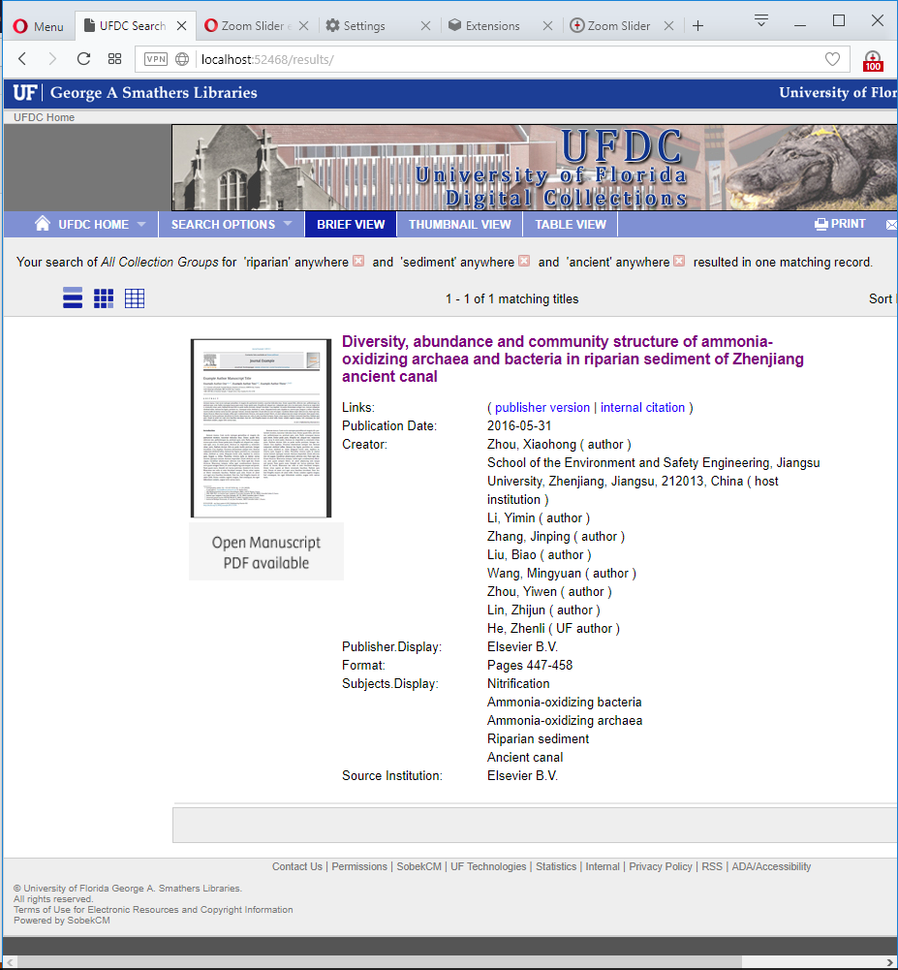
Accepted Manuscripts Post-embargo

Slide 6
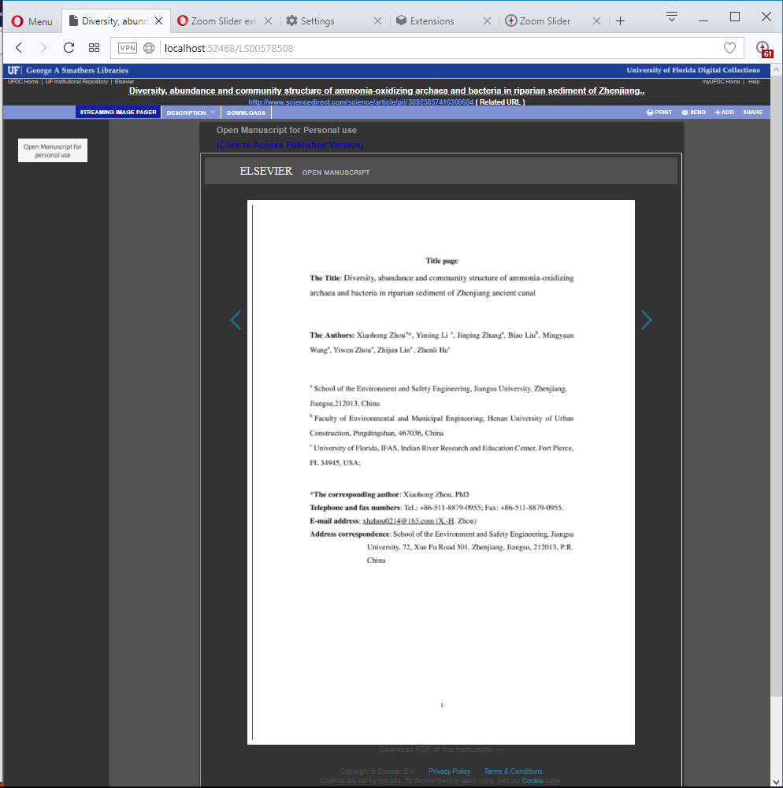
Manuscript Streaming Viewer

Slide 7
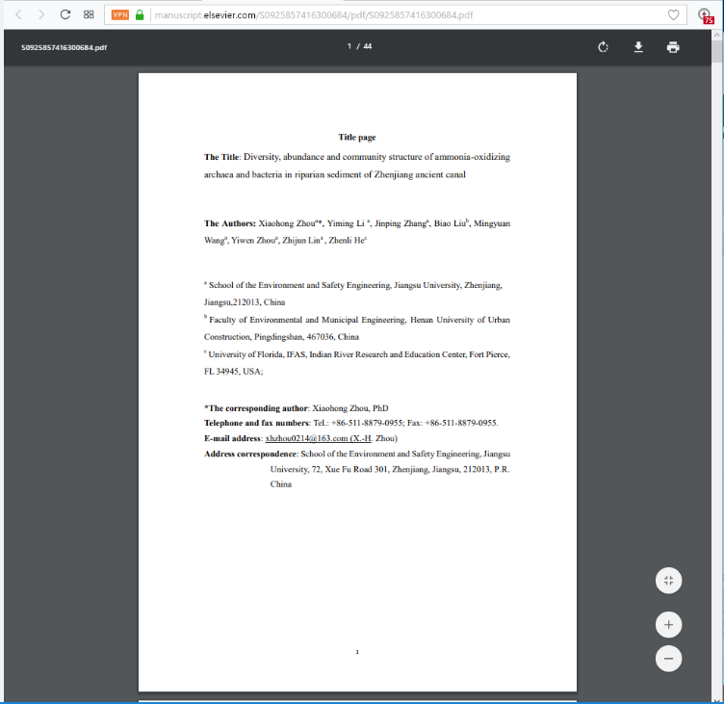
Manuscript PDF Viewer and Downloader

Slide 8
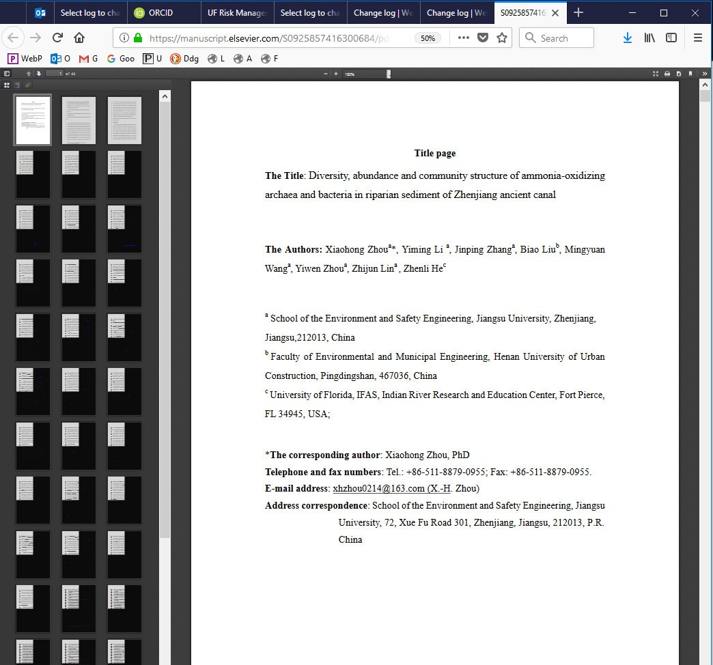
Elsevier PDF Viewer – March 2018 – Early Version
Notes:
Note: This viewer is provided by Elsevier and visited by clicking the PDF Download link below the UFDC Streaming viewer.
This viewer also does support ‘ctrl-f’ standard functionality to accept text search strings and to find them in the document.
Other view options include display of a table of contents in the left margin, zooming options, too.
The PDF download icon and icons at the top (for example the icon used to print the document) are now very small.

