Slide 1
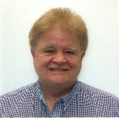
Institutional Repository Efficiencies via a Unique Partnership Now Extending to Others
Presented By: Robert Vernon Phillips, University of Florida (UF) George A. Smathers Libraries, Application Programmer II
With resources shared by:
Judy Russell – Dean of UF George A. Smathers Libraries
and Jean P. Shipman – Elsevier
Notes:
-See first page rules for er&L:
https://www.electroniclibrarian.org/conference-info/presenter-logistics/#SESSIONPR
-

Slide 2
Institutional Repository Efficiencies via a Unique Partnership Now Extending to Others
Presented By: Robert Vernon Phillips, University of Florida (UF) George A. Smathers Libraries, Application Programmer II
With resources shared by:
Judy Russell – Dean of UF George A. Smathers Libraries
Jean P. Shipman – Elsevier

Slide 3
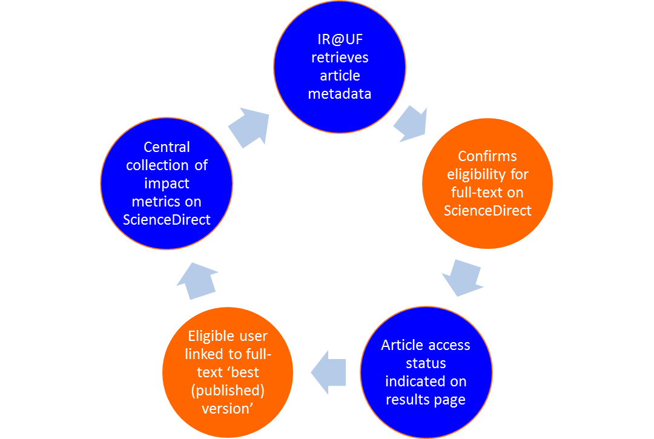
Elsevier APIs for Institutional Repositories

Slide 4
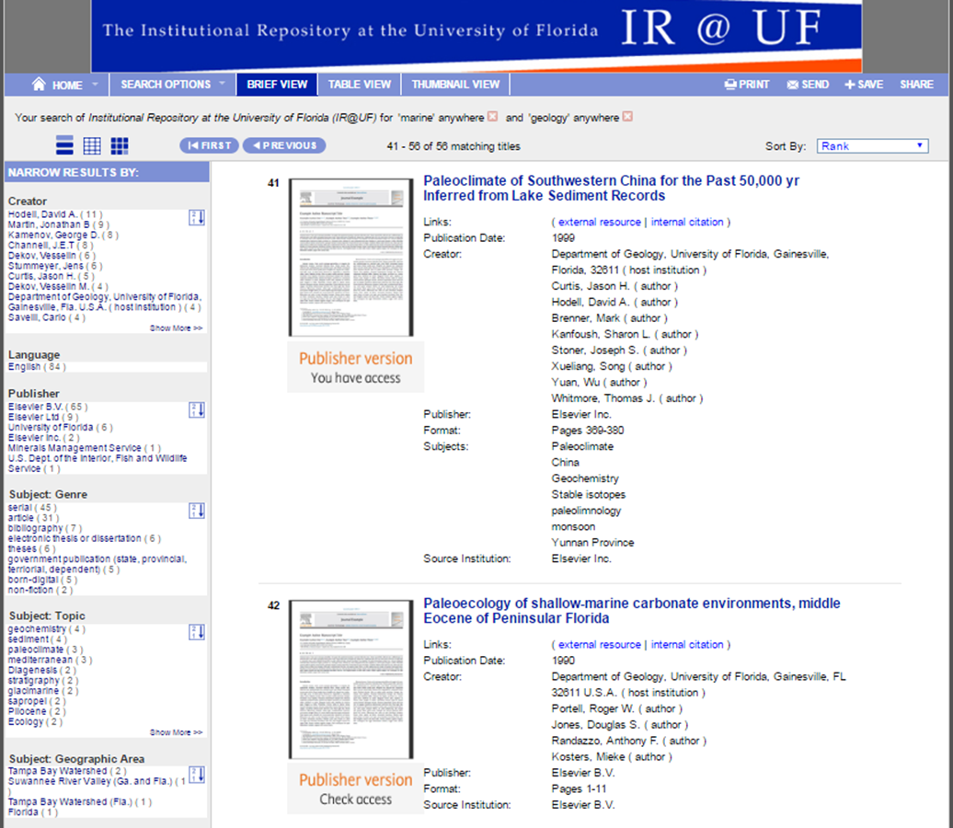
Search Results – Published Journal Articles (subscribed and unsubscribed articles)

Slide 5
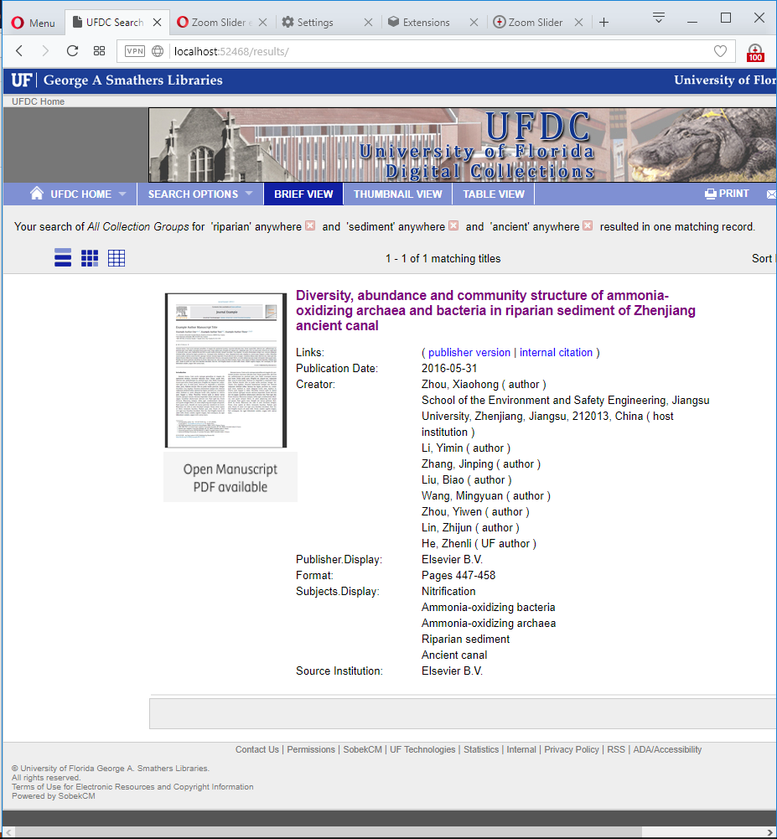
Accepted Manuscripts Post-embargo

Slide 6
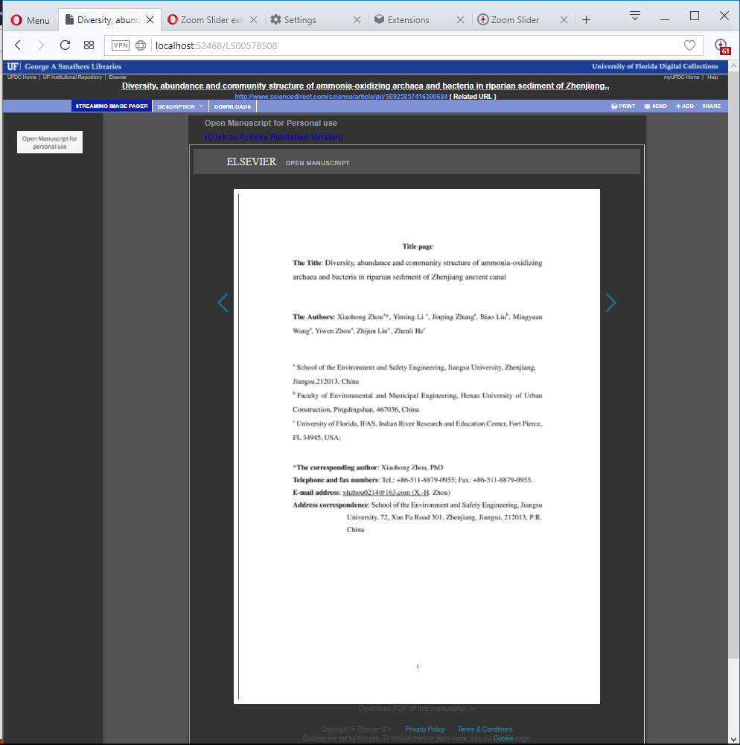
Manuscript Streaming Viewer

Slide 7
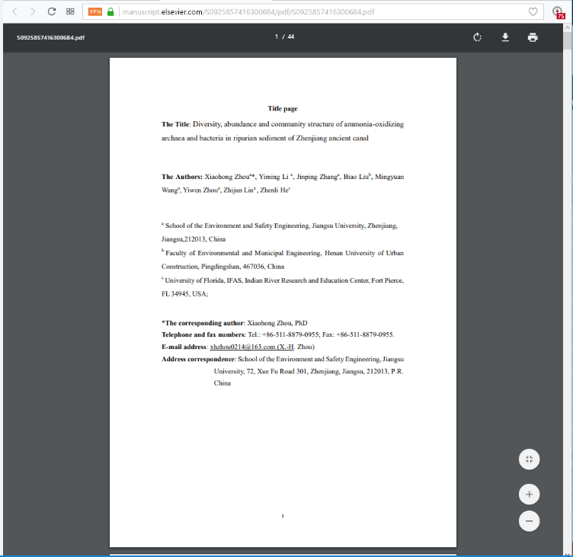
Manuscript PDF Viewer and Downloader

