Slide 1
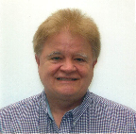
Institutional Repository Efficiencies via a Unique
Partnership Now Extending to Others
Presented By: Robert Vernon Phillips, University of Florida (UF) George A. Smathers Libraries, Application Programmer II
With resources shared by: Judy Russell – Dean of UF George A. Smathers Libraries and Jean P. Shipman – Elsevier
Notes:
-See first page rules for er&L:
https://www.electroniclibrarian.org/conference-info/presenter-logistics/#SESSIONPR
-

Slide 2
Institutional Repository Efficiencies via a Unique
Partnership Now Extending to Others
Presented By: Robert Vernon Phillips, University of Florida (UF) George A. Smathers Libraries, Application Programmer II
With resources shared by: Judy Russell – Dean of UF George A. Smathers Libraries and Jean P. Shipman – Elsevier

