Slide 1
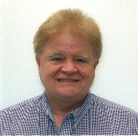
Institutional Repository Efficiencies via a Unique Partnership Now Extending to Others
Presented By: Robert Vernon Phillips, University of Florida (UF) George A. Smathers Libraries, Application Programmer II
With resources shared by:
Judy Russell – Dean of UF George A. Smathers Libraries
and Jean P. Shipman – Elsevier
Notes:
1
-See first page rules for er&L:
https://www.electroniclibrarian.org/conference-info/presenter-logistics/#SESSIONPR
-

Slide 2
UF/Elsevier Project: Implement the Elsevier API Infrastructure to Deliver Enhanced Repository Services
Increase comprehensiveness of coverage of Elsevier-published content by UF authors through the IR@UF.
Provide subscribers with access to the best available (published) version through the IR@UF.
Integrate published articles with other IR@UF content.
Allow users to return to their IR search results when reading final articles from ScienceDirect.
4
Notes:
I Initially approached Elsevier to request access to manuscripts by UF authors. Elsevier had the final submitted copy. Elsevier knew what rights our authors had retained or signed away.
When we began to explore that option, we learned that Elsevier had developed and wanted to test APIs to provide access to the published version through university institutional repositories. The implementers on the Libraries staff quickly decided to use the APIs, rather than to continue to seek the manuscripts.
There is not a culture of deposit at UF. We had only 7 Elsevier articles on deposit in the IR when the projected started. They were all supported by the UF Open Access Publishing Fund which required deposit of the final article in the IR.
<number>

Slide 3
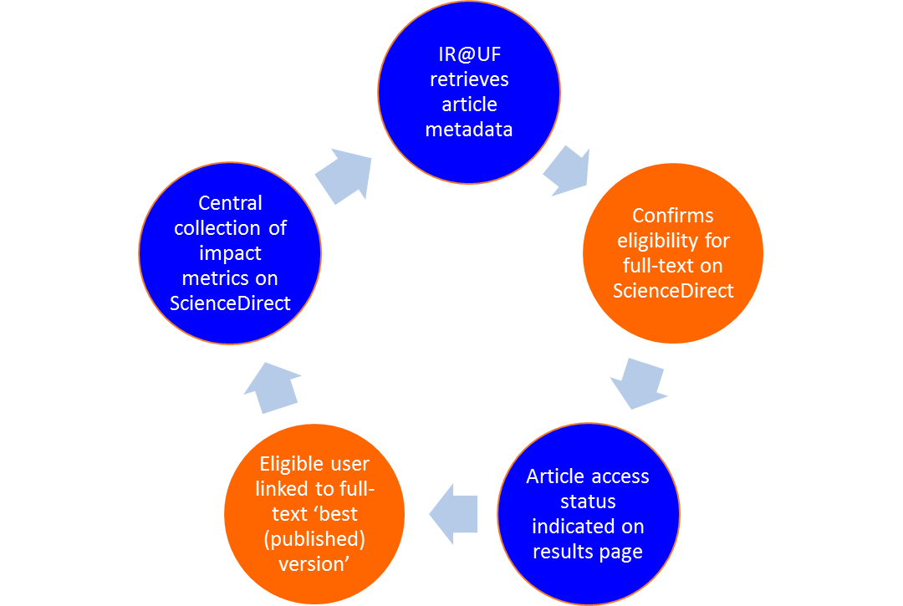
Elsevier APIs for Institutional Repositories

Slide 4
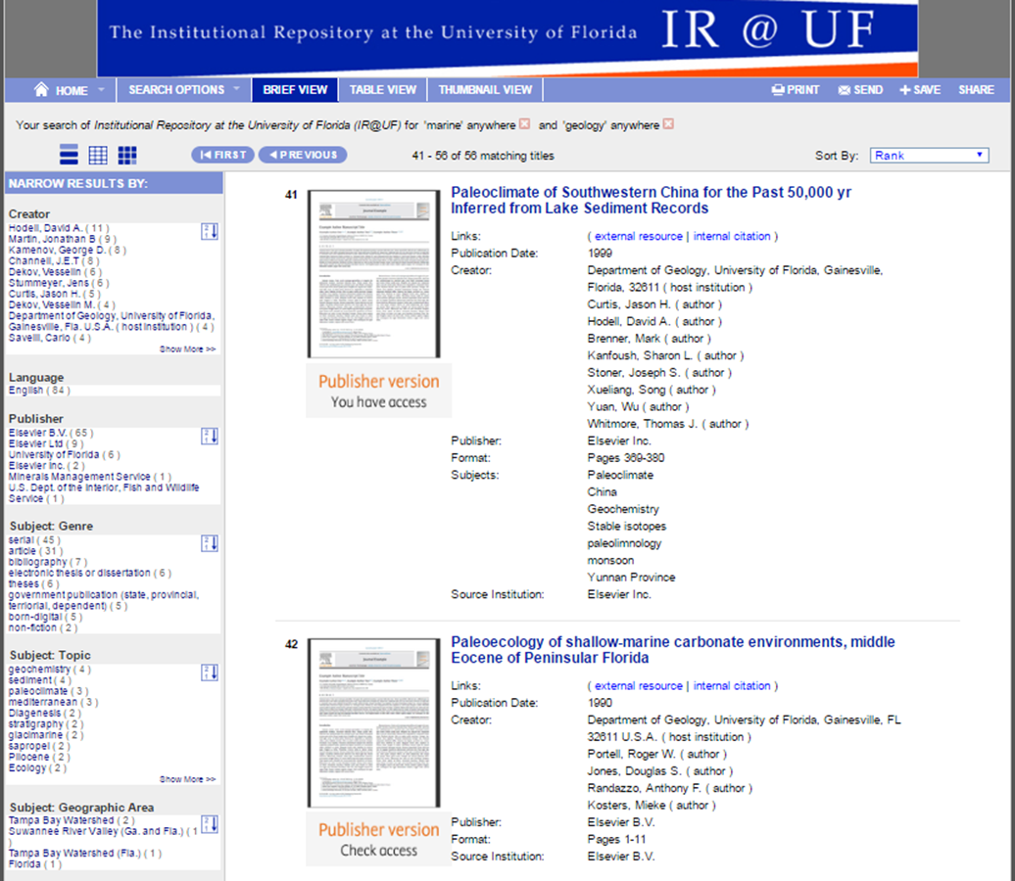
Search Results – Published Journal Articles (subscribed and unsubscribed articles)
Notes:
This is a typical UFDC ‘brief results’ page that happens to feature the first two Elsevier items that appear in a search.
1

Slide 5
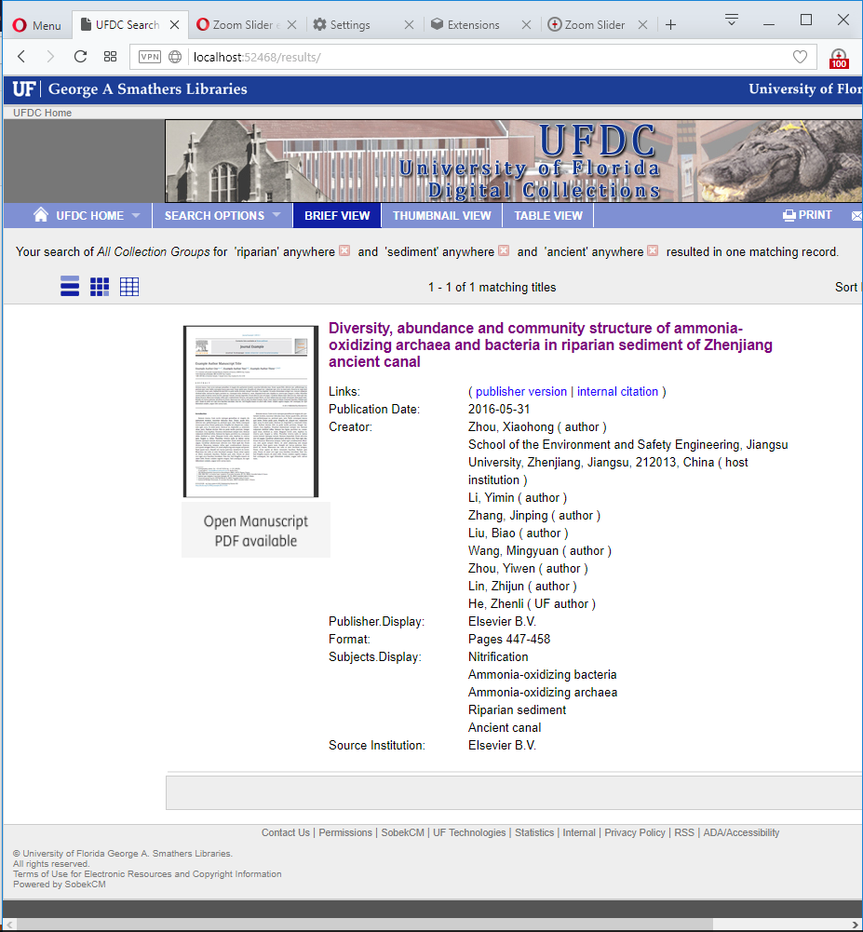
Accepted Manuscripts Post-embargo
Notes:
Note: The thumbnail image label wording is undergoing review between Elsevier and UF.
1

Slide 6
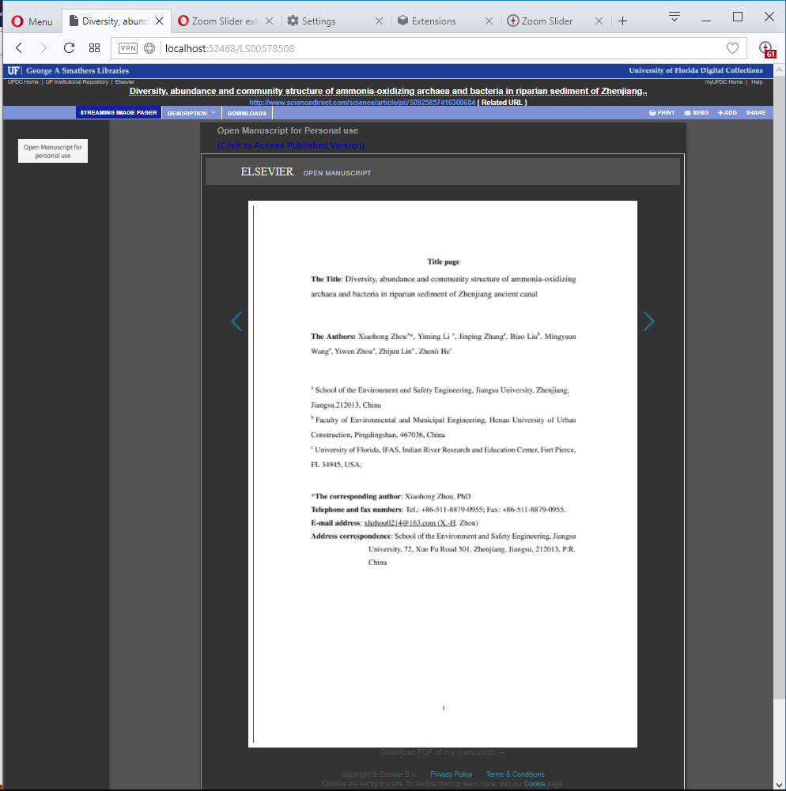
Manuscript Streaming Viewer
Notes:
This is the Elsevier Streaming Image viewer, visited when a UFDC user clicks on a result for an Accepted Manuscript (the phrase
Open Manuscript is also under consideration).
This is an image only viewer with left and right arrows to allow quick paging through the document page images.
UF IR Web software shows the Elsevier viewer in the main frame (i-frame), but UF software does retain control of the display in the top and left margins.
In the left margin, UF displays a badge to remind the user of any use restrictions, and UF may make future use of that space to
provide the user with other important notices for the user about this document.
At the bottom of the Elsevier Streaming Image Viewer frame is a hard to see link (Elsevier plans to make it more prominent) that
when clicked, leads to the under-development Elsevier PDF text viewer.
UF has no control of the Elsevier PDF Text viewer, and so this pre-requisite streaming image viewer is used to display important notices and provide other IR@UF standard options for the document in the top blue-colored menu bar.
Also under consideration is a design that calls for the final version of the Elsevier PDF text viewer to be housed directly in the I-Frame.
<number>

Slide 7
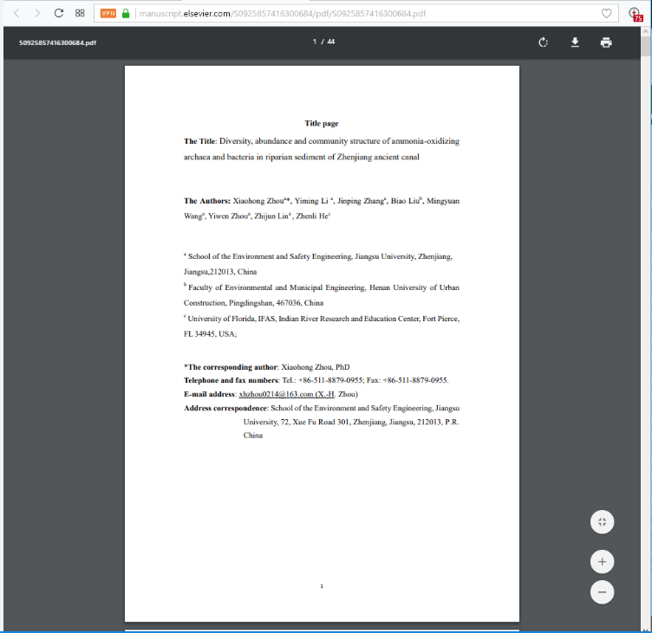
Manuscript PDF Viewer and Downloader

Slide 8
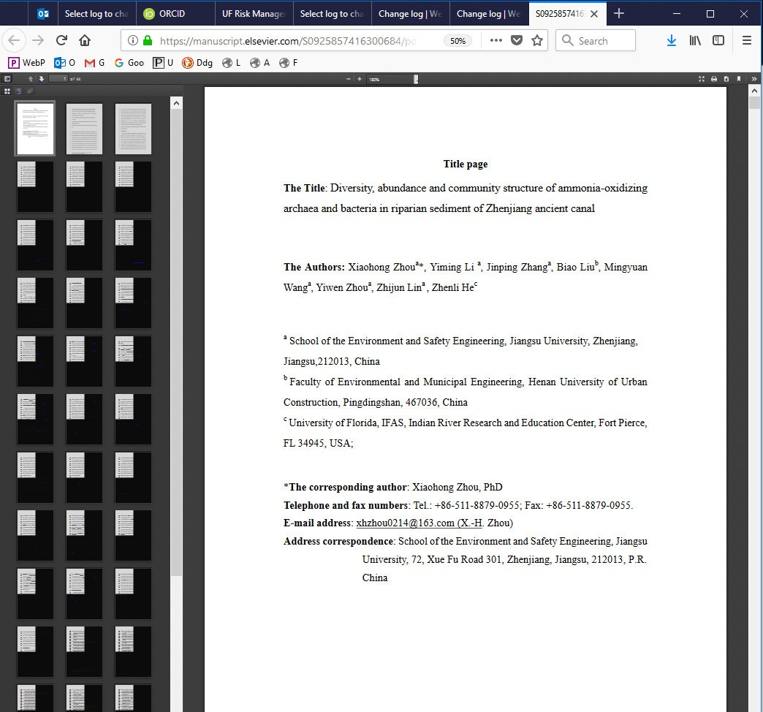
Elsevier PDF Viewer – March 2018 – Early Version
Notes:
Note: This viewer is provided by Elsevier and visited by clicking the PDF Download link below the prerequisite UFDC Streaming viewer.
In contrast, this PDF-text viewer does support ‘ctrl-f’ standard functionality to accept text search strings and to find them in the document.
Other PDF-Text viewer options include display of a table of contents in the left margin, as well as zooming options.
The PDF download icon and icons at the top (for example the icon used to print the document) are now very small.
<number>

