Slide 1

BeatShare
Create your own beats

Slide 2
Creating your beats
Beatshare app lets you register as user with a unique id and password
After you register successfully, Beatshare lets you login to your custom homepage
The homepage has a set of 16 beats that can be switched on/off simultaneously or separately to produce sounds
A wave passes through the beats and plays the music according to the beats selected

Slide 3
Login/ Register
Login and register is handled by passport.js
We have also enabled sessions so that unless a users logs out the browser will keep him logged in for one day
Beats homepage with the console is only available to the users when they successfully login into the system
The systems accepts a register request only when the email field has a valid email and the password and confirm password fields match each other

Slide 4
Mongo DB
We have extensively used the mongo database with the mongoose schema
While the username and email ids are stored in the form of strings, the password is hashed before entering the database
The hashed password is stringyfied before comparing it with the user so that a valid user can log in the system

Slide 5
Saving the Beats
A valid user can save his own beats to the database with the schema and can retrieve the beats back from the system
Beats are saved in the form of json objects which has tempo, name sequence and grid length

Slide 6
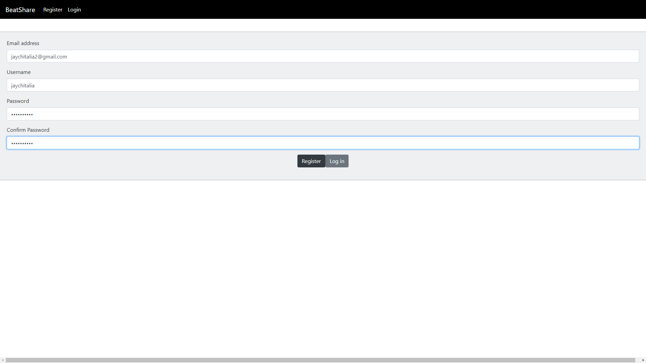

Slide 7
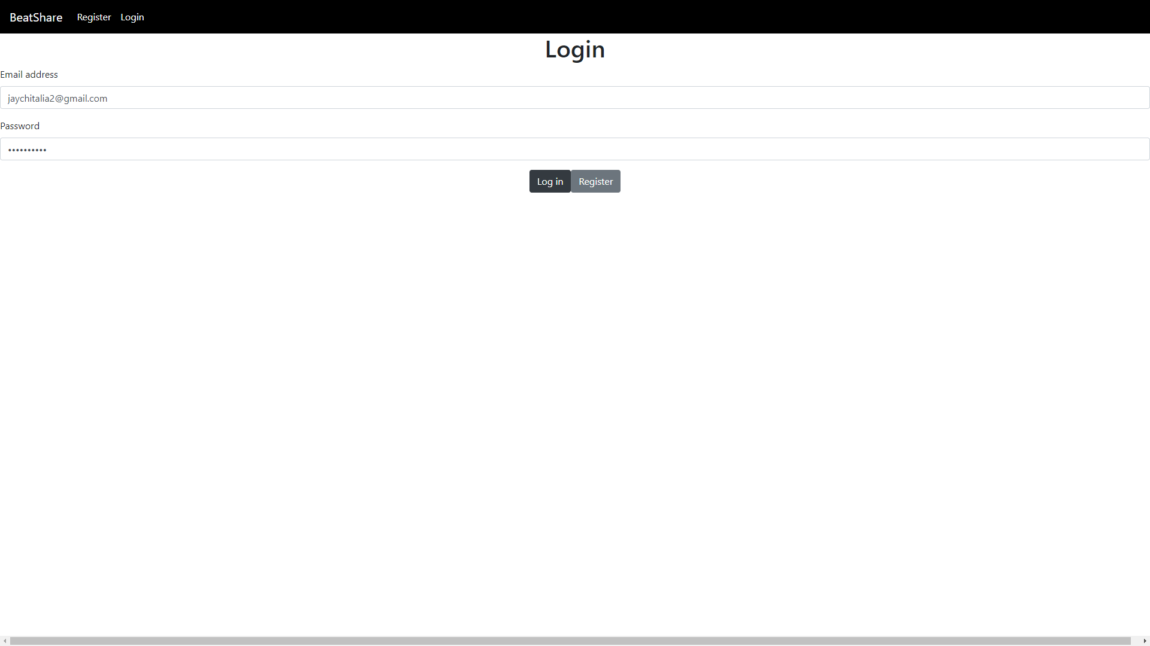

Slide 8
