Slide 1


Slide 2
Fullstack2 project
Submitted To
Bachelor of Technology
Department of Computer Science and engineering
GLA University, Mathura
NH2 ,Mathura-Delhi road Mathura,
Uttar Pradesh 281406 ,INDIA
Submitted To
Mrs. Pankaj Kapoor

Slide 3
Group members
Alok kumar Upadhyay (181500068)
Kshitiz Gupta(181500338)
Gopal Gupta(181500240)
Hemant Gaur(181500265)
Anubhav Kumar tomar (181500112)
Project Mentor
Mrs. Pankaj Kapoor

Slide 4

Presentation on
E-Commerce for small vendor(online shopping)

Slide 5
Introduction
E-commerce definition
About our system

Slide 6
What is E-Commerce
Commonly known as Electronic Marketing.
“It consist of buying and selling goods and services over an electronic systems Such as the internet and other computer networks.”

Slide 7
Our System
◆ Our System is an e-commerce website from where people can buy products online.
◆ Admin mange the products ,database of users and checks the transactions.

Slide 8
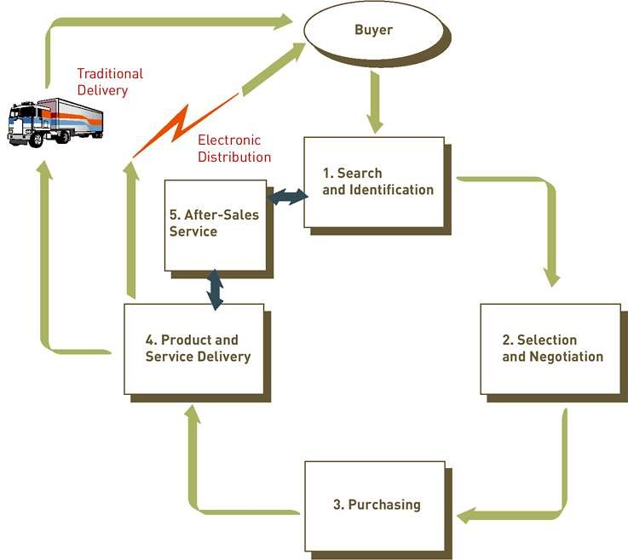
THE PROCESS OF E-COMMERCE

Slide 9
Feature
Menu
Catalog Browsing
Category List Product List
Catalog Management
Product Browsing
Product Reviews Related Products
Shopping Cart
Checkout
Auto generated bill
Payment Gateway

Slide 10
TOOLS :- 1.REACTjs 2.mongoDB 3.expres 4.Nodejs 5.Vscode 6.github 7.internet 8.chrome browser (or any other web application)
Technology used

Slide 11
Hardware Requirement
System Requirement:-
Minimum Marshmallow version 7.0 ( for android )
Pentium IV or higher, (PIV- 300GHz recommended)
Hard-Disk 250GB or more
RAM 4GB or more
Processor i3 (7th Gen)
1024 x 768 Display
Internet

Slide 12
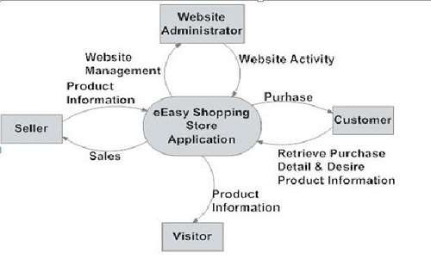
Data Flow Diagram

Slide 13
Business process model
Start
Product List
Buy Product
Customer
Payment Type
End
Admin
Check Transaction

Slide 14
ADVANTAGES OF E-COMMERCE
Faster buying/selling procedure, as well as easy to find products.
Buying/selling 24/7.
More reach to customers, there is no theoretical geographic limitations.
Low operational costs and better quality of services.
No need of physical company set-ups.
Easy to start and manage a business.

Slide 15
DISADVANTAGES OF E-COMMERCE
Unable to examine products personally
Not everyone is connected to the Internet
There is the possibility of credit card number theft
Mechanical failures can cause unpredictable effects on the total processes.

Slide 16
Future plan
◆ We are thinking of some modifications and adding some advanced new features in out system. Some of them are –
# GUI modification (more user friendly) # Users can sell their products
# Users can signup / login using their social media account such as facebook , google+ etc.

Slide 17
Work Contribution:-
Alok Kumar Upadhyay:→Front-end, Back-end and Designer of pages.
Gopal Gupta→Testing components of front-end , Documentation work.
Heamant Gaur →Front- end designer ,backend and
documentation work
Kshitiz Gupta→Front- end designer and
documentation work
Anubhav kumar tomar→Testing components of front-end , Documentation work.

Slide 18
SCREENSHOT OF PROJECT
(GUI)

Slide 19
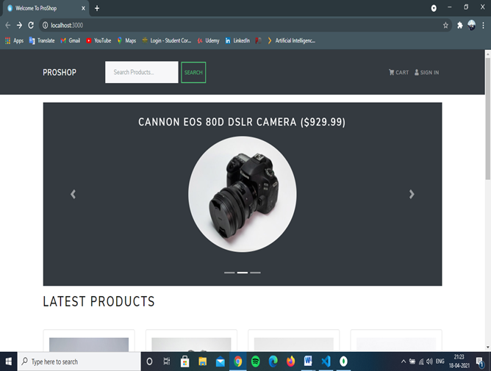
Home Page

Slide 20
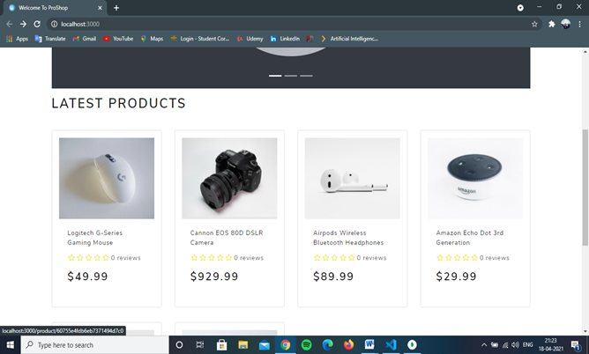
Project Work:-

Slide 21
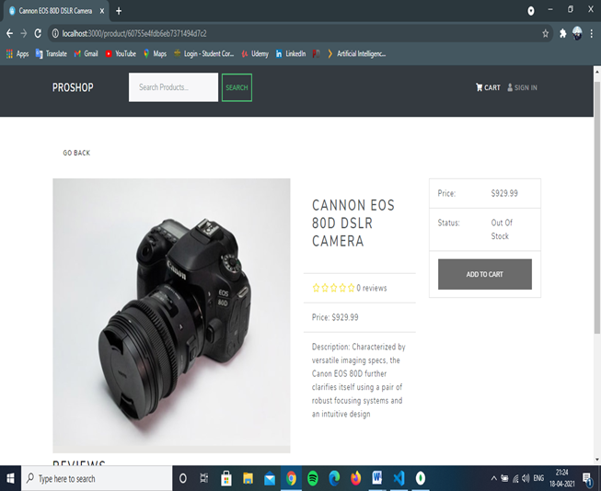
Product Description Page

Slide 22
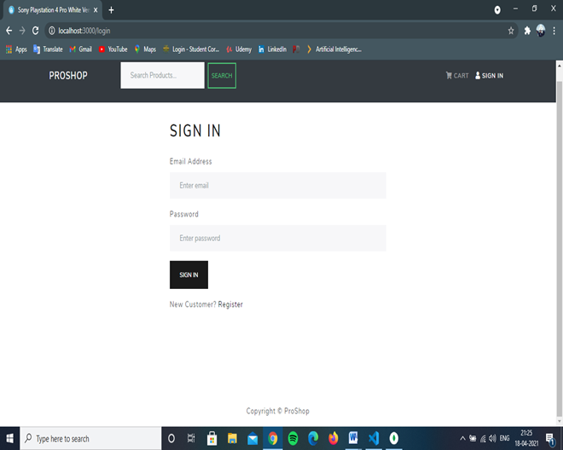
Sign In Page

Slide 23
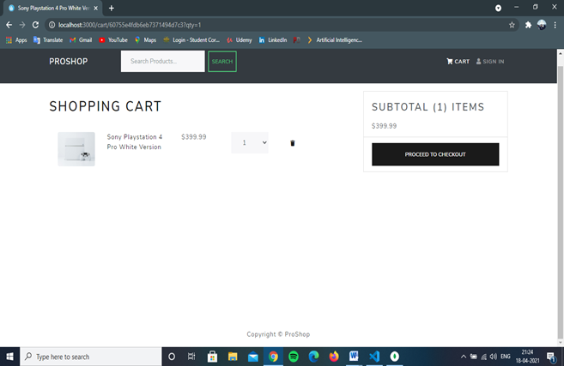
Cart page

Slide 24
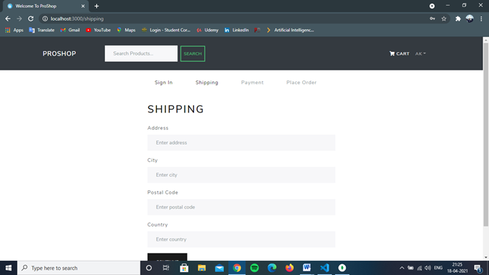
Shopping Address

Slide 25
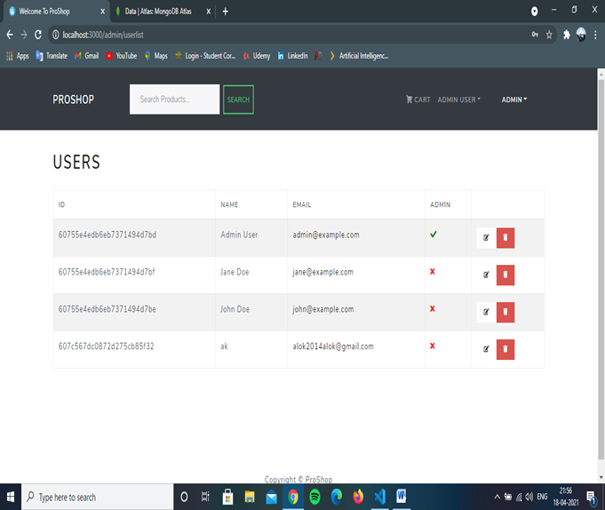
Admin Page

Slide 26
Shopping Address

Slide 27
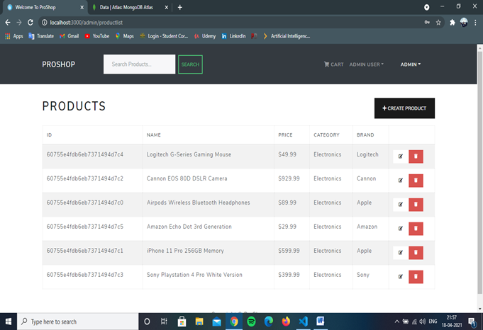
Check List

Slide 28
Any Question ?

