Slide 1

GLA University Mathura
Department of CSE (3Year)

Slide 2

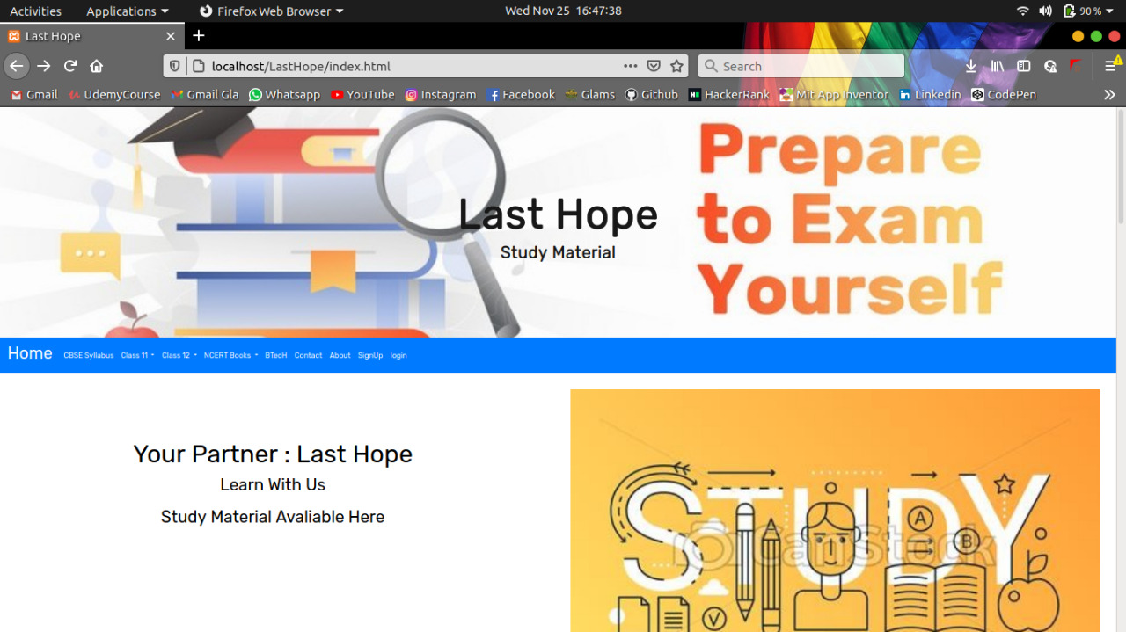
Project Title LAST HOPE (e-Learning website)

Slide 3
Introduction
Team Members:
Kshitiz Gupta (181500338)
Gopal Gupta (181500240)
Lokesh Yadav (181500351)
Aditya Kumar Dubey (181500042)
Alok Kumar Upadhyay (181500068)

Slide 4
Outlinne
Background Details
Purpose
Application details
Requiremens
Modules Description Application Description

Slide 5
Purpose:
To make a website for school level or for college students .
To provides notes, solutions and sample paper free of cost
Easy to download
Enhance the learning of students
A storehouse of education, information and knowledge.

Slide 6
Advantages
a) Synchronous Learning
b) Enhance skills
c) User convenient
d) Self pacing for slow and quick learners
e) Easily download materials

Slide 7
System Requirements:
Software Requirements.
Hardware Requirements.

Slide 8
1. Software Requirements:
SYSTEM SOFTWARE :-
.Operating System (Windows 10, Linux)
APPLICATION SOFTWARE :-
. HTML ( front-end )
. CSS
. JavaScript (back-end )
. BootStrap
MySQL (back-end )
php
Github
Xampp server
Web Browser :-
Google Chrome , Firefox , Safari , Mozilla , Internet Explorer

Slide 9
2. Hardware Requirements:
20 Gb Ofharddisk
Processor I3 (7th Gen)
1024 X 768display
Internet
Minimum Marshmallow Version 7.0 ( For Android )
Pentium IV Or Higher, (Piv-300ghz Recommended)
Hard-disk 250GB Or More
RAM 4GB Or More
Processor I3 (7th Gen)

Slide 10
Contribution Summary
1. Kshitiz Gupta :- Leader , front-end and back-end developer
2. Gopal Gupta :- Front-end Developer and Designer
3. Lokesh Yadav :- Front-end Developer and Designer
4. Alok Kumar Upadhyay :- Front-end Developer
5. Aditya Kumar Dubey :- Front-end Developer

Slide 11
Module Descriptions:
Log in
Sign up
Create Account
About Us
Default fontend page
Download study material
Syllabus of class 11th ,12th
Refrences for video lecture online

Slide 12
Default Display Page

Slide 13
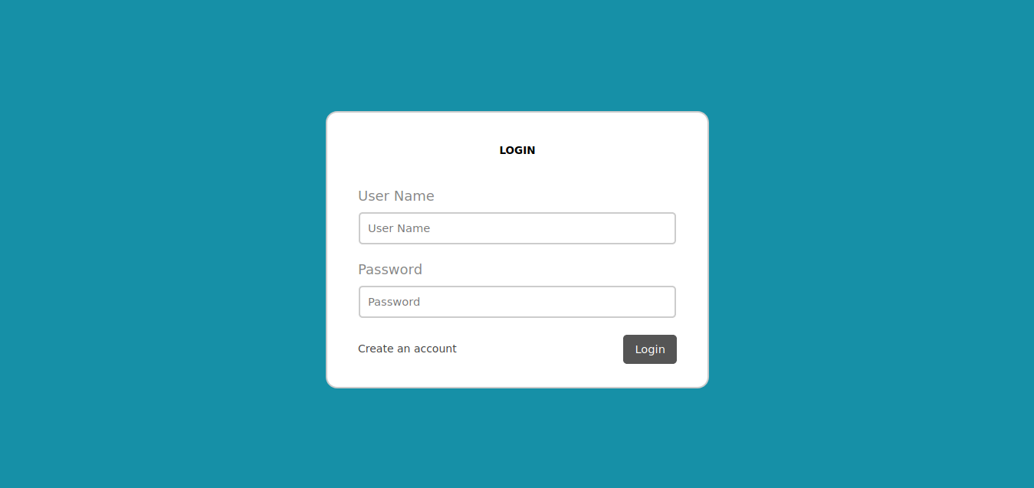
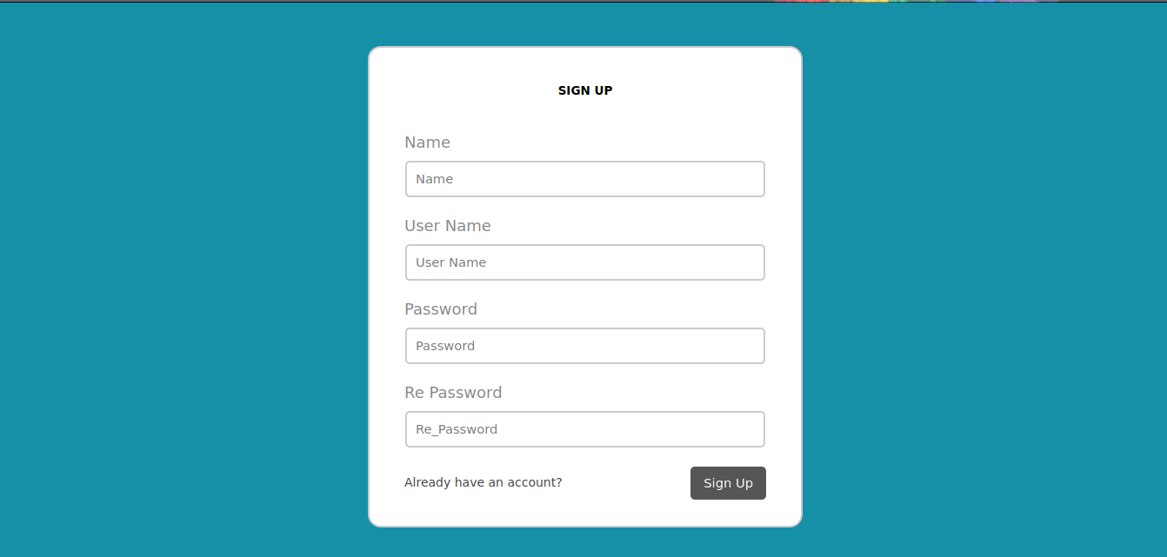
Login / Signup

Slide 14
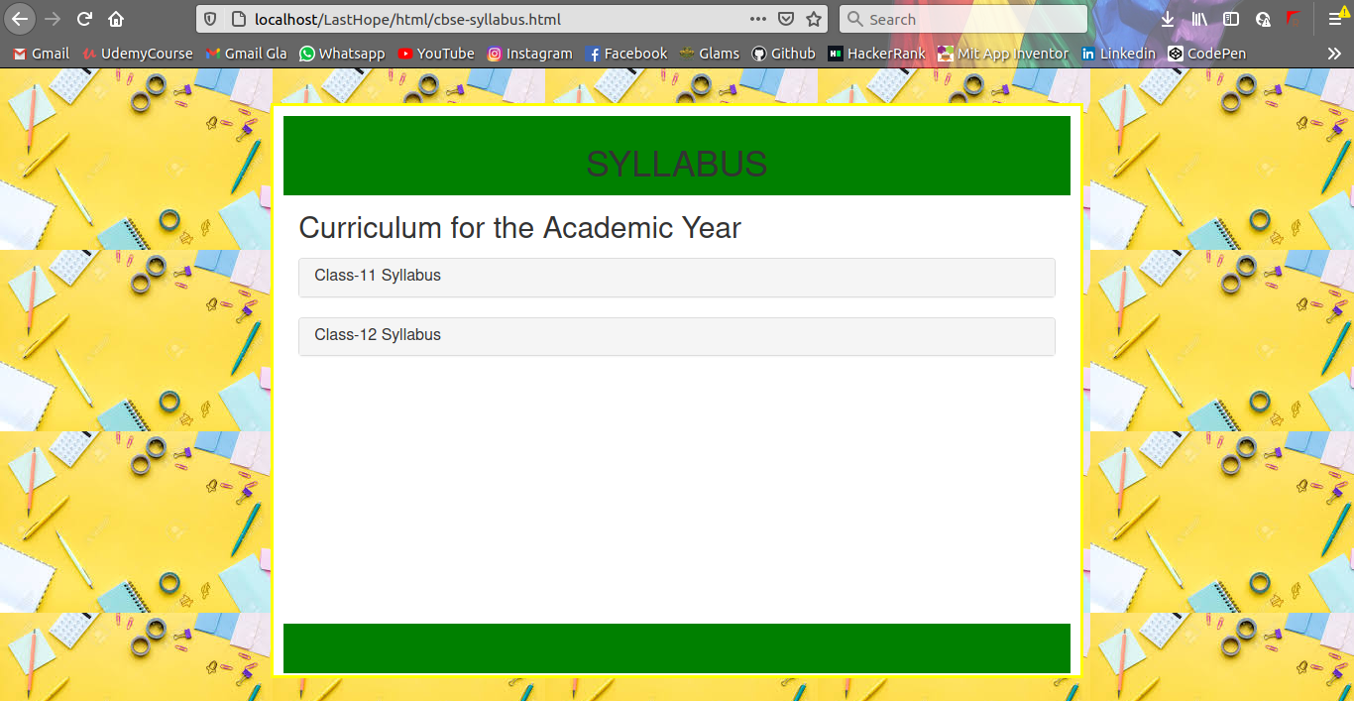
CBSE Syllabus

Slide 15
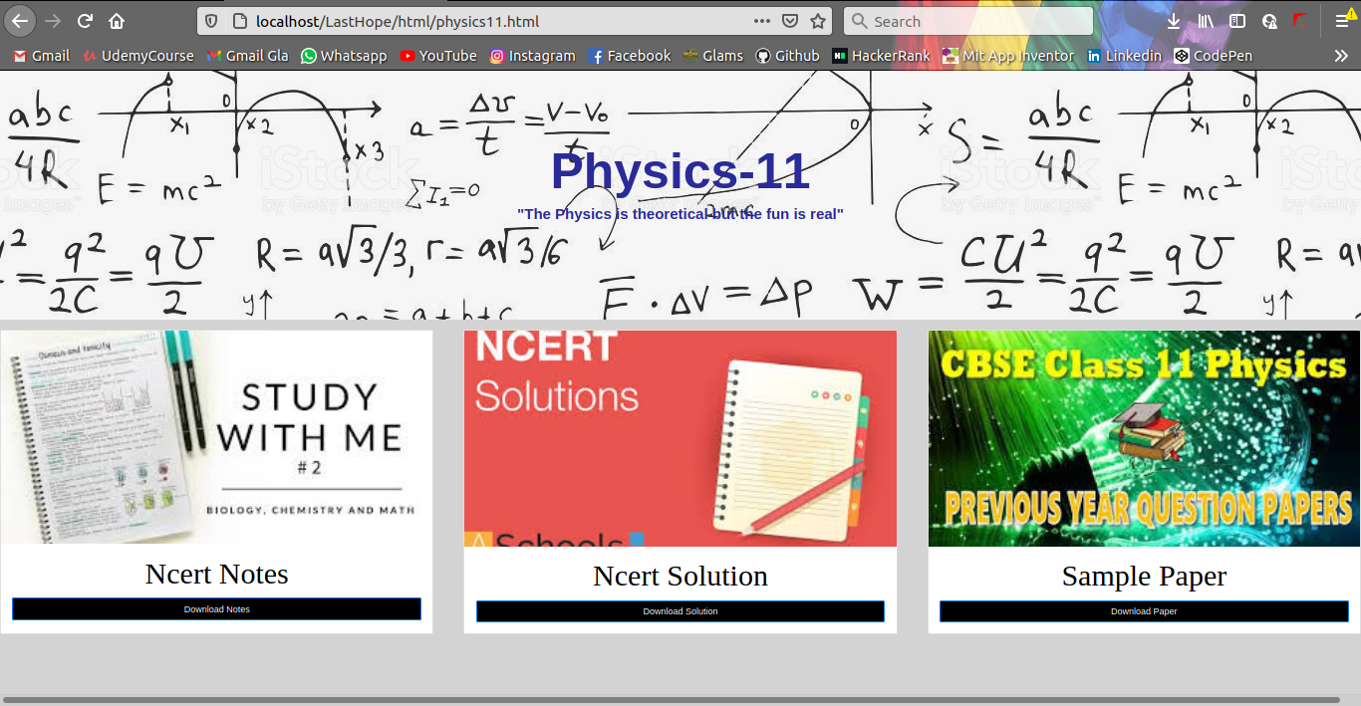

Slide 16
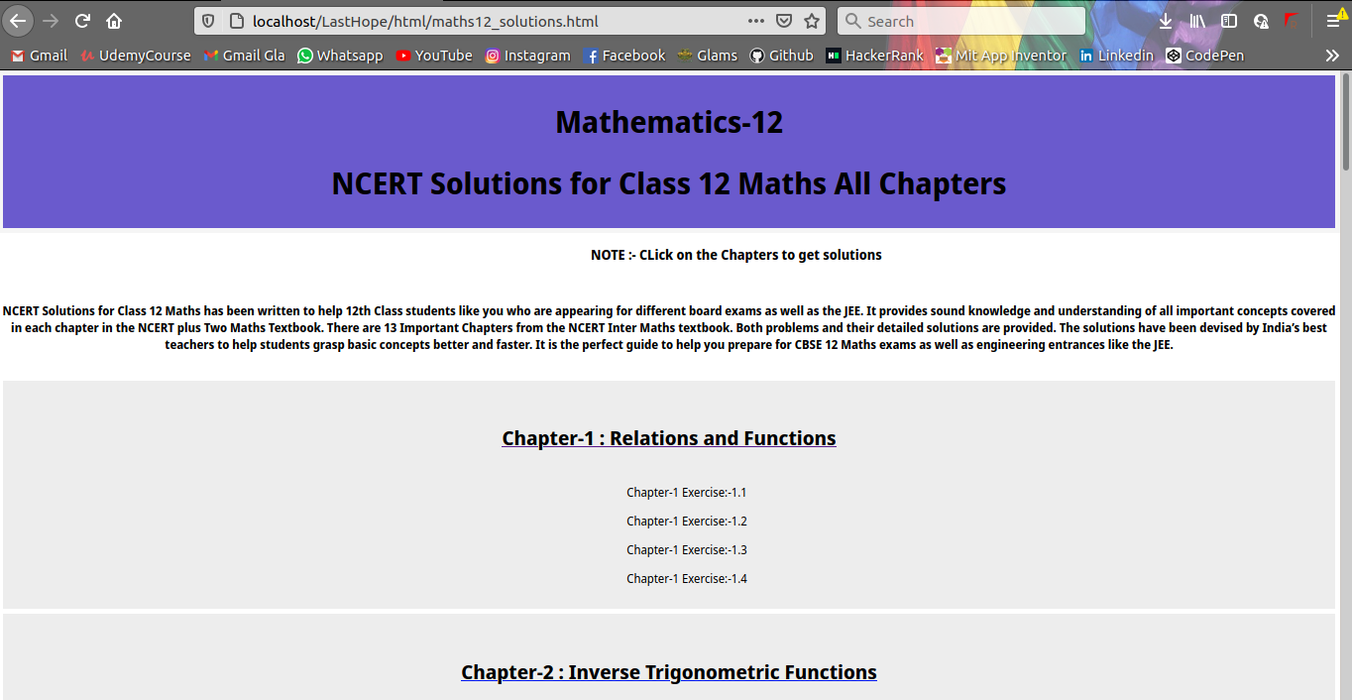

Slide 17
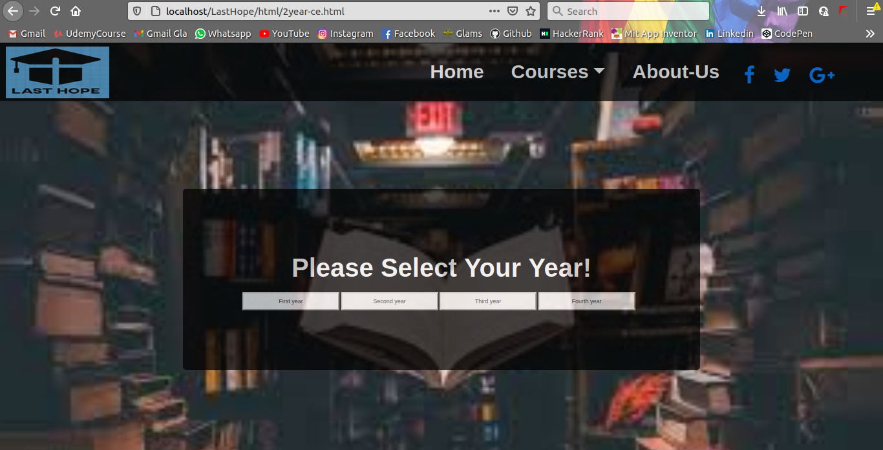

Slide 18
Thank You

