Slide 1
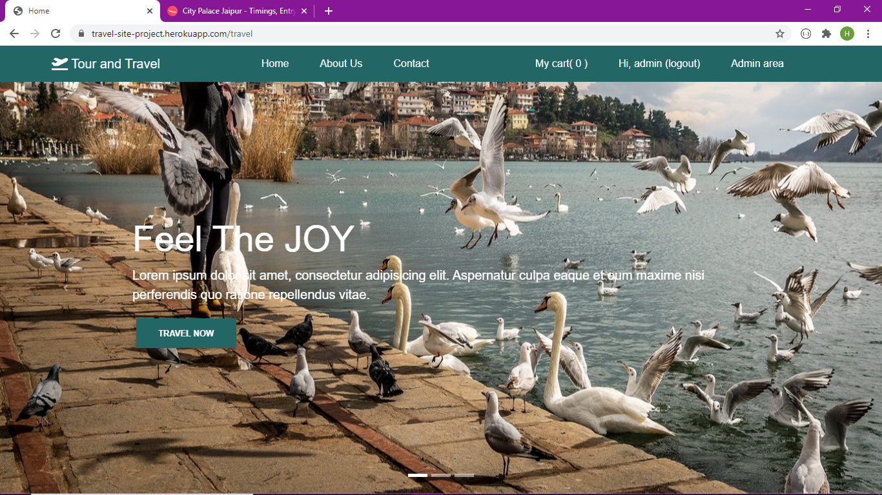
MINI PROJECT
Explore India(Tour and Travel)

Slide 2
Procedure to make the website-:
First we created the login page by using HTML, CSS and Node js for styling the page.
In the page, the user can login and Register.
When the user login , the user comes to the page where the user can see tourism places.

Slide 3
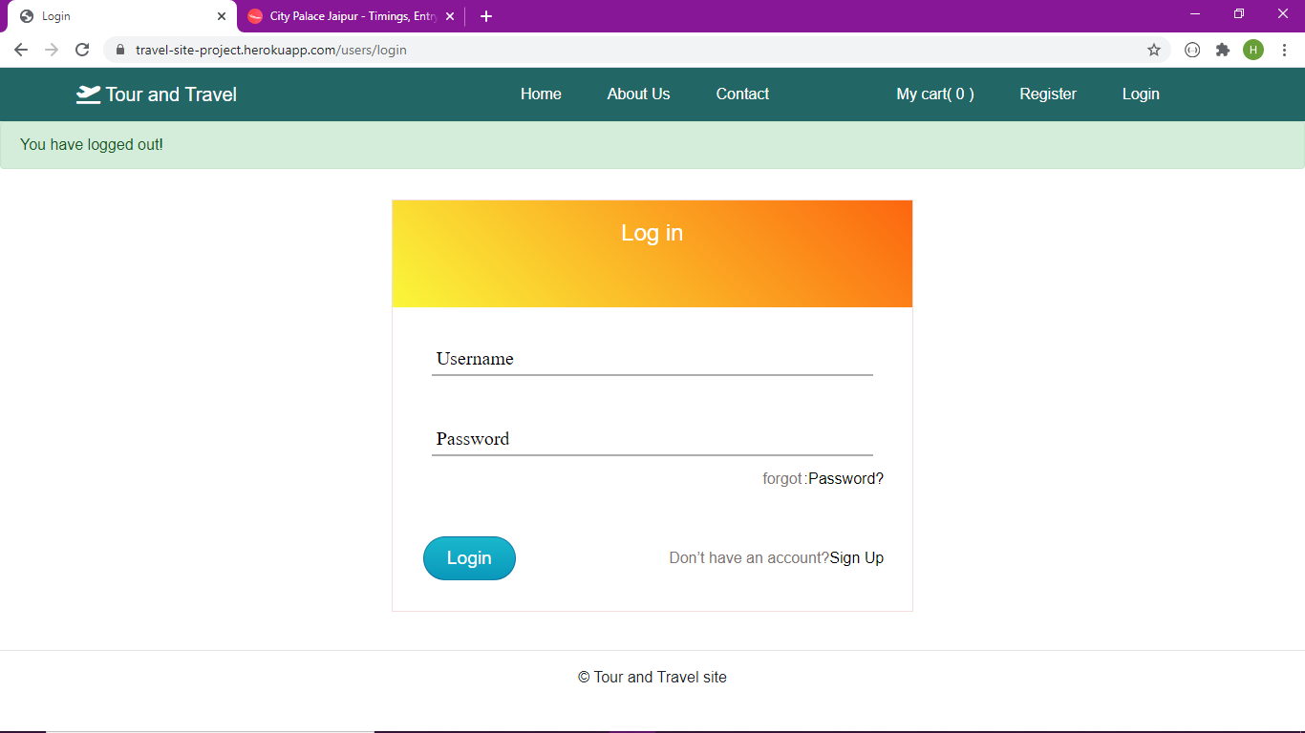
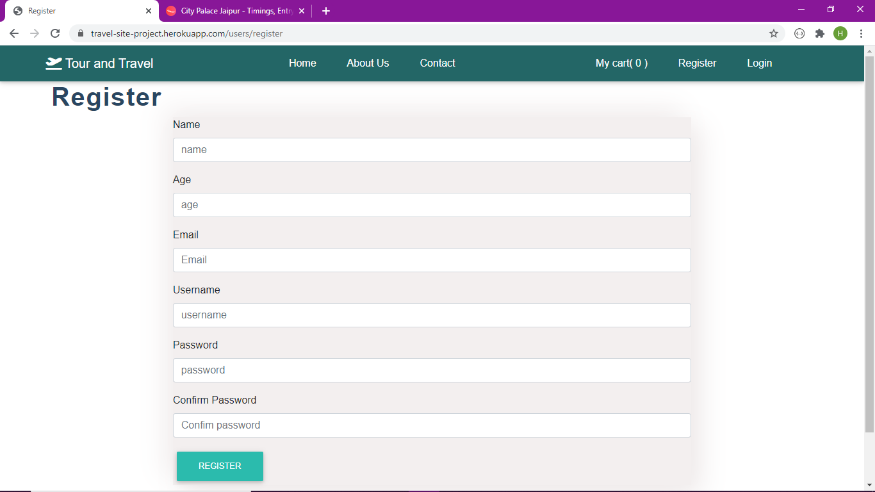
Admin(User) Login Page :

Slide 4
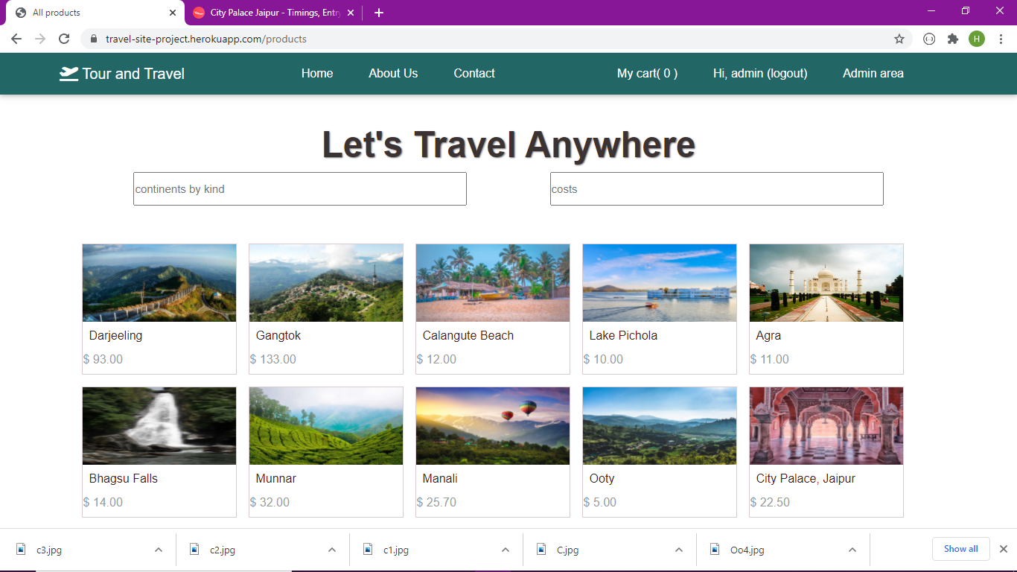
After the user login into his account he lands on the main page of website.

Slide 5
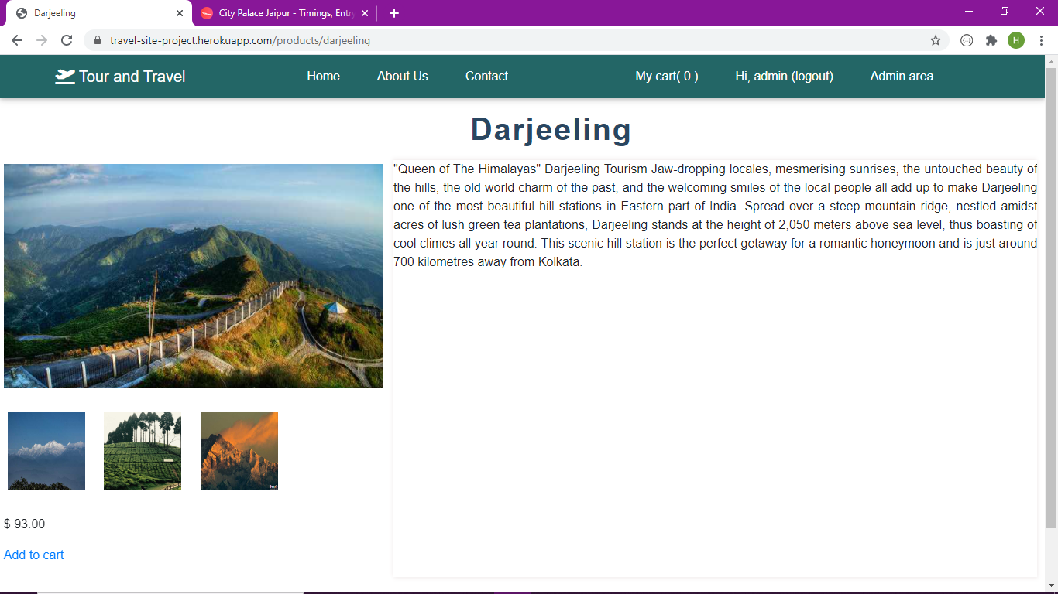

Slide 6
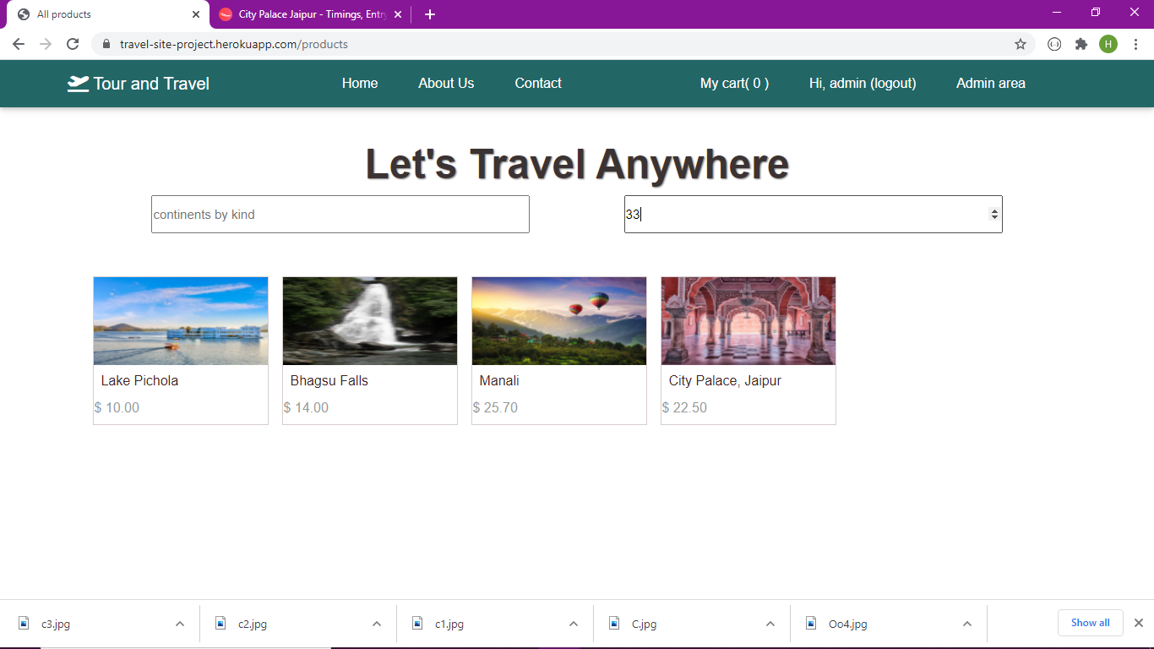

Slide 7
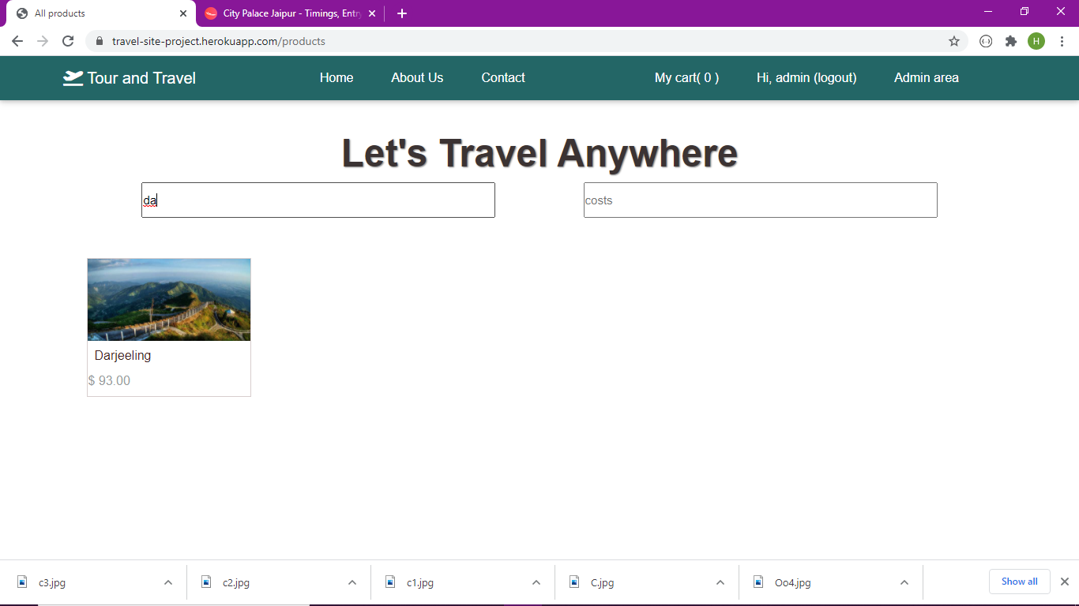

Slide 8
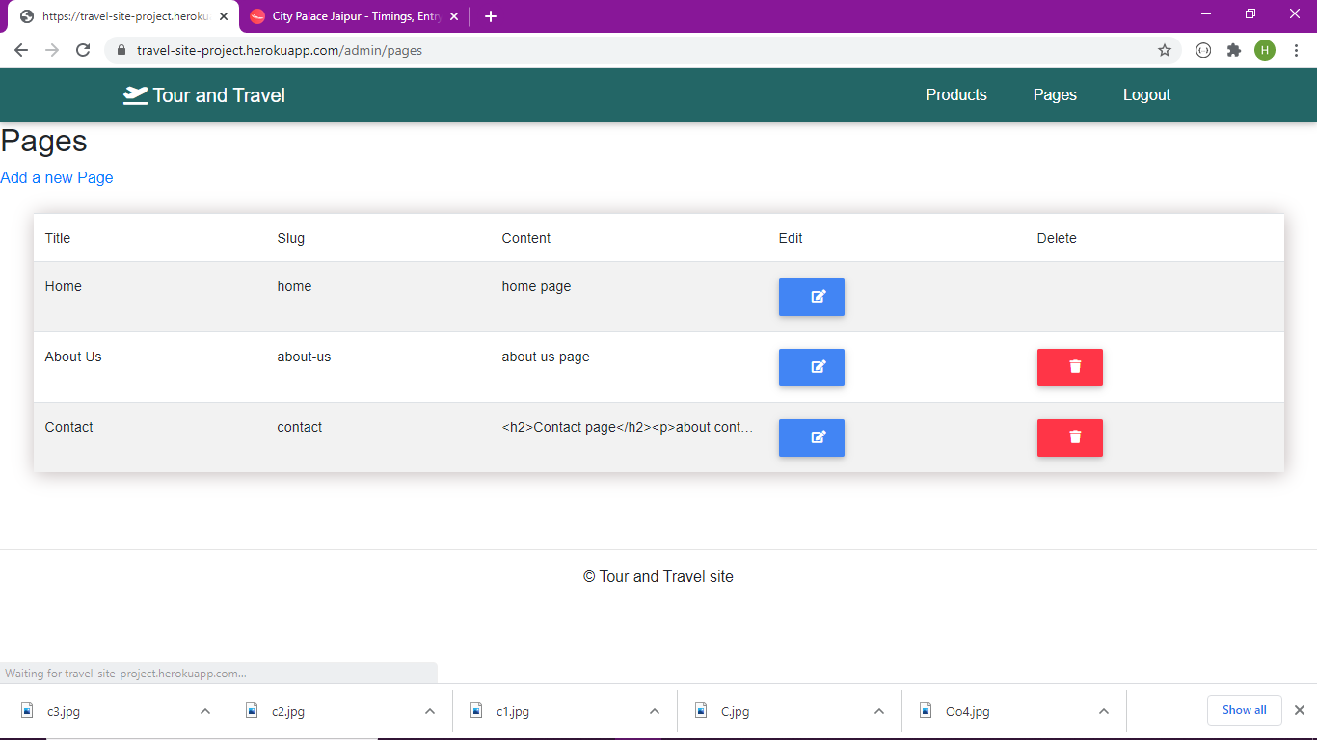
Admin add new pages

Slide 9
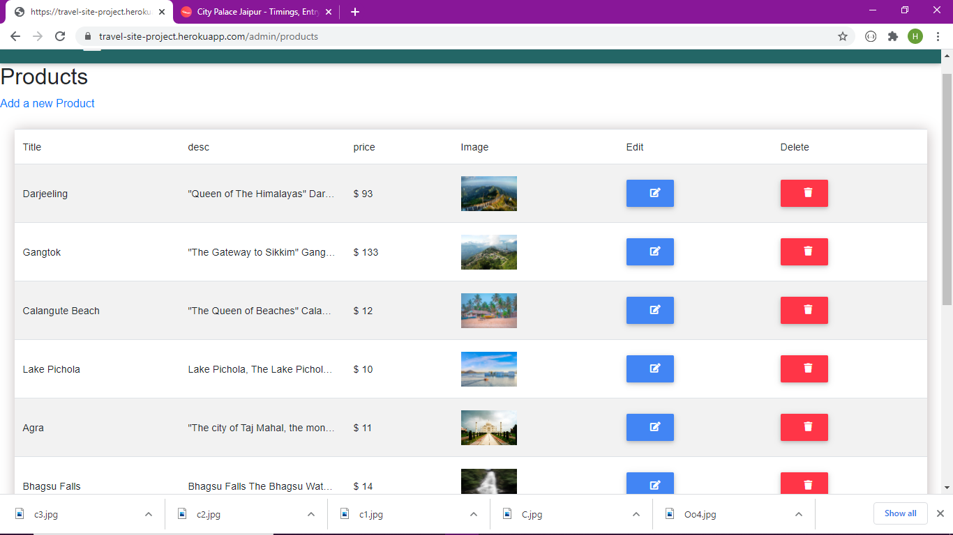
Admin add new products and Edit
Developers of Last Hope

Slide 10
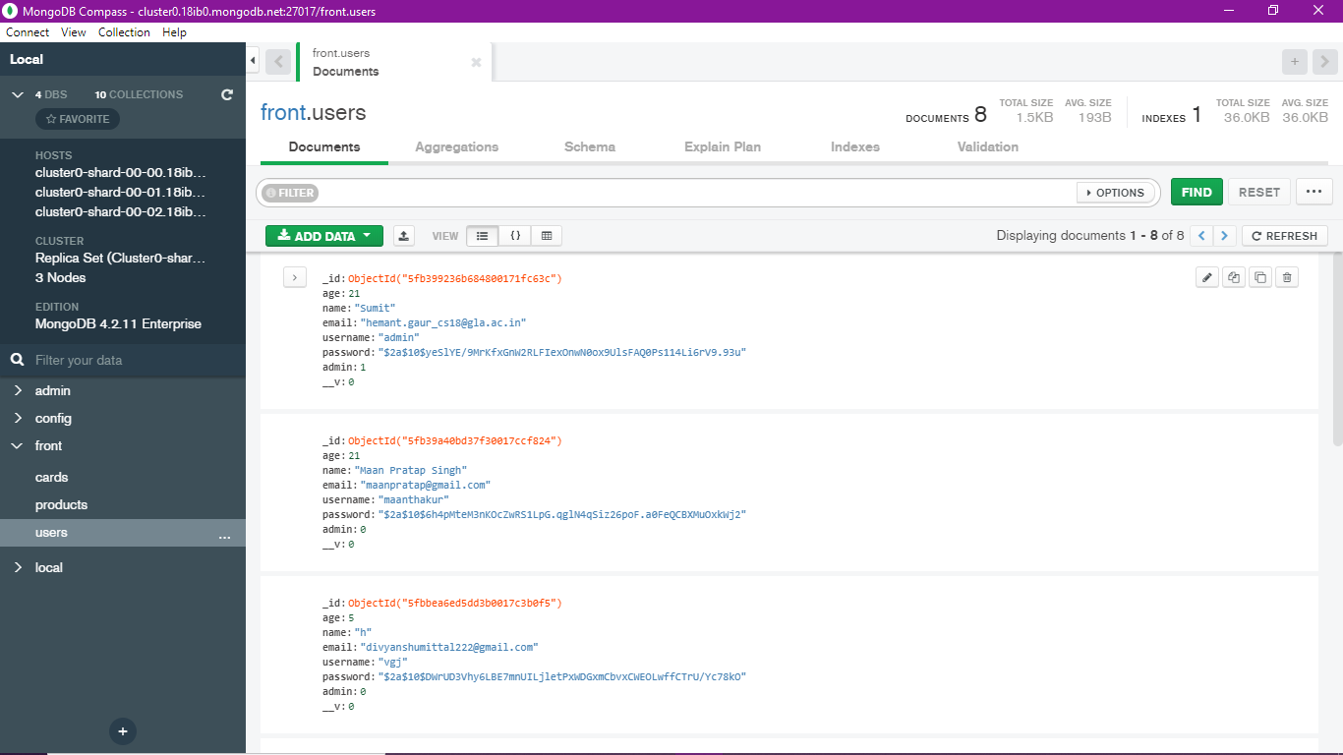

Slide 11
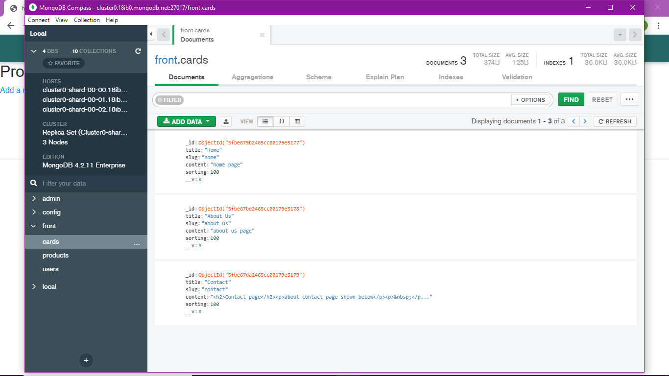

Slide 12
Admin login

Slide 13
Successful Completion
After all queries have executed, the website run correctly as we want. Also the front-end work – HTML, CSS, Javascript has been finished correctly.
And back-end work done by nodejs and database used is mongoDB.

Slide 14
Features:
User login-logout
User register and welcome mail
Admin login
Admin edit pages and products
User can increase quantity
User can add product in cart
12/6/20

Slide 15
Work Distribution
a) Kshitiz Gupta : Front-end and Back-end Developer
b) Gopal Gupta : Front-end and Back-end Developer
c) Amit Varshney : Front-end Developer
Divyansh Sharma: Front-end Developer
12/6/20

