Slide 1



Churn_Analysis
View in Power BI
Last data refresh:
8/29/2024 6:54:49 PM UTC
Downloaded at:
10/2/2024 5:28:11 AM UTC

Slide 2
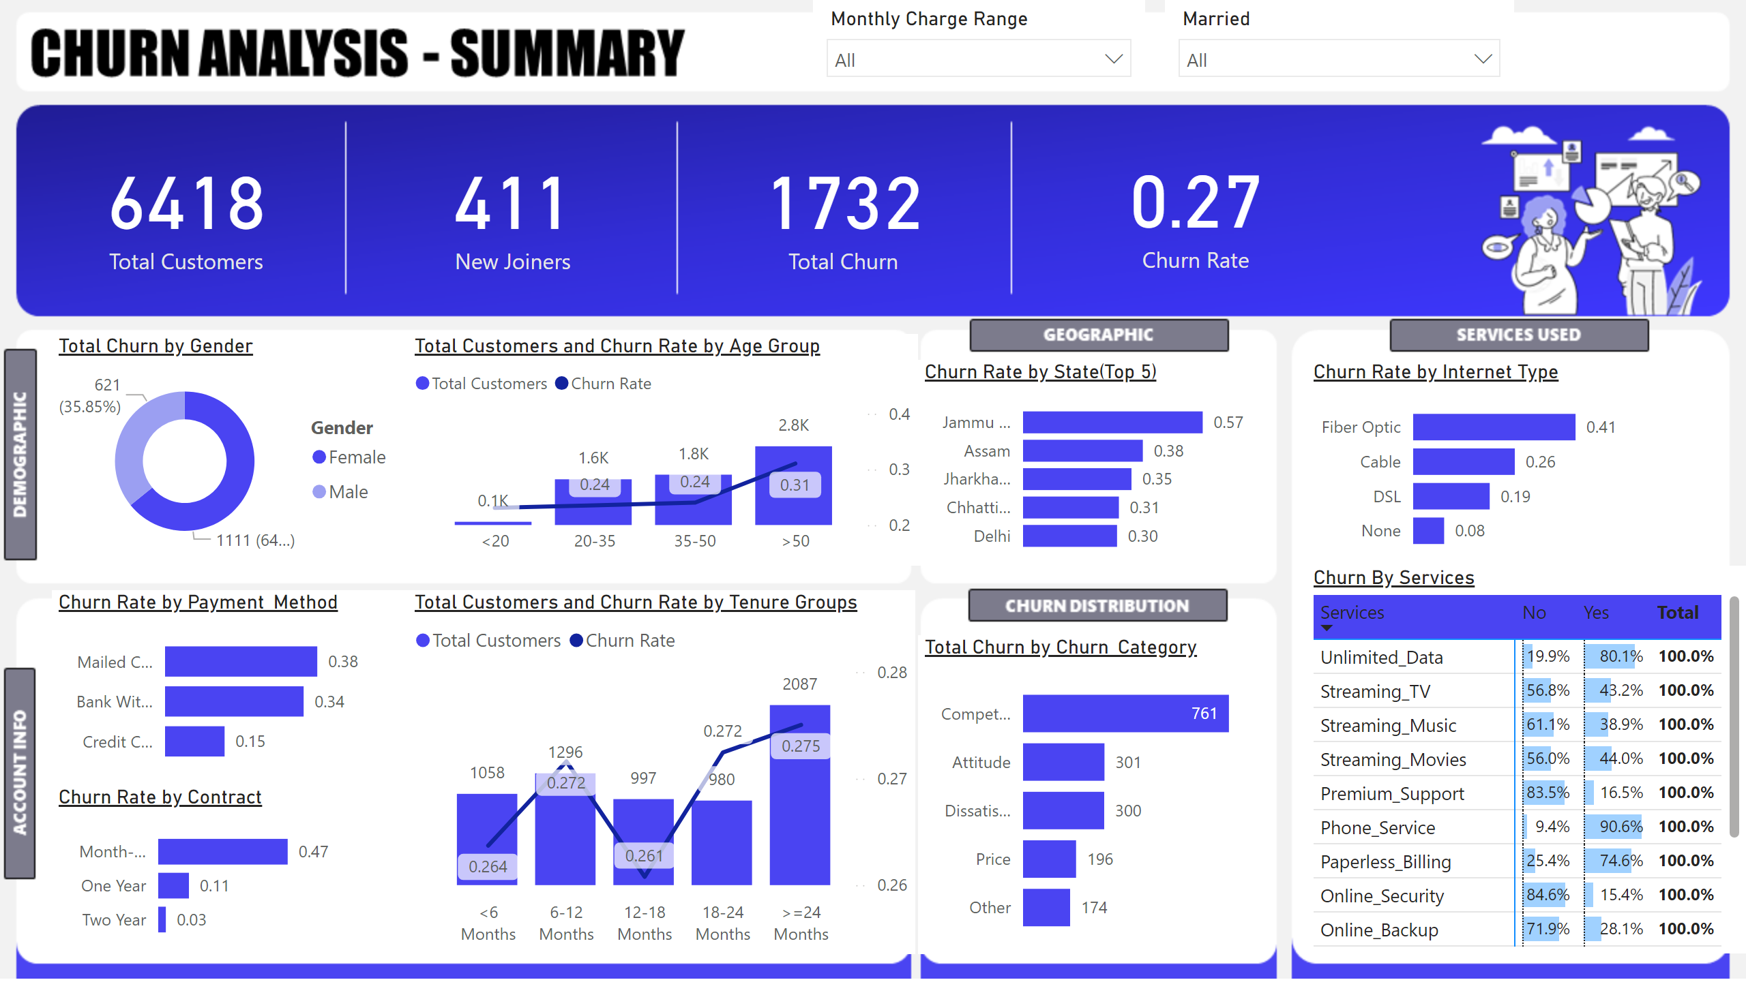
Summary
Notes:
slicer
No alt text provided
slicer
No alt text provided
Churn By Services
No alt text provided
Churn Rate by Internet Type
No alt text provided
clusteredBarChart
No alt text provided
Churn Rate by State(Top 5)
No alt text provided
lineStackedColumnComboChart
No alt text provided
clusteredBarChart
No alt text provided
clusteredBarChart
No alt text provided
lineStackedColumnComboChart
No alt text provided
donutChart
No alt text provided
Chu
No alt text provided
card
No alt text provided
card
No alt text provided
card
No alt text provided

Slide 3
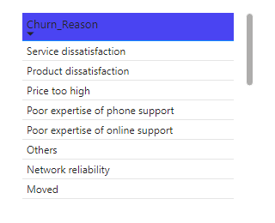
Churn Reason
Notes:
tableEx
No alt text provided

Slide 4
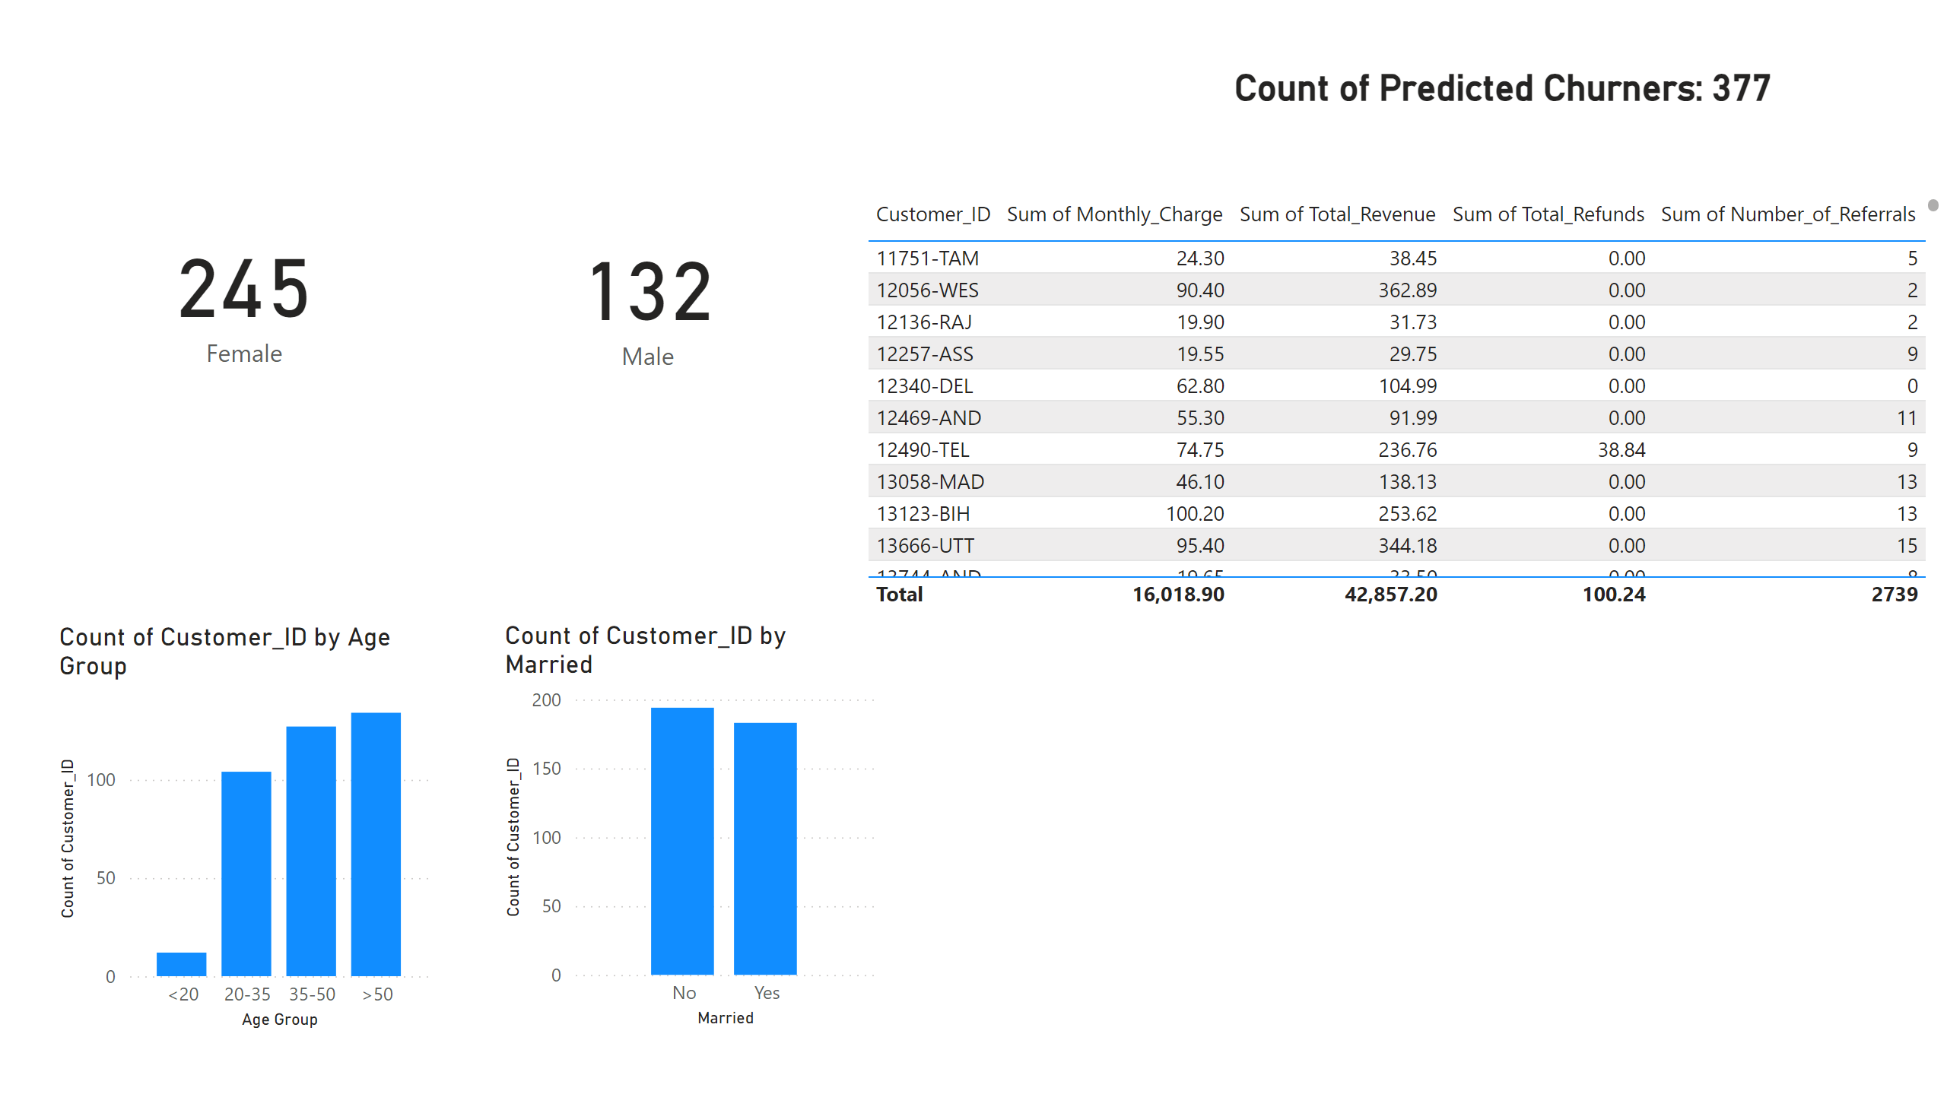
Churn Prediction
Notes:
tableEx
No alt text provided
card
No alt text provided
card
No alt text provided
card
No alt text provided
clusteredColumnChart
No alt text provided
clusteredColumnChart
No alt text provided

