Slide 1
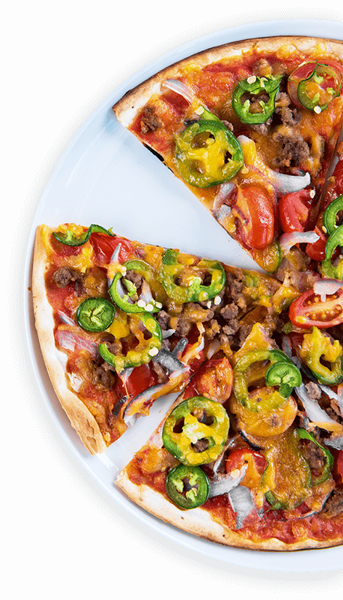
PIZZA
Sales Report
“Pizza sales surged by 15% this quarter, driven by new menu items and successful marketing campaigns, boosting overall revenue.”

Slide 2
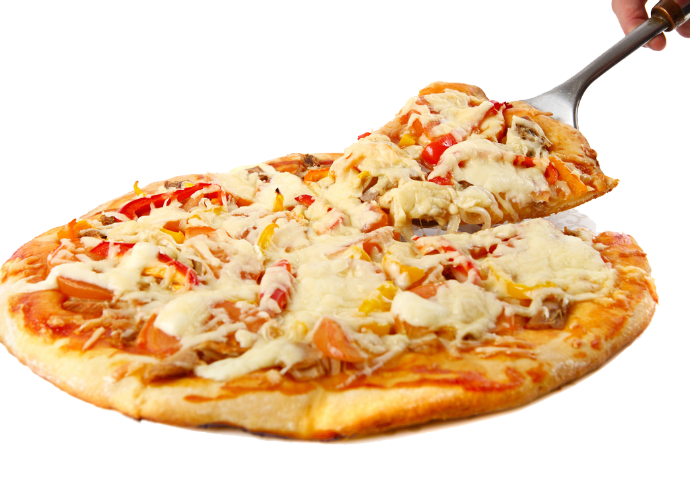
Our Pizza Journey: A Slice of Success
Innovative Flavors:
Introduced 5 new gourmet pizzas
Customer favorites: Truffle Mushroom, Spicy BBQ Chicken
Marketing Magic:
Social media campaigns reached 1 million users
Collaborations with local influencers
Sales Highlights:
15% increase in quarterly sales
Record-breaking weekend sales
Customer Feedback:
4.8/5 average rating
Over 500 positive reviews
Notes:
Image by kisspng.com

Slide 3
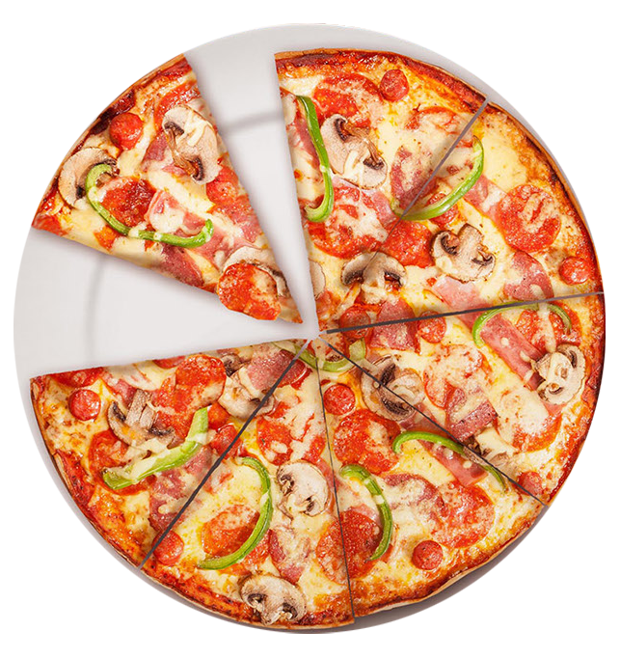

Retrieve the total number of order placed
Notes:
Image by pngfly.com

Slide 4
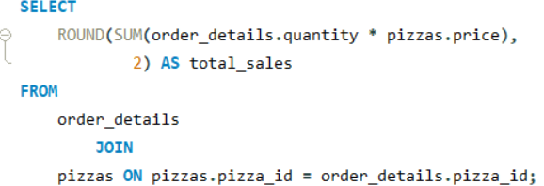

Calculate the total revenue generated from pizza sales.
Notes:
Image by pngfly.com

Slide 5
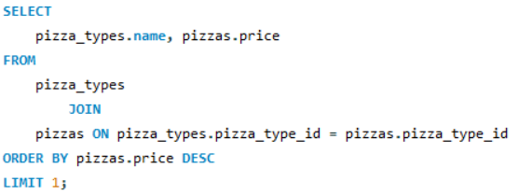

Identify the highest-priced pizza.
Notes:
Image by pngfly.com

Slide 6
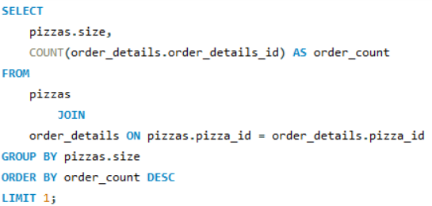

Identify the most common pizzas size ordered.
Notes:
Image by pngfly.com

Slide 7
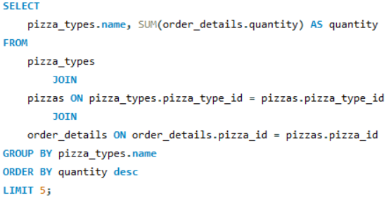
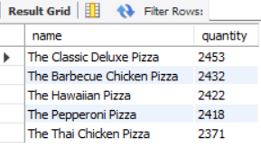
List the top 5 most ordered pizzas types along with their quantities.
Notes:
Image by pngfly.com

Slide 8
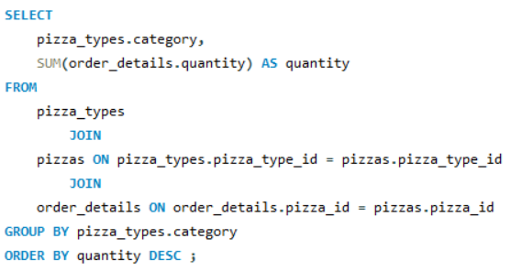
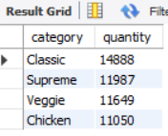
join the necessary tables to find the total quantity of each pizza category ordered.
Notes:
Image by pngfly.com

Slide 9
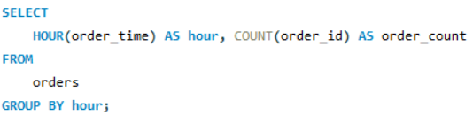
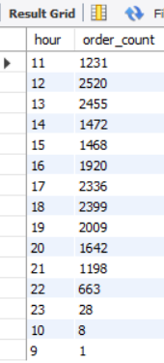
Determine the distribution of orders by hour of the day.
Notes:
Image by pngfly.com

Slide 10

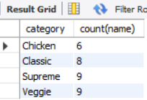
join relevant tables to find the category-wise distribution of pizzas.
Notes:
Image by pngfly.com

Slide 11
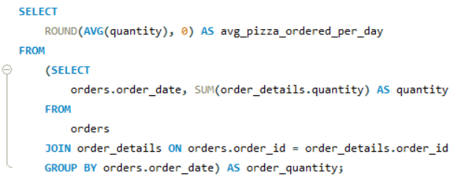

Group the orders by date and calculate the average number of pizzas ordered per day.
Notes:
Image by pngfly.com

Slide 12
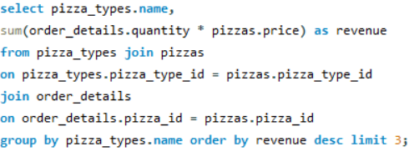
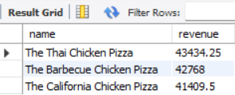
Determine the top 3 most ordered pizza types based on revenue alter.
Notes:
Image by pngfly.com

Slide 13
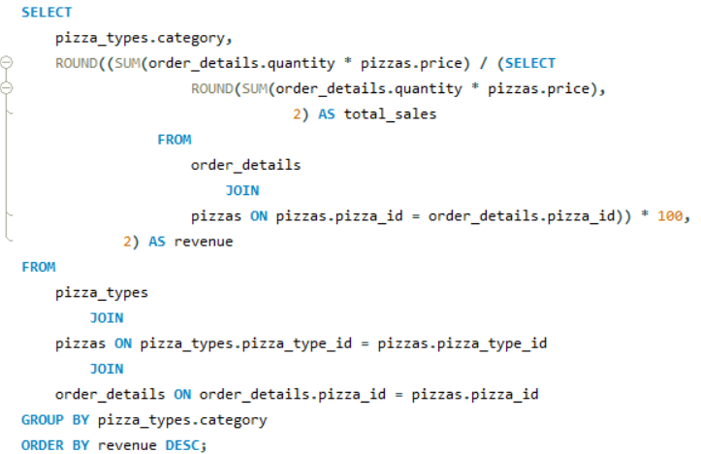
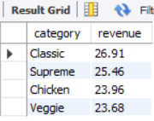
Calculate the percentage contribution of each pizza type to total revenue.
Notes:
Image by pngfly.com

Slide 14
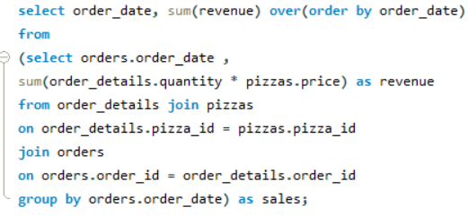
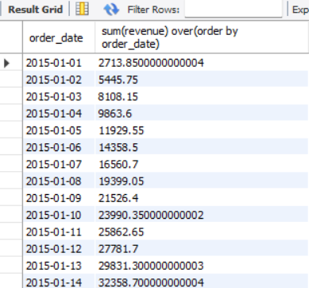
Analyze the cumulative revenue generated over time.
Notes:
Image by pngfly.com

Slide 15
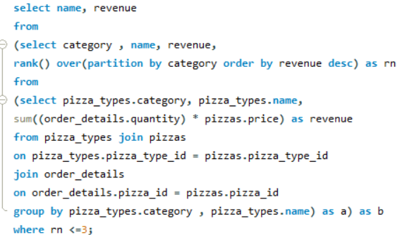
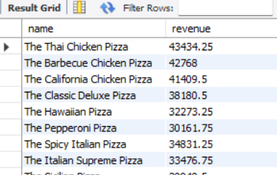
Determine the top 3 most ordered pizza types based on revenue for each pizza category.
Notes:
Image by pngfly.com

Slide 16
THANK YOU

