Slide 1
LENDING CLUB CASE STUDY
- Kshitiz_Jaiswal and Senbagam K

Slide 2
A SMALL LOAN MAKES A DEPT; A GREAT ONE MAKES AN ENEMY”
- PUBLILIUS SYRUS

Slide 3
INDEX
1. PROBLEM STATEMENT AND APPROACH
2. UNIVARIATE ANALYSIS
3. BI- VARIATE ANALYSIS
4. MULTIVARIATE ANALYSIS
5. CONCLUSION

Slide 4
1. PROBLEM STATEMENT
LendingClub is a prominent peer-to-peer lending platform that facilitates loans for individuals and small businesses.
LendingClub collects a vast amount of data on loan applicants, investors, and loan performance.
This data can be leveraged to improve the platform's efficiency, risk assessment, and investor experience.
The main goal is to reduce credit loss

Slide 5
Objective
The objective of this project is to analyze LendingClub's loan data and address specific challenges or opportunities related to the platform's operations, risk management, or investor strategies.

Slide 6
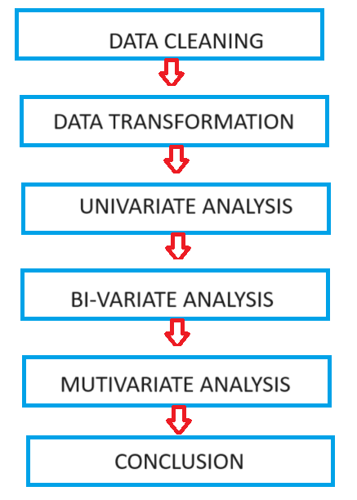
APPROACH

Slide 7
2.UNIVARIATE ANALYSIS
Univariate Analysis is a type of data visualization where we visualize only a single variable at a time.
It helps us to analyze the distribution of the variable present in the data

Slide 8
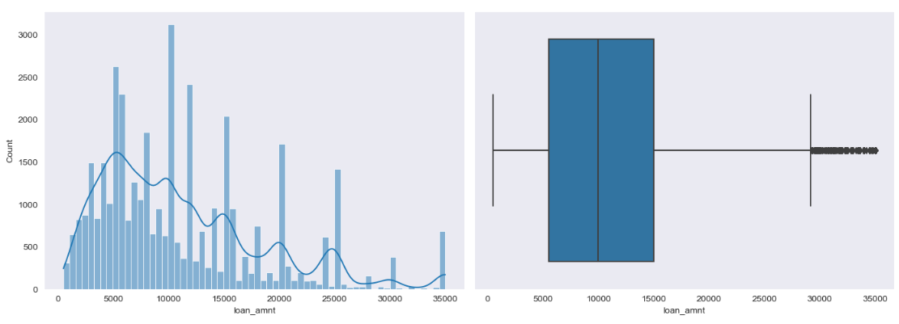
1.Loan amount

Slide 9
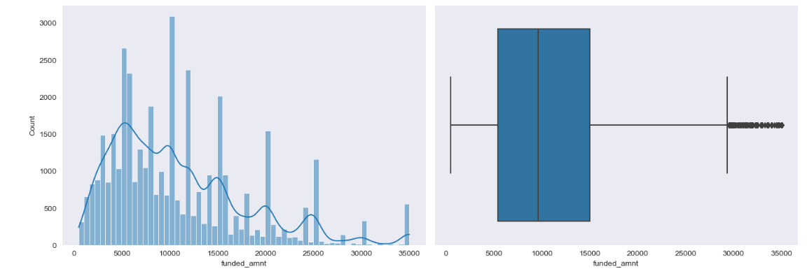
2. Funded amount - The total amount committed to that loan at that point in time.

Slide 10
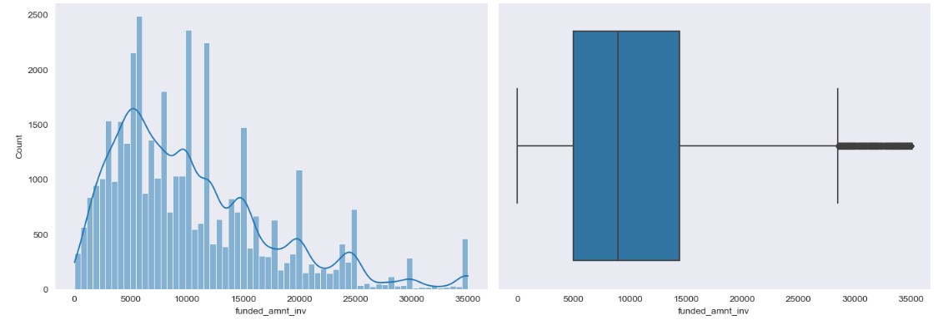
3. funded_amnt_inv - The total amount committed by investors for that loan at that point in time.

Slide 11
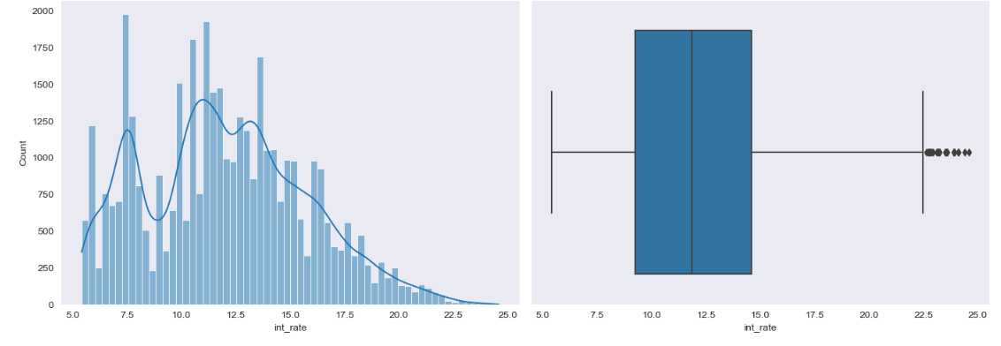
4.int_rate

Slide 12
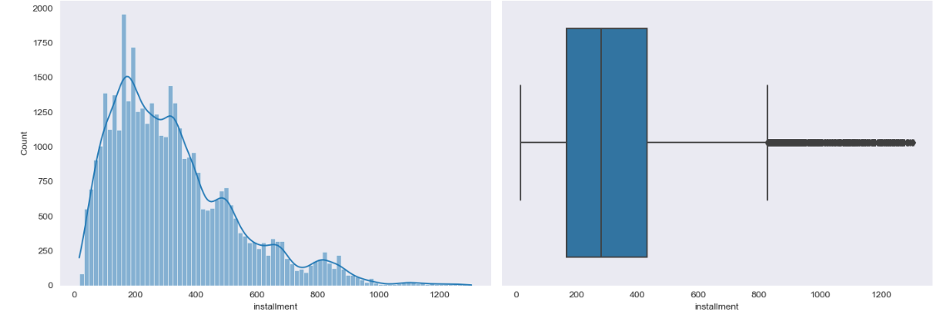
5.installment

Slide 13
3.BI-VARIATE ANALYSIS
Bivariate analysis is one of the simplest forms of quantitative analysis
It involves the analysis of two variables
It can help determine to what extent it becomes easier to know and predict a value for one variable (dependent variable) if we know the value of the other variable (independent variable

Slide 14
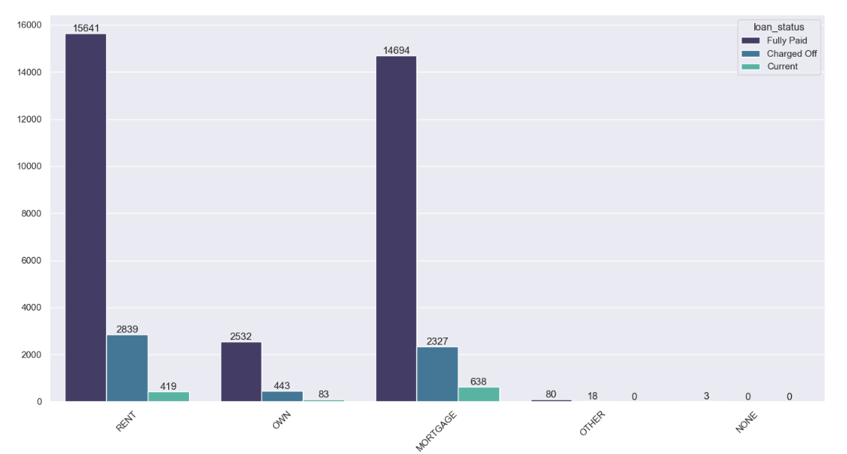
1.Home Ownership with Loan Status

Slide 15
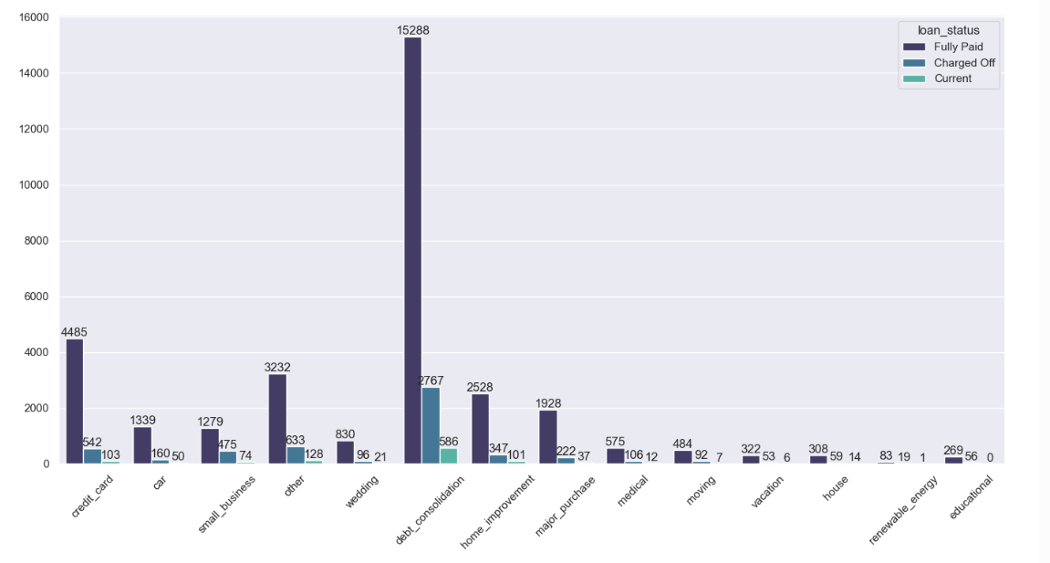
2.Purpose with Loan Status

Slide 16
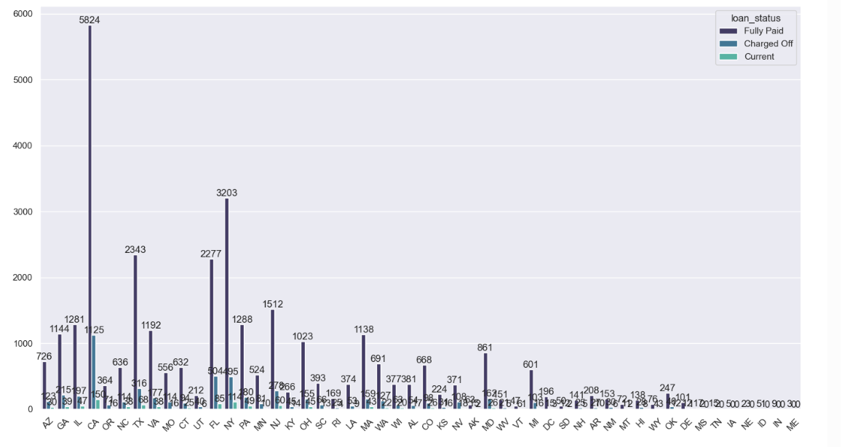
3.Address state with Loan Status

Slide 17
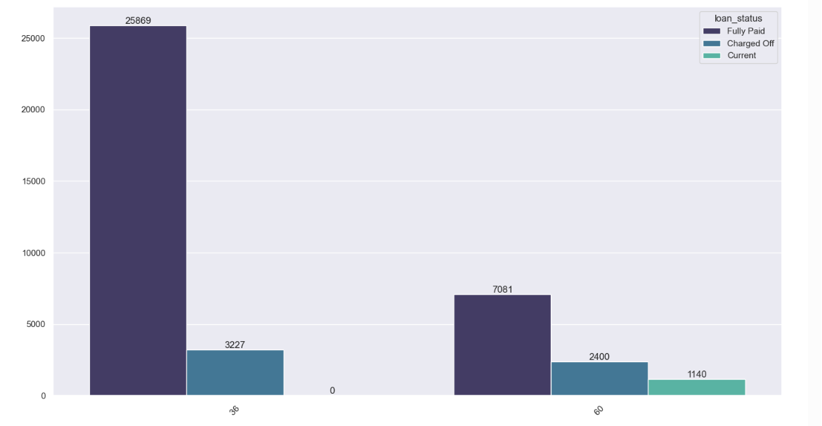
4.term with Loan Status

Slide 18
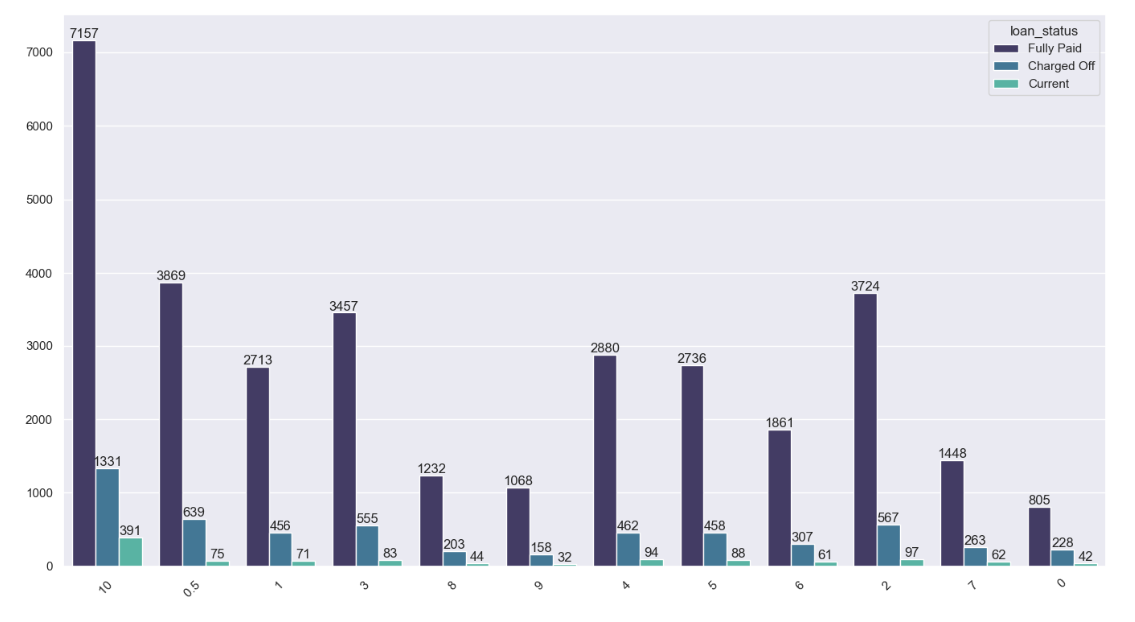
5.grade with Loan Status

Slide 19
6.emp_length with Loan Status

Slide 20
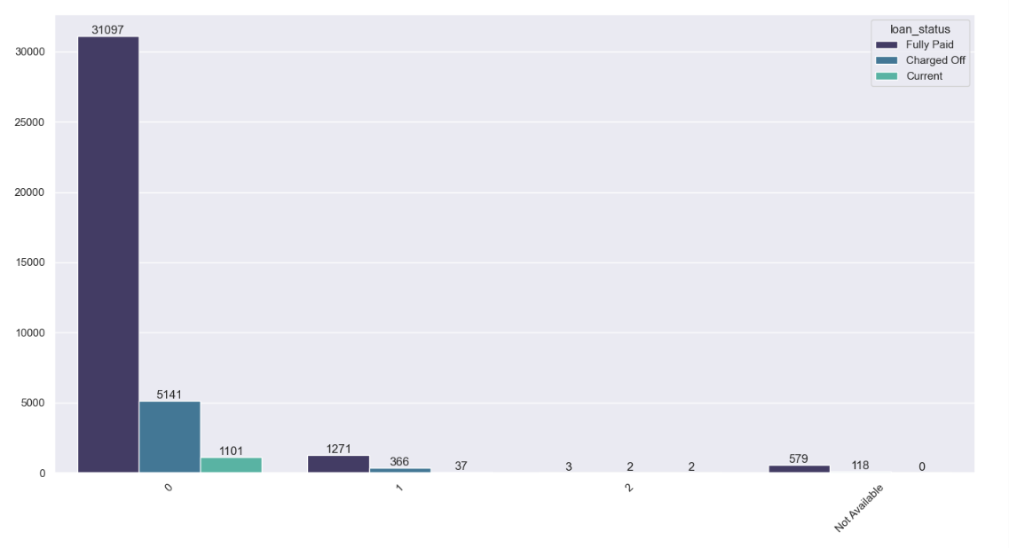
7.pub_rec_bankruptcies with Loan Status

Slide 21
4.MULTIVARIATE ANALYSIS
Multivariate analysis is a statistical technique used to analyze data that contains more than two variables.
Multivariate analysis allows you to find patterns between variables, helping you better understand the effects that different factors have on each other and the relationships between them.
It represents a critical tool for marketers looking for ways to get deeper insight into the outcome of campaign decisions.

Slide 22
5.CONCLUSION
The findings from this case study can serve as a guide for informed decision-making and the implementation of best practices in the lending industry. Adhering to these key principles can lead to sustainable growth and success in the highly competitive and dynamic loan market."

