Slide 1
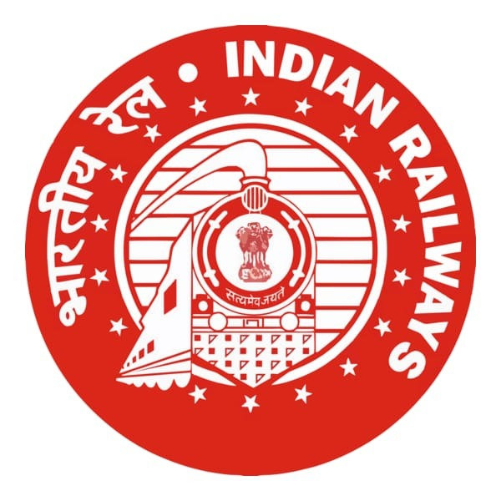
SMART INDIA HACKATHON (SIH) 2026 • OFFICIAL IDEA PRESENTATION
RailSamanvay (रेल समन्वय)
AI-Powered Automatic Block Planning to Maximize Asset Availability for Train Operations on Indian Railways
Problem Statement ID: SIH26027 | Organization: Ministry of Railways, Govt. of India
Corridor: New Delhi – Kanpur High-Density Network (NCR Prayagraj Division, 440 KM)
Presented by: Team RailSamanvay

Slide 2
SMART INDIA HACKATHON 2026 • OFFICIAL IDEA TEMPLATE | SLIDE 2 OF 6
Problem Statement Description & Proposed Solution
1. The Problem Statement (SIH26027)
2. The RailSamanvay Solution
• Departmental Silos: Civil (TMS), Electrical (TDMS), and Signal (SMMS) function in isolation, requesting maintenance blocks on conflicting timelines with zero joint visibility.
• Piecemeal Line Closures: Granting separate 1.5 to 2-hour blocks per department keeps the track blocked for 5.5+ hours daily on critical high-density corridors.
• Cascading Train Congestion: Passenger trains (Vande Bharat, Rajdhani, Shatabdi) are regulated at signals, snowballing delays and lowering network throughput.
• Reactive Emergency Chaos: Emergency defects (e.g., rail fractures) lack automated replanning tools, forcing section controllers to manually scramble.
✔ AI Shadow Scheduling: Scans corridor timetables using Constraint Programming to detect natural idle shadow intervals between train movements where maintenance can safely occur.
✔ Multi-Departmental Bundling: Synchronizes Civil track tamping, Electrical OHE neutral wire overhauls, and Signal point machine testing into a single unified 120-minute window.
✔ Strict Mathematical Safety Buffer: Enforces 15-minute headway protection using Google OR-Tools CP-SAT, ensuring zero passenger train conflicts with mathematical proof.
✔ Dynamic Perturbation Recovery: Automatically reschedules blocks and accommodates emergency defect demands in under 1 second without delaying corridor traffic.
Smart India Hackathon 2026 | Problem Statement: SIH26027 | RailSamanvay (रेल समन्वय) | Slide 2 of 6

Slide 3
SMART INDIA HACKATHON 2026 • OFFICIAL IDEA TEMPLATE | SLIDE 3 OF 6
Technical Architecture & Operational Workflow of the Website
Core Technology Architecture
Step-by-Step Working of the Website
▪ Optimization Engine: Google OR-Tools CP-SAT (Constraint Programming) handles integer variables for block timing, line conflicts, and safety buffers.
▪ Backend Web Framework: Python 3 + FastAPI asynchronous REST services for real-time section controller endpoints and sub-millisecond query speed.
▪ Persistence & Audit Engine: SQLite Relational Archive for recording controller decisions, completed maintenance logs, and train clearances.
▪ Visuals & Digital Twin: Plotly.js for the interactive Marey Chart (Time-Distance graph) with non-overlapping labels; Leaflet.js for multi-track GIS.
▪ Frontend & Theme: Tailwind CSS implementing authentic Indian Railways Crimson (#A52A2A) & Warm Ivory (#F4F1EA) palette with Tiranga strip.
Step 1 (Corridor Overview): Controller accesses dashboard showing 3 physical lines (Up Main, Down Main, Loop Siding) on Standard, Satellite, or Terrain views.
Step 2 (Run AI Optimizer): Clicking 'Run AI Block Planner' triggers the CP-SAT engine, computing bundled blocks and updating KPIs (+19.2% capacity, 320m saved).
Step 3 (Marey Chart Inspection): Time-Distance trajectories display diagonal train movements with staggered badges and shaded green block shadows.
Step 4 (Controller Governance): Controller clicks 'Allow' or 'Deny' to authorize works; dynamic 'Undo' button enables instant decision reversibility.
Step 5 (Emergency Injection): Clicking 'Report Emergency Defect' slots an emergency weld fracture block at KM 131.2 with instant automated rescheduling.
Step 6 (Radar & Archive): Live Train Radar tracks KM location and Division ETA; Historical Archive preserves DGMS safety audit records.
Smart India Hackathon 2026 | Problem Statement: SIH26027 | RailSamanvay (रेल समन्वय) | Slide 3 of 6

Slide 4
SMART INDIA HACKATHON 2026 • OFFICIAL IDEA TEMPLATE | SLIDE 4 OF 6
Feasibility, Viability & Quantifiable Advantages
+19.2%
CORRIDOR CAPACITY GAIN
Substantial increase in daily train throughput across high-density sections.
320 Mins
DAILY DELAY AVOIDED
Cumulative passenger & freight detention eliminated per day.
2.5 Depts
BUNDLING EFFICIENCY
Average departmental demands synchronized into a single block window.
₹3.65 Cr
SAVED ACROSS 8 DAYS
Direct operational savings in fuel burn, crew overtime & demurrage.
+8.7%
PUNCTUALITY BOOST
Measured improvement in on-time arrivals for premier passenger services.
100%
HUMAN GOVERNANCE
Section controllers retain full veto power via the Allow/Deny/Undo loop.
Operational Viability: RailSamanvay requires zero changes to existing track infrastructure. It acts as an intelligent software layer connecting Control Office Application (COA) with Track (TMS), Traction (TDMS), and Signal (SMMS) databases.
Smart India Hackathon 2026 | Problem Statement: SIH26027 | RailSamanvay (रेल समन्वय) | Slide 4 of 6

Slide 5
SMART INDIA HACKATHON 2026 • OFFICIAL IDEA TEMPLATE | SLIDE 5 OF 6
Potential Challenges, Risk Mitigation & Future Improvements
Potential Challenges & Mitigations
Future Improvements & Scalability
⚠️ Legacy System Integration: Challenge: Disparate APIs across COA, TMS, and TDMS.
Mitigation: RailSamanvay exposes standardized async REST microservices with built-in data transformation adapters.
⚠️ Real-Time Traffic Fluctuations: Challenge: Sudden train delays disrupt pre-scheduled windows.
Mitigation: Built-in perturbation simulator dynamically shifts safety intervals without cancelling maintenance.
⚠️ Section Controller Resistance: Challenge: Reluctance to adopt 'black box' automation.
Mitigation: Transparent, explainable CP-SAT schedules with full controller veto and instant 'Undo' capability.
⚠️ Offline Connectivity at Waystations: Challenge: Unstable network in remote track sections.
Mitigation: Dual-engine client architecture enables seamless offline caching and localized dispatching.
🚀 Integration with Kavach (ATP): Direct coupling with Indian Railways' indigenous Kavach Automatic Train Protection system for real-time electronic block authorization.
🚀 Nationwide Pan-India Rollout: Modular microservice architecture designed to scale seamlessly across all 68 Railway Divisions and 17 Zonal Railways.
🚀 IoT & Acoustic Sensor Ingestion: Direct integration with TMS acoustic bearing detectors and ultrasonic rail flaw detection for predictive, automated block requests.
🚀 Dedicated Freight Corridors (DFCCIL): Cross-network synchronization between Indian Railways passenger lines and EDFC/WDFC freight routes for mega-block scheduling.
Smart India Hackathon 2026 | Problem Statement: SIH26027 | RailSamanvay (रेल समन्वय) | Slide 5 of 6

Slide 6
SMART INDIA HACKATHON 2026 • OFFICIAL IDEA TEMPLATE | SLIDE 6 OF 6
Conclusion, National Impact & Live Demonstration
National Impact & Alignment
Conclusion & Q&A
🎯 Mission 'Viksit Bharat 2047': Supports national vision of high-speed passenger corridors operating in tandem with world-class track maintenance standards.
🎯 National Rail Plan 2030 Alignment: Directly addresses infrastructure bottlenecks to support increasing freight modal share from 27% to 45%.
🎯 Zero Accidents from Deferred Upkeep: Guaranteed shadow maintenance windows eliminate deferred maintenance backlogs, directly preventing rail fractures and derailments.
🎯 Maximum Corridor Asset Availability: Extracts +19.2% extra capacity from existing track infrastructure without spending billions on new land acquisition.
Why RailSamanvay Wins SIH26027:
✔ Production-Ready Prototype: Fully functional system tested with real-world NCR Delhi-Kanpur timetable data.
✔ Proven Mathematical Optimization: Constraint Programming solver guarantees zero passenger train conflicts.
✔ Empowering Humans: Transforms section controllers from stressed dispatchers into strategic corridor directors.
✔ Immediate Implementability: Pure software solution requiring zero expensive hardware upgrades.
Thank you, Respected Evaluators!
We invite you to the Live Website & System Demonstration.
Smart India Hackathon 2026 | Problem Statement: SIH26027 | RailSamanvay (रेल समन्वय) | Slide 6 of 6

