Slide 1
JOB-A-THON
Kshitiz Sharma
kshitizs545@gmail.com

Slide 2
Problem Statement
Credit Card Lead Prediction
Happy Customer Bank is a mid-sized private bank that deals in all kinds of banking products, like Savings accounts, Current accounts, investment products, credit products, among other offerings.
The bank also cross-sells products to its existing customers and to do so they use different kinds of communication like tele-calling, e-mails, recommendations on net banking, mobile banking, etc.
In this case, the Happy Customer Bank wants to cross sell its credit cards to its existing customers. The bank has identified a set of customers that are eligible for taking these credit cards.
Now, the bank is looking for your help in identifying customers that could show higher intent towards a recommended credit card, given:
Customer details (gender, age, region etc.)
Details of his/her relationship with the bank (Channel_Code,Vintage, 'Avg_Asset_Value etc.)

Slide 3
DATA: Train data shape (245725,11) & Test data shape (105312,10)
Train Data
Test Data
Variable | Definition
ID | Unique Identifier for a row
Gender | Gender of the Customer
Age | Age of the Customer (in Years)
Region_Code | Code of the Region for the customers
Occupation | Occupation Type for the customer
Channel_Code | Acquisition Channel Code for the Customer (Encoded)
Vintage | Vintage for the Customer (In Months)
Credit_Product | If the Customer has any active credit product (Home loan, Personal loan, Credit Card etc.)
Avg_Account_Balance | Average Account Balance for the Customer in last 12 Months
Is_Active | If the Customer is Active in last 3 Months
Is_Lead(Target) | If the Customer is interested for the Credit Card 0 : Customer is not interested 1 : Customer is interested
Variable | Definition
ID | Unique Identifier for a row
Gender | Gender of the Customer
Age | Age of the Customer (in Years)
Region_Code | Code of the Region for the customers
Occupation | Occupation Type for the customer
Channel_Code | Acquisition Channel Code for the Customer (Encoded)
Vintage | Vintage for the Customer (In Months)
Credit_Product | If the Customer has any active credit product (Home loan, Personal loan, Credit Card etc.)
Avg_Account_Balance | Average Account Balance for the Customer in last 12 Months
Is_Active | If the Customer is Active in last 3 Months

Slide 4
Encoding Technique
I use 2 encoding technique
I have tried the one hot embeding in it but it turns out that it did not work that well in and accuracy not improved so i drop the idea of using One Hot Encoding.
2) I used Label Encoding on the categorical features to convert them into numerical one so that model get trained. This is the technique I used in the final model/

Slide 5
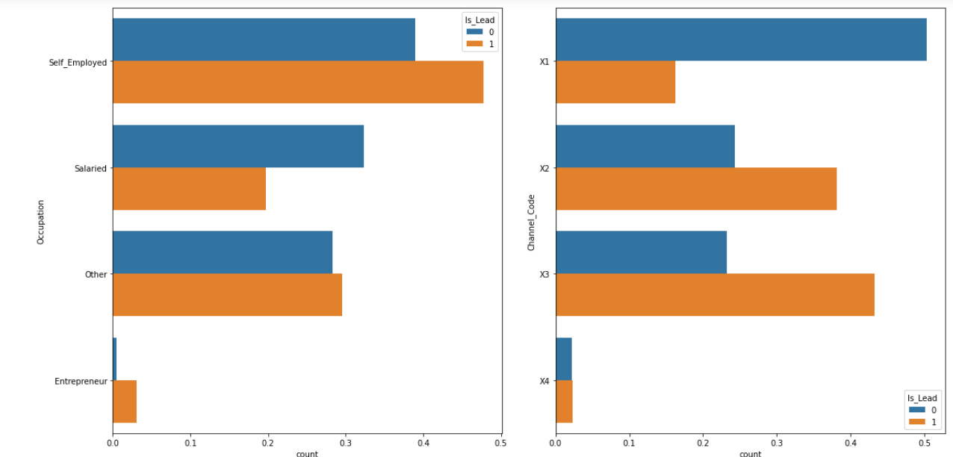
Distribution Plot
Types of distribution plot used
Biavariet Analysis
1) Here we are checking that which category in every feature has how many customers who are eligible to take the credit card and how many of them are not
eligible to take the credit card by doing so we will attain the information that which category is more skewed towards which class unique variables towards the 0 and 1 class.(This is just the part of full figure that is present in the code file)

Slide 6
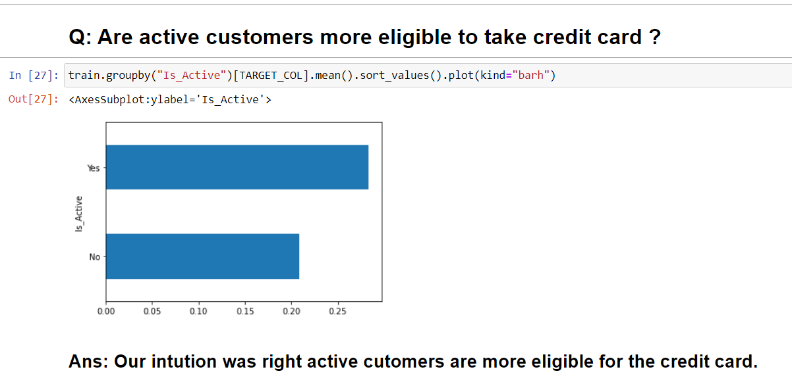
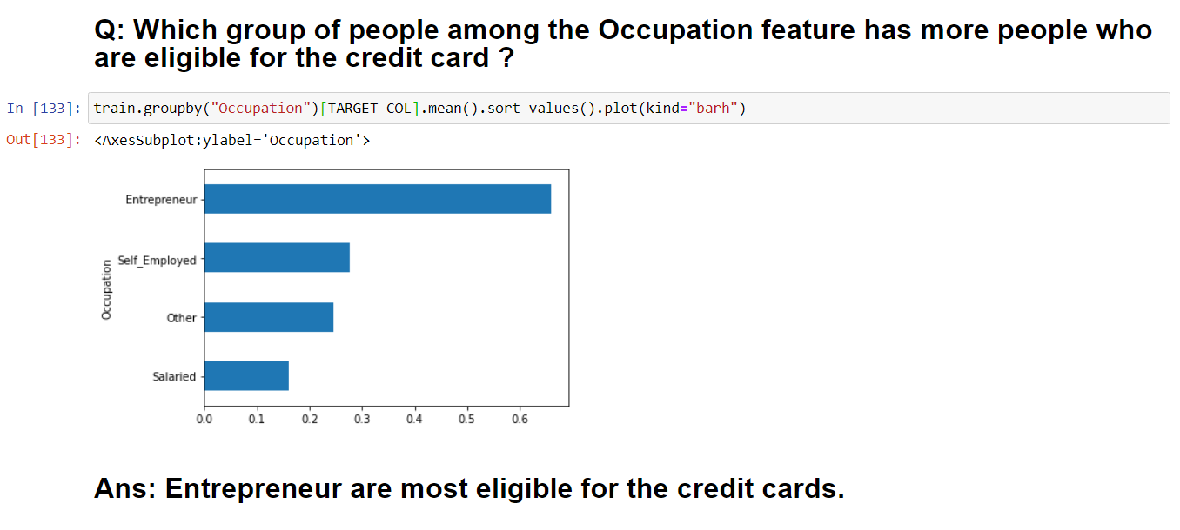
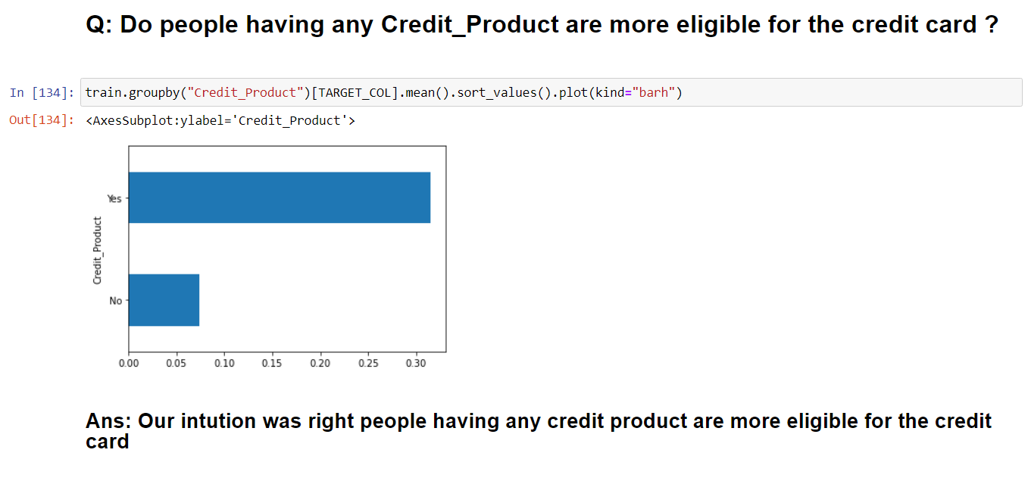
2)The below mentioned figures are the analysis based on some hypothesis on categorical features.

Slide 7
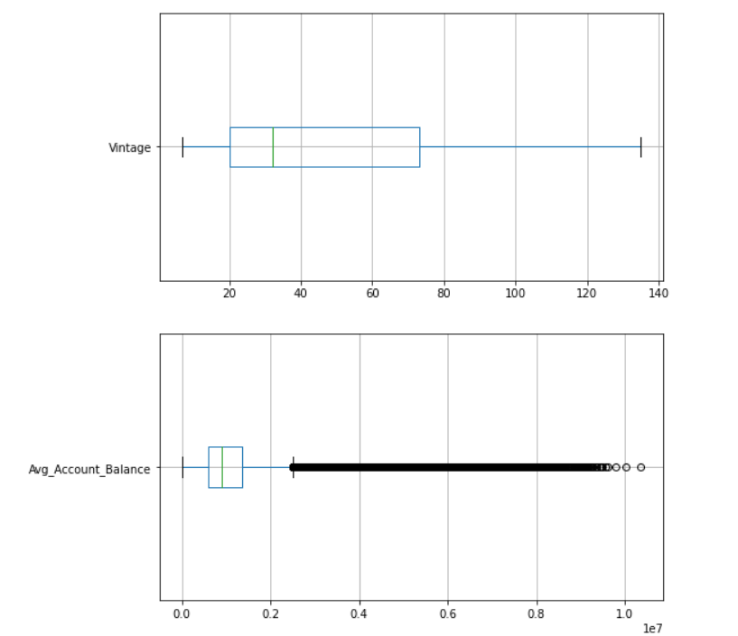
3) Here we are checking the distribution of all the numerical variables in train as well as test data to find any outliers among them .

Slide 8
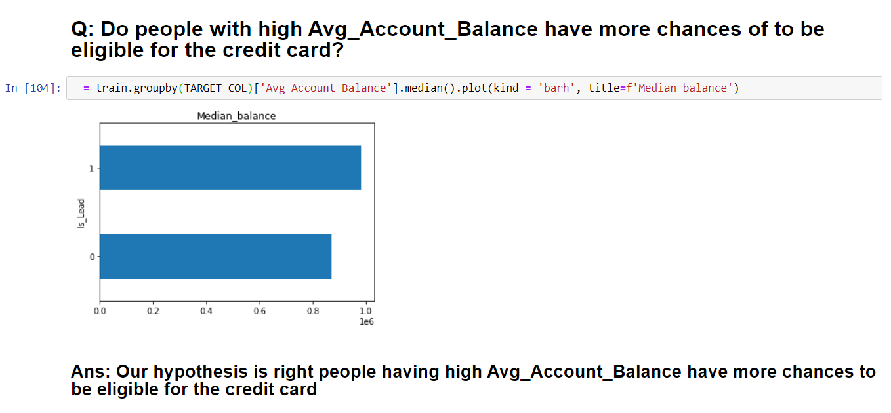
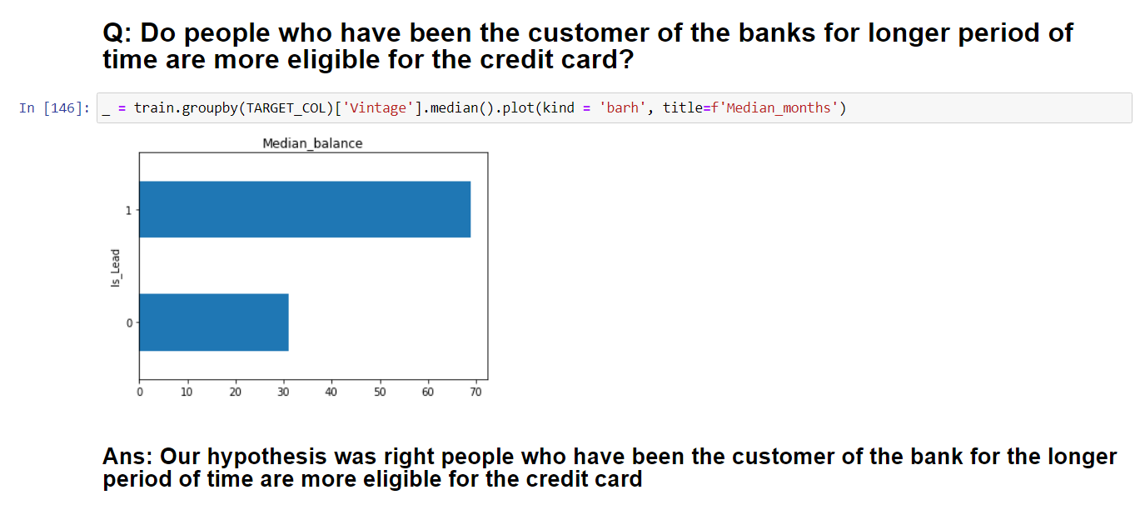
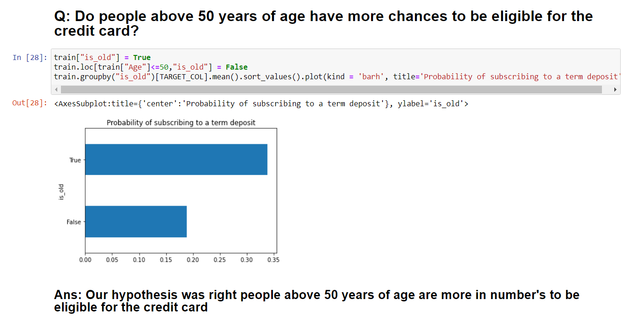
4) The below mentioned figures are the analysis based on some hypothesis on numerical features.

Slide 9
Filling NAN Values
There is 1 feature where NAN values are present which is
Credit_Product
I use two techniques to fill the NAN values among which I use only one in final model the one which gives best result
I try to train a model in which we will take "Credit_Product" feature as an dependent variable and remove the original dependent feature that is "Is_Lead" from duplicate data set i combine all the rows from train and test which do not have any NAN values and assume it as our train data which have dependent variable as "Credit_Product" at the same time will will merge all the rows from train and test which have NAN values and assume it as our test data now we will train a very very simple model on our train data having dependent variable as "Credit_Product" and try predicting the NAN values for our dependent variable(Credit_Product). For this purpose i train onw simple XGBoost model and fill the predicted values in the original dataset in place of NAN values. But this technique did not work well and accuracy diid increased so I dropped the idea of using it.
This is the method i use in our final model by repalcing all the NAN values with a string NAN this indicate that it did not have idea of whether customer do have any Credit_Product or not so our binary categorical feature get converted to feature having 3 categorical values NAN,Yes & No .

Slide 10
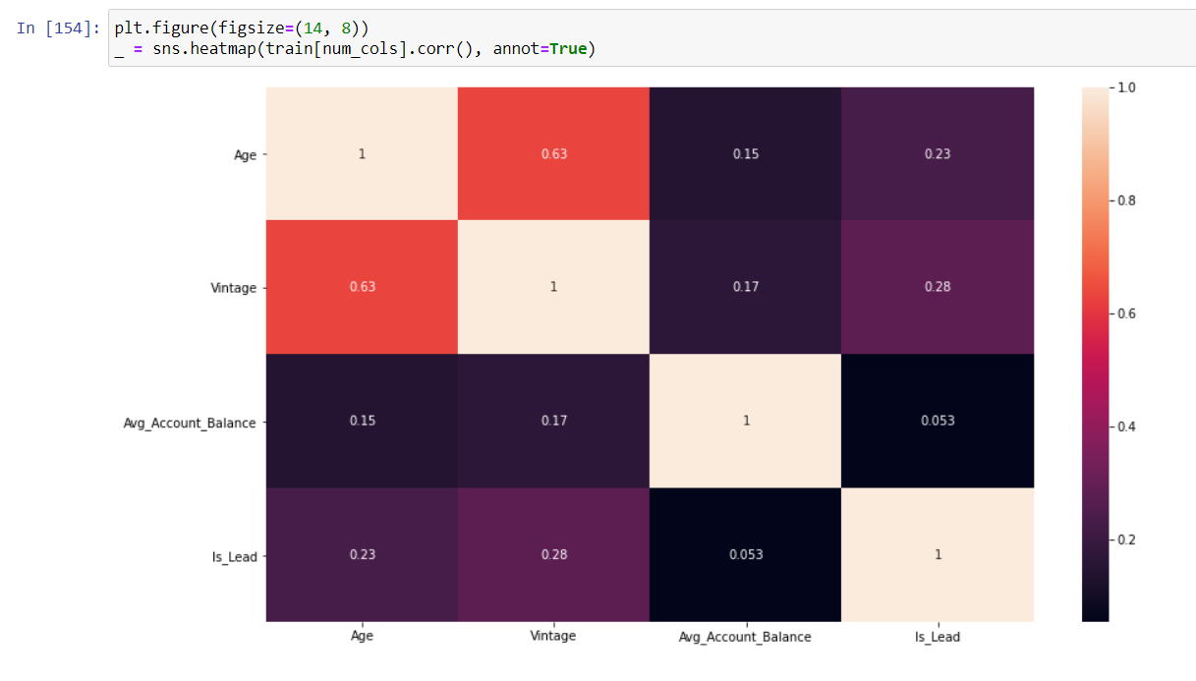
Correlation Between Different values
There is no high correlation between the numerical features given the highest correlation can be seen among the features age & vintage which is 0.63 which is not that big to drop one of the given feature

Slide 11
Models Used
XGBoost
Catboost
LightGBM
Weighted Ensemble Of Catboost , LightGBM & XGBoost ( Final Model - performed best among all models )

Slide 12
Error Metrics
roc_auc_score is used as the error metrics

Slide 13
Thanks

