Slide 1
Information Retrieval
Term Project
Presentation by
Group 8

Slide 2
Project Title: Stress detection from Smartphone typing metadata
Need: Mental health and smartphone usage are interrelated. So we can use the typing/swyping characteristic to predict mood of the user.
Work Procedure: Given smartphone typing metadata extracted from an application (without the actual text), we trained the data set to predict mood based on the psychological monitoring of the users.
Processes Involved: Data extraction via application, data analysis, applying different Machine Learning Algorithms and finding the most suitable one.

Slide 3
Data Collection
User Data Source- An Android application
Salient features of Android application:-
TouchSense- a client-server application, where the client component runs on the smartphone as an Android app and the server program runs in the background.
TouchLogger- which traces both type and swype interactions during text entry. Implemented by instrumenting QWERTY keyboard.
Our dataset contains session-wise details of 54 active unbiased users
The columns of the dataset are as follows:-
Session_ID | App | Timestamp | Emotion_code | Keycode | Mood_record_timestamp | Pressure | Velocity | Duration

Slide 4
Data Description
Session ID- A unique session ID assigned to a user for certain time duration
App- Application a user is working on
Timestamp- Time reading
Emotion Code- A code assigned to certain Emotion
SAD/DEPRESSED: -2
HAPPY/EXCITED: 2
STRESSED: 1
RELAXED: 0
NO RESPONSE: -99
Keycode- ASCII code corresponding to typed character
Mood record timestamp- Time at which mood is recorded by a user
Pressure- Pressure at which a key is pressed while typing or swiping
Velocity- typically a user typing or swiping speed
Duration- time duration for which a user is typing or swiping

Slide 5
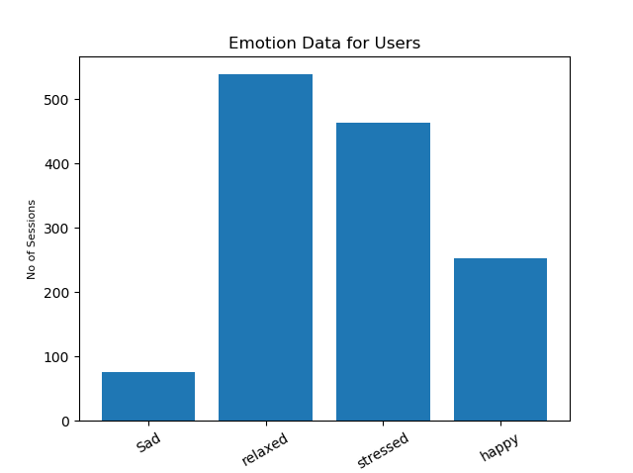
Overview of user emotions from data
From the graph it is clear that data is highly skewed.

Slide 6
Data Analysis
There is significant difference between typing and swyping speeds so there is a need to differentiate between typing , swyping and mixed type of sessions.
During swyping, the speed is in general very high than that of typing activity.
We applied K-means clustering (K=2) to group sessions into typing and swyping sessions , for mixed sessions we applied same method to further divide the session into two groups(typing and swyping).
We use natural logarithm of speed values while clustering sessions.

Slide 7
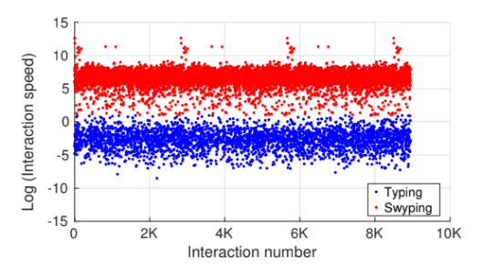
Data Analysis
Plot of natural logarithm of speed values shows clear distinction between typing and swyping sessions.

Slide 8
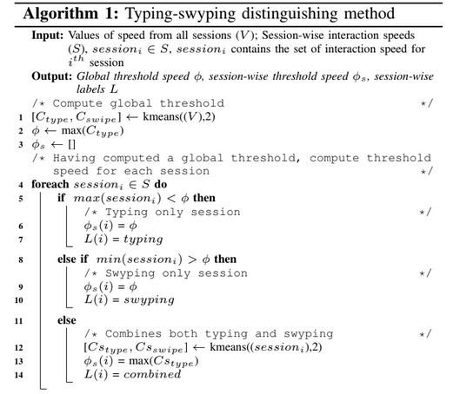
Following algorithm is applied to distinguish typing, swyping and mixed sessions

Slide 9
Data Processing
Removal of No Response Labels - We filter out all sessions marked with No Response as they do not reveal any emotion.
Distant Session Elimination - We remove the sessions where emotion self report is recorded more than 3 hours after the last touch interaction in that session.
Elimination of Small Sessions - We discarded any session with less than 20 touch interactions to ensure that there is enough information to distinguish between typing and swyping sessions.

Slide 10
Feature Extraction
We compute the features extracted from the touch interactions log during text entry.Primarily, the features can be categorized into two groups - typing and swyping, as summarized below
Category | Feature name
Typing | Mean Session ITD (MSI) Refined Mean Session ITD (RMSI) Number of special characters (splchar %) Number of backspace (or delete)(backspace %)
Swyping | Mean pressure (pressure mean) Std. dev pressure (pressure sdv) Mode pressure (pressure mode) Swype percentage (swype %)
Both (Typing, Swyping) | Session duration (duration)

Slide 11
System Description
We Train 2 Models for Emotion Prediction :-
Random Forest Classifier
Personalized MTL-NN
We Evaluate the Models on the following metrics :-
AUROC Score
Accuracy
These Metrics are reported for every user
we use 80-20 split for training and cross validation set respectively.

Slide 12
Personalized MTL-NN
We Build a personalized MTL-NN in which predicting the emotion of one user is treated as one task.
The MTL-NN contains several initial hidden layers that are shared among all the users ,followed by final hidden layers unique to each user.
Shared layers learn to extract information into a generalizable embedding.
User specific layers learn how to map this embedding to prediction customized for that user.

Slide 13
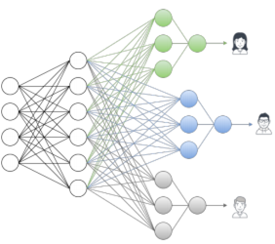
Model Architecture
Input Layer
Dimension = 9
No. of Shared Layers = 1
Dimension = 8
Dropout = 0.15
Activation = RELU
No. of hidden Layers per user = 1
Dimension = 5
Activation = RELU
Output Layer(per user)
Dimension = 4
Activation = Softmax
To Train the network , data from a user is used to predict the target label for that user, the errors are then backpropagated to update the user specific weights and shared layer weights.

Slide 14
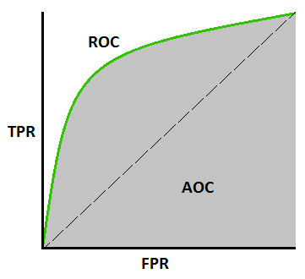
Results
TPR = TP
FPR = FP
An ROC curve shows the performance of a classification model at all classification thresholds
AUC measures the entire two-dimensional area underneath the entire ROC curve
For a multiclass classification we can draw one vs all ROC for every class and average them for the classifier
TP + FN
TN + FP

Slide 15
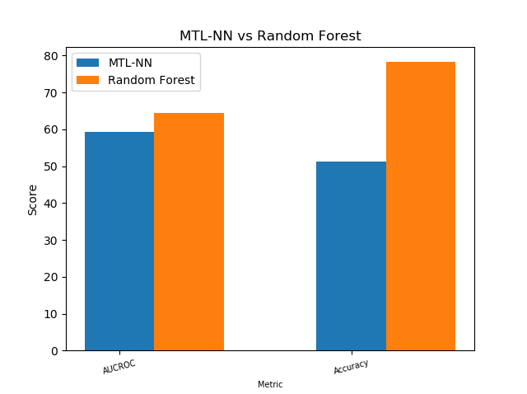
Results

Slide 16
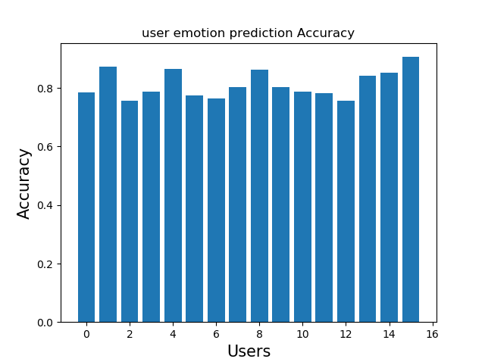
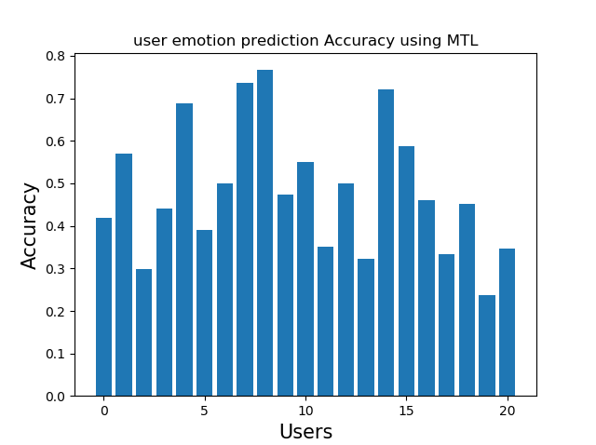
Results

Slide 17
Work Allocation
Data Analysis: Vishal, Ankit, Saurav,
Algorithm Implementation (Baseline): Ayush, Rupak
MTL Implementation: Ayan, Nishchal, Shivam
Results: Tejasvi, Ayan, Aniket, Abhinav

