Slide 1

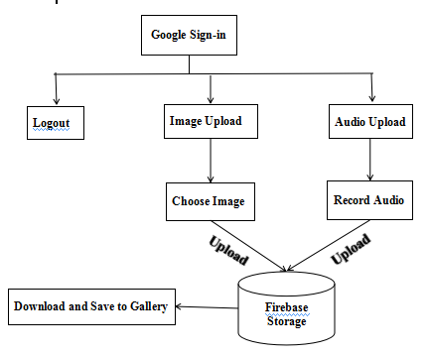
Mahavir Education Trust's Shah & Anchor Kutchhi Engineering College, Chembur, Mumbai 400 088 UG Program in Computer Engineering
EXPLORING FIREBASE CLOUD CHARACTERISTICS FOR MOBILE STORAGE
Abstract - Nowadays technology is advancing very rapidly and due to these new inventions our life has changed tremendously.As a result security of our smartphones and social networking sites becomes very important.So there is a need to design such a system on which we could upload our data on cloud securely and retrieve it as and when it is required.The main advantage of this system is that there is no need of storing all the data in a smartphone as there is a memory limit in a smartphone.Our project deals with the uploading images,audios on the cloud and then downloading it from cloud as and when required.Our application will be useful for common people as well as investigators.
Design and Implementation - Firebase is a mobile and web application platform with tools and infrastructure designed to help developers build high quality apps.Firebase services include analytics,cloud messaging,auth,realtime database,storage,hosting,etc.Steps to implement a firebase project are as follows :
1. Connect to firebase.
2. Add firebase storage,realtime database to your app.
3.Create a reference.
4.Upload a file.
5. Download a file.
Block Diagram -
Conclusion - As the technology is advancing new varieties of smartphones are emerging in the markets.But such a small device cannot accomodate huge amount of data.So we need to store the data on cloud and retrieve it whenever it is required.Thus this technique is userfriendly,cost-effective and efficient enough.
Introduction - In this era everyone is using smartphones for performing several tasks.But the memory of a smartphone is restricted to certain amount;we cannot exceed that limit.Hence we need to store huge amount of data somewhere so that we can use it whenever we need it.So our application will allow the users to upload their data on cloud securely and download it from cloud as and when it is required.Our application is cost-effective,easy to use and efficient.
References -
1. Navdeep Singh ,“Study of Google Firebase API for Android”,2016, International Journal of Innovative Research in Computer and Communication Engineering.
Guide Name : Mrs. Sonali A. Bhutad.
Members :
Bhumi P. Lodaya.
Shivangee D. Kulkarni.
Manali R. Patil.
Shweta K. Shimpi.

