Slide 1
Image preprocessing, testing for z = 1 … 5
Keshav Shivam

Slide 2
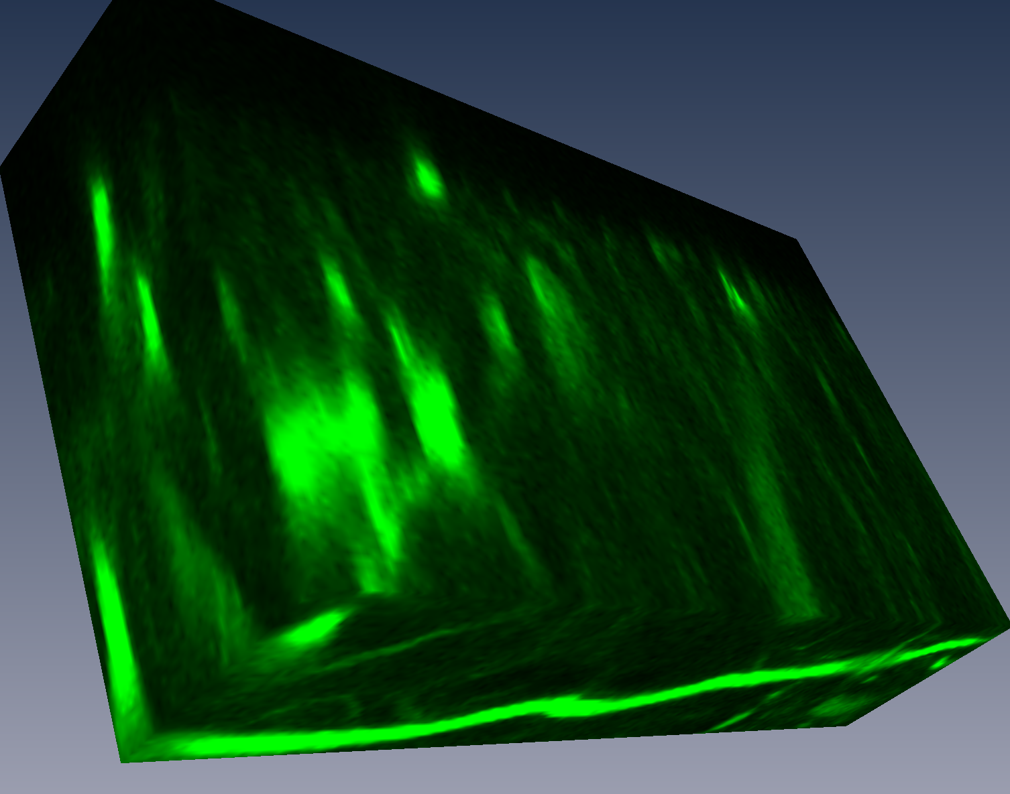
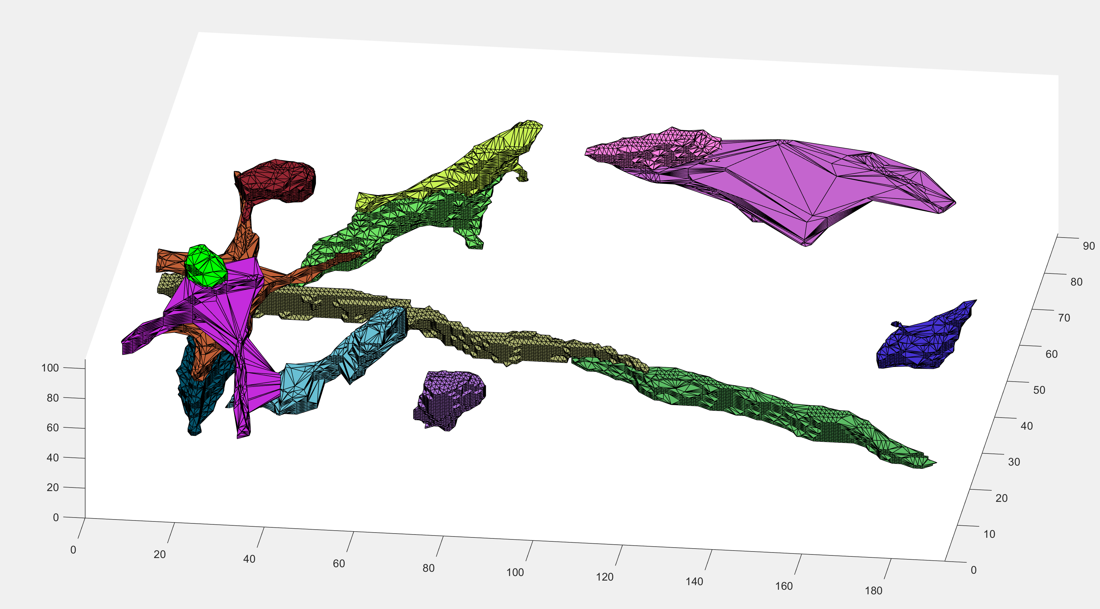
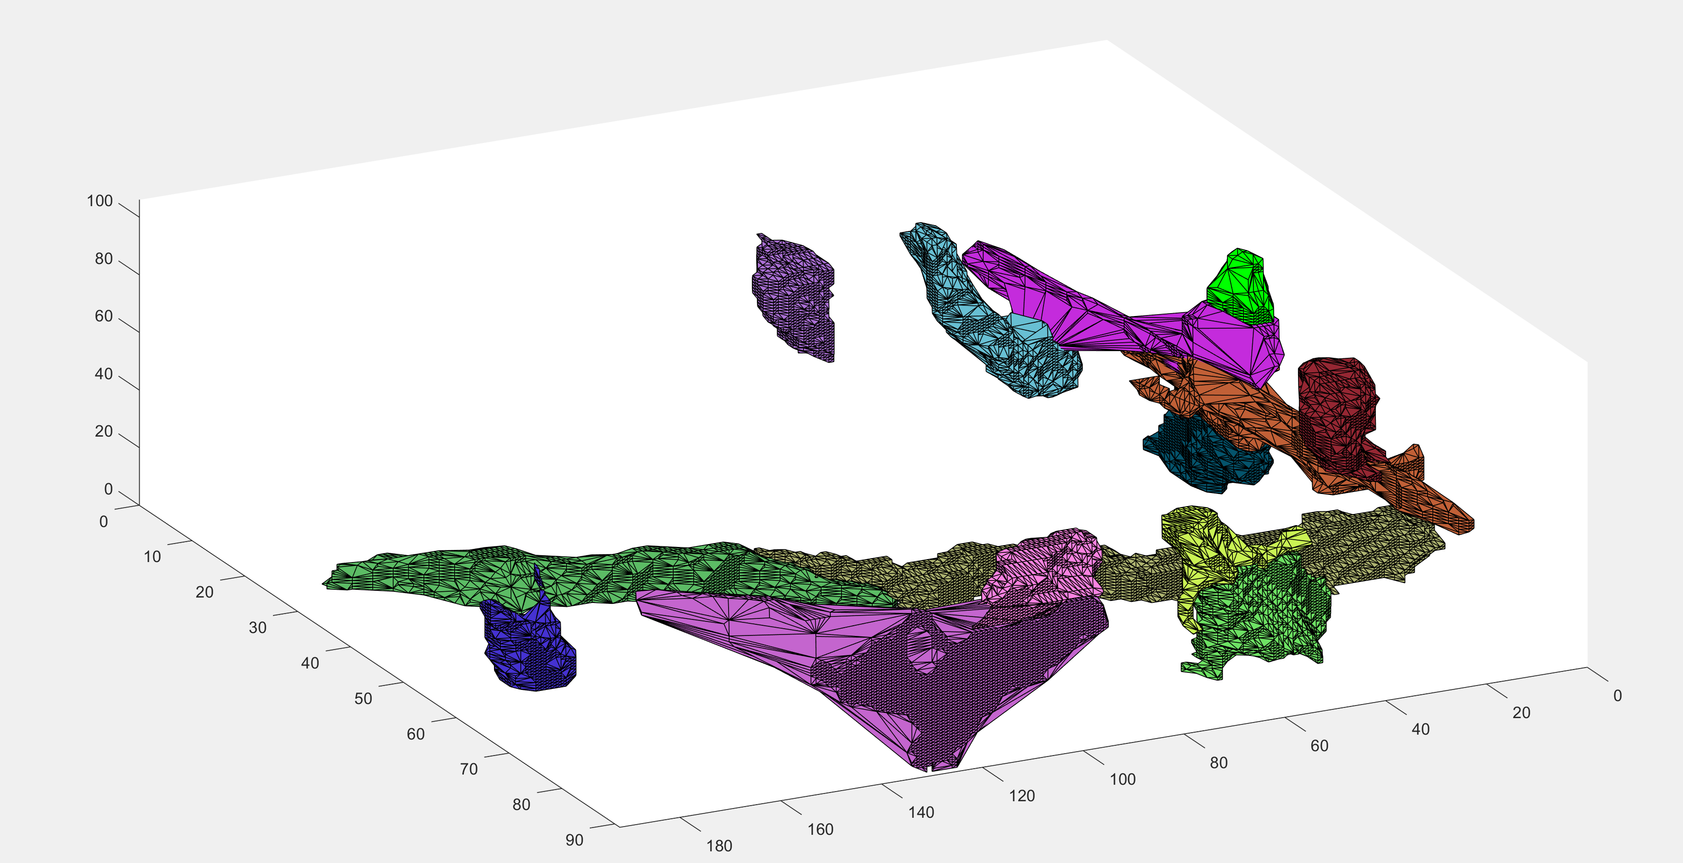
Results after mean subtract
fibers = FiberFinder(1, height, width, imgArray, 10, 5, 2, 1, 10); No DFS limit

Slide 3
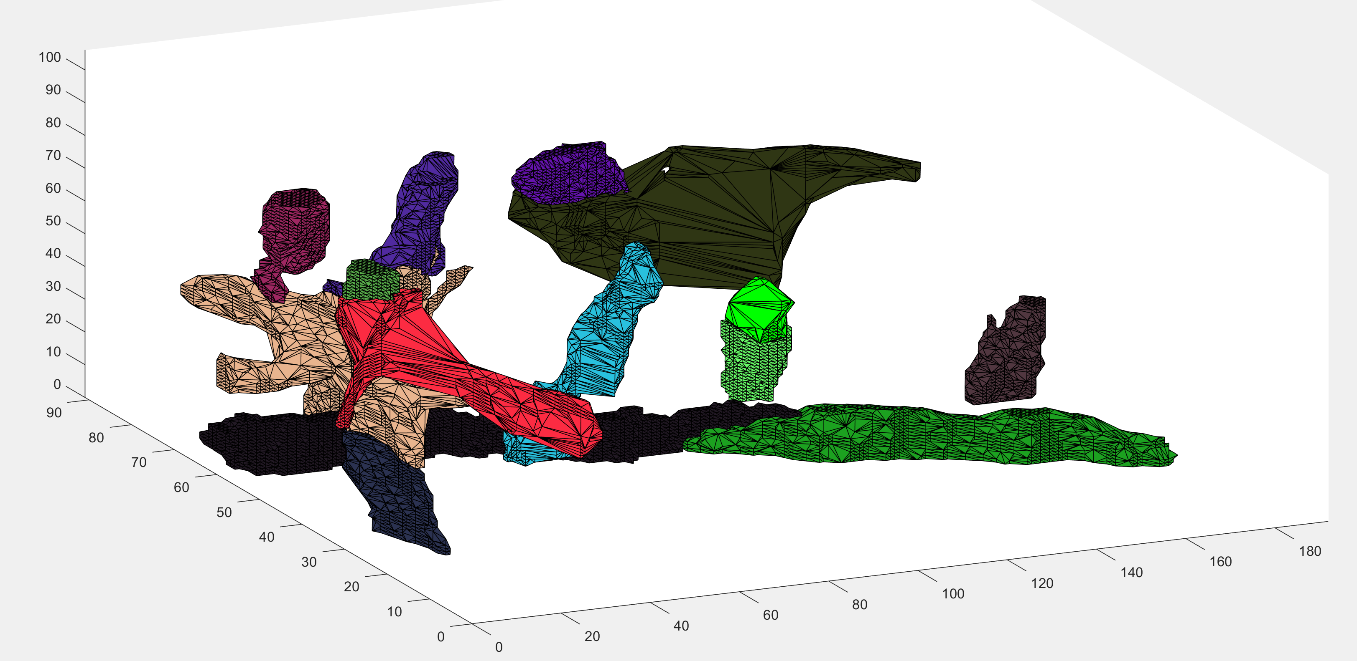
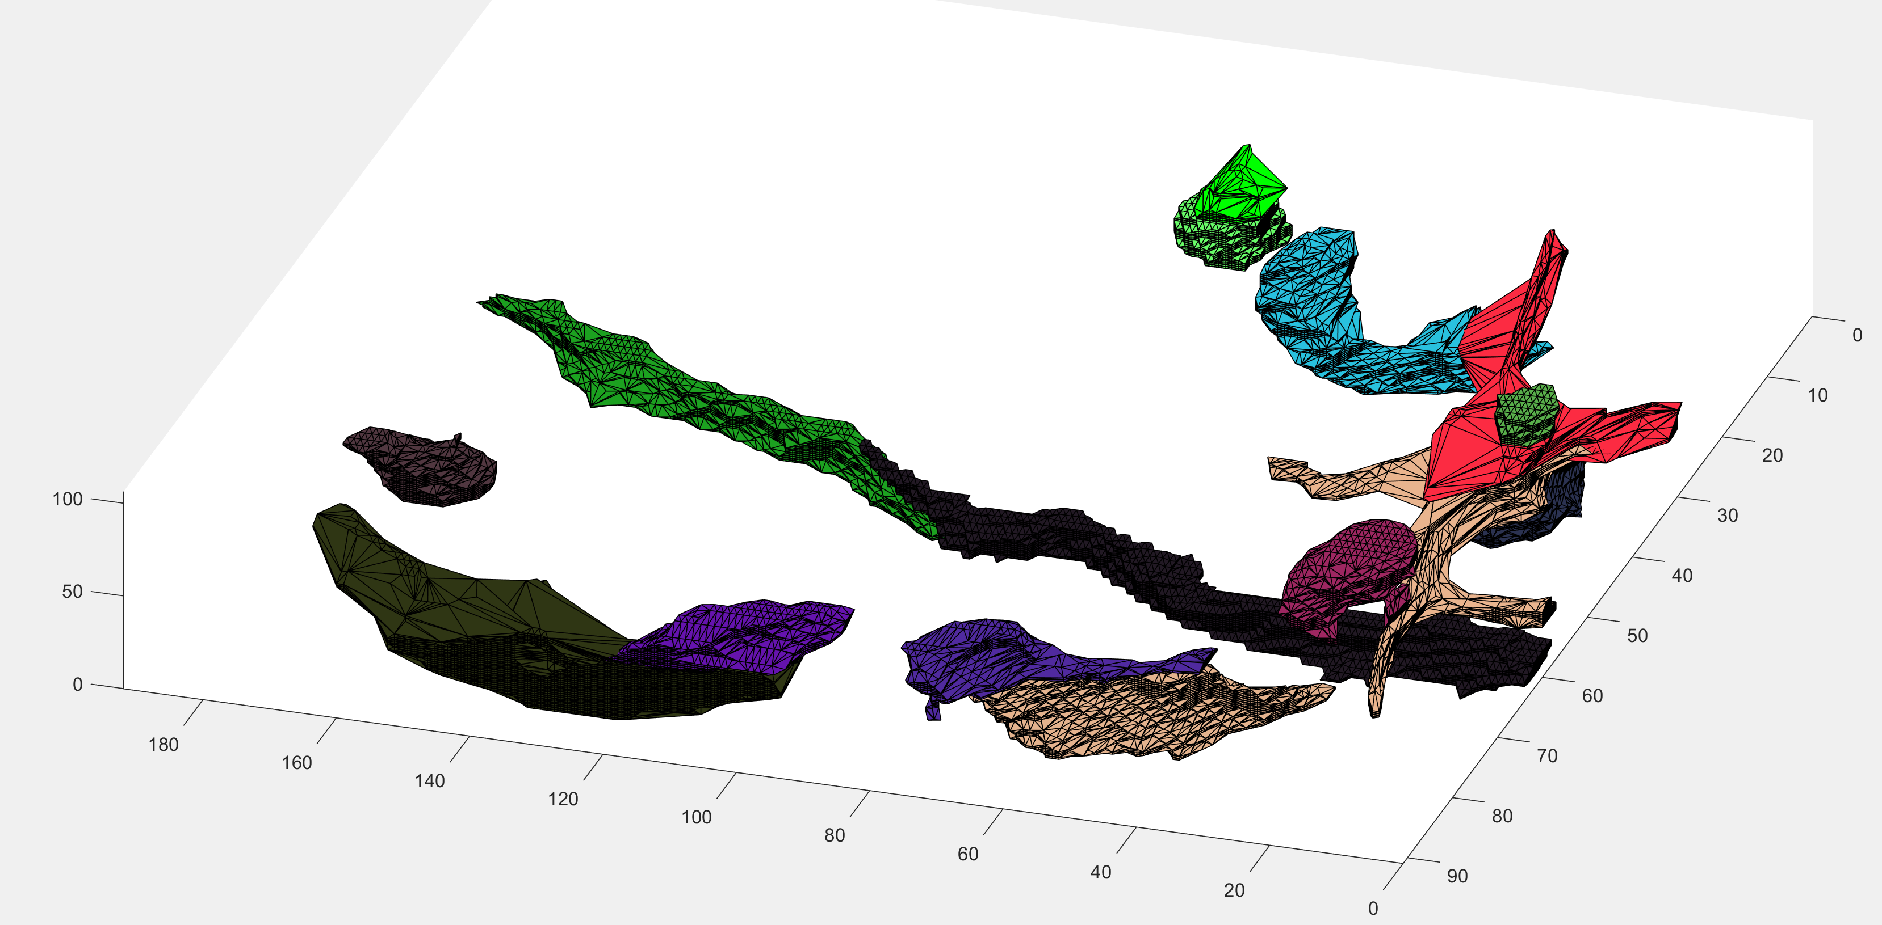
Results after mean subtract and bwareafilt()
fibers = FiberFinder(1, height, width, imgArray, 10, 5, 2, 1, 10); No DFS limit

Slide 4
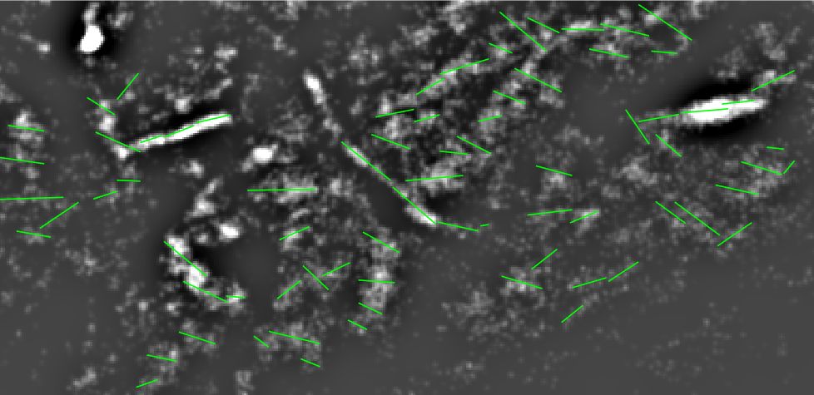
Z = 1

Slide 5
Z = 2

