Slide 1
Logistic Regression!
Research, Fall 2021
Dr. Shoemaker

Slide 2
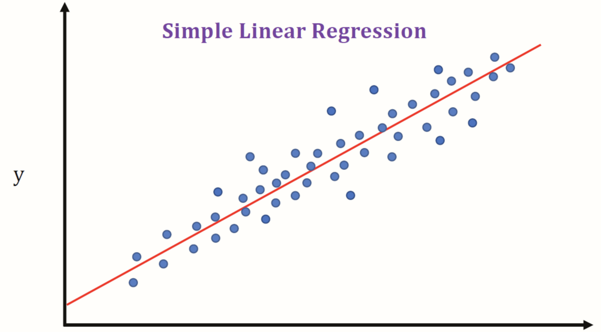
You’ve seen regression

Slide 3
Regression, for Classification
Two classes, one continuous variable, linear regression

Slide 4
Logistic Regression
For the Default data:
Using linear regression to classify, we get the blue curve to the right.
The orange ticks are the 0/1 values for no/yes default, the Balance variable is on the x axis.
Some of these predictions are negative, and none get to 1!

Slide 5
Logistic Regression
For this data:
Using logistic regression to classify, we get the blue curve to the right.
The orange ticks are the 0/1 values for no/yes default, the Balance variable is on the x axis.
This is much nicer, the probabilities all lie between 0 and 1!

Slide 6
Logistic Regression
For this data, logistic regression models the probability of default, given balance, P(default = yes | balance) shortened to p(balance)
These values are in [0,1], and with them, we can make a prediction for any value of balance!
So, you might predict default = yes for anyone for which p(balance) > 0.5
If you wanted to be more conservative, you can choose a different threshold.

Slide 7
Logistic Model
We want to model $p(X) = Pr⁡(Y = 1 | X)$and X.
Going the linear regression route, $p\left(X\right)=β_{0}+β_{1}X$ gave us the graph from before: negative probability of default for small balances.
If we predicted for large balances, we’d get values greater than 1.
Aka, nonsense.
To prevent this, we model $p\left(X\right)$ with a function that only gives values between 0 and 1!
For logistic regression, the function we use is the logistic function:
$$p\left(X\right)= \frac{e^{β_{0}+β_{1}X}}{1+e^{β_{0}+β_{1}X}}$$

Slide 8
Logistic Function
This logistic function will always give this S-shaped curve
For low values, we predict the probability is close to, but never below, 0.
Same for high values and 1
So, no matter what value of X we want to predict for, we get a valid probability.

Slide 9
Multiple Logistic Regression
Just like from SLR to MLR, we can generalize our model to have multiple predictors:
$$\log\left(\frac{p\left(X\right)}{1−p\left(X\right)}\right)=β_{0}+β_{1}X_{1}+…+β_{p}X_{p}$$
Which we can rewrite as:
$p\left(X\right)=\frac{e^{β_{0}+β_{1}X_{1}+…+β_{p}X_{p}} }{1+e^{β_{0}+β_{1}X_{1}+…+β_{p}X_{p}}}$

