Slide 1
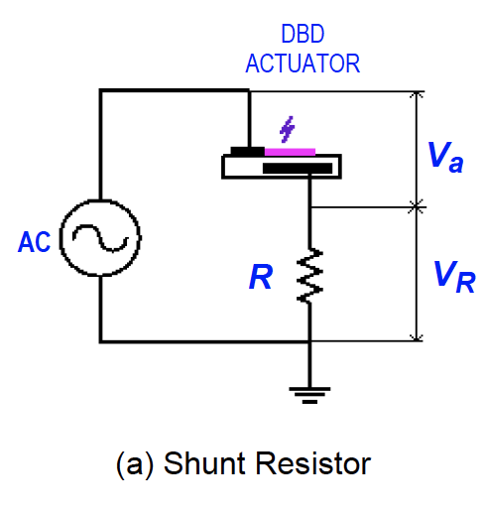
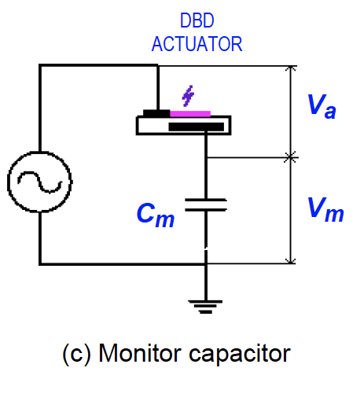
Shunt Resistor Method:
Monitor Capacitor Method:
Https://ntrs.nasa.gov/archive/nasa/casi.ntrs.nasa.gov/20120009957.pdf

Slide 2

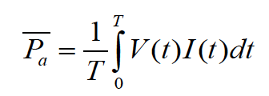
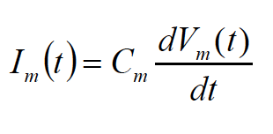
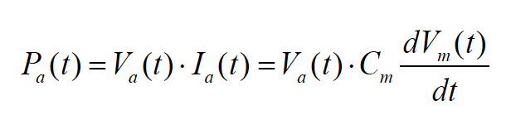

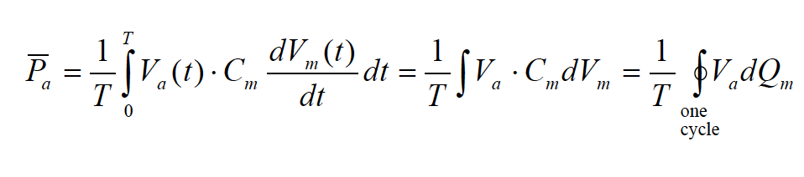
Electric Current (Shunt Capacitor Method:
Monitor Capacitor Method:
Instantaneous Charge on monitor capacitor:
Average Power:
Current through the capacitor:
Instantaneous Power:
Average Power over one period:
Lissajous Curve:

Slide 3
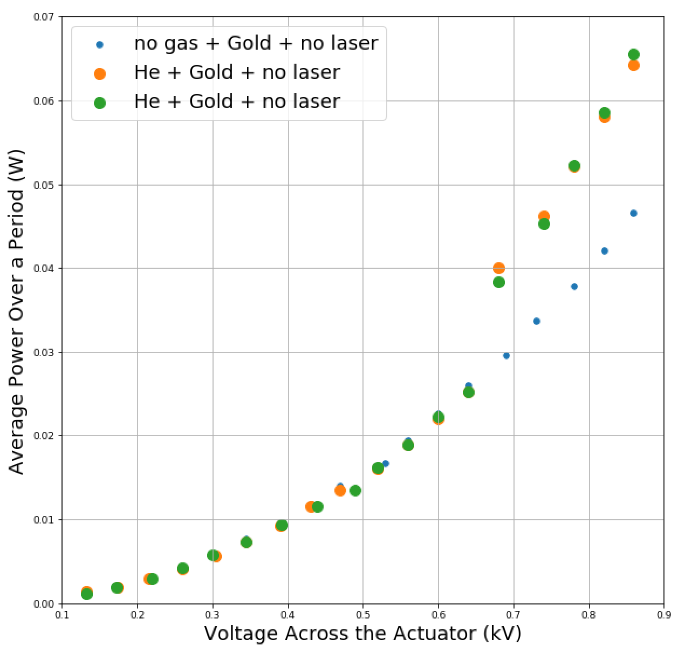
Monitor Capacitor Method:
Frequency: 20kHz
Capacitor: 10.43 nF

Slide 4
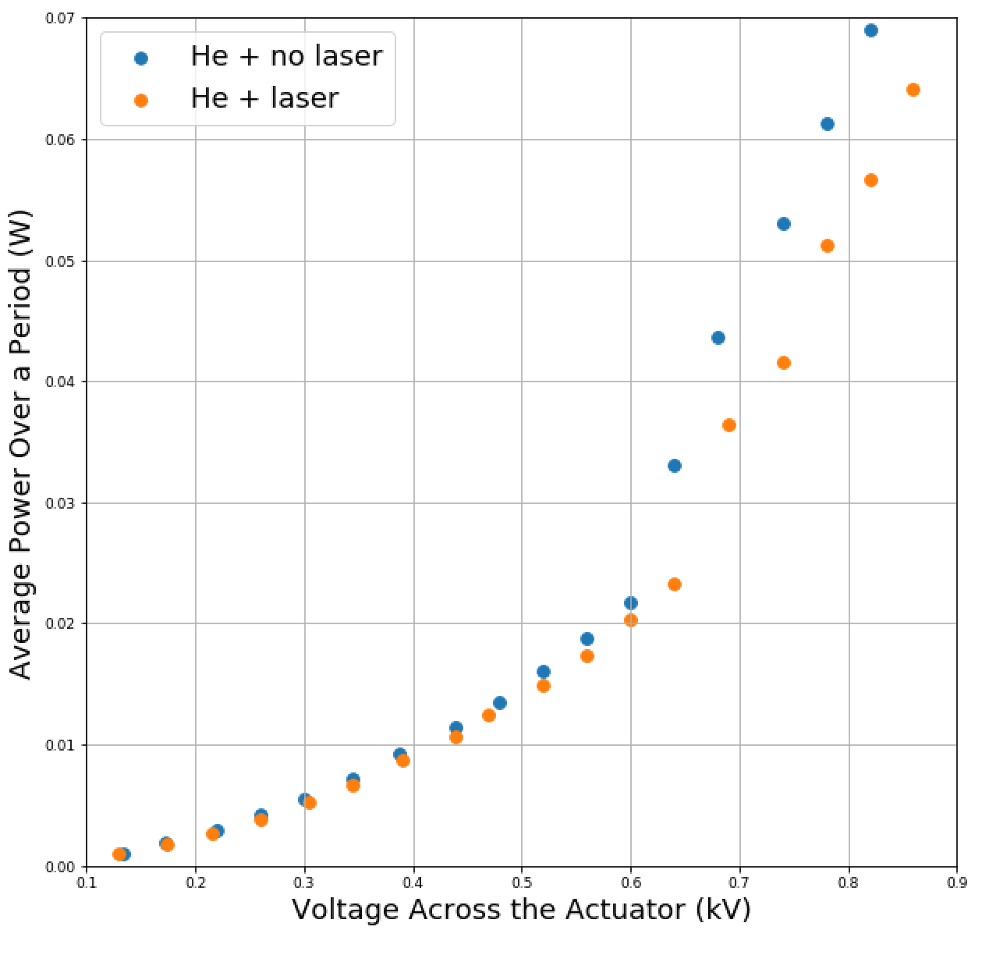
Monitor Capacitor Method:
Frequency: 20kHz
Capacitor: 10.43 nF

Slide 5
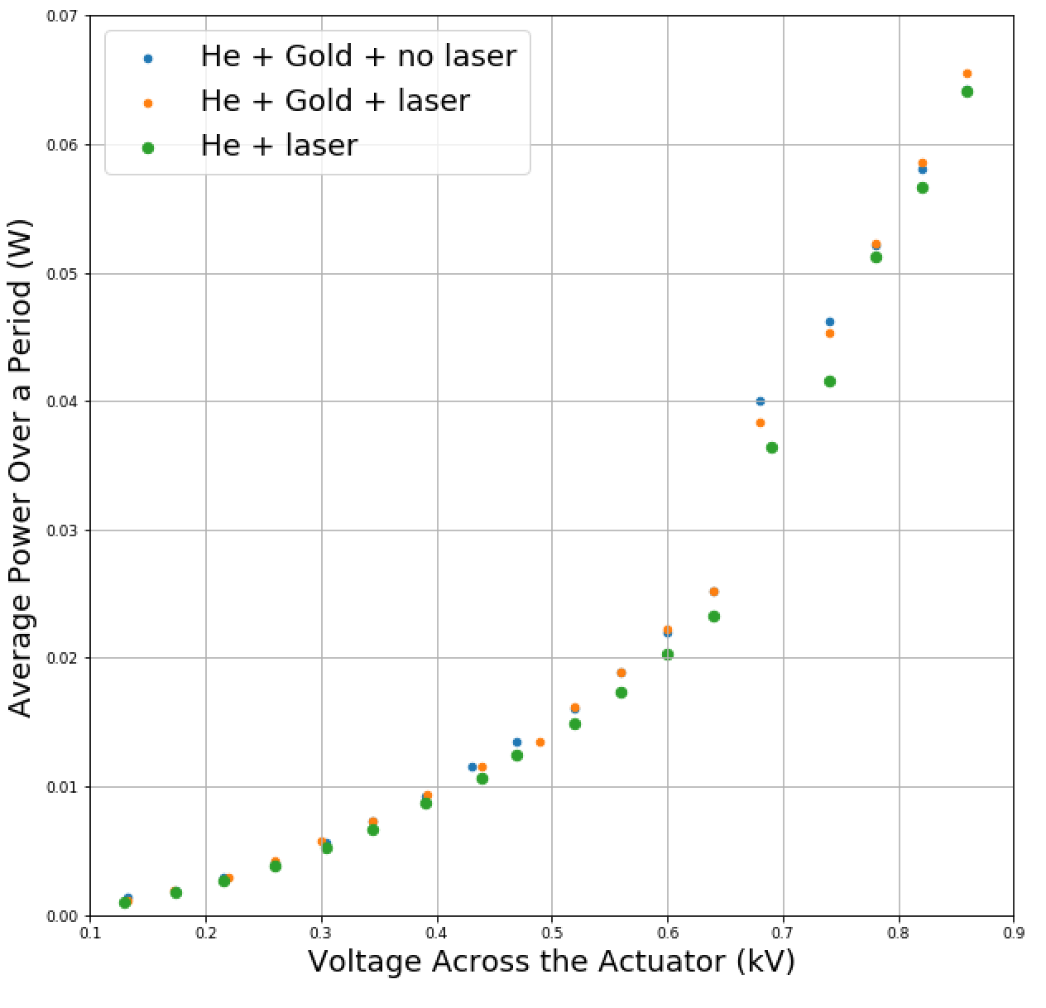
Monitor Capacitor Method:
Frequency: 20kHz
Capacitor: 10.43 nF

