Slide 1
Distributed Computing Project
Shraddha Kabade
Aditya Raghavan

Slide 2
Introduction
Technologies Used
Proof of Concept
System Architecture
Environment Setup Challenges
Code walkthrough and demo
References

Slide 3
INTRODUCTION
Design distributed system with:
REST APIs
Distributed cache
Policy server
NoSQL database
Happy Patients Hospital – designing a hospital management system on a distributed infrastructure
Provide CRUD functionalities on patient personal data and patient treatment data

Slide 4
TECHNOLOGIES USED
OS – Linux Ubuntu 14.04
IDE - Eclipse Oxygen
Container - Apache Tomcat 8.5
Distributed Cache – Hazelcast
No SQL DB – MongoDB, Cassandra
REST implementation framework – JERSEY
Message Broker – ActiveMQ 5.5

Slide 5
PROOF OF CONCEPT
Installed container and create a dynamic web project
Added JERSEY jars and implemented simple functionality for every REST API
Added Hazelcast jars and tested sample code on multiple nodes
Added Cassandra jars and connected to DB on client
Created an account on mLab and accessed mongoDB server remotely
Installed ActiveMQ and tested sample message queue on default port

Slide 6
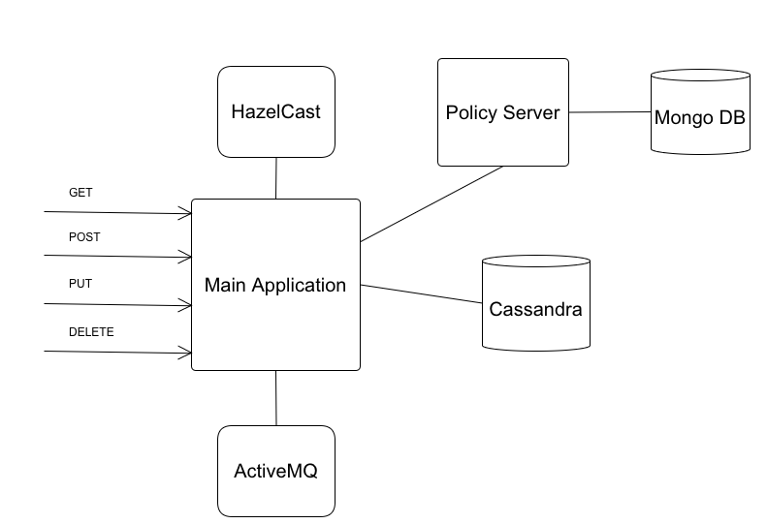
System Architecture

Slide 7
Environment Setup Challenges
Installing and setting up modules without any prior knowledge.
Reinstalled few things to resolve issues (ActiveMQ, Tomcat).
Implemented services using JERSEY in small amount of time.

Slide 8
Code Walkthrough and Demo

Slide 9
THANK YOU

Slide 10
Q & A

Slide 11
REFERENCES
https://academy.datastax.com/resources/getting-started-apache-cassandra-and-java-part-i?unit=getting-started-apache-cassandra-and-java-part-i
https://www.mulesoft.com/tcat/tomcat-eclipse
https://www.mkyong.com/webservices/jax-rs/jersey-hello-world-example/
http://docs.mlab.com/data-api/
http://www.baeldung.com/httpclient-post-http-request
https://gist.github.com/yangzhe1991/10349122
https://docs.wso2.com/display/BAM200/Installing+Apache+ActiveMQ+on+Linux

