Slide 1
Byzantium: Byzantine-Fault-Tolerant Database Replication Providing Snapshot Isolation

Slide 2
Introduction
Transaction processing database system - key component of infrastructure behind today's computer systems.
Hardware and software faults, or attacks against the database system very common.
Service using BFT can tolerate arbitrary failures from a subset of its replicas.
Byzantium - BFT database replication middleware, ensures snapshot isolation (SI).
Minimizes number of operations needed to execute three-phase agreement protocol that BFT replication uses.

Slide 3
System Model
Byzantium uses the PBFT state machine replication algorithm.
Assumptions:
Faulty nodes (client or servers) may behave arbitrarily.
Adversary can coordinate faulty nodes but cannot break cryptographic techniques used.
At most f nodes are faulty out of 3f+1 replicas.
Guarantees safety properties in any asynchronous distributed system.

Slide 4
Database Model
Byzantium provides the snapshot isolation (SI) level.
Transaction commits if no write-write conflict with any committed concurrent transaction. Else, aborts.
SI allows increased concurrency among transactions when compared with serializability.
For many typical workloads(TPC-A, TPC-B, TPC-C, and TPC-W), execution under SI is equivalent to strict serializability

Slide 5
System Architecture
Each server is composed by Byzantium replica proxy, which is linked to PBFT replica library, and a database system.
Replica proxy controls the execution of operations in the database system.
Replica proxy receives inputs from PBFT replication library and Byzantium clients.
Applications accessing conventional database systems using JDBC interface can use Byzantium with no modification.
Client side protocol consist of invoking operations that run through PBFT replication protocol.
PBFT is used as a black box.

Slide 6
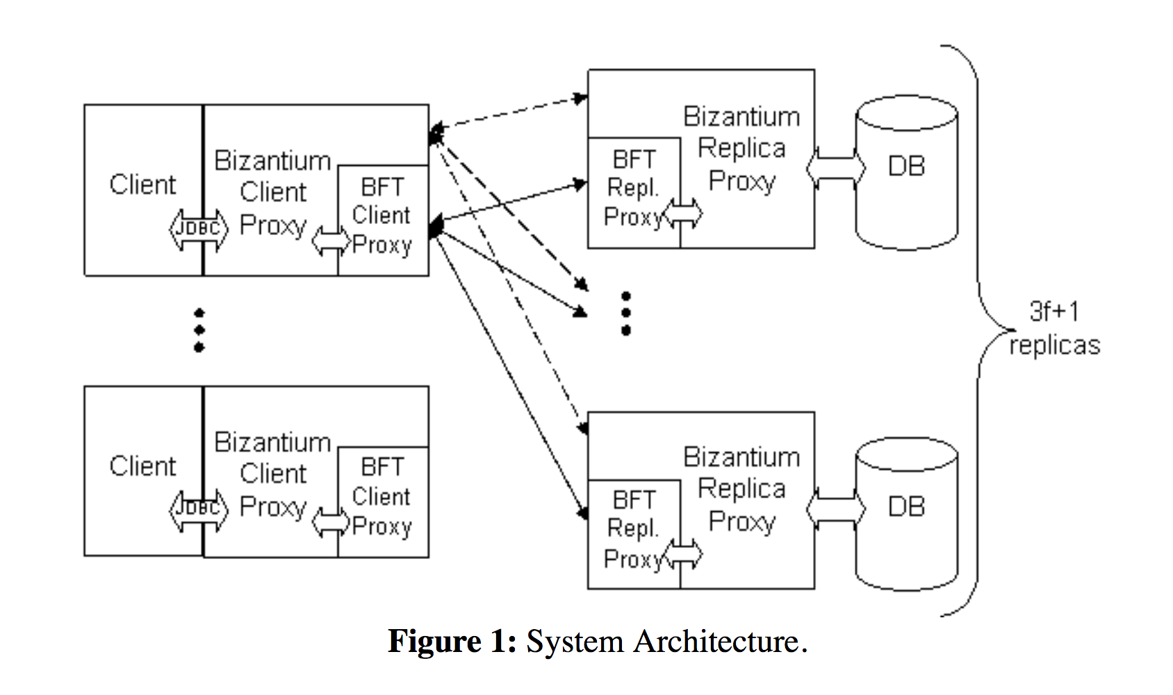

Slide 7
System Operation
Assumption: Clients are not Byzantine.
Application executes BEGIN operation.
Client generates a UID for the transaction and selects replica (coordinator) to speculatively execute the transaction.
Client issues BFT operation to execute in all replicas.
Serial execution of BEGIN and COMMIT.
Each operation executes only in coordinator of the transaction

Slide 8
Transaction started in the same (equivalent) snapshot of the database in every correct replica.
Steps to validate a transaction prior to commit:
All other replicas executes the operations and verify by comparing with coordinator’s results.
If coordinator is faulty, the results will not match those sent by the client and correct replicas will abort.
Replicas verify if SI properties hold for the committing transaction.

Slide 9
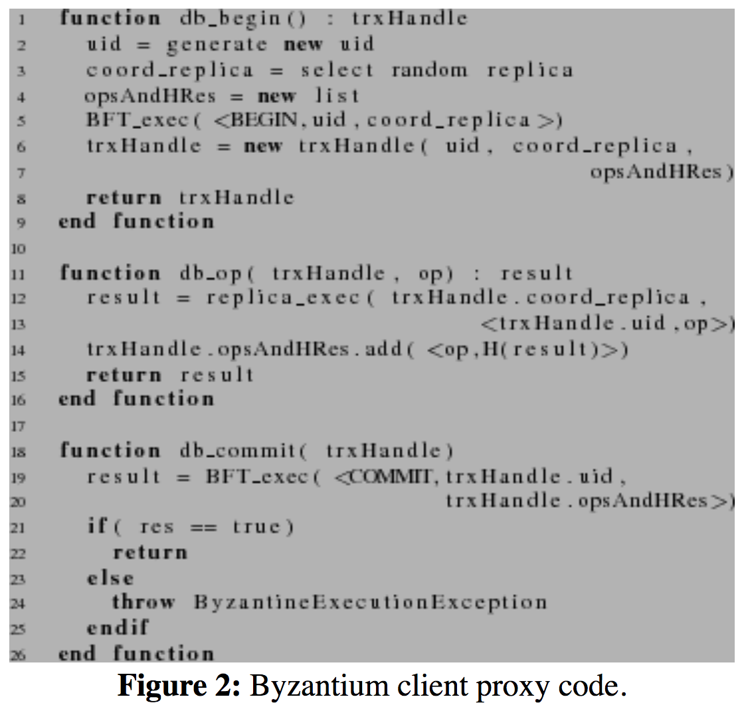
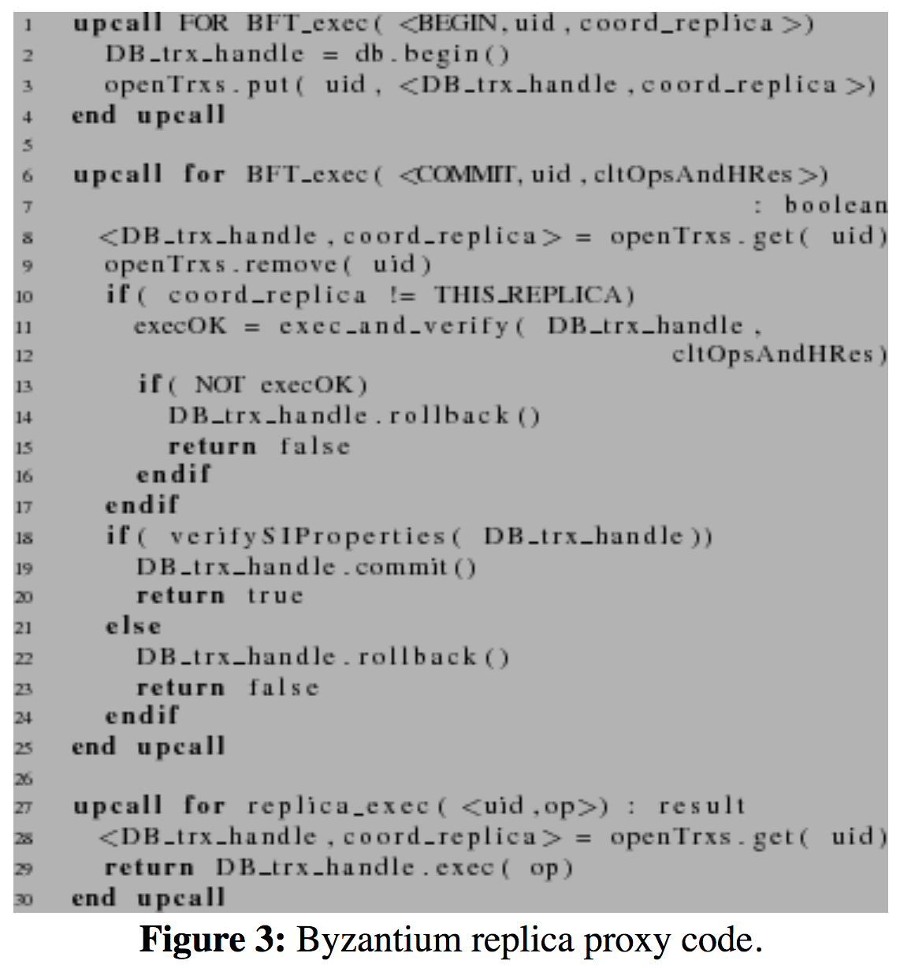

Slide 10
Tolerating Byzantine Clients
Validate operations that are issued to the database engines running in the replicas.
Replicas check if they are receiving a valid sequence of operations from each client.
Compare if the sequence of operations submitted initially is the same that is submitted at commit time.

Slide 11
Coordinator logs the operations and their results as they are executed.
At commit time, if the received list differs from the log, the coordinator discards executed operations in the current transaction and executes operations in the received list.
For discarding the executed operations in the current transaction, savepoints are used.

Slide 12
Tolerating Faulty Coordinator
Types of failure - Coordinator returns erroneous results - Coordinator fails to return any results
Erroneous results addressed by verifying at commit time, correctness of results returned to replicas.
Only coordinators which return correct results for every operation committed.
Client selects new coordinator and starts re-executing all previously executed applications if current coordinator fails to reply.
ROLLBACK executed and transaction aborted by client if results don’t match.

Slide 13
Handling Aborted Transactions
Aborted transaction should not abort in all replicas without verifying previously returned results.
Faulty coordinator might return application to erroneous state.
Verification of database state important when transaction is aborted.
ROLLBACK operation must be done on valid database state.
Force the system to verify correctness of results returned when transaction ends with ROLLBACK.
If verification fails, ROLLBACK raises an exception.

Slide 14
Correctness
Correctness determined by safety and liveness.
Theory based on assumptions, yet to be formally proven.
Correctness relies on guarantees provided by PBFT.
Correct replica will allow transaction to commit if it observed SI semantics which ensures output of PBFT COMMIT also conforms to it
Operations under PBFT - BEGIN, COMMIT, ABORT operations guaranteed to eventually execute.
Operations not under PBFT are simple RPC’s with same set of assumption of progress.

