Slide 1
CS 274 - Final Milestone
LOGISTIC REGRESSION
Group3:
Priyatha Joji Abraham, Qiao Liu,
Shradha Kabade, Tina Philip

Slide 2
Agenda
Data Refinement
Implementation and Interpretation
Data Normalization and Feature Extraction
Conclusion

Slide 3
1.Data Refinement
Feature Selection techniques:
Domain knowledge
Recursive Feature Elimination (RFE)
Notes:
Feature selection is a process where you automatically select those features in your data that contribute most to the prediction variable or output in which you are interested.

Slide 4
Advantages of Feature Selection
Reduces Overfitting
Improves Accuracy
Reduces Training Time

Slide 5
Recursive Feature Elimination (RFE)
class sklearn.feature_selection.RFE (estimator, n_features_to_select=None, step=1, verbose=0)[4]
Estimator trained on initial set of features
Assigns weights to features
Select features by recursively considering smaller and smaller sets of features
Prune smaller weight features.
Repeat procedure recursively on pruned set until desired result obtained
Calculates feature importance.
Notes:
t uses the model accuracy to identify which attributes (and combination of attributes) contribute the most to predicting the target attribute.

Slide 6
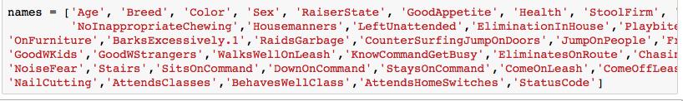
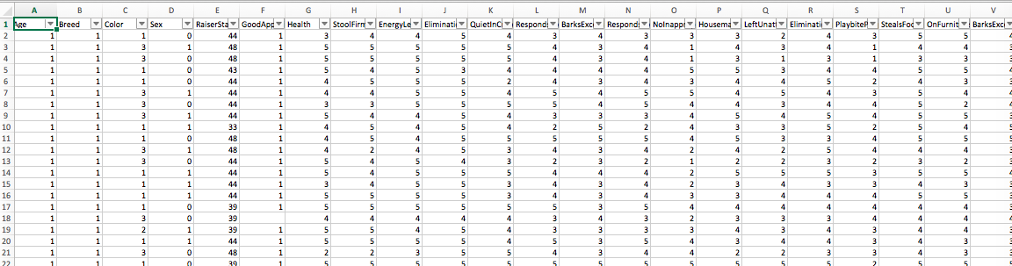
Our Processed Data Set

Slide 7
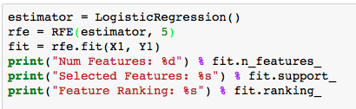
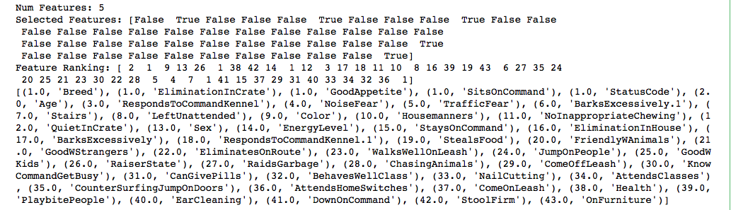
Feature Ranking - 5 Features
Select top 5 -10 features - X: training input, Y: output
1 refers to the best feature
Notes:
selecting top features for model performance improvement

Slide 8
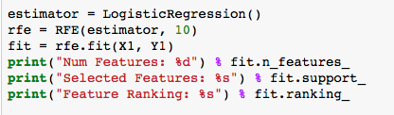
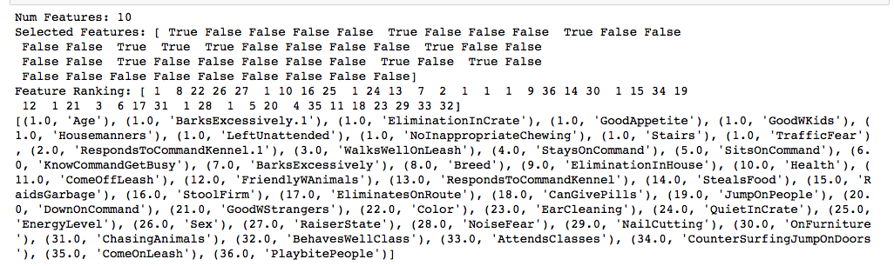
Feature Ranking - 10 Features

Slide 9
Data Preparation - Selected Features
5 features: Recommended features by RFE
Breed, GoodAppetite, EnergyLevel, EliminationInCrate, Housemanners
9 features (Milestone 1)
Breed, Age, Sex, Health, ResponsToCommandKennel, Traffic Fear, GoodWStrangers, StayOnCommand, BehavesWellClass
11 features: Recommended features by RFE
Breed, Color, GoodAppetite, EnergyLevel, EliminationInCrate, RespondsToCommandKennel, Housemanners, BarksExcessively, TrafficFear, NoiseFear, Stairs
15 features: Explore other features
EliminationInCrate, QuietInCrate, RespondsToCommandKennel, BarksExcessively, RaidsGarbage, CounterSurfing, JumpOnDoors, JumpOnPeople, FriendlyWAnimals, GoodWKids, GoodWStrangers, TrafficFear, NoiseFear, StaysOnCommand, BehavesWellClass
20 features: More comprehensive features.
Sex,DogBreedDescription,Health,StoolFirm,EnergyLevel,EliminationInCrate,QuietInCrate,RespondsToCommandKennel,BarksExcessively,RaidsGarbage,CounterSurfingJumpOnDoors,JumpOnPeople,FriendlyWAnimals,GoodWKids,GoodWStrangers,TrafficFear,NoiseFear,StaysOnCommand,BehavesWellClass

Slide 10
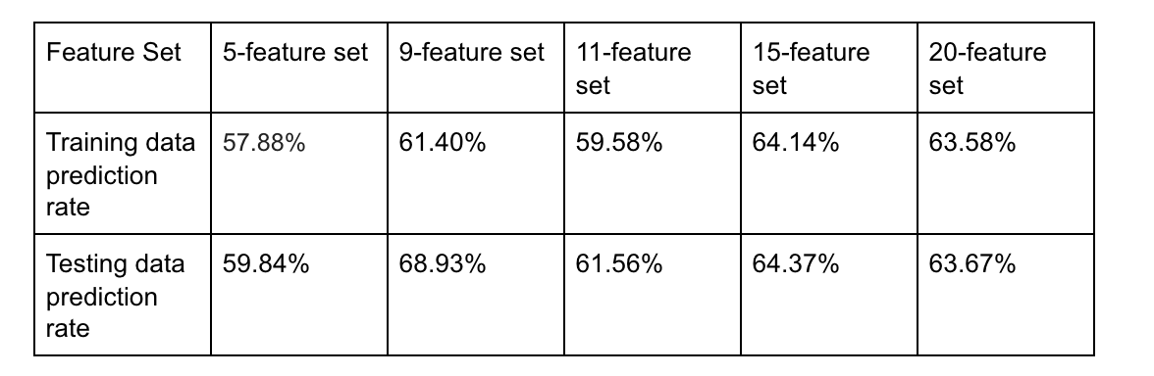
Implementation and Interpretation - Random Split
Outcome of 5 different data set, with random split
5-feature model suffers underfitting for both training and testing data.
Better training data prediction when model has more features. The model learns better about training data when taking more features
From 11 to 15 features, we gain better prediction rate, but decrease with 20 features. 15 features is optimal. 11 features might suffer underfitting. 20 features might suffer overfitting. The result of 9-feature comes from milestone 1, which has the old dataset.

Slide 11
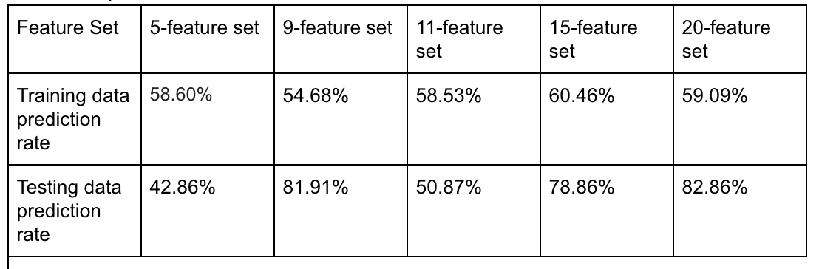
Implementation and Interpretation - Fixed Split
Outcome of 5 different data set, with fixed split
5-feature model suffers underfitting for both training and testing data.
Better training data prediction when model has more features. The model learns better about training data when taking more features
15-feature and 20-feature are optimal, with 20-feature slightly better than 15-feature. Both are significantly better than 5-feature and 11-feature sets.

Slide 12
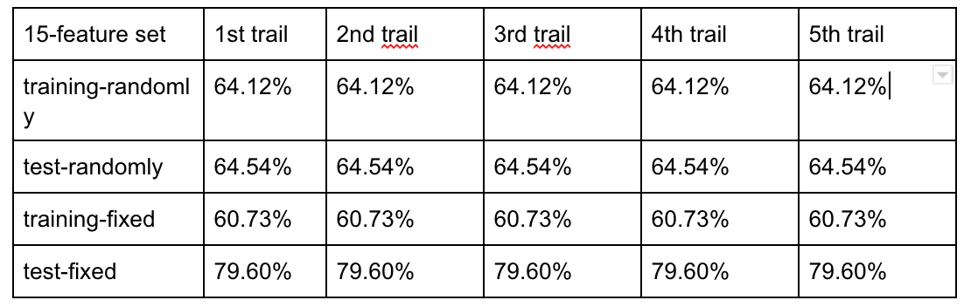
Implementation and Interpretation contd. - Iteration

Slide 13
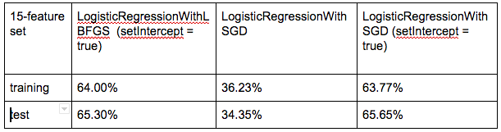
Implementation and Interpretation contd.- Different Algorithm and methods
For LogisticRegressionWithLBFGS Algorithm :
SetIntercept = true, Results were better
SetValidateData = true, Results were same
For LogisticRegressionWithSGD Algorithm :
Results were not good as LogisticRegressionWithLBFGS
This is slower than above algorithm.
SetIntercept = true Results were better

Slide 14
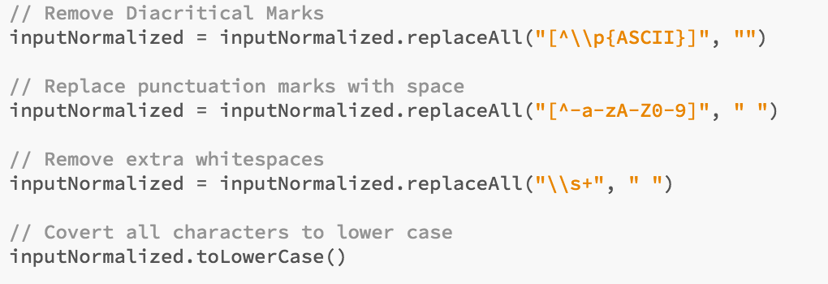
3. Data Normalization
Import Java normalizer library : import java.text.Normalizer
Use Regular expressions

Slide 15
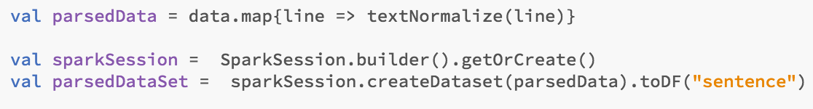
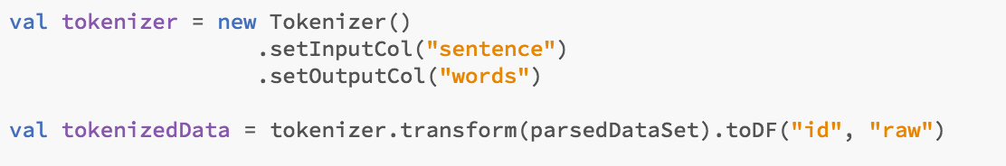
Data Normalization contd..
3. Create DataSet using normalized data and specify the column name
4. Use Spark tokenizer to tokenize data.

Slide 16
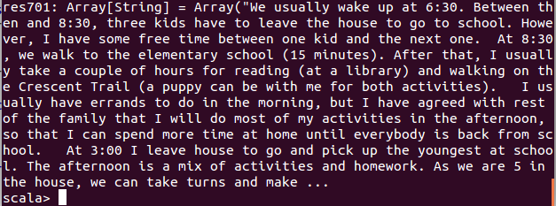
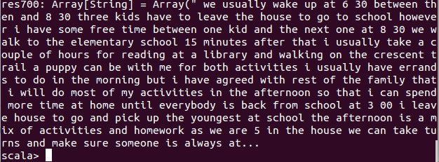

Slide 17
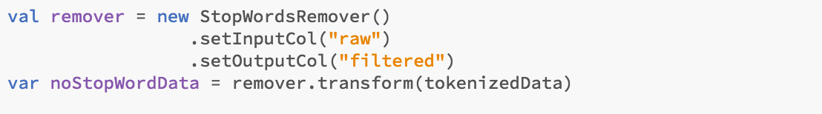
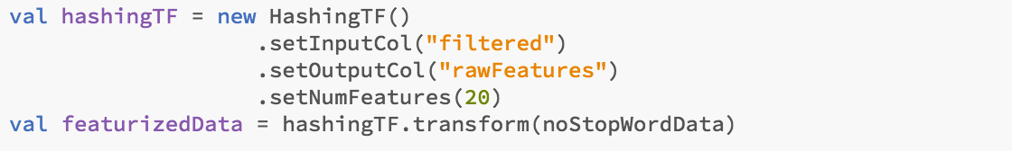
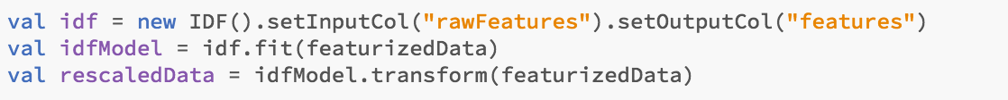
Data Normalization contd..
5. Remove Stopwords
6. Feature Extraction with TF-IDF

Slide 18
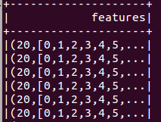
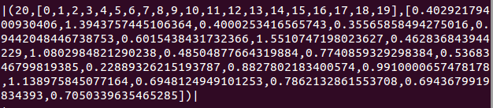
Data Normalization contd..
Final output for first few rows :
For 1st row the final output looks like below :

Slide 19
Feature Extractor
TF - IDF
b) Word2Vec Takes sequences of words representing documents and trains a Word2VecModel.
Notes:
Word2Vec is an Estimator which takes sequences of words representing documents and trains a Word2VecModel. The model maps each word to a unique fixed-size vector. The Word2VecModel transforms each document into a vector using the average of all words in the document; this vector can then be used as features for prediction, document similarity calculations,

Slide 20
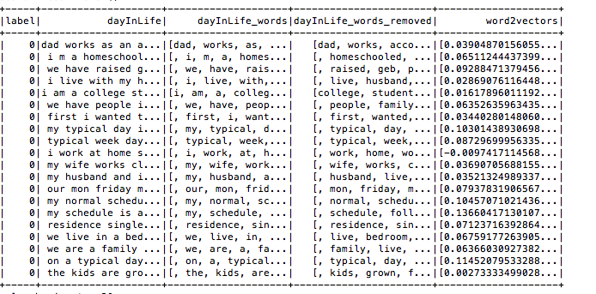
b) Word2Vec

Slide 21
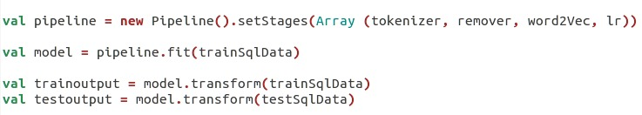
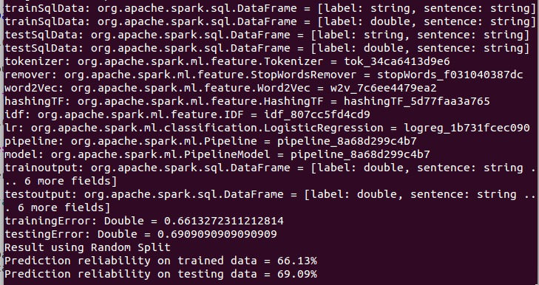
Pipeline

Slide 22
Implementation and Interpretation - Random Split
Outcome of Trainer info data set, with random split
Using TF-IDF
Using Word2Vec
Feature Set | 2 features ( Statuscode, DayinLife)
Training data | 65.27 %
Test data | 67.2
Feature Set | 2 features ( Statuscode, DayinLife)
Training data | 66.13%
Test data | 69.09%
Notes:
5-feature model suffers underfitting for both training and testing data.
Better training data prediction when model has more features. The model learns better about training data when taking more features
From 11 to 15 features, we gain better prediction rate, but decrease with 20 features. 15 features is optimal. 11 features might suffer underfitting. 20 features might suffer overfitting. The result of 9-feature comes from milestone 1, which has the old dataset.

Slide 23
5. Conclusion
Prediction accuracy rate depends upon many factors like number of features, number of rows, algorithm used, different methods of algorithm, data consistency etc.
Normalized text can be used for training and prediction with spark pipelines.

Slide 24
6. References
Feature Extraction in Apache Spark: https://spark.apache.org/docs/2.1.0/ml-features.html
Apache Spark documentation for MLlib: https://spark.apache.org/docs/2.1.0/mllib-data-types.html
Machine Learning course by Andrew Ng: https://www.coursera.org/learn/machine-learning/lecture/wlPeP/classification
Feature selection: http://scikit-learn.org/stable/modules/feature_selection.html
Feature selection using Recursive Feature Elimination:
http://machinelearningmastery.com/feature-selection-machine-learning-python/

