Slide 1





kshreya2k / Credit-Card-
Approval-Prediction
An academic group project for the Data Engineering Final Project (DSCI 6007-04). In this project, credit card approval data was analyzed and a machine learning model was developed to predict the approval of credit card request.
2

Slide 2




TEAM 13
SHREYA BANIK
BHIRAVAJOSYULA KRISHNA SAI

Slide 3

Business scenario overview
Existing credit card approval processes lack accuracy and efficiency, leading to potential risks and inefficiencies for financial institutions. Manual review processes are time-consuming and prone to errors, resulting in delayed decisions and potential loss of business opportunities.

Slide 4

Solution overview
We aim to implement a robust machine learning model trained on analyzed credit card approval data. This model will automate the approval process, accurately predicting the likelihood of credit card approval based on various demographic and financial factors. As part of our solution, we will explore exploratory data analysis (EDA) techniques to gain deeper insights into the data, identify patterns, and refine feature selection. By leveraging data engineering techniques, we can streamline decision-making processes, reduce manual intervention, and enhance risk management practices, ultimately optimizing the credit card approval process for improved efficiency and profitability.

Slide 5
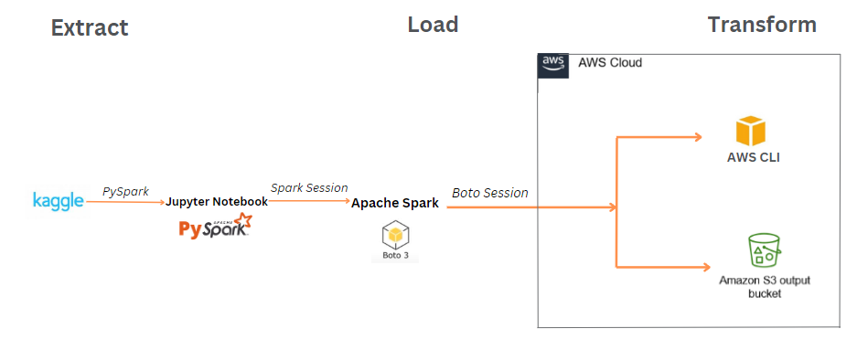
ARCHITECTURE DIAGRAM OF THE SOLUTION

Slide 6















CRISP - DM - METHODOLOGY
Business Understanding: We aim to help financial institutions make better decisions by predicting credit card approvals accurately. This helps in managing risk and improving customer satisfaction.
Data Understanding: We analyzed our dataset to understand important factors like age, income, and credit score that could influence credit card approval. Understanding these factors helps in building an effective predictive model.
Data Preparation: We prepared our data by cleaning it up, handling missing values, and selecting relevant features like debt, employment length, and credit score. This step ensures that our model has the right inputs to make accurate predictions.
Modeling: We used a machine learning algorithm called Random Forest to train our model. Random Forest is known for its ability to handle large datasets and make accurate predictions, making it suitable for our tasks.
Evaluation: We evaluated our model's performance using metrics like accuracy, precision, and recall. These metrics help us understand how well our model predicts credit card approvals and identify areas for improvement.

Slide 7
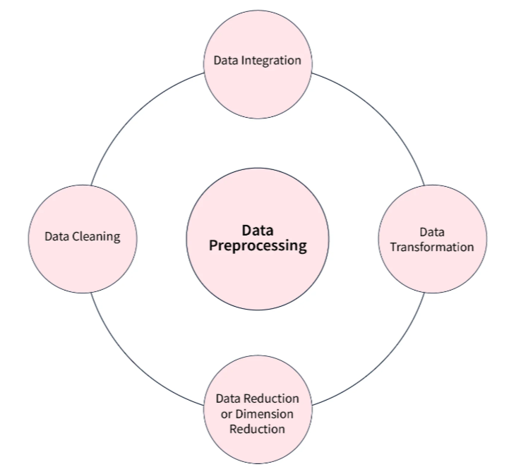
DATA PREPROCESSING
The dataset was loaded from Kaggle, a reliable source, and imported into the analysis environment.
Missing value handling strategies were implemented, including imputation techniques or removal of incomplete records, to ensure data completeness and quality.
Relevant features for model training were identified based on domain knowledge and statistical analysis, optimizing model performance.
Features were transformed and engineered to extract meaningful information and enhance predictive power, improving the accuracy of machine learning models.
Categorical variables were encoded into numerical representations using techniques like one-hot encoding or label encoding, enabling compatibility with machine learning algorithms.

Slide 8
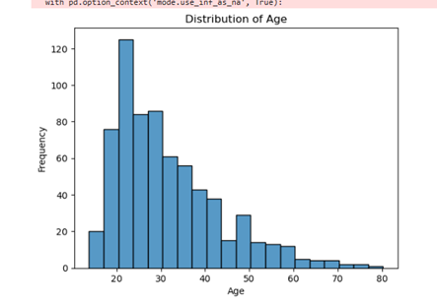
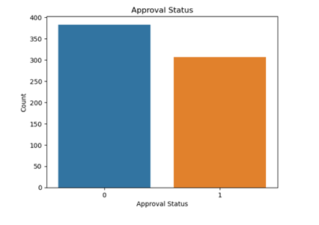
DATA VISUALIZATION

Slide 9
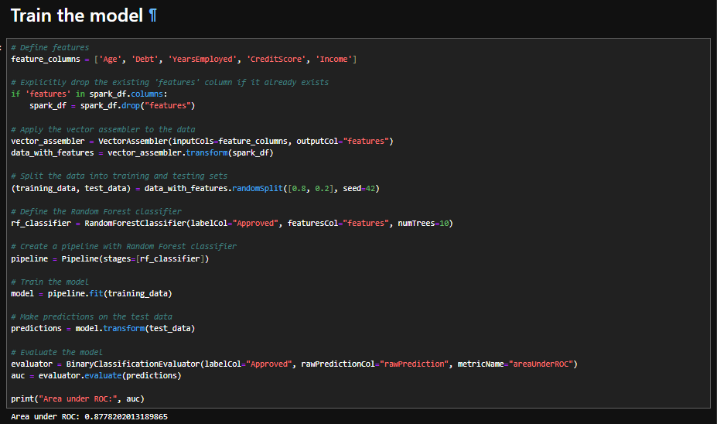
MODEL SELECTION
Features such as Age, Debt, YearsEmployed, CreditScore, and Income are selected for model training.
Data is split into training and testing sets with an 80:20 ratio.
A Random Forest classifier with 10 trees is chosen for model training.
A pipeline is created and trained on the training data.
Model performance is evaluated using the Area under the ROC curve metric, with an achieved value of 0.877(approx.).

Slide 10
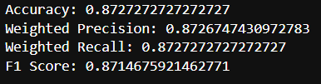
EVALUATION
Model evaluation is performed using various classification metrics.
The accuracy of the model is calculated, yielding a value of 87%(approx.).
Additional metrics such as weighted precision, weighted recall, and F1 score are computed.
Results are printed to assess the performance of the model in predicting credit card approvals accurately.

Slide 11
CONCLUSION
Our Random Forest Classifier model achieved an impressive Area under ROC (AUC) score of 0.878, indicating its strong ability to discriminate between approved and denied credit card applications.
The model also demonstrated high accuracy, with an accuracy score of 0.873, suggesting its effectiveness in correctly predicting credit card approvals.
Furthermore, the weighted precision of 0.873 and weighted recall of 0.873 highlight the model's balanced performance in accurately identifying positive and negative instances.
The F1 score, a harmonic mean of precision and recall, reached 0.871, affirming the model's robustness in handling imbalanced classes.
With these results, our model showcases promising potential for automating and optimizing the credit card approval process, contributing to improved efficiency and profitability for financial institutions.

Slide 12
DISCUSSION
Model Performance: Our Random Forest Classifier achieved an impressive Area under ROC (AUC) score of 0.878, signifying its strong discriminatory power between approved and denied credit card applications.
Accuracy and Precision: With an accuracy of 0.873, the model demonstrates its proficiency in correctly predicting credit card approvals, while a weighted precision of 0.873 underscores its precision in identifying true positives among all predicted positives.
Balanced Evaluation: The model's weighted recall of 0.873 ensures comprehensive capture of actual positive instances, while the F1 score of 0.871 reflects its harmonized precision-recall trade-off.
Operational Implications: Our model presents significant opportunities to streamline the credit card approval process, reducing manual effort and mitigating error risks through automated decision-making based on demographic and financial data.
Future Directions: Further exploration of feature engineering techniques and ongoing model monitoring and recalibration will be pivotal for continuous enhancement of model performance and adaptability to evolving credit market dynamics.
Ethical Considerations: Acknowledgment of inherent biases and continuous scrutiny of fairness and transparency are essential to ensure responsible AI practices and uphold principles of equity and inclusion in credit decision-making processes.

Slide 13
REFERRENCES
The dataset used for this project is sourced from Kaggle, titled Credit Card Approval Clean Data.
Gain insights into Random Forest algorithms by referring to this comprehensive article: Understanding Random Forest.
Explore various techniques for Exploratory Data Analysis (EDA) in data science through this informative blog post: Exploratory Data Analysis (EDA) Techniques.
Learn about different evaluation metrics used for classification models in this research paper: Evaluation Metrics for Classification Models.
Dive into the ethical considerations surrounding AI and machine learning in this insightful webinar: Ethical Considerations in AI and Machine Learning.

Slide 14




