Slide 1

DATAQUEST 3.0
ROUND 1
OFFICIAL PARTICIPANT PPT TEMPLATE
PROJECT DETAILS
TEAM & MEMBERS
PROJECT TITLE
ParseAnything: High-Fidelity Universal Document Ingestion Engine
ONE-LINE PITCH
Every PDF has a story. We know how to read it.
TRACK
DQCL
TEAM
ByteSized
PARTICIPANTS
  Chitwan SIngh- 24BAI1629
  Shruthi K- 24BYB1078
  Akshitha Muralidharan- 24BYB1012
  Gayathridevi S- 24BYB1003
  Andukuri Navya Nandika- 24BYB1074

Slide 2
DATAQUEST 3.0 · ROUND 1
02 Problem Definition
Who is impacted · Today's workarounds · Why current methods fail · Concrete proof
01 · AUDIENCE
02 · STATUS QUO
WHO & HOW OFTEN
Finance, legal, compliance and enterprise teams process large volumes of complex documents every day including reports, contracts, statements, filings and scanned documents.
Pain: Manual extraction and verification is slow, repetitive and error-prone. Existing methods dont accurately parse complex layouts.
CURRENT APPROACH
Teams rely on traditional PDF parsers, OCR tools and manual workflows. A tool that is very similar to the chosen problem is MinerU but it comes with many limitations. These existing tools often handle text well but struggle with tables, multi-column layouts, charts, equations and scanned pages, requiring manual correction.
03 · DEFICIENCY
04 · VALIDATION
WHY IT FALLS SHORT
Current solutions tend to:
  Scramble reading order
  Break complex/merged tables
  Lose figures & equations
  Miss scanned content (Handwritten documents)
  Remove source/bounding-box context
Information is extracted, but its accuracy and origin aren't always trustworthy.
EVIDENCE
  MinerU reports known limitations in complex layouts, including reading-order errors and row/column errors in complex tables. [MinerU Documentation (2026)]
  Microsoft Azure Document Intelligence extracts text, tables, figures, sections and reading-order information, but complex tables require dedicated structural handling, including row/column spans and cross-page processing.[Microsoft Azure Document Intelligence (2026)]
  OCR/document analysis systems must handle bounding regions, confidence scores and structural relationships in addition to raw text recognition.[Microsoft Azure Document Intelligence (2026)]

Slide 3
DATAQUEST 3.0 · ROUND 1
03 Proposed Solution
System identity · End-to-end user workflow · Competitive advantages
SOLUTION CORE
ParseAnything
A high-fidelity document ingestion engine that converts complex document layouts into structured Markdown + JSON while preserving text, tables, figures, equations, reading order, bounding-box provenance, and confidence.
USER FLOW
2. PROCESSING
Analyze → Route → Extract → Assemble → Verify
Detect page structure and content → intelligently route each region → extract text, OCR, tables, figures & equations → reconstruct reading order and cross-page content → validate with confidence, provenance & fail-safe checks.
1. USER INPUT
Digital, scanned, or mixed-layout pdfs
➔
➔
3. OUTPUT
bounding boxes with IDs+ document.md + document.json
with confidence & errors
ADVANTAGE
INNOVATION
WHY IT IS BETTER
  One unified pipeline instead of multiple tools
  Handles text + tables + visuals + equations
  Preserves reading order & source coordinates
  Confidence scoring flags uncertain content
  Fail-safe processing prevents silent data loss
  Self-hostable for sensitive documents
WHAT IS DIFFERENT
For every paragraph, table, figure, equation, or other semantic block, the system preserves:
  Exact page number
  Bounding-box coordinates of the source region
  Semantic block type
  Reading-order position
  Extraction method: native text, OCR, table extraction, etc.
  Confidence score
  Warnings when extraction is uncertain
This creates a complete chain:
If a user sees a suspicious value in the generated JSON or Markdown, they can trace it back to the exact location in the original PDF and verify it visually.

Slide 4
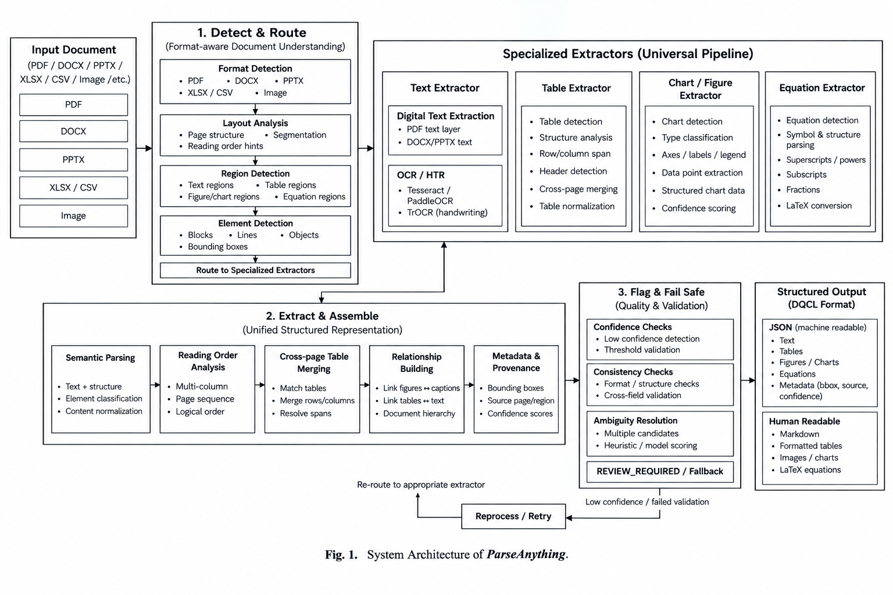
DATAQUEST 3.0 · ROUND 1
04 System Architecture
System diagram is the primary visual · Engineering decisions · Validation
SYSTEM DIAGRAM

Slide 5
DATAQUEST 3.0 · ROUND 1
04 System Architecture
System diagram is the primary visual · Engineering decisions · Validation
TECH 01
TECH 02
TECH 03
KEY TECHNICAL DECISION
Pipeline:
Upload → Detect & Route → Specialized Extraction → Assemble → Confidence + Provenance → Canonical Document → JSON/Markdown
Why this stack?
PyMuPDF → PDF ingestion, text/layout geometry
python-docx / python-pptx / openpyxl → native Office parsing
Tesseract / PaddleOCR → scanned-page OCR
OpenCV → scanned-table/grid detection
Pydantic models → unified Document / Block / Table representation
FastAPI + React → API + interactive interface
Key decision: all extractors produce the same canonical blocks, so JSON, Markdown, Search, Summary and source navigation operate on one representation.
HARDEST PART
Reconstructing the document correctly, not simply extracting text
The hardest technical challenge is preserving the meaning and structure of a complex document when information is distributed across different visual regions.
Particularly difficult cases include:
  Multi-column reading order
  Sidebars, captions, headers and footnotes
  Merged/multi-row table cells
  Tables spanning multiple pages
  Mixed digital + scanned pages
  Equations embedded as images
  Charts alongside explanatory text
  Maintaining relationships between captions and figures
VALIDATION
1. Extraction Quality
Tested across:
Digital + scanned PDFs
DOCX / PPTX / XLSX
Multi-column layouts
Tables + merged cells
Figures / charts
Mathematical equations
OCR
2. Structural Validation
Every block retains provenance
Bounding boxes remain within page/slide boundaries
Reading order is validated
Cross-page tables are checked before merging
Table totals/consistency are mathematically validated
3. Performance & Reliability
Measured using real time.perf_counter()

Slide 6
DATAQUEST 3.0 · ROUND 1
05 Feasibility & Scope
Concrete boundaries · Operational run rate · Risk mitigation · Post-hackathon plans
01 · BOUNDARIES
02 · ECONOMICS
1. SCOPE
  Digital & scanned PDF ingestion
  DOCX / PPTX / XLSX / standalone image parsing
  OCR, reading-order & layout detection
  Table extraction + cross-page table merging
  Figure/chart detection & preservation
  Bounding boxes, provenance & confidence scores
  Markdown + JSON output
  Web-based upload, processing & download
2. RUNNING COST
  Self-hosted / open-source prototype
  PyMuPDF + OpenCV + Tesseract/PaddleOCR
  No mandatory per-page API cost
  Compute cost depends on document volume and OCR workload
  Production deployment can use scalable cloud compute as usage grows
03 · CONTINGENCY
04 · HORIZON
3. RISKS & FALLBACK
  OCR failure → alternate OCR engine / preserve source region
  Low-confidence extraction → flag as REVIEW_REQUIRED
  Table extraction failure → preserve table as image + continue parsing
  Ambiguous reading order → lower confidence + flag ambiguity
  Unsupported/corrupt files → structured error response
4. AFTER THE HACKATHON
Production hardening: scalable workers, persistent queues, monitoring & cost optimization
Enterprise deployment: secure API/SDK integration for finance, legal & regulated workflows
Continuous improvement: benchmark-driven accuracy, multimodal understanding & model optimization

Slide 7
DATAQUEST 3.0 · ROUND 1
06 Impact & Metrics
Primary measurable impact · Transparent calculation · Stakeholder advantages
PRIMARY METRIC
[ 90% ]
High-Fidelity Extraction Accuracy
HOW IT WAS MEASURED
Correctly extracted elements / Total ground-truth elements × 100
IMPACT 01
IMPACT 02
IMPACT 03
WHAT IMPROVES
Higher-fidelity document extraction
  Reduces missing and misread content
  Preserves correct reading order and document structure
~20–25% higher extraction accuracy vs. baseline
WHO ELSE BENEFITS
Beyond the End User
Primary beneficiaries include:
Finance & Investment Teams
Legal & Compliance Teams
Data / AI Teams
Auditors / Reviewers
RISKS / MISUSE
Risk: Incorrect extraction may be trusted as fact.
Mitigation:
  Block-level confidence
  Page + bounding-box provenance
  Fail-safe extraction
  Structured error reporting
  Human review of low-confidence content
When ParseAnything isn't sure, it tells you.

Slide 8
DATAQUEST 3.0 · ROUND 1
07 Why This Project?
Direct contrast with today's alternatives · Unfair technical advantage
STATUS QUO
OUR SOLUTION
CURRENT APPROACH
Current document-processing workflows typically rely on separate tools for text extraction, OCR, tables and document conversion, followed by manual correction when complex layouts are encountered. Existing document parsers can perform well on ordinary text but become less reliable with multi-column layouts, scanned pages, complex tables, formulas and visual content.
When extraction is uncertain, users often have to inspect the original and manually verify or correct the output.
OUR APPROACH
One unified intelligent pipeline
Analyze → Route → Extract → Assemble → Verify
Specialized extraction for text, OCR, layouts, tables, figures and equations, followed by structured assembly into Markdown + JSON.
Every block carries confidence + provenance + bounding-box metadata.
MOAT / DIFFERENTIATION
KEY DIFFERENCE
“We don't just extract information: we make every extraction verifiable.”
This is especially important for finance, legal and regulated documents, where knowing where information came from can matter just as much as extracting the information itself.

Slide 9
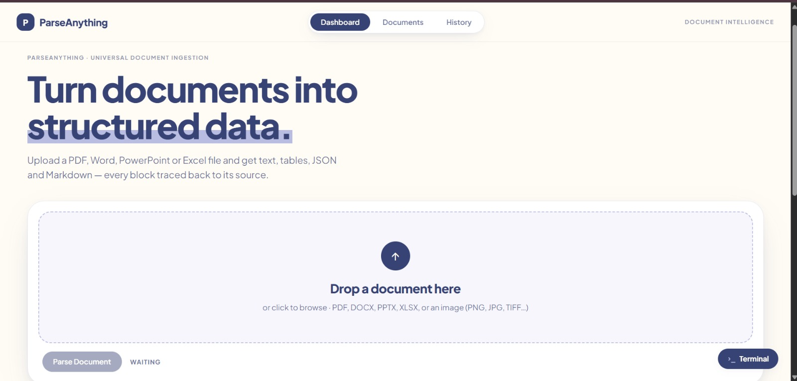
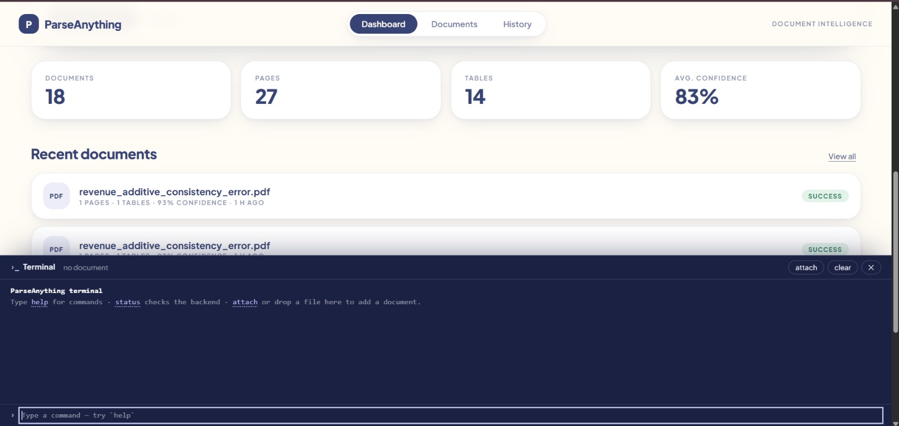
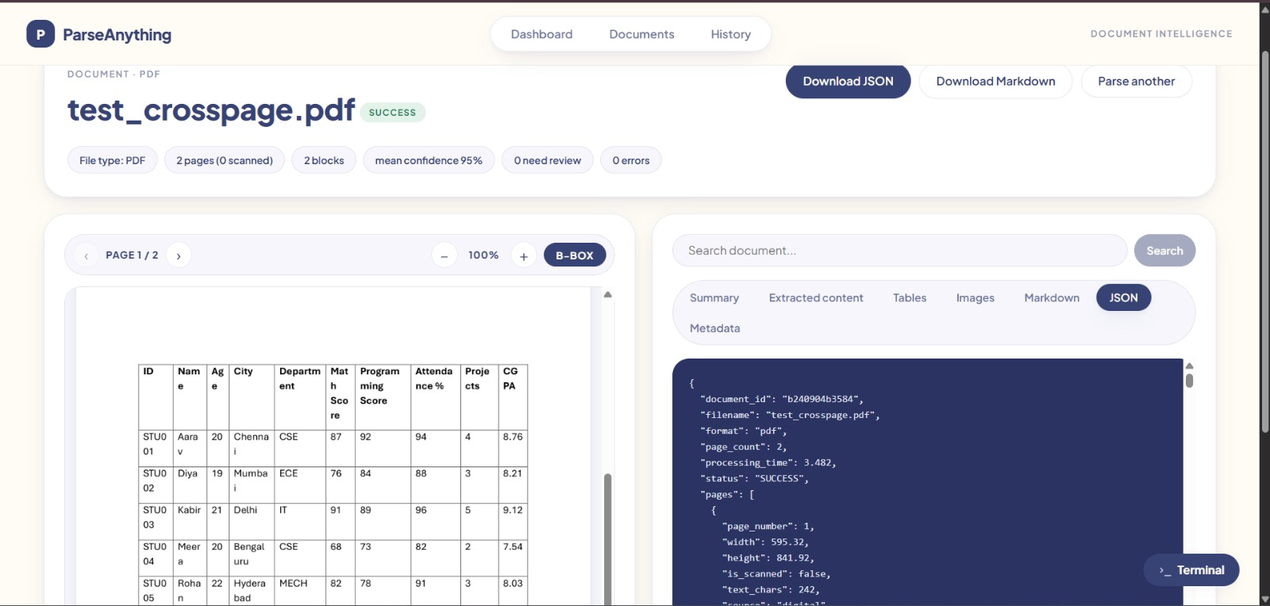
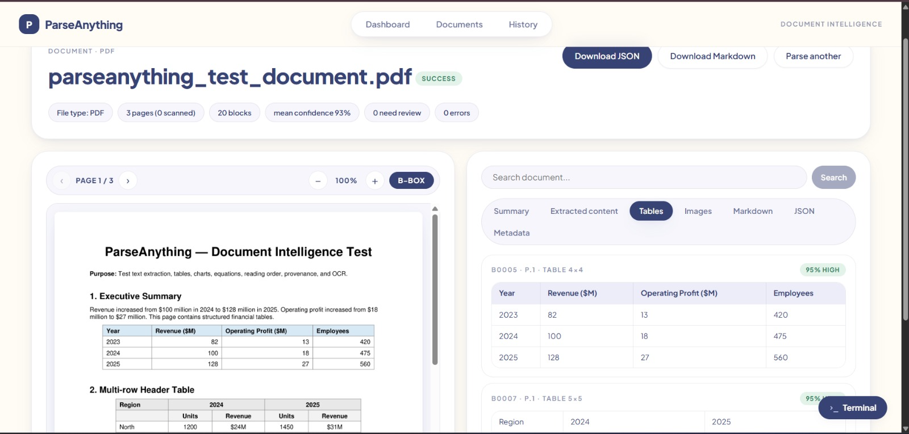
DATAQUEST 3.0 · ROUND 1
08 Extra Slide
Optional appendix · Extra diagrams, product screenshots, benchmarks, or backup details

