Slide 1
Support Vector Machine
Group 4

Slide 2
Support Vector Network
It is a supervised learning model with associated learning algorithms (SMO) that analyze data used for classification and regression analysis.
Sequential minimal optimization(SMO) is an algorithm for solving the quadratic programming problem that arises during the training of support vector machines.

Slide 3
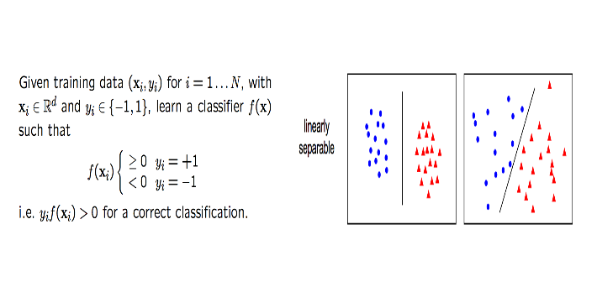
Linear SVM

Slide 4
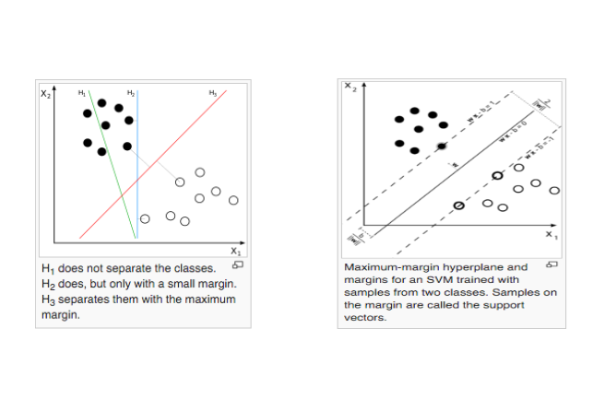
Linear Classifiers

Slide 5
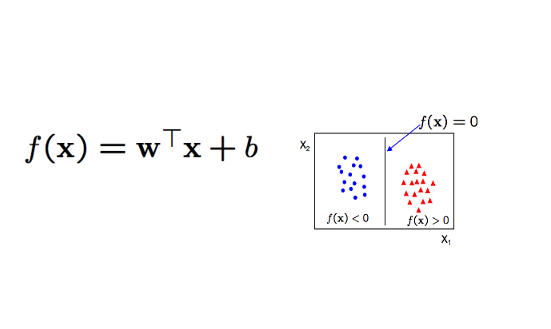
Linear classifier will be of form

Slide 6
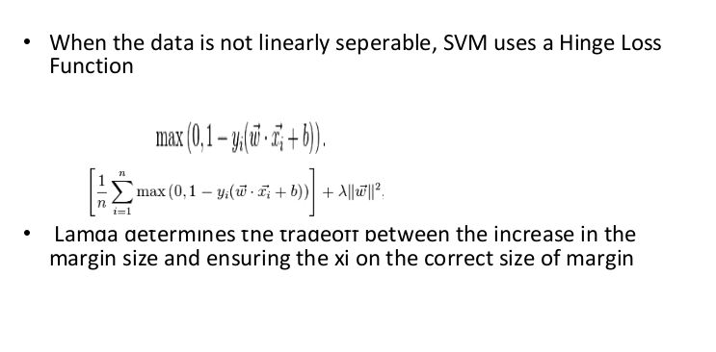
Soft Margin:

Slide 7
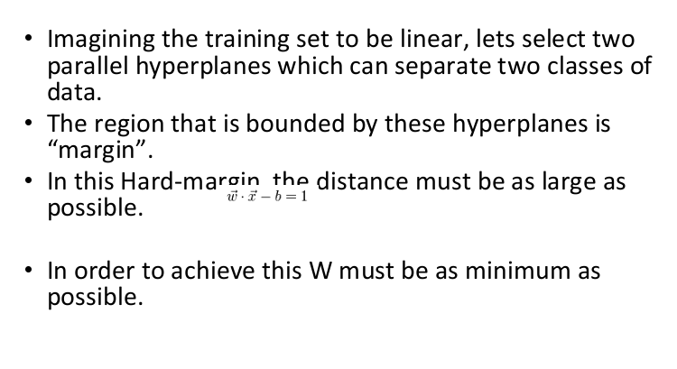
Hard Margin

Slide 8
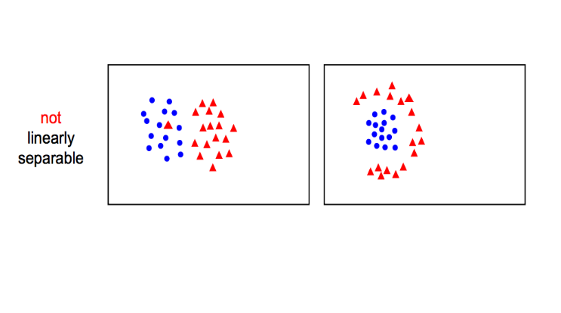
Non-Linear SVM

Slide 9
Advantages & Disadvantages
It has a regularization parameter, which makes the user think about avoiding over-fitting.
Secondly it uses the kernel trick, so you can build in expert knowledge about the problem via engineering the kernel.
Thirdly an SVM is defined by a convex optimization problem (no local minima) for which there are efficient methods (e.g. SMO)
The hinge loss used in the SVM results in sparsity.
kernel models can be quite sensitive to over-fitting the model selection criterion

