Slide 1
k-Medians/k-Medoids & Hierarchical Clustering
By : Team 4

Slide 2
K-medoids Clustering technique
Both k-means and k-medoids attempt to minimize the distance between points labelled to be in a cluster and a point designated as the center of the cluster
k-medoids choses data points as center(called as medoids or exemplars) and works with an arbitrary matrix of distances
The clustering technique using K-medoids is called as PAM(Partitioning around medoid)

Slide 3
PAM
1. Initialize: randomly select k of the n data points as the medoids
2. Associate each data point to the closest medoid(closest distance can be found by an valid distance metric , example Manhattan distance, Euclidean distance or Minkowsky distance)
3. For each medoid m, for each non medoid point o swap m and o and compute the total cost of the configuration
4. Select the configuration with the lowest cost
5. Repeat step 2-4 until there is no change in medoid

Slide 4
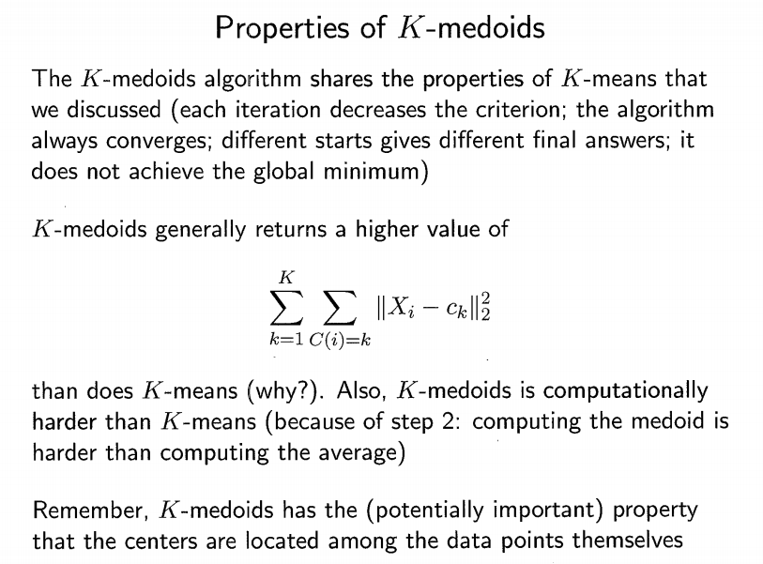

Slide 5
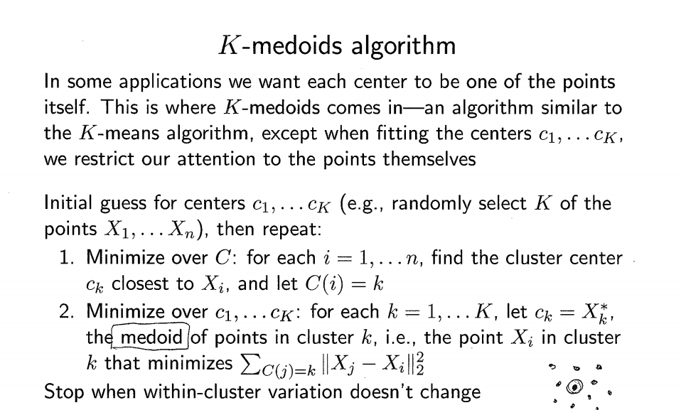

Slide 6
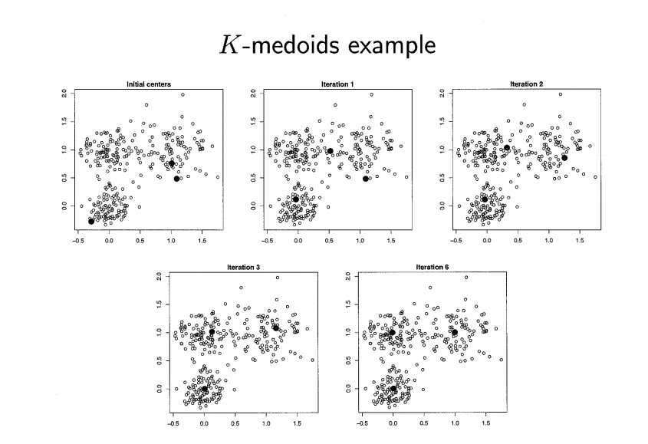

Slide 7
Hierarchical Clustering
A method of cluster analysis which seeks to build a hierarchy of clusters
The results of hierarchical clustering are usually presented in a dendogram.

Slide 8
Contd..
Given pairwise dissimilarities dij between data points, hierarchical clustering produces a consistent result, without the need to choose initial starting positions (number of clusters)
The catch: we need to choose a way to measure the dissimilarity between groups, called the linkage
Given the linkage, hierarchical clustering produces a sequence of clustering assignments. At one end, all points are in their own cluster, at the other end, all points are in one cluster

Slide 9
Agglomerative:
This is a "bottom up" approach: each observation starts in its own cluster, and pairs of clusters are merged as one moves up the hierarchy until there is only one cluster.
The complexity of agglomerative clustering is , which makes them too slow for large data sets
Divisive:
This is a "top down" approach: all observations start in one cluster, and splits are performed recursively as one moves down the hierarchy until all points belong to their cluster.
Divisive clustering with an exhaustive search is , which is even worse

Slide 10
Dendogram
Dendogram: convenient graphic to display a hierarchical sequence of clustering assignments. This is simply a tree where:
1. Each node represents a group
2. Each leaf node is a singleton (i.e., a group containing a single data point)
3. Root node is the group containing the whole data set
4. Each internal node has two daughter nodes (children), representing the the groups that were merged to form it

Slide 11
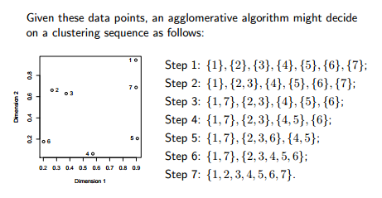
Example:

Slide 12
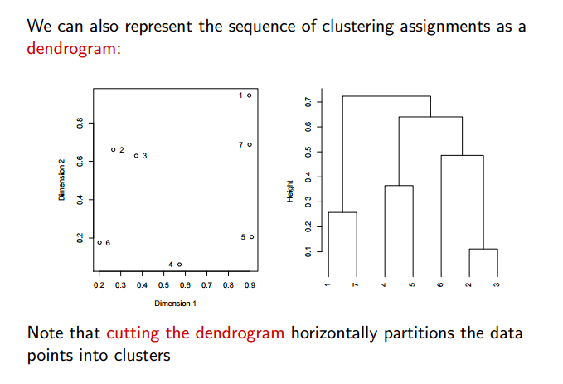
Dendogram:

