Slide 1
Spark SQL: Relational Data Processing in Spark
Michael Armbrust, Reynold Xin, Cheng Lian, Yin Huai,
Davies Liu, Joseph K. Bradley, Xiangrui Meng, Tomer Kaftan, Michael J. Franklin, Ali Ghodsi, Matei Zaharia
Presented By
Shuchita Khandelwal (10)
Anuja Sawant (25)

Slide 2
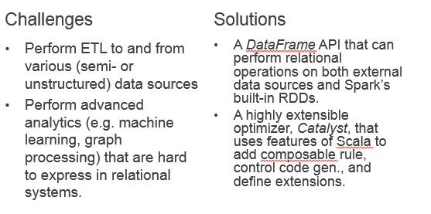
Challenges and Solutions

Slide 3
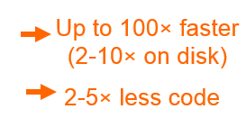
What is Apache Spark?
Fast and general cluster computing system, interoperable with Hadoop, included in all major distros
Improves efficiency through:
In-memory computing primitives
General computation graphs
Improves usability through:
Rich APIs in Scala, Java, Python
Interactive shell

Slide 4
Spark Model
Write programs in terms of transformations on distributed datasets
Resilient Distributed Datasets (RDDs)
Collections of objects that can be stored in memory or disk across a cluster
Parallel functional transformations (map, filter, …)
Automatically rebuilt on failure

Slide 5
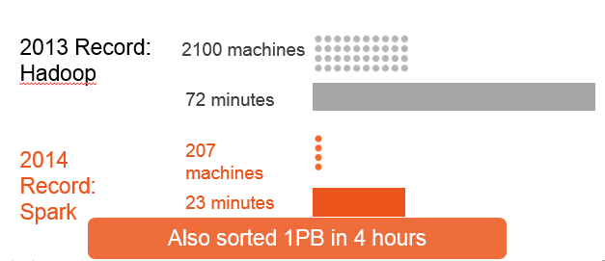
On-Disk Sort Record: Time to sort 100TB

Slide 6

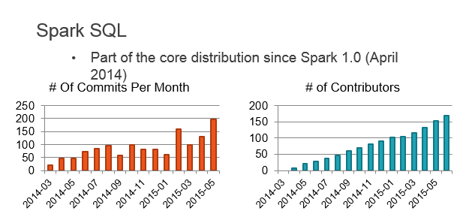
About
SQL

Slide 7
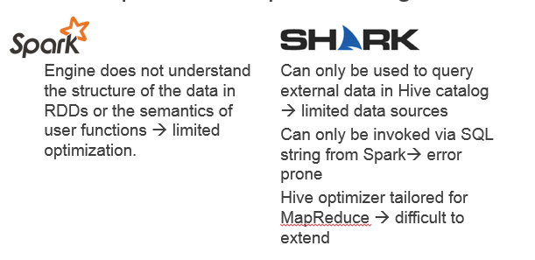
Improvement upon Existing Art

Slide 8
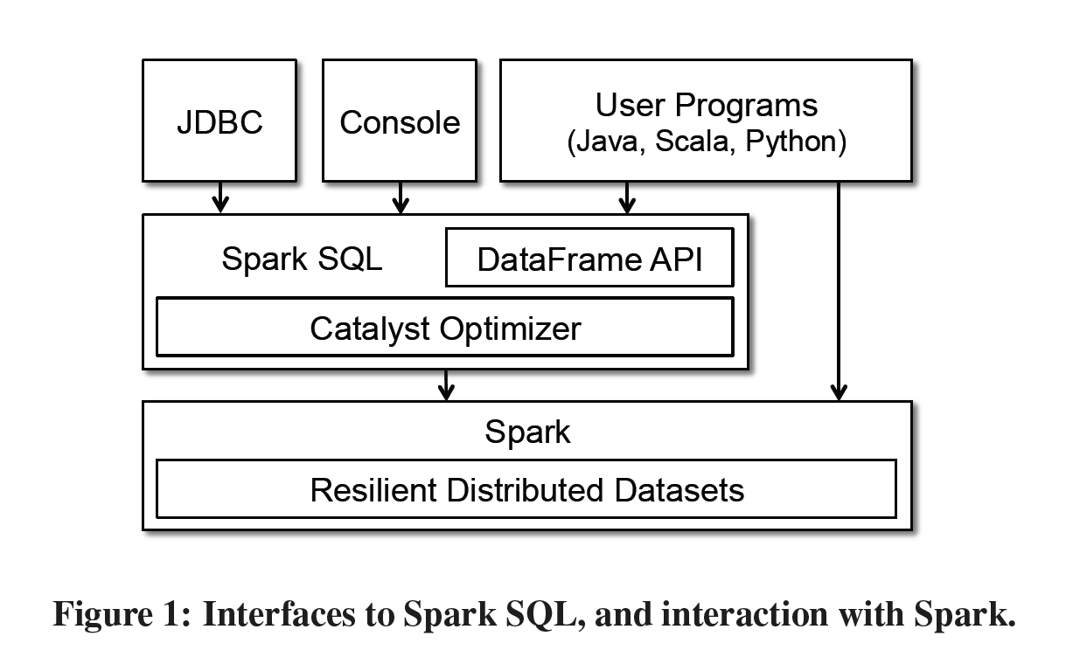
Programming Interface

Slide 9
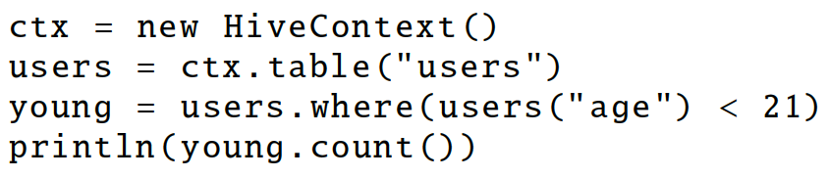
A distributed collection of rows with the same schema (RDDs suffer from type erasure)
Can be constructed from external data sources or RDDs into essentially an RDD of Row objects (SchemaRDDs as of Spark < 1.3)
Supports relational operators (e.g. where, groupby) as well as Spark operations.
Evaluated lazily → unmaterialized logical plan

Slide 10
Data Model
Nested data model
Supports both primitive SQL types (boolean, integer, double, decimal, string, data, timestamp) and complex types (structs, arrays, maps, and unions); also user defined types.
First class support for complex data types

Slide 11
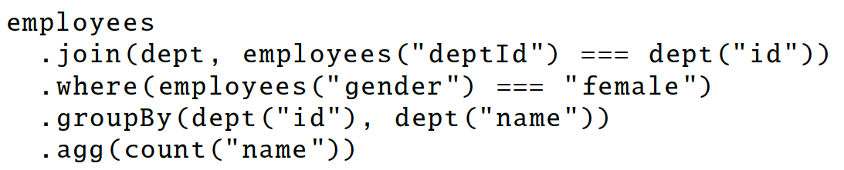
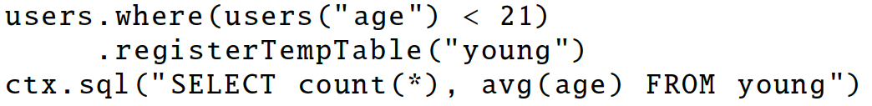
DataFrame Operations
Relational operations (select, where, join, groupBy) via a DSL
Operators take expression objects
Operators build up an abstract syntax tree (AST), which is then optimized by Catalyst.
Alternatively, register as temp SQL table and perform traditional SQL query strings

Slide 12
Advantages over Relational Query Languages
Holistic optimization across functions composed in different languages.
Control structures (e.g. if, for)
Logical plan analyzed eagerly → identify code errors associated with data schema issues on the fly.

Slide 13
Querying Native Datasets
Infer column names and types directly from data objects (via reflection in Java and Scala and data sampling in Python, which is dynamically typed)
Native objects accessed in-place to avoid expensive data format transformation.
Benefits:
Run relational operations on existing Spark programs.
Combine RDDs with external structured data
Columnar storage with hot columns cached in memory

Slide 14
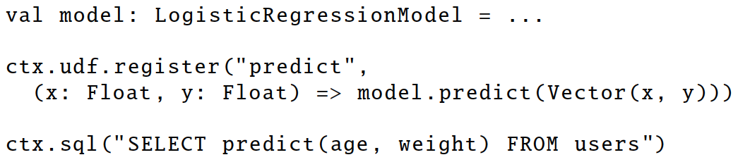
User-Defined Functions (UDFs)
Easy extension of limited operations supported.
Allows inline registration of UDFs
Compare with Pig, which requires the UDF to be written in a Java package that’s loaded into the Pig script.
Can be defined on simple data types or entire tables.
UDFs available to other interfaces after registration

Slide 15
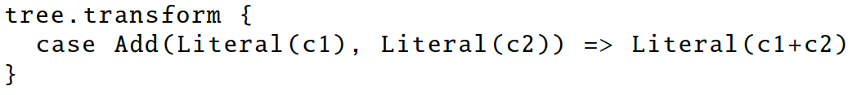
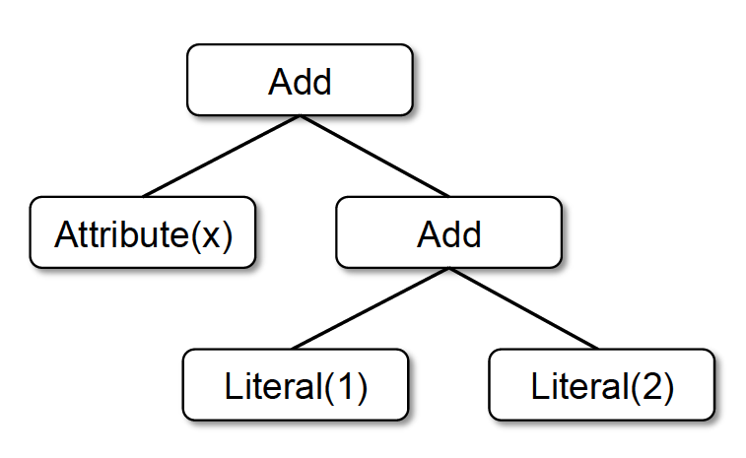
Catalyst
Add
Attribute(x)
Literal(3)
x + 3
x + (1 + 2)

Slide 16
Prior Work: Optimizer Generators
Volcano / Cascades:
Create a custom language for expressing rules that rewrite trees of relational operators.
Build a compiler that generates executable code for these rules.
Cons: Developers need to learn this custom language. Language might not be powerful enough.

Slide 17
Catalyst Rules
Pattern matching functions that transform subtrees into specific structures.
Partial function—skip over subtrees that do not match → no need to modify existing rules when adding new types of operators.
Multiple patterns in the same transform call.
May take multiple batches to reach a fixed point.
transform can contain arbitrary Scala code.

Slide 18
Using Catalyst in Spark SQL:
Four phases of Catalyst’s general tree transformation framework:
Analysis
Logical Optimization
Physical Planning
Code Generation

Slide 19
Plan Optimization & Execution
Analysis
Logical
Optimization
Physical
Planning
Code
Generation
SQL AST
Unresolved Logical Plan
Logical Plan
Optimized Logical Plan
Physical Plans
Selected Physical Plan
RDDs
Cost Model
DataFrame
Catalog
DataFrames and SQL share the same optimization/execution pipeline

Slide 20
Analysis Phase:
An attribute is unresolved if its type is not known or it’s not matched to an input table.
To resolve attributes:
Look up relations by name from the catalog.
Map named attributes to the input provided given operator’s children.
UID for references to the same value
Propagate and coerce types through expressions (e.g. 1 + col)
Analysis
Unresolved Logical Plan
Logical Plan
Catalog
SELECT col FROM sales

Slide 21
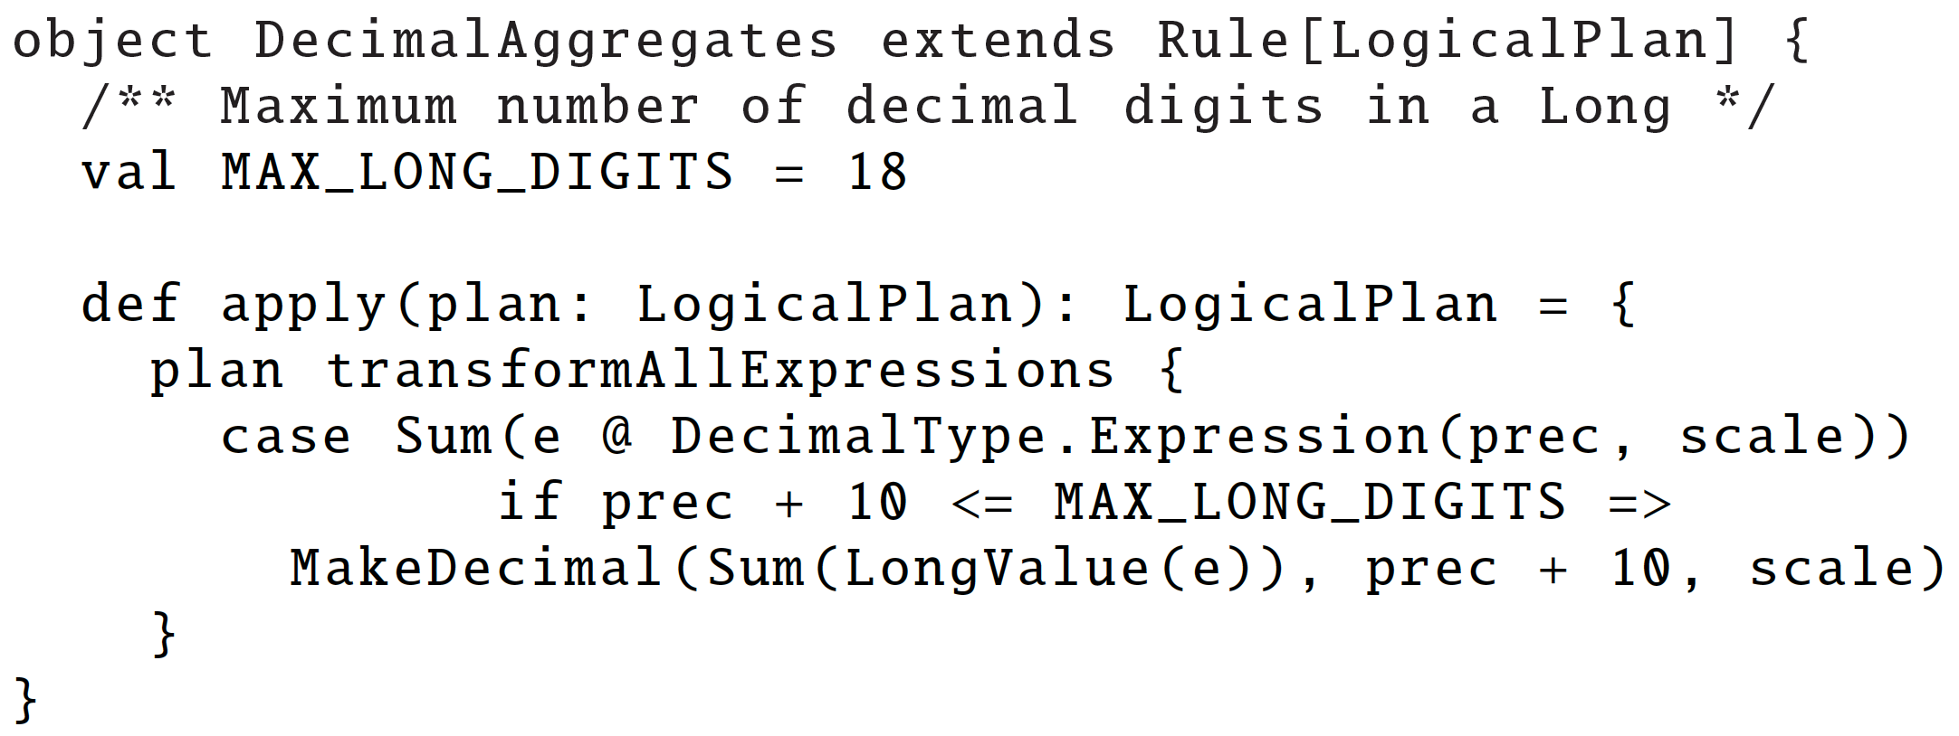
Logical Optimization:
Applies standard rule-based optimization (constant folding, predicate-pushdown, projection pruning, null propagation, boolean expression simplification, etc)
800LOC
Logical
Optimization
Logical Plan
Optimized Logical Plan

Slide 22
Physical Planning:
Generates one or more Physical Plans
Cost-model for plan selection
Rule based optimization
500 LOC

Slide 23
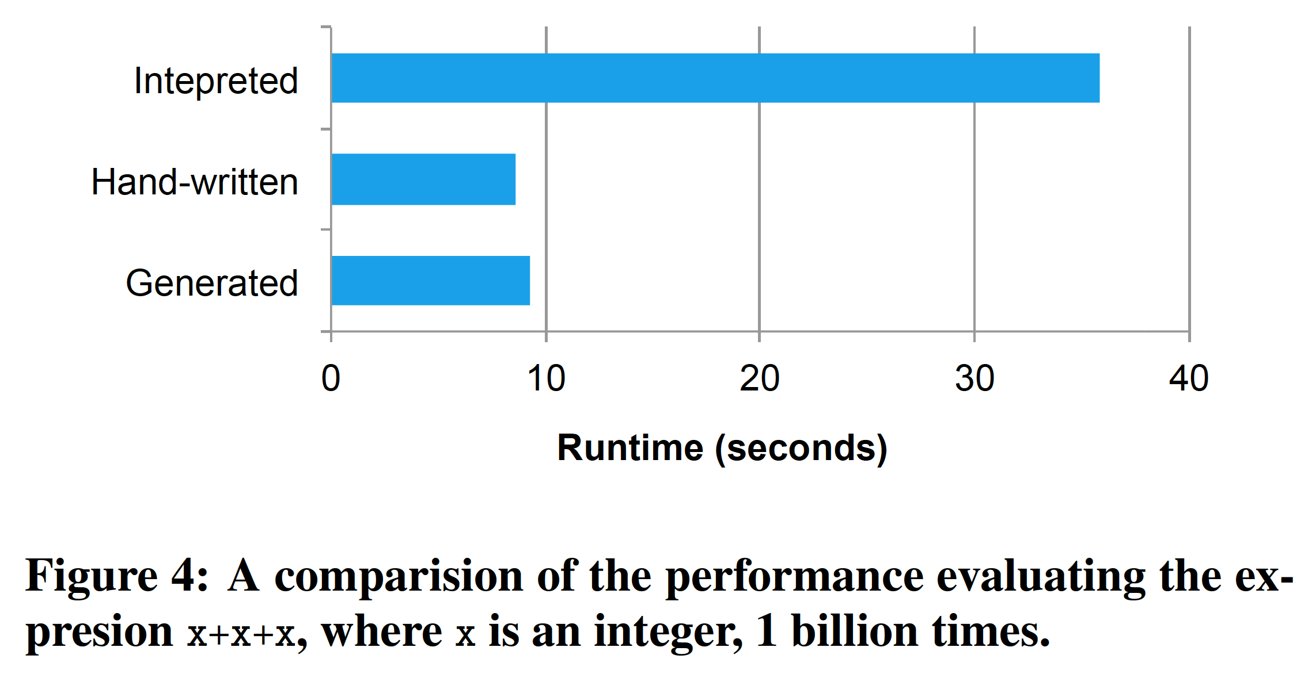
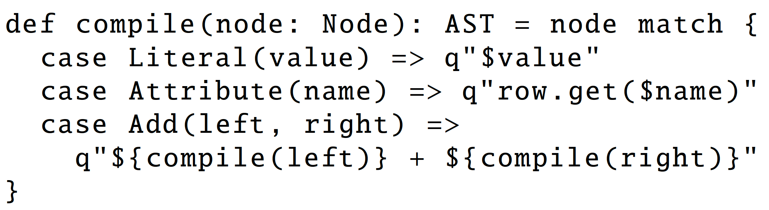
Code Generation:
Generation of Java Bytecode
Relies on Scala’s quasiquotes to simplify code gen.
Catalyst transforms a SQL tree into an abstract syntax tree (AST) for Scala code to evaluate expression and generate code
700LOC

Slide 24
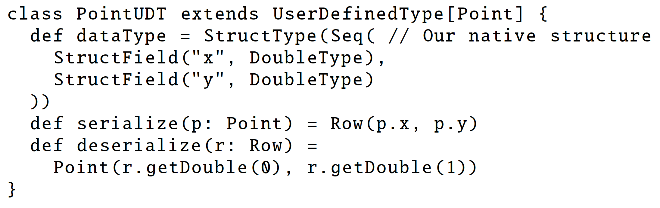
Extension Points:
Data Sources
-Must implement a createRelation function that takes a set of key-value parameters and returns a BaseRelation object.
-E.g. CSV, Avro, Parquet, JDBC
User-Defined Types (UDTs)
-Map user-defined types to structures composed of Catalyst’s built-in types.

Slide 25
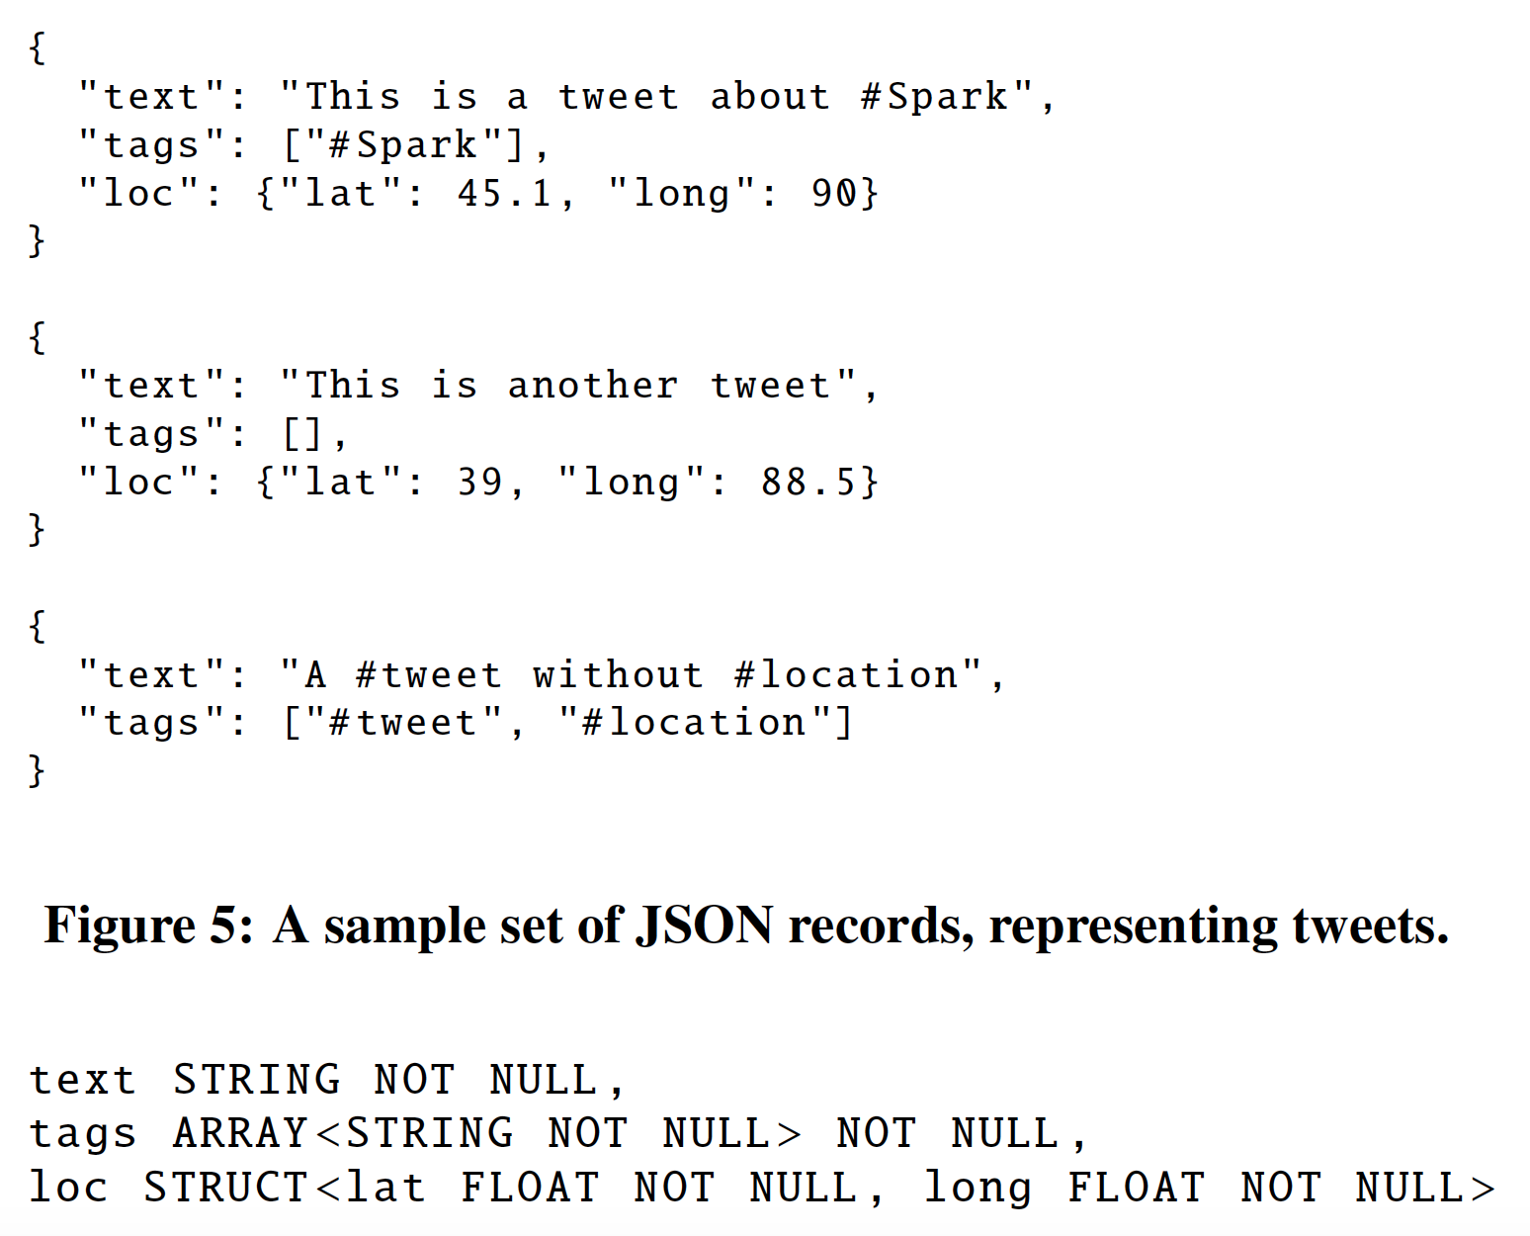
Advanced Analytics Features:
Schema Inference for Semistructured Data:
JSON
Automatically infers schema from a set of records, in one pass or sample
A tree of STRUCT types, each of which may contain atoms, arrays, or other STRUCTs.
Find the most appropriate type for a field based on all data observed in that column. Determine array element types in the same way.
Merge schemata of single records in one reduce operation.
Same trick for Python typing

Slide 26
Spark MLlib Pipelines:
Pipeline: Graph of transformations on data
tokenizer = Tokenizer(inputCol="text", outputCol="words”)
hashingTF = HashingTF(inputCol="words", outputCol="features”)
lr = LogisticRegression(maxIter=10, regParam=0.01)
pipeline = Pipeline(stages=[tokenizer, hashingTF, lr])
df = sqlCtx.load("/path/to/data")
model = pipeline.fit(df)
lr
ds0
ds1
ds2
lr.model
ds3
tokenizer
hashingTF
Pipeline Model

Slide 27


Query Federation to External Databases:
Leverages Catalyst to push predicate down into data sources whenever possible

Slide 28
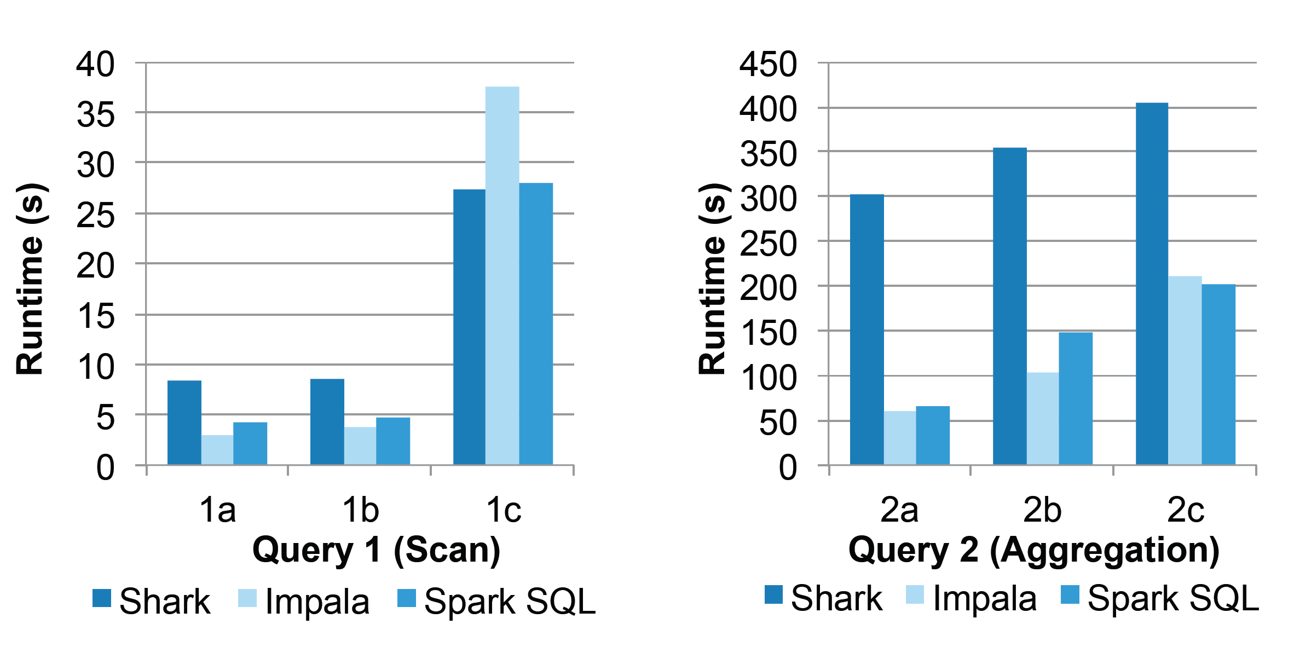
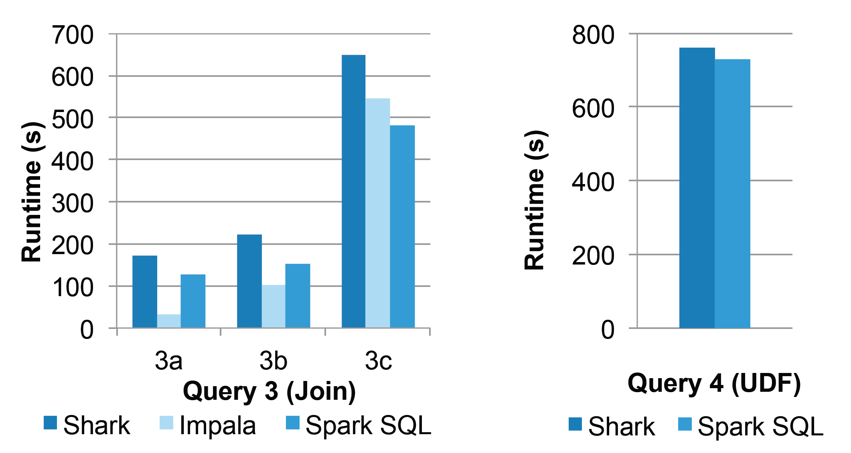
Evaluation: SQL Performance
110GB of data
after columnar
compression
with Parquet

Slide 29
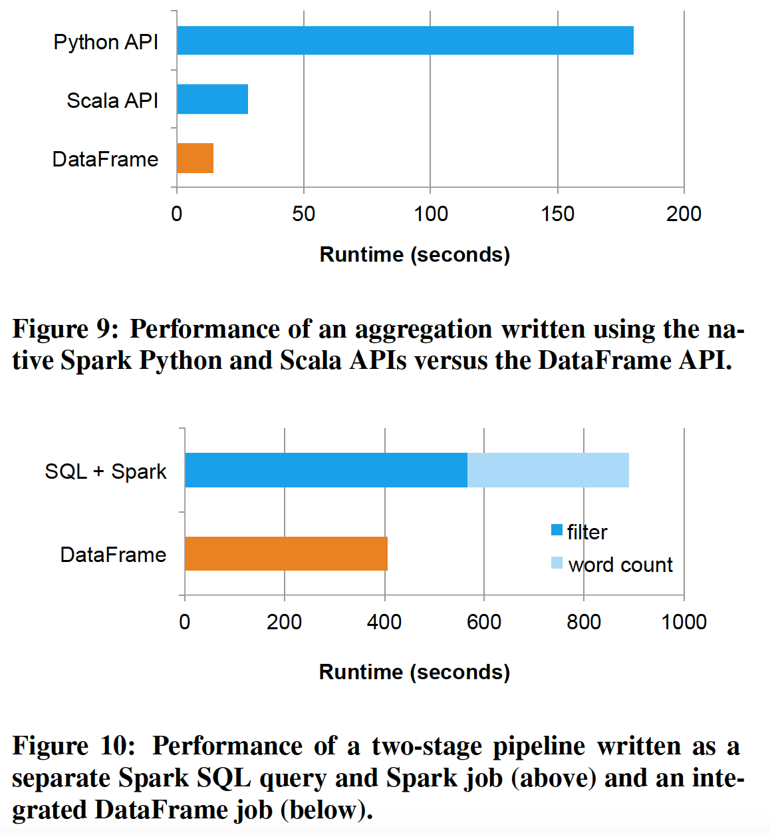
Evaluation:
Data Frames vs. Native Spark Code
Pipeline Evaluation

Slide 30
Future Work: Project Tungsten
Overcome JVM limitations:
Memory Management and Binary Processing: leveraging application semantics to manage memory explicitly and eliminate the overhead of JVM object model and garbage collection
Cache-aware computation: algorithms and data structures to exploit memory hierarchy
Code generation: using code generation to exploit modern compilers and CPUs

Slide 31
References:
http://www-cs-students.stanford.edu/~adityagp/courses/cs598/
https://databricks.com/blog/2015/04/13/deep-dive-into-spark-sqls-catalyst-optimizer.html

Slide 32
THANK YOU

