Slide 1
Serving Large-scale Batch Computed Data with Project Voldemort
By
Roshan Sumbaly Jay Kreps Lei Gao Alex Feinberg Chinmay Soman Sam Shah
LinkedIn
Presenters:
Tarun Chandrashekar
Geetha Chandrashekar
Anuja Sawant
Shuchita Khandelwal
David Rodgers
Shubhabrata Mukherjee
Sai Tejaswi Pullela

Slide 2

Introduction & Related work
- Tarun Chandrashekar

Slide 3
Voldemort
What is it?
Motivation
Inspiration
2. Implementation
What’s next?

Slide 4
Introduction
The featured data cycle in this context consists of a continuous cycle of three phases:
1. Data collection
Log consumption
2. Processing
Running algorithms.
3. Serving

Slide 5
Introduction contd.
This complete cycle means that the live updates are not necessary.
Voldemort was originally designed to support fast online read writes.
High throughput for batch output even during complete data refreshes.
Quick rollback, leading to less time in error as well as fast development.
Excellent live serving performance for batch output on connection of a read only storage engine.

Slide 6
KEY CONTIBUTIONS
The key contributions of this work are:
• A scalable offline index construction, based on MapReduce, which produces partitioned data for online consumption.
• Complete data cycle to refresh terabytes of data with minimum effect on existing serving latency.
• Custom storage format for static data, which leverages the operating system’s page cache for cache management.

Slide 7
RELATED WORK
MySQL storage engine consists of two most commonly used storage engines MyISAM, InnoDB
MyISAM
Compact disk structure.
Ability to delay re-creation of index after load.
Tree like cache (requires more memory).
Locks the table for the duration of the load.
InnoDB
Row level locking.
On disk structure(requires more memory).
Bulk loading relatively slower than MyISAM.

Slide 8


PNUTS vs VOLDEMORT
VS

Slide 9
Project Voldemort
- Geetha Chandrashekar

Slide 10
Project Voldemort
Voldemort cluster can contain multiple nodes, each with a unique identifier
Unlike others, LinkedIn maintain a one-to-one mapping
Cluster have the same number of stores, which correspond to database tables

Slide 11
Configurable Parameters
N - The replication factor
R - The number of blocking reads
W - The number of blocking writes
Key Value Serialization/Compression
- Have different serialization schemes for key and value
- Uses custom binary JSON format
- Supports per-tuple based compression
Storage engine type
- various read- write storage formats
- supports custom read-only storage engine for bulk loaded data

Slide 12





Voldemort Architecture
Client API
Responses
Conflict Resolution
Requests
Serialization
Repair Mechanism
Network Client /
Routing
Server
Storage Engine

Slide 13
Pluggable Architecture
Client API
- simple get and put API
-Every tuple is replicated (Vector Clock Versioning)
Conflict Resolution and Repair Mechanism
- used only by read-write storage engines
- deals with inconsistent replicas
- doesn’t apply with read only stores
Routing
- It deals with partitioning as well as replication
Storage engine
- ability to stream data out

Slide 14
Hash Ring Cluster Topology
Hash ring is divided in to equal size partition's
Partitions never change
- Partitions ownership
can change
Replication
- Each partition is stored by ‘N’ nodes
Every Node has 2 pieces of metadata
- complete cluster topology and store definitions
MD5(key)
Partition 11
Partition 0
Partition
Preference list
Node 2
Node 0
hashed to
N0
N1
N2
Partition 10
Partition 1
0
0
1
Node 1
Node 1
1
1
2
Paratition 9
2
3
2
Node 0
Partitioan 2
3
3
4
Node 2
4
4
5
5
6
5
Partition 8
Partition 3
6
6
7
Node 2
Node 0
7
7
8
Partition 7
Partition 4
8
9
8
Node 1
Node 1
9
9
10
Partition 6
Partition 5
10
10
11
Node 0
Node 2
11
0
11

Slide 15
Routing
Voldemort supports two routing modes
- server side and client side routing
Client side routing
- most commonly used strategy
- Requires initial bootstrap step where it retrieves the metadata required for routing by load balancing to a random node
- makes rebalancing of the complicated data
- once metadata is received by client , one fewer hop is necessary compared to server side routing

Slide 16

Questions??????

Slide 17
Alternative Approaches
- Anuja Sawant

Slide 18
Analysis and Results
Analysis of existing read-write storage engines
Recognized the requirements
Criteria of Success

Slide 19
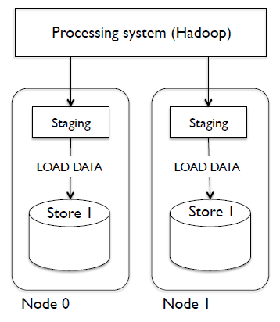
Bulk Load Approach - 1
Hadoop
Staging Area
Load Data Statement
https://www.usenix.org/conference/fast12/serving-large-scale-batch-computed-data-project-voldemort

Slide 20
Bulk Load Approach - 2
Bulk load into a different table
MyISAM storage Engine
Problem !!

Slide 21
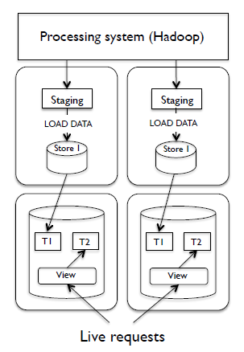
Bulk Load Approach - 2
Maintain new Cluster
https://www.usenix.org/conference/fast12/serving-large-scale-batch-computed-data-project-voldemort

Slide 22
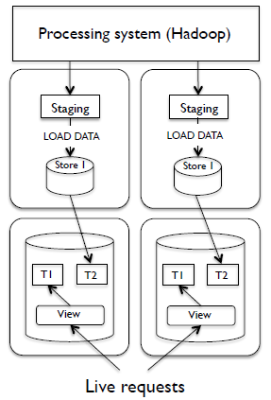
Bulk Load Approach - 2
Maintain new Cluster
https://www.usenix.org/conference/fast12/serving-large-scale-batch-computed-data-project-voldemort

Slide 23
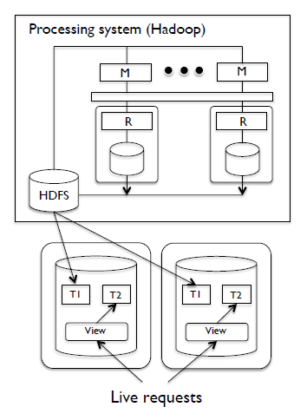
Bulk Load Approach - 3
Move index construction
into Hadoop
Extra map-reduce step
Problem !!
https://www.usenix.org/conference/fast12/serving-large-scale-batch-computed-data-project-voldemort

Slide 24
Requirements
Minimal performance impact on live requests
Fault Tolerance and Scalability
Rollback Capability
Ability to handle large data sets

Slide 25


Slide 26
Voldemort
By: Shuchita Khandelwal

Slide 27
Read-Only Extensions
Data is generated by algorithms run on Hadoop. The Process:
The driver program coordinates a refresh of data
It triggers a build of output data and stores in HDFS
The data is versioned every time it is updated after being fetched by Voldemort nodes as parallel fetch
Once it is fetched, the new versioned data is swapped with the old Version of data
Now the data on Voldemort nodes are ready to serve.

Slide 28
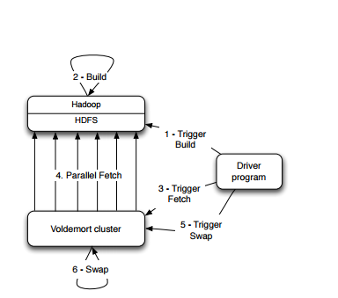
Figure: Complete Data Deployment pipeline.

Slide 29
Storage Format
Since the data is immutable, Voldemort memory maps the entire index into address space
The input data is split into “multiple chunk buckets”
Each chunk bucket is in turn split into “chunk sets”
The Index File is a compact structure containing the stored upper 8 bytes of the MD5 of the key followed by 4 byte offset
The Data File is also a packed structure where we store the number of collided tuples followed by the list of them

Slide 30
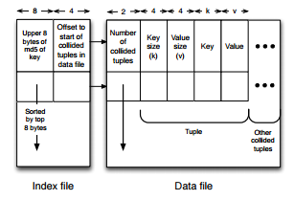
Store→Partitions→Chunk Sets
Chunk Set= Index File +Data File

Slide 31
Chunk Set Generation
Chunk set construction is a single map reduce job
Inputs= no. of chunk sets per bucket, cluster topology, store definition and input data location on HDFS
Replication and partitioning done by the job and saves into separate nodes
Every reducer is responsible for single chunk set
Input is automatically sorted by Hadoop based on the key and so the index and data files can be constructed by simple appends on HDFS.

Slide 32
Read Only Extensions Contd.
- David Rodgers

Slide 33
Read Only Extensions Contd.
Data Versioning
Data Load Process
Data Retrieval
Data Retrieval Optimization
Notes:
Introduce self
Will talk about project Voldemort’s
Data versioning
Data load process
Data retrieval
And how the data retrieval process is optimized

Slide 34
Data Versioning
Requirement: Perform instantaneous rollback of data
System must demote previous copy to earlier state each time a new copy of the whole data set is created
Keeping track of each version
Each store is represented by a directory, which contains directories corresponding to different “versions”
Symbolic link per store is used to point to current version directory
Each copy has a configurable number tied to it
This provides ability to perform a quick rollback of data
Cache usage and latency remains unaffected (only one version directory in use)
Notes:
We have requirement to perform an instantaneous rollback of data (can’t afford large downtime to do this)
So, every time a whole new data set is created, system must be able to remember old data in an organized way.
Doing this requires keeping track of each version to easily roll back to if necessary
To do so:
Each store of data is its own directory, in which there are directories for different “versions”
A symbolic link per store is used to point to current version directory
Each has a configurable number associated with it; being able to easily refer to each copy makes it possible to perform quick rollbacks
Because all version directories except the serving one is inactive, cache usage and latency is unaffected

Slide 35
Swapping in a new data version (single node)
Entire operation is coordinated using a read-write lock
Rollback follows same steps, but opens an older version directory
Very fast - only metadata operations, no data reads take place
Notes:
Explain : emphasize abstract representation of swapping process Colors (red v green = directories)
Cloud = data (black = closed, white – open) Explain how to do so: 1. copy data into a new version directory
2. Close current set of active chunk set files 3. Open chunk set files from new version 4. memory map all of the index files
5. Change symbolic link to the new version
**Highlight important features:
-Operation is coordinated using read-write block
-Rollback is very similar, but instead of new verison, points to older version -Swap operation : avg speed = 0.012 (about 1 hundredth of a ms,) worst = 0.050 (5 hundredths) ms. STOP and check for general understanding before moving on

Slide 36
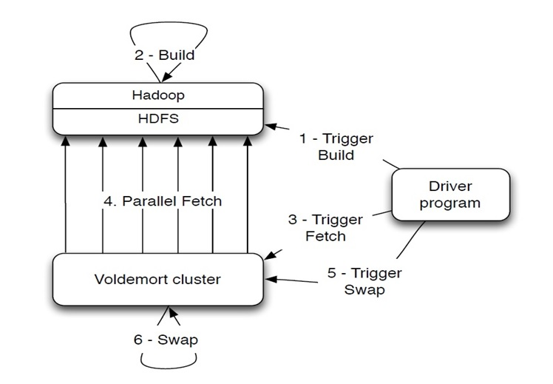
Roshan Sumbaly, Jay Kreps, Lei Gao, Alex Feinberg, Chinmay Soman, and Sam Shah. 2012. Serving large-scale batch computed data with project Voldemort. In Proceedings of the 10th USENIX conference on File and Storage Technologies (FAST’12). USENIX Association, Berkeley, CA, USA, 18-18
Data Load Process
Notes:
Initiator – standalone driver program: constructs, fetches and swaps the data 1. Program triggers Hadoop job
2. this job generates data on a per-node basis and stores it in HDFS. While streaming data to HDFS, Hadoop job also calculates a checksum on a per-node basis by storing a running MD5 on the individuals MD5s of all the chunk set files. 3. After Hadoop job, driver triggers fetch on Voldemort nodes, which is received by each node’s “administrative service”
4. This service initiates a parallel fetch from HDFS into its new version directory. While data is being streamed from HDFS, checksum is validated with checksum from build step. NOTE: Voldemort Pull vs Push because it can control better how it acquires data with a pull method vs receiving it at different time latencies with a push
5. After data is available on each node in the new version directory, driver program triggers a swap operation.
6.Swap operation occurs. Driver program ensures that all nodes have successfully swapped their data. If some swaps fail, all swaps are rolled back, including successful ones NOTE: multiple stores can run this process concurrently STOP and check for general understanding/questions

Slide 37
Data Retrieval
To Find a Key, client generates preference list and directs request to individual nodes. At the node:
Calculate the MD5 of the Key
Generate 3 variables:
Primary Partition ID
Replica ID (replica being searched when querying this node)
Chunk Set ID
Find corresponding active chunk set files (data file and index file) using these 3 variables
Notes:
Requests are directed to individual nodes:
Calculate MD5 of the key
Generate 3 variables – primary partition ID, replica ID, chunk set ID
-** chunk set ID = (1st 4 bytes of MD5 key) modulo (number of chunk sets per bucket)
Find corresponding active chunk set files using these variables

Slide 38
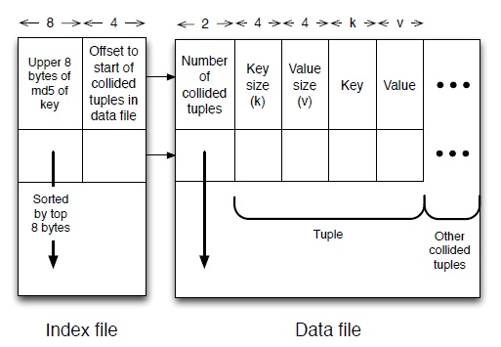
Data Retrieval (cont’d)
Perform a search using top 8 bytes of MD5 of the key as the search key in the stored index file. Data location of i th element = 12*i + 8
If found, grab the data location from the index file and jump to the location of the data file. Return corresponding value on key match
Roshan Sumbaly, Jay Kreps, Lei Gao, Alex Feinberg, Chinmay Soman, and Sam Shah. 2012. Serving large-scale batch computed data with project Voldemort. In Proceedings of the 10th USENIX conference on File and Storage Technologies (FAST’12). USENIX Association, Berkeley, CA, USA, 18-18
Notes:
Explain how there are 12 bytes per key, 8 = key, last 4 = offset, so you search for a key using top 8 bytes of MD5
If found, use the corresponding data location from the index file to find the location of the data file. Return corresponding value on the key match
-To do so, you need to iterate through potential collided tuples & compare keys STOP and check for understanding

Slide 39
Optimizing Data Retrieval
Most time consuming step? The search for the index file
Binary search in an index of 1 million keys → (log N) → about 20 key comparisons
If not cached, then 20 disk seeks per one read value
Voldemort fetches index files keep them in the page cache (small optimization)
Interpolation Search Strategy
Uses key distribution to predict the approximate location of the key
Works well for uniformly distributed keys
Time complexity for search improves significantly: O(log N) → O(log log N)
This further reduces the number of overall disk seeks per read value
MD5 provides a fairly representative uniform distribution, favoring Interpolation as primary search strategy
Notes:
Most time consuming step is to search for the index file
-could use binary search: gives us 20 comparisons for a million keys
-data retrieval could be exasperated if keys are not cached, as this would require20 disk seeks per 1 read value
-while fetching the files from HDFS, Voldemort fetches index files after all data files to aid in keeping the index files in the page, but this is a relatively small optimization
Instead: interpolation search strategy - this strategy relies on the key distribution to predict the approximate location of the key vs halving the search space each iteration. - best used for uniformly distributed keys and makes the search time complexity better from O(log n) to O(log of log n)
Faster search time means fewer disk seeks per read value
What if keys are not uniformly distributed?
Authors tried two techniques (Fast and Pegasus) which are better suited for non-uniform distributions
But MD5 provides a fairly representative uniform distribution, so there will be minimal optimization from these techniques. Thus the interpolation search strategy is the most effective strategy.

Slide 40
Questions?

Slide 41

Schema Upgrades & Rebalancing
Shubhabrata Mukherjee

Slide 42
Schema revision: Offline Upgradation
Non revertible changes to schema supported
No system downtime due to offline processing.
Addition of extra version bytes during serialization.
The updated data propagation through re-bootstrap.
Supports rollback by pointing to a older schema version.
Example: Our project!

Slide 43
Rebalancing process
Future cluster topology metadata & listing of partitions to be moved
Listing of stealing & donor nodes by rebalancing plan
Asynchronous copy processes & ownership changes of individual partitions
Nodes enter to “Rebalancing state” to stop swapping new data
After fetching rebalancing tool updates intermediate cluster topology to nodes & clients.
Rebalancing
Tool

Slide 44
Rebalancing: Present & Future
Shuffle
zone expansion
Cluster expansion
Zone contraction
Cluster contraction
Present Support
Future Developments

Slide 45
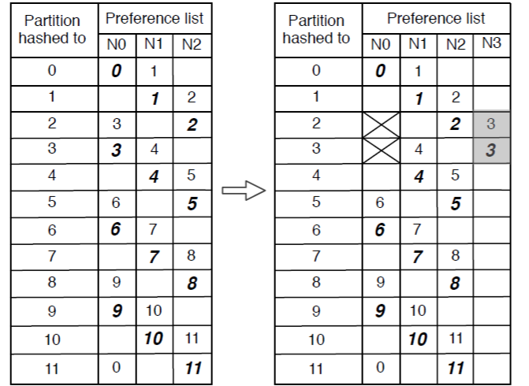

Example of rebalancing plan

Slide 46
Credits and Q&A
http://www.project-voldemort.com/voldemort/
Credit:
The Original Voldemort Paper
Q & A
?????

Slide 47
Evaluation of Voldemort
Pullela Sai Tejaswi

Slide 48
Evaluation answers the following questions
Can system deploy new data sets in less time?
Read latency Voldemort Vs MySQL
Impact on latency during new data set deployment?
This evaluation has been performed comparing the Voldemort results with MYSQL

Slide 49
New data set deployment
To faster deployment of new data set, the build time should be made faster.
Voldemort build time
- chunk set is assigned to each reducer
- one chunk set has index and data file
- Use of binary search on this sorted data,
makes search faster which results in faster data
set deployment
MySQL build time
- Applied several optimizations to make MySQL faster
- It exhibits slow build times as it buffers changes
to indexes before sending it to disk
●
Voldemort
MySQL
350
300
250
time (mins)
200
150
100
50
●
●
●
●
●
●
●
●
●
●
0
●
0
250
500
750
1000
1250
1500
size (GB)

Slide 50
Read latency Voldemort Vs MySQL
Read latency is also an important factor to be considered.
10 million requests (100 GB) have been used in this experiment
Voldemort
In this read-only storage engine, both
binary search and interpolation search algorithms
have been measured.
MySQL
Indexes will not be cached in case of MySQL,
due to this MySQL starts with high latency
Interpolation
Binary
MySQL
32
16
8
median latency (ms)
4
2
1
0.5
0
30
60
90
120
150
180
time since swap (mins)

Slide 51
Read latency scaling with data size and nodes
Read latency scales with data size and number of nodes being used.
Latency is a function of data size and independent of replication factor
Increase in data set size, reduces the memory to data ratio which will increase the read latency
Reducing latency would require additional nodes since the data packets will be distributed over the nodes
Users can tune this ratio to achieve desired latency verses the necessary hardware footprint

Slide 52
Performance- Single node latency
100 GB of data , 24GB RAM

Slide 53
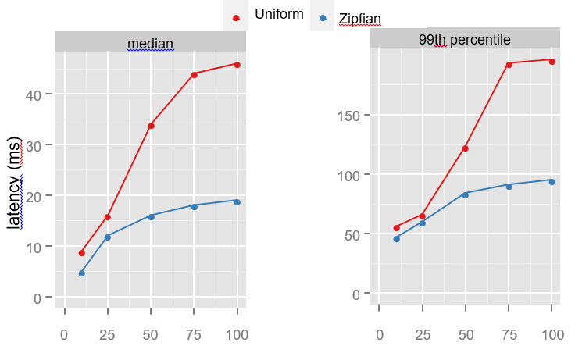
Performance- Multinode Latency
Output size(TB)
32 node client side latency

Slide 54
Performance- production

Slide 55
Some Production numbers
Linkedin
Serving - 120 stores in production
Fetching- 4TB of data every day
76 Stores swapped every day
open source
http://www.project-voldemort.com

Slide 56
References
https://www.usenix.org/comment/267
http://www.project-voldemort.com/voldemort/
http://static.usenix.org/events/fast/tech/full_papers/Sumbaly.pdf

Slide 57
Questions??????

Slide 58


