Slide 1
APPLAB | SENIOR DATA ENGINEER ASSESSMENT
Design. Build.
Validate. Deliver.
A PySpark-based sales ETL solution with auditable data quality controls and a proposed Azure production architecture.
IMPLEMENTED: DATABRICKS
SQL SERVER VERIFIED
Technical assessment presentation | 13 November 2026

Slide 2
01 | OVERVIEW
Executive summary
THE BUSINESS NEED
WHAT WAS BUILT
WHAT WAS PROVEN
Turn multi-source sales data into trusted, analytics-ready facts while retaining a complete trail of rejected data.
A PySpark ETL workflow covering ingestion, profiling, validation, deduplication, enrichment, FX conversion and exception outputs.
Rejected records and error logs loaded to SQL Server and verified: 6 rejected rows and 7 error events.
THE KEY OUTCOME
The pipeline deliberately stopped FactSales publication when the rejection rate reached 31.58%, above the 5% acceptance threshold. This is an intentional quality-control outcome—not a silent partial load.
The presentation distinguishes implemented assessment work from the proposed production target design.
APPLAB • TECHNICAL ASSESSMENT • IMPLEMENTATION & TARGET DESIGN
02

Slide 3
02 | BUSINESS CONTEXT
Problem statement and solution requirements
BUSINESS CHALLENGE
ENGINEERING REQUIREMENTS
Sales data may contain missing identifiers, invalid dates, negative amounts, unknown products and mixed currencies. Downstream reporting needs consistent, explainable records.
• Ingest and standardise source data
• Validate business rules and retain reasons
• Remove exact duplicates
• Enrich product and FX attributes
• Fail publication if rejects exceed 5%
DESIGN PRINCIPLE
Never trade data integrity for a green pipeline status. Preserve rejected data, explain each failure and publish only when the batch passes its quality gate.
APPLAB • TECHNICAL ASSESSMENT • IMPLEMENTATION & TARGET DESIGN
03

Slide 4
03 | TARGET-STATE DESIGN — PROPOSED, NOT DEPLOYED
Proposed production architecture
SOURCE SYSTEMS
ORCHESTRATION
RAW / BRONZE
TRANSFORM / SILVER
CURATED / GOLD
SERVING
POS / sales files
Product reference
Customer data
FX rates API
Azure Data Factory
Schedule / trigger
Parameters & retries
ADLS Gen2
Immutable raw files
Run ID + metadata
Azure Databricks
PySpark validation
Dedup + enrichment
FX conversion
ADLS Gen2 Delta
FactSales + dimensions
Quality-approved only
Azure SQL DB / Synapse SQL
Power BI semantic model
Reports & analytics
CROSS-CUTTING PLATFORM CONTROLS
Microsoft Entra ID • Key Vault / secrets • RBAC • Private networking • Purview / lineage • Azure Monitor / Log Analytics • Audit & alerting • CI/CD
Proposed production pattern: orchestrate independently, land immutable raw data, transform with Spark, publish curated data only after quality acceptance.
APPLAB • TECHNICAL ASSESSMENT • IMPLEMENTATION & TARGET DESIGN
04

Slide 5
03 | TARGET-STATE DESIGN
Target-state data flow and control points
ACCEPTED PATH
Publish Gold FactSales
and downstream dimensions
INGEST
TRANSFORM
QUALITY GATE
Validate file / schema
Assign batch & run IDs
Standardise • validate
Deduplicate • enrich
Reconcile counts
Reject rate ≤ 5%?
PASS
REJECTED / ERROR PATH
Quarantine records, reasons,
error events and source lineage
FAIL / HOLD
RECONCILIATION
IDEMPOTENCY
RECOVERY
Source = deduplicated + duplicates removed; then deduplicated = valid + rejected.
Use batch IDs, deterministic keys and merge/upsert logic to make retries safe.
Retry transient failures; preserve failed batch state; alert owners and rerun safely.
APPLAB • TECHNICAL ASSESSMENT • IMPLEMENTATION & TARGET DESIGN
05

Slide 6
04 | IMPLEMENTED SOLUTION
What was implemented in the assessment
IMPLEMENTED IN PRACTICE
CSV INPUT
DATABRICKS
QUALITY OUTPUTS
CSV HANDOFF
SQL SERVER
Sales + product
reference
PySpark ETL
15 logical sections
Valid / rejected
error events
Export files for
local SQL Server
DDL + loaded
exception tables
IMPLEMENTED COMPONENTS
DATABASE DELIVERABLES
Local CSV ingestion • explicit schemas • profiling • validation • deduplication • product lookup • FX API integration • USD conversion • rejection/error outputs • threshold check
SQL DDL for FactSales, RejectedRecords and ErrorLogs; Python/Jupyter-based CSV loading; SQL verification queries and observed row counts.
Environment note: assessment implementation used Databricks Free Edition, local files and SQL Server Express—not a deployed Azure production environment.
APPLAB • TECHNICAL ASSESSMENT • IMPLEMENTATION & TARGET DESIGN
06

Slide 7
05 | ENGINEERING IMPLEMENTATION
PySpark implementation: end-to-end workflow
01
Setup & config
Imports, paths, run settings
02
Ingestion
Read sales and product CSVs with explicit schemas
03
Profile
Inspect shape, nulls, duplicates and distributions
04
Standardise
Normalise types, dates, currency and identifiers
05
Validate
Apply mandatory-field, domain and business rules
06
Deduplicate
Remove exact duplicate source records
07
Enrich
Join product reference attributes
08
FX conversion
Retrieve rates, apply fallback and calculate USD
09
Route outcomes
Write valid, rejected and error outputs
10
Quality gate
Reconcile counts and enforce 5% reject threshold
Implementation principle: preserve source lineage and explicit failure reasons; do not silently discard bad rows.
APPLAB • TECHNICAL ASSESSMENT • IMPLEMENTATION & TARGET DESIGN
07

Slide 8
05 | ENGINEERING IMPLEMENTATION
Data quality design and exception handling
MISSING_CUSTOMER_ID
Customer identifier is mandatory
REJECTED RECORD
One row-level record with one or more consolidated rejection reasons. Retains source values for investigation.
PRODUCT_NOT_FOUND
Product key must resolve in reference data
MISSING_ORDER_DATE / INVALID_ORDER_DATE
Order date must be present and parseable
ERROR EVENT
MISSING_SALE_AMOUNT
Sales amount is mandatory
One row per individual validation error. A single rejected record can generate multiple error events.
NEGATIVE_SALE_AMOUNT
Sales amount must be non-negative
Example: OrderID 1005 has two error events (missing customer ID and product not found), but remains one rejected record.
APPLAB • TECHNICAL ASSESSMENT • IMPLEMENTATION & TARGET DESIGN
08

Slide 9
05 | ENGINEERING IMPLEMENTATION
Currency conversion and resilience
RATE SOURCE
FALLBACK BEHAVIOUR
OUTPUT FIELDS
Call the exchange-rate API and extract the required currency-to-USD rate for conversion.
Use a controlled fallback rate when the API request or expected response is unavailable; log the condition.
Retain source currency and exchange rate, then calculate SaleAmountUSD for downstream reporting.
PRODUCTION HARDENING RECOMMENDATIONS
Cache rates by effective date • validate API payload and freshness • set timeouts/retries • secure API credentials • persist rate provenance and fallback indicator
Assessment note: currency conversion and fallback logic were implemented in the PySpark workflow; production-grade secrets management and rate governance belong in the target design.
APPLAB • TECHNICAL ASSESSMENT • IMPLEMENTATION & TARGET DESIGN
09

Slide 10
06 | OUTCOMES
Execution results: batch-level reconciliation
20
1
19
Source rows
Exact duplicate removed
Post-dedup rows
13
6
31.58%
Valid rows
Rejected rows
Rejection rate
QUALITY THRESHOLD
31.58% actual
5% allowed
RESULT: QUALITY GATE FAILED — FactSales publication correctly blocked; rejected records and error logs were retained.
APPLAB • TECHNICAL ASSESSMENT • IMPLEMENTATION & TARGET DESIGN
10

Slide 11
07 | DATABASE IMPLEMENTATION
SQL Server design: target schema and loading
dbo.FactSales
dbo.RejectedRecords
dbo.ErrorLogs
Primary key: OrderID
Sales dimensions and measures
Product attributes, currency, FX rate, USD amount, date, discount and region
Expected current batch: 0 rows
Rejected source values
Consolidated RejectionReason
ErrorTimestamp and PipelineName
OrderDate stored as VARCHAR to preserve invalid source date text
Loaded: 6 rows
ErrorID IDENTITY primary key
OrderID + source keys
ErrorType per validation issue
ErrorTimestamp and PipelineName
Loaded: 7 rows
LOADING METHOD USED
Databricks output CSVs → local Jupyter / Python + pyodbc → SQL Server Express. Explicit column lists were used; ErrorID was omitted so SQL Server generated identity values.
Technical constraint: Databricks Free Edition could not directly reach the locally hosted SQL Server instance in this setup. CSV handoff was used as a controlled assessment workaround—not represented as production JDBC integration.
APPLAB • TECHNICAL ASSESSMENT • IMPLEMENTATION & TARGET DESIGN
11

Slide 12
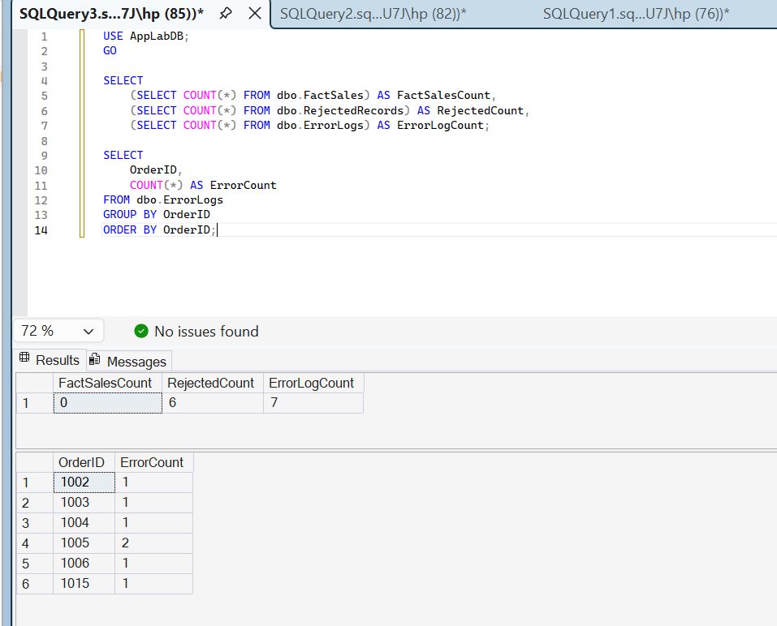
07 | DATABASE EVIDENCE
SQL Server verification: observed database state
Verified in SSMS: 6 rejected rows, 7 error events, and zero FactSales rows for the failed batch.
APPLAB • TECHNICAL ASSESSMENT • IMPLEMENTATION & TARGET DESIGN
12

Slide 13
08 | DELIVERY TRANSPARENCY
Technical constraints, decisions and trade-offs
Databricks Free Edition networking
Local SQL Server was not directly reachable from the hosted notebook environment.
Export CSVs and load locally through Jupyter + pyodbc; verify in SSMS.
Assessment input access
Source data supplied as files rather than a live operational database connection.
Use file ingestion with explicit schemas; document source assumptions.
Quality threshold exceeded
31.58% rejects vs 5% allowed.
Block FactSales publication; preserve rejects and error events.
Production deployment scope
Azure services were not provisioned as part of this local assessment.
Present Azure architecture as proposed target state, not deployed infrastructure.
A controlled workaround is acceptable when it is explicit, repeatable, auditable and not misrepresented as the target production pattern.
APPLAB • TECHNICAL ASSESSMENT • IMPLEMENTATION & TARGET DESIGN
13

Slide 14
09 | OPERATIONAL READINESS
Production non-functional design
SECURITY
RELIABILITY
OBSERVABILITY
Managed identity / service principals
Key Vault secrets
RBAC + least privilege
Private endpoints / encryption
Idempotent batch processing
Retries for transient errors
Dead-letter / quarantine path
Checkpoint and recovery strategy
Run ID + batch metrics
Structured logs and audit
Data-quality dashboards
Alerts on SLA / threshold failures
PERFORMANCE
DATA GOVERNANCE
DELIVERY
Partition by workload needs
Broadcast small reference data
Avoid skew and excess shuffles
Optimize Delta layout
Catalog and lineage
Retention and classification
Schema evolution policy
Data contracts and ownership
Git version control
CI/CD and environment promotion
Parameterized configuration
Automated unit / integration tests
APPLAB • TECHNICAL ASSESSMENT • IMPLEMENTATION & TARGET DESIGN
14

Slide 15
10 | ROADMAP
Recommended next steps to productionise
1
Harden the pipeline
Unit tests, schema contracts, rate cache, API retries, structured logs and idempotent writes.
2
Deploy Azure foundation
ADLS Gen2, ADF, Azure Databricks, Key Vault, managed identity, network controls and monitoring.
3
Automate serving loads
Replace CSV handoff with secure JDBC / supported connector to Azure SQL or Synapse SQL; use staging + MERGE.
4
Operationalise quality
Persist batch metrics, rejection thresholds, reconciliation results, alerts and restart controls.
5
Validate business outcomes
Correct source data, rerun a clean batch, confirm ≤5% rejects, and publish FactSales.
APPLAB • TECHNICAL ASSESSMENT • IMPLEMENTATION & TARGET DESIGN
15

Slide 16
APPLAB | SENIOR DATA ENGINEER ASSESSMENT
Engineering outcome
A transparent ETL implementation that protects downstream data consumers, explains data defects and preserves an auditable exception trail.
BUILT
VERIFIED
PROPOSED
PySpark pipeline and SQL exception schema
6 rejects + 7 error events loaded and queried
Scalable Azure production architecture
Thank you | Questions

