Slide 1
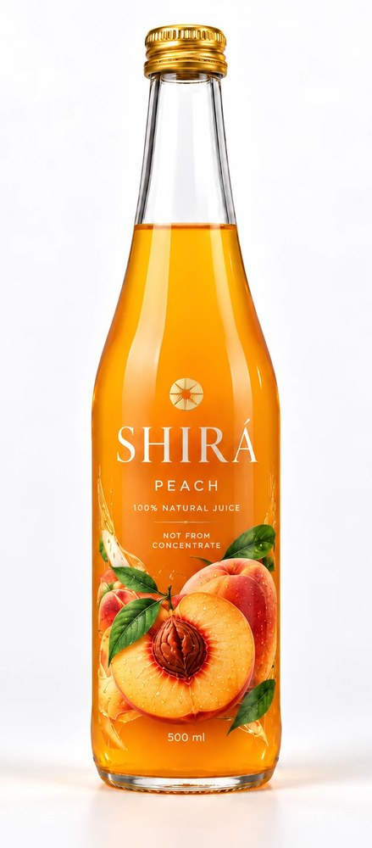
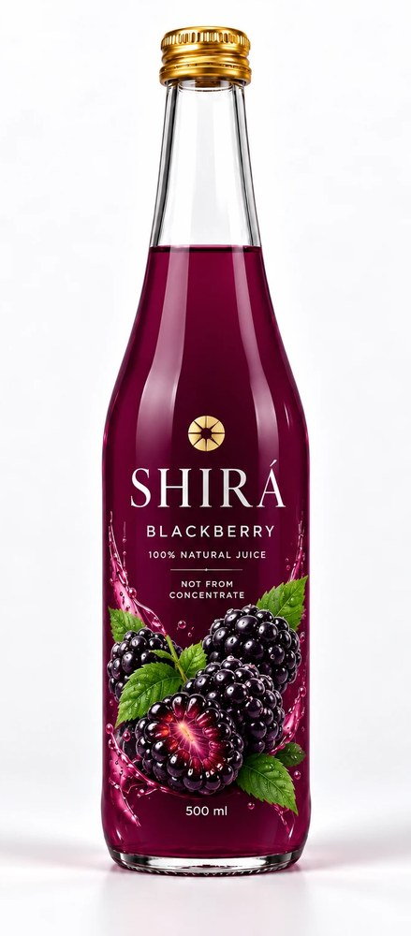
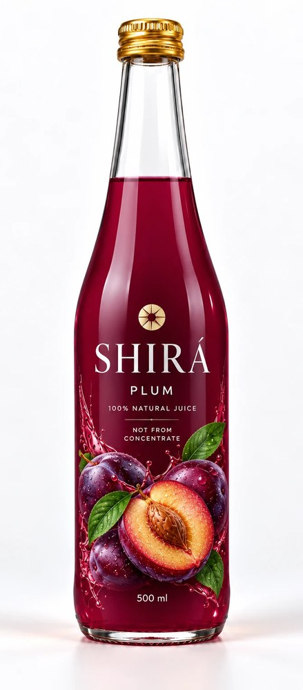
SHIRÁ
100% natural juices
Range presentation for retail and sales partners
10 flavours · 500 ml glass bottle · Not from concentrate

Slide 2
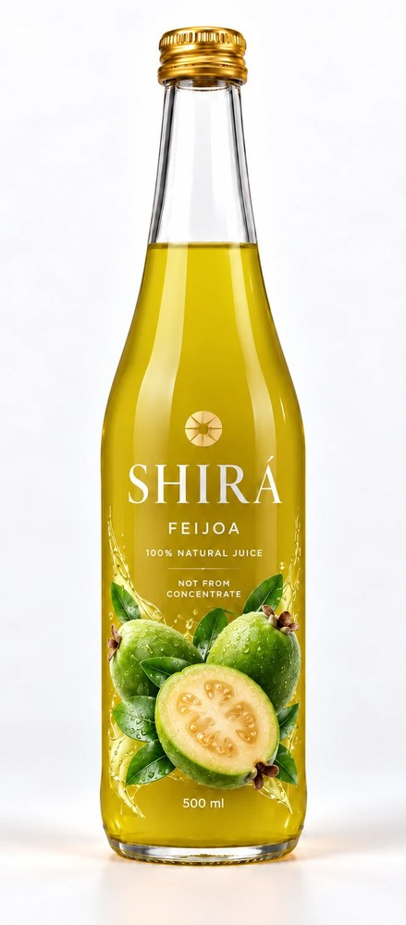
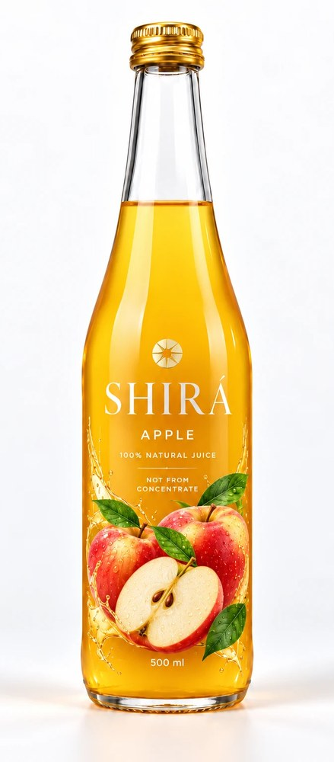
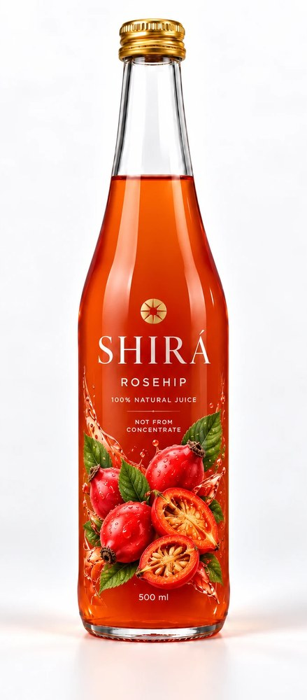
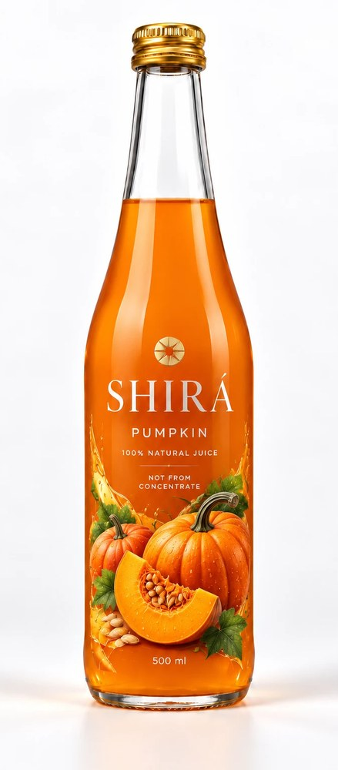
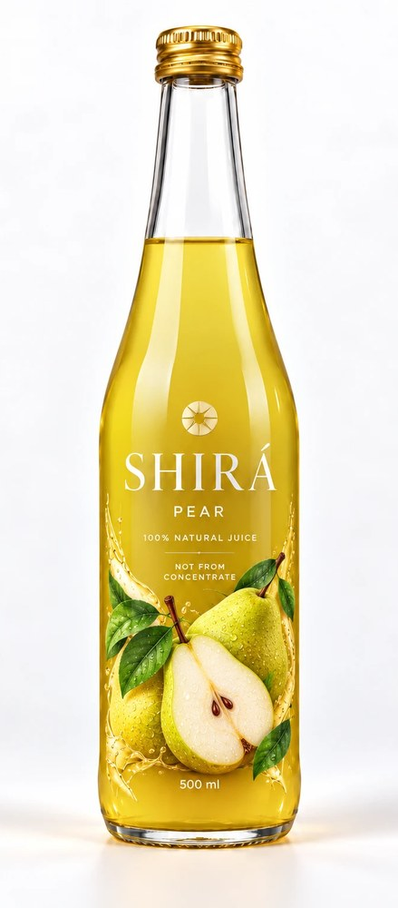
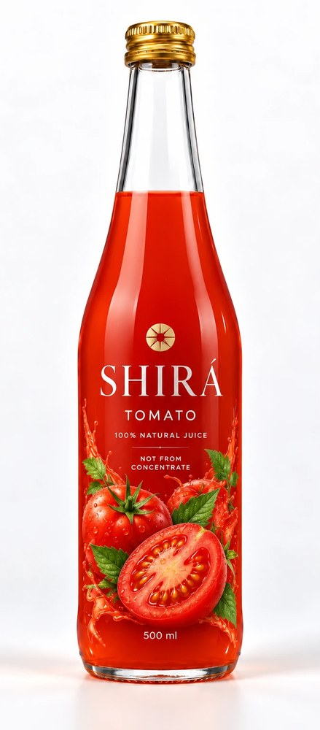
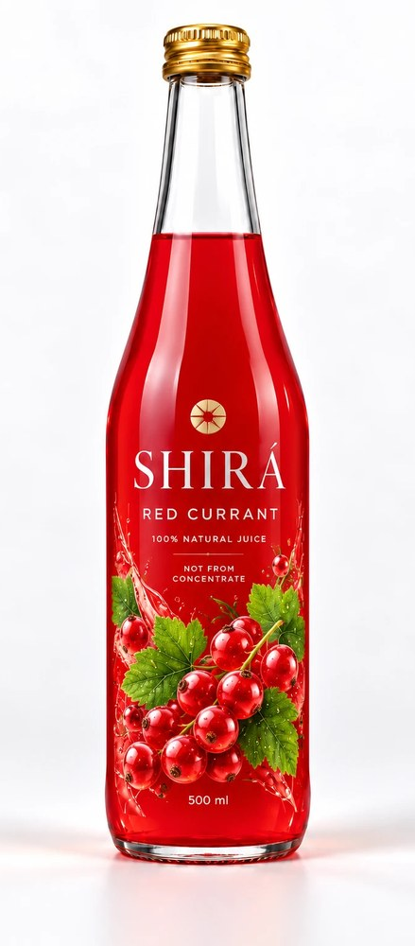
Ten flavours, one clean label
Peach
Feijoa
Blackberry
Apple
Rosehip
Pumpkin
Pear
Plum
Tomato
Red Currant
100% natural juice
Nothing else in the bottle
Not from concentrate
Made from sun-ripened fruit
No added sugar
No preservatives
500 ml glass
Recyclable packaging

Slide 3
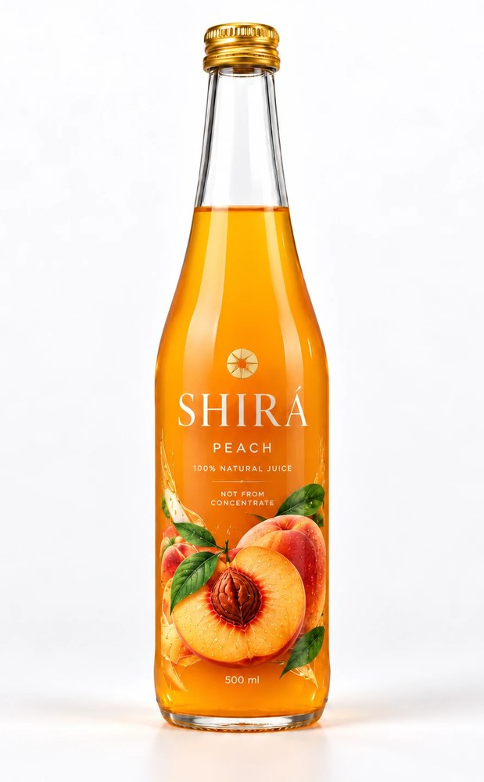
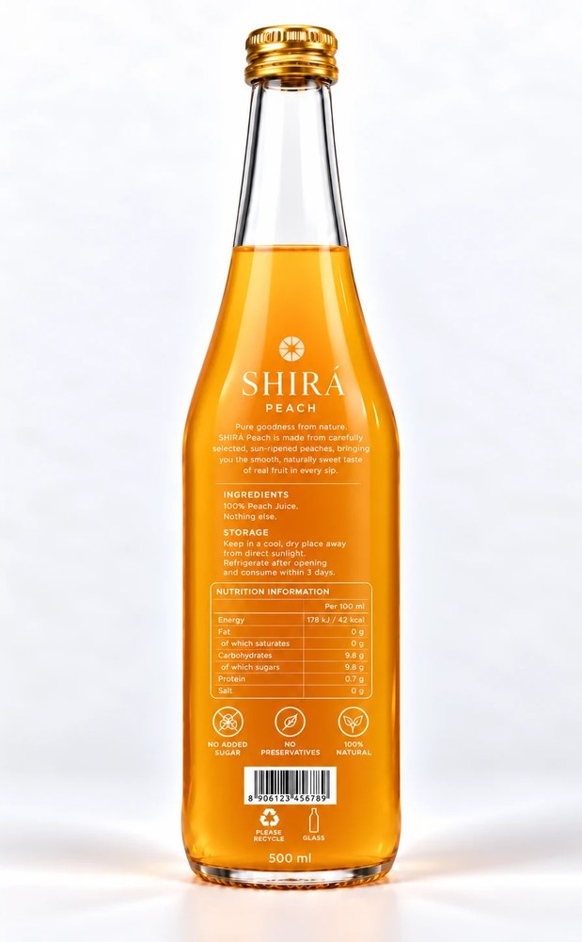
SHIRÁ · 500 ml
Peach
Smooth, naturally sweet taste of real peaches in every sip.
PER 100 ML
42
9.8 g
0.7 g
kcal
sugars
protein
Energy 178 kJ · Fat 0 g · Carbohydrate 9.8 g · Salt 0 g
100% natural · Not from concentrate · No added sugar
Front
Back

Slide 4
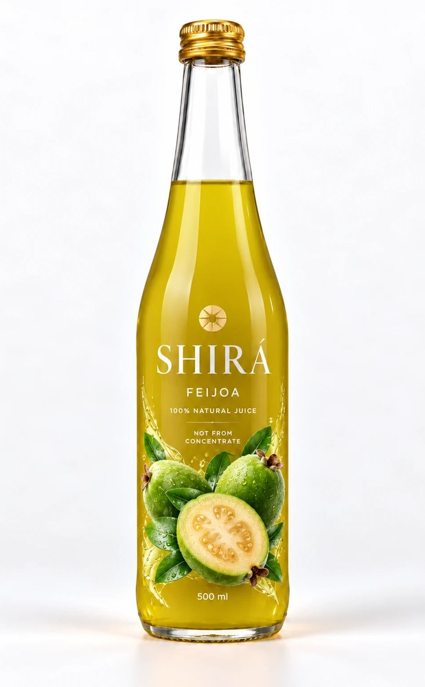
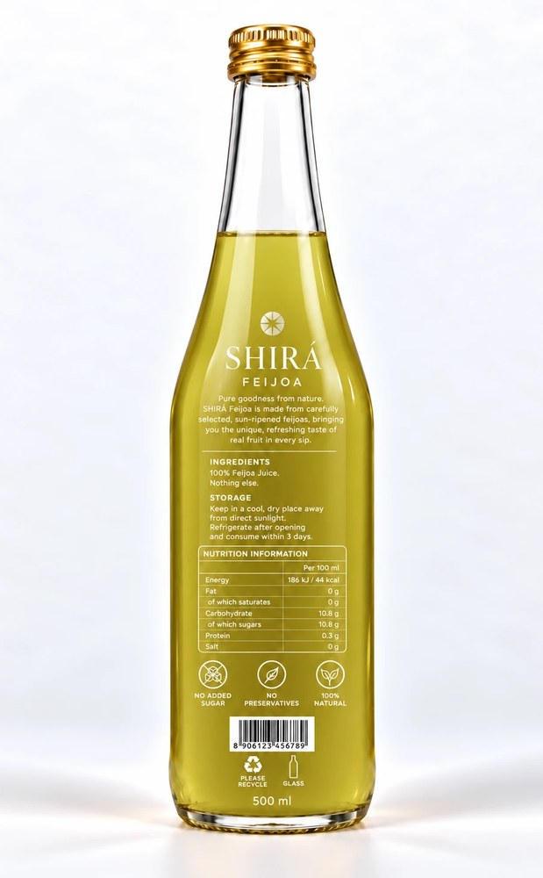
SHIRÁ · 500 ml
Feijoa
The unique, refreshing taste of real feijoa in every sip.
PER 100 ML
44
10.8 g
0.3 g
kcal
sugars
protein
Energy 186 kJ · Fat 0 g · Carbohydrate 10.8 g · Salt 0 g
100% natural · Not from concentrate · No added sugar
Front
Back

Slide 5
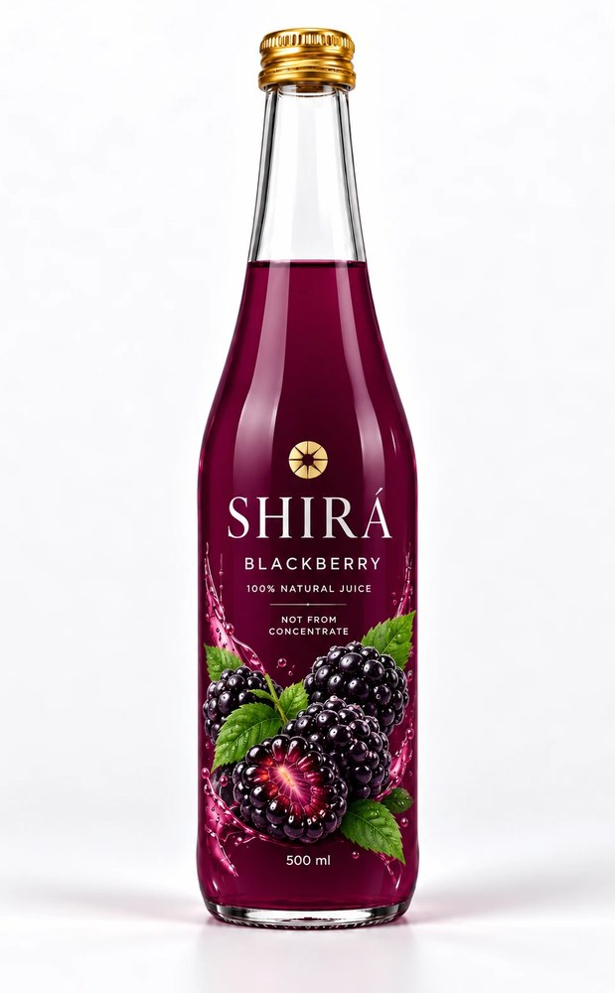
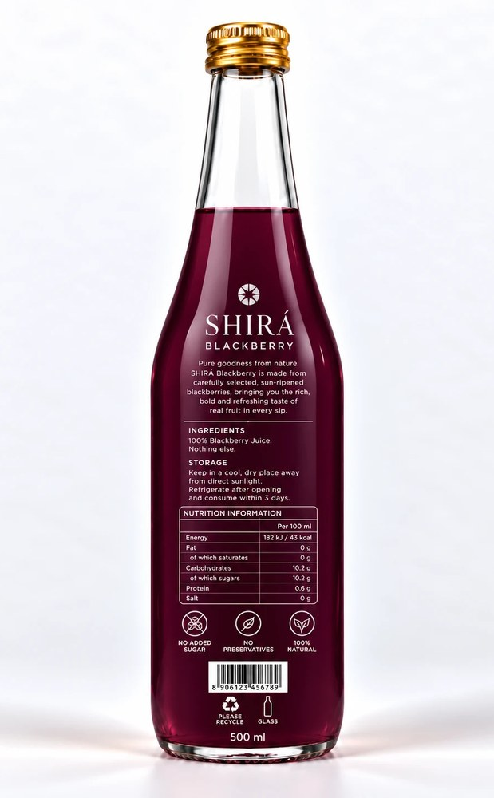
SHIRÁ · 500 ml
Blackberry
Rich, bold and refreshing taste of real blackberries.
PER 100 ML
43
10.2 g
0.6 g
kcal
sugars
protein
Energy 182 kJ · Fat 0 g · Carbohydrate 10.2 g · Salt 0 g
100% natural · Not from concentrate · No added sugar
Front
Back

Slide 6
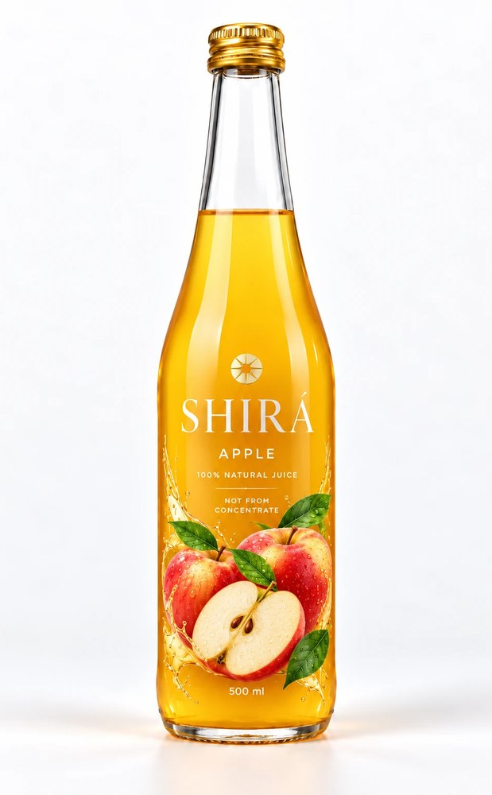
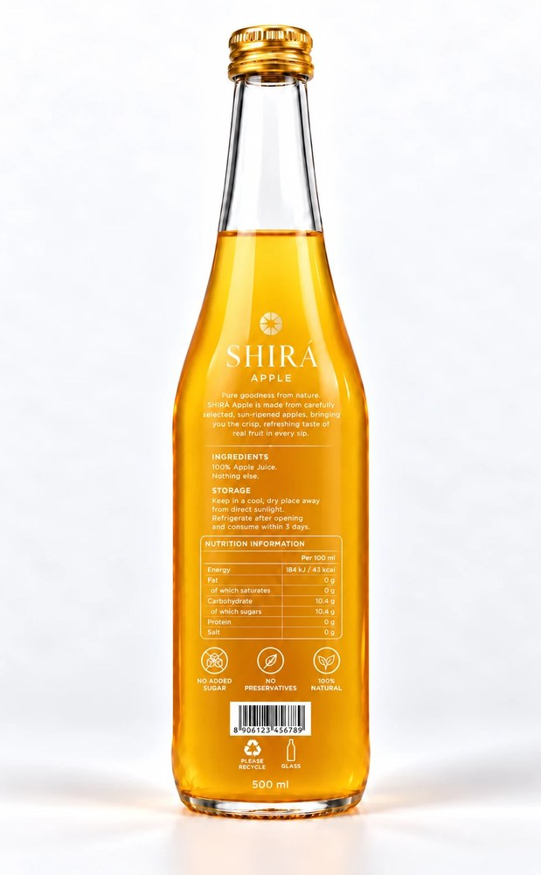
SHIRÁ · 500 ml
Apple
Crisp, refreshing taste of real apples in every sip.
PER 100 ML
43
10.4 g
0 g
kcal
sugars
protein
Energy 184 kJ · Fat 0 g · Carbohydrate 10.4 g · Salt 0 g
100% natural · Not from concentrate · No added sugar
Front
Back

Slide 7
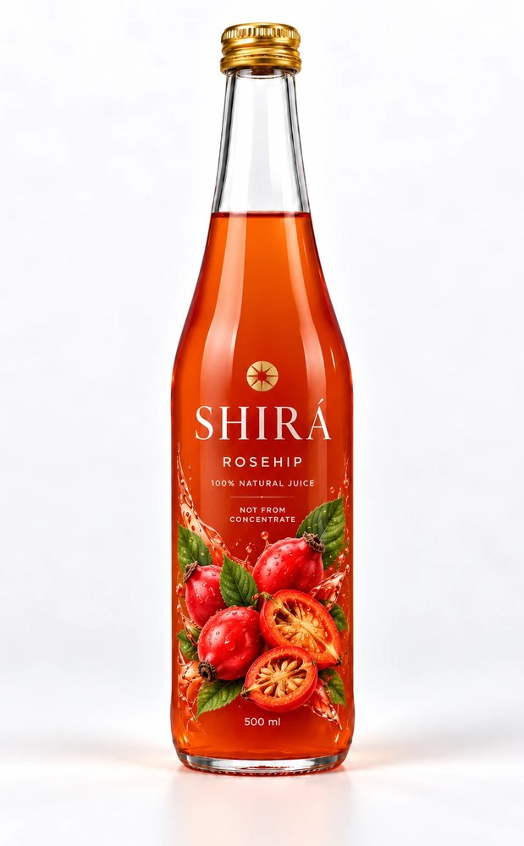
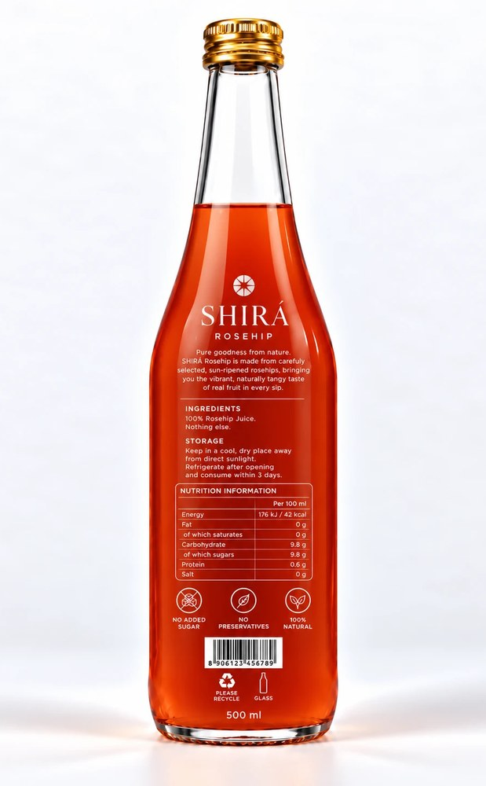
SHIRÁ · 500 ml
Rosehip
Vibrant, naturally tangy taste of real rosehips.
PER 100 ML
42
9.8 g
0.6 g
kcal
sugars
protein
Energy 176 kJ · Fat 0 g · Carbohydrate 9.8 g · Salt 0 g
100% natural · Not from concentrate · No added sugar
Front
Back

Slide 8
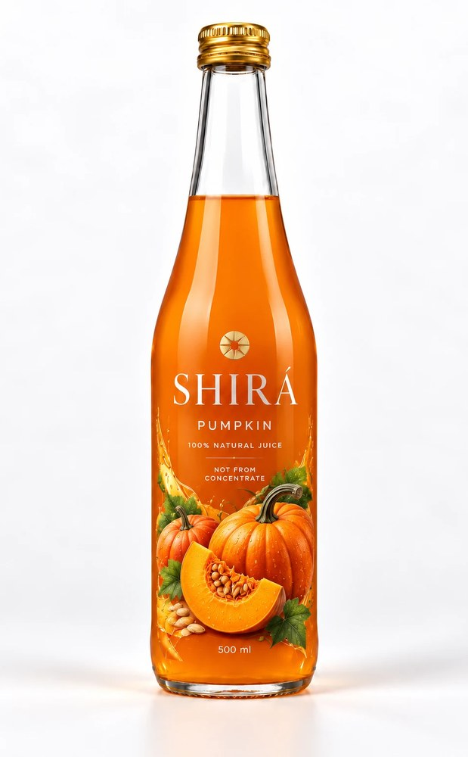
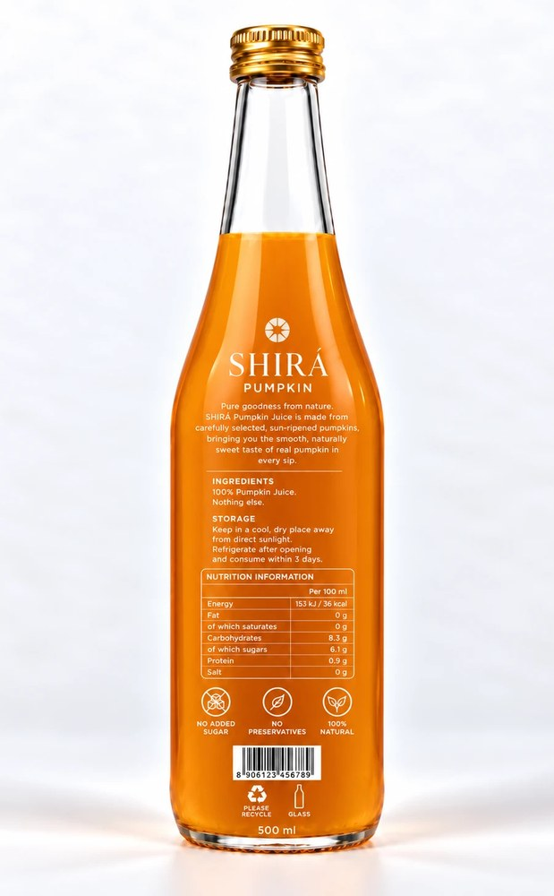
SHIRÁ · 500 ml
Pumpkin
Smooth, naturally sweet taste of real pumpkin in every sip.
PER 100 ML
36
6.1 g
0.9 g
kcal
sugars
protein
Energy 153 kJ · Fat 0 g · Carbohydrate 8.3 g · Salt 0 g
100% natural · Not from concentrate · No added sugar
Front
Back

Slide 9
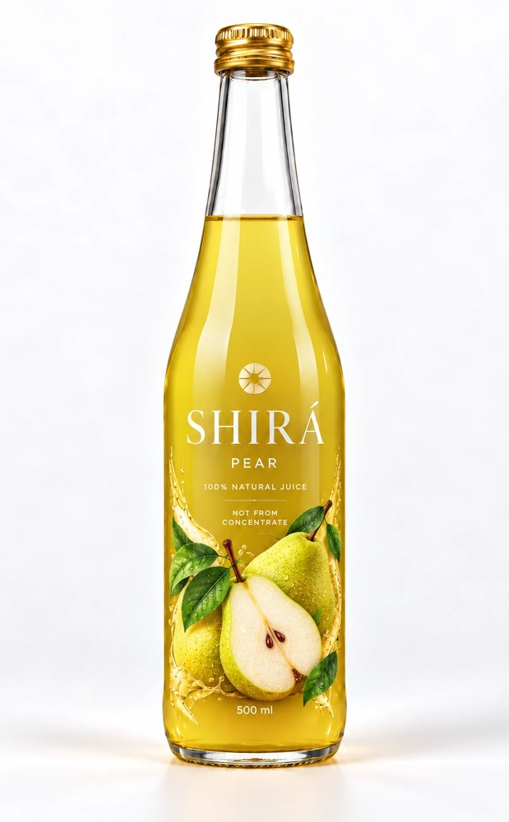
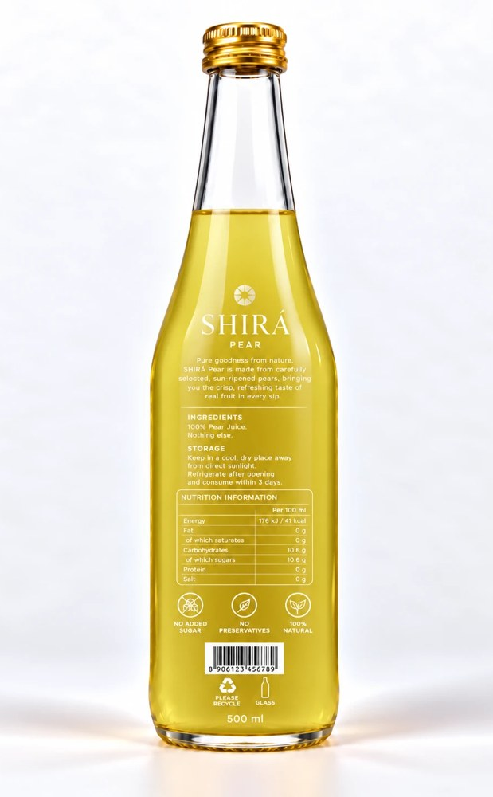
SHIRÁ · 500 ml
Pear
Crisp, refreshing taste of real pears in every sip.
PER 100 ML
41
10.6 g
0 g
kcal
sugars
protein
Energy 176 kJ · Fat 0 g · Carbohydrate 10.6 g · Salt 0 g
100% natural · Not from concentrate · No added sugar
Front
Back

Slide 10
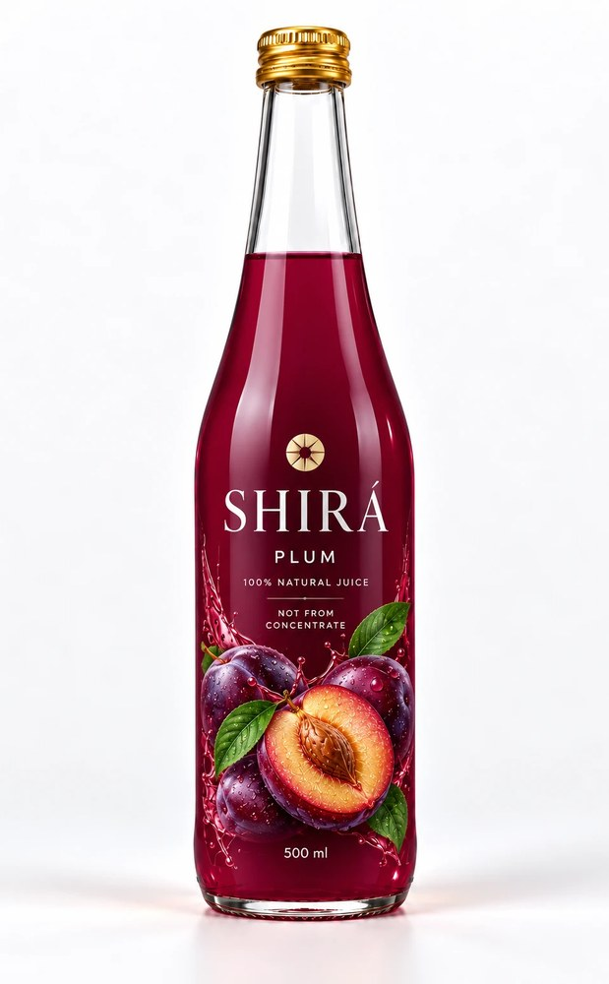
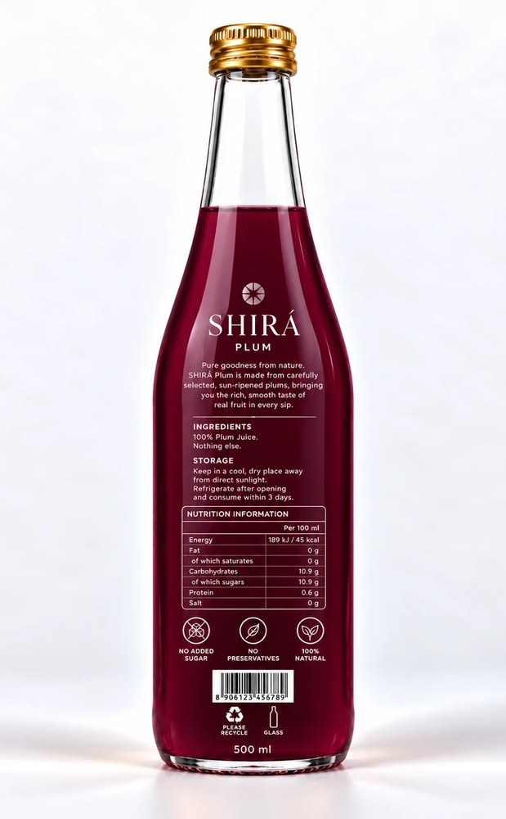
SHIRÁ · 500 ml
Plum
Rich, smooth taste of real plums in every sip.
PER 100 ML
45
10.9 g
0.6 g
kcal
sugars
protein
Energy 189 kJ · Fat 0 g · Carbohydrate 10.9 g · Salt 0 g
100% natural · Not from concentrate · No added sugar
Front
Back

Slide 11
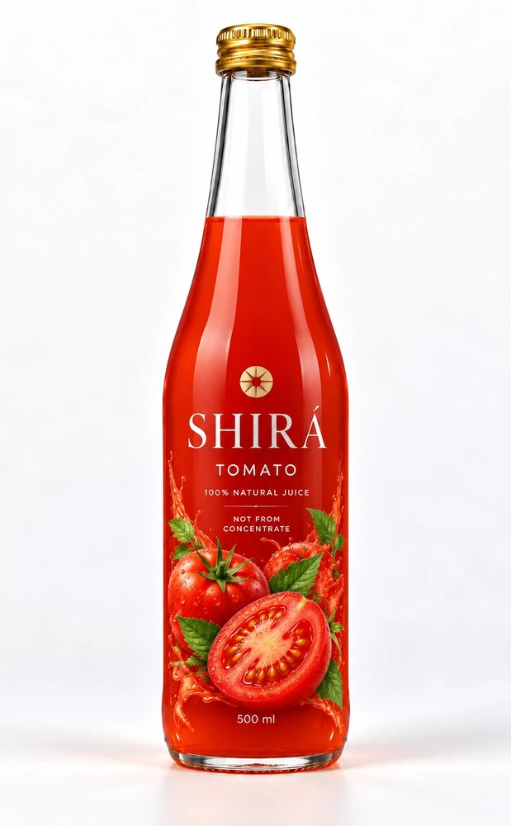
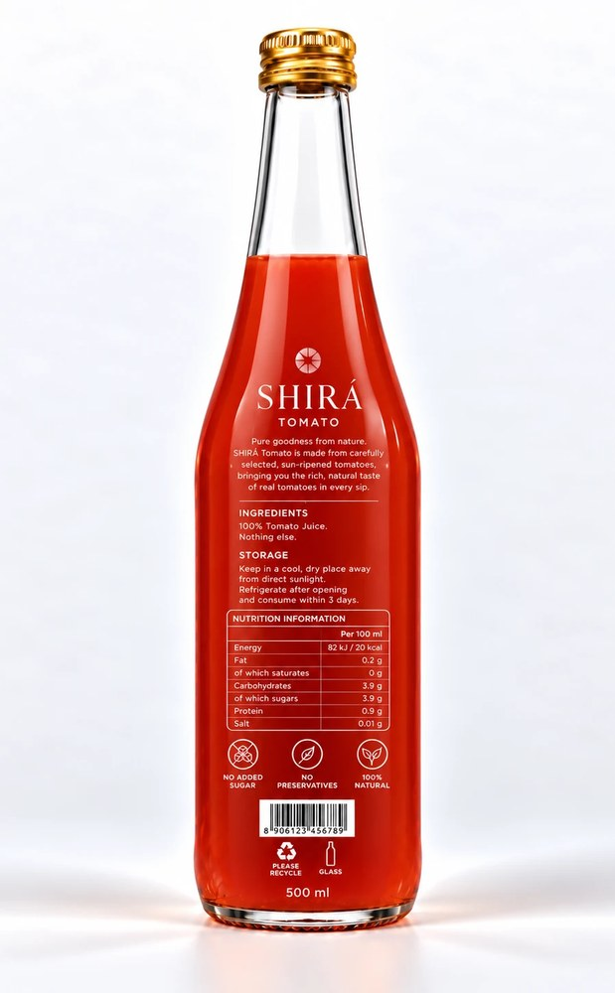
SHIRÁ · 500 ml
Tomato
Rich, natural taste of real sun-ripened tomatoes.
PER 100 ML
20
3.9 g
0.9 g
kcal
sugars
protein
Energy 82 kJ · Fat 0.2 g · Carbohydrate 3.9 g · Salt 0.01 g
100% natural · Not from concentrate · No added sugar
Front
Back

Slide 12
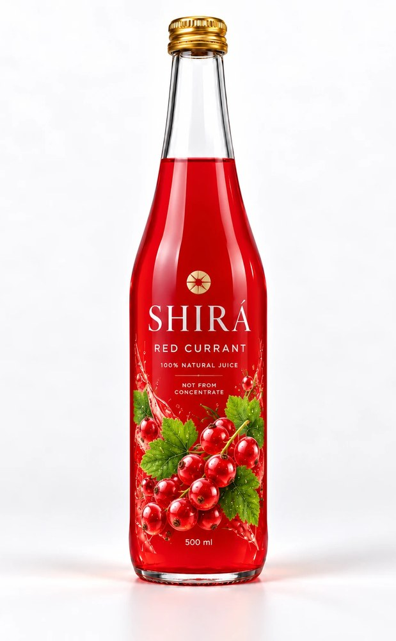
SHIRÁ · 500 ml
Red Currant
Bright, vivid red currant juice, 100% natural and not from concentrate.
Nutrition details to be confirmed
100% natural · Not from concentrate · No added sugar

Slide 13
Pure goodness from nature
Ten fruit and vegetable juices, one simple promise: 100% juice, nothing else.
SHIRÁ

