Slide 1

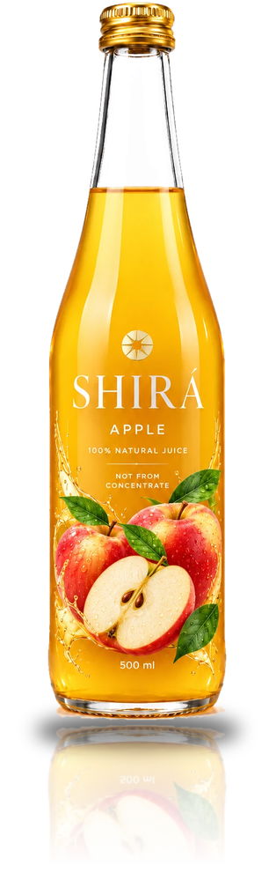
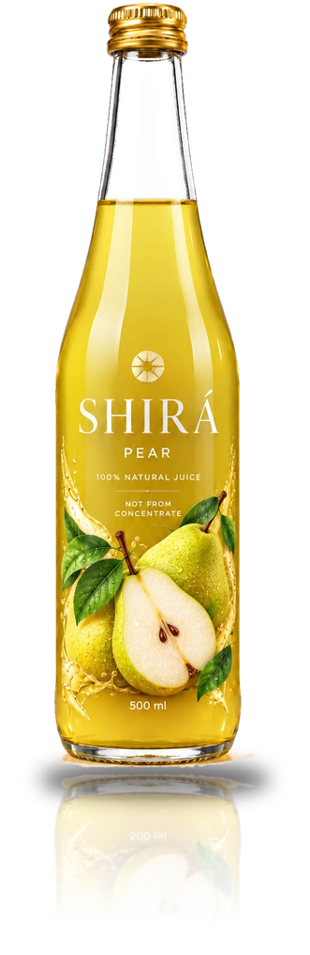
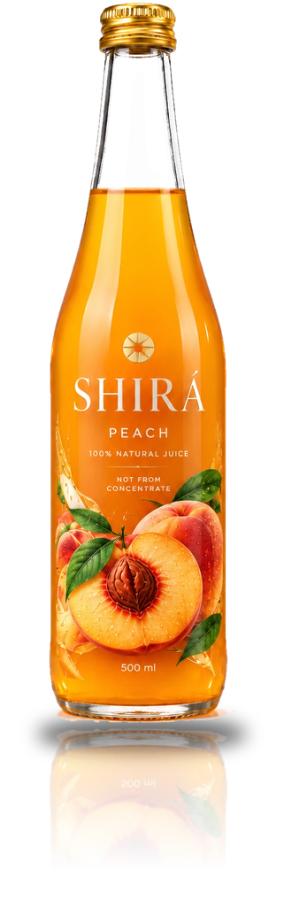
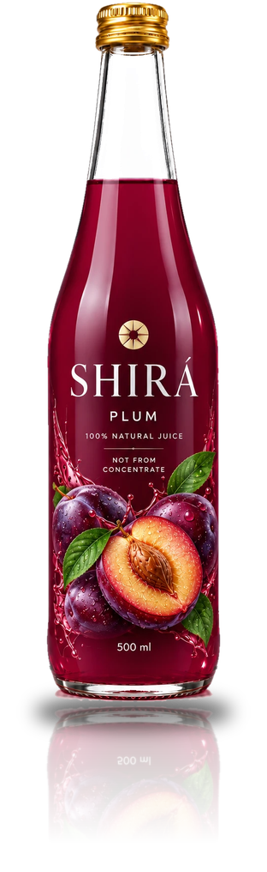
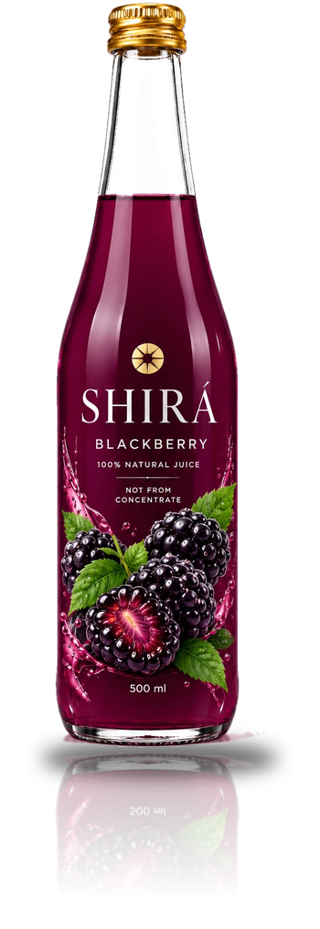
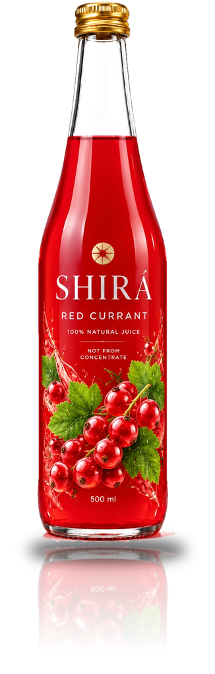
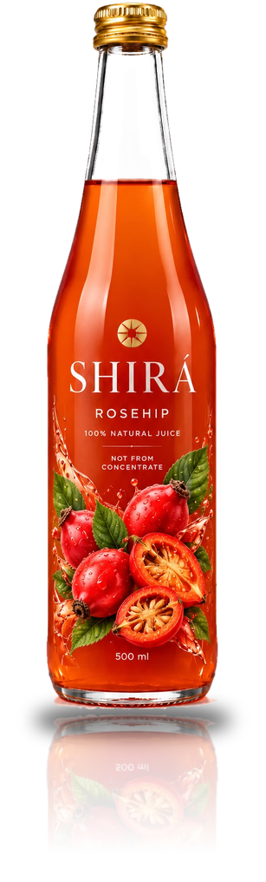
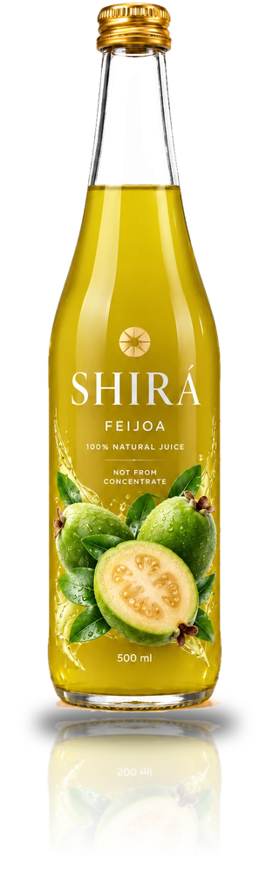
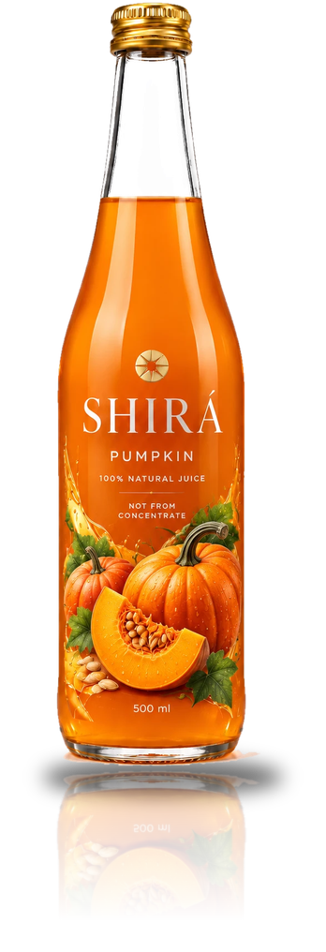
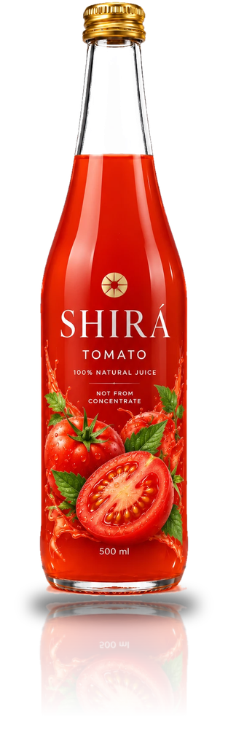
THE COLLECTION
100% natural juices.
Not from concentrate.
SHIRÁ
Range presentation for retail and sales partners
Notes:
Cover. Ten flavours in one line-up, arranged by flavour family: Orchard, Berries & Hips, Garden & Exotic.

Slide 2




THE PROMISE
Pure goodness
from nature.
100% natural juice
Not from concentrate
Ingredients: 100% juice. Nothing else.
Made from carefully selected, sun-ripened fruit.
Each SHIRÁ bottle holds one ingredient: the fruit or vegetable named on the label. Nothing else.
No added sugar, no preservatives
500 ml glass bottle
Only the natural sugars of the fruit.
Gold cap. Please recycle.
Notes:
The promise is printed on every bottle: 100% juice, nothing else; not from concentrate; no added sugar; no preservatives; 500 ml recyclable glass.

Slide 3

THE RANGE
Ten flavours. Three families.
Apple
Pear
Peach
Plum
Blackberry
Red Currant
Rosehip
Feijoa
Pumpkin
Tomato
ORCHARD
BERRIES & HIPS
GARDEN & EXOTIC
Notes:
Three flavour families: Orchard (apple, pear, peach, plum), Berries & Hips (blackberry, red currant, rosehip), Garden & Exotic (feijoa, pumpkin, tomato).

Slide 4

I
FLAVOUR FAMILY
Orchard
Crisp, smooth and naturally sweet.
Apple · Pear · Peach · Plum
Notes:
Section: Orchard. Crisp, smooth and naturally sweet.

Slide 5

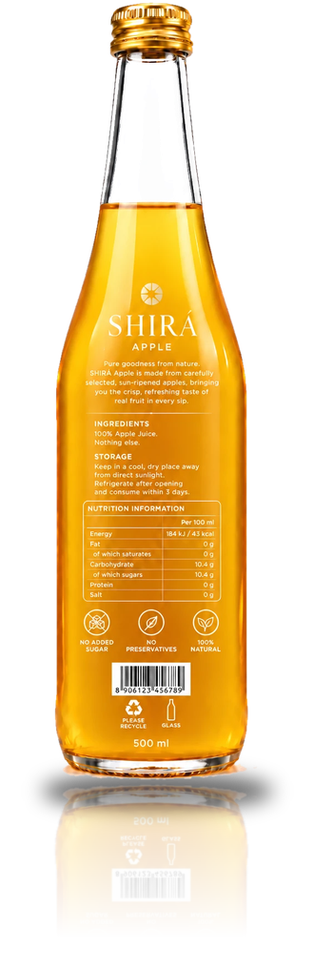
01
ORCHARD · 01 / 10
Apple
Crisp, refreshing taste of real apples in every sip.
PER 100 ML
43
10.4 g
0 g
kcal
sugars
protein
Energy 184 kJ · Fat 0 g · Carbohydrate 10.4 g · Salt 0 g
Notes:
Apple: Crisp, refreshing taste of real apples in every sip. Per 100 ml: 43 kcal (184 kJ), 10.4 g sugars, 0 g protein. Source: bottle label.

Slide 6

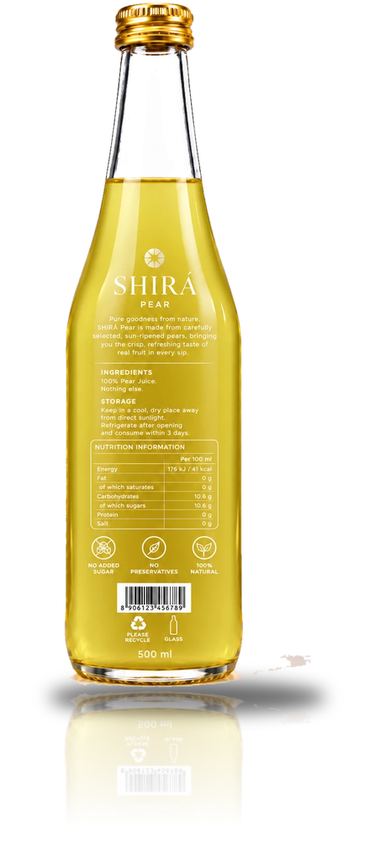
02
ORCHARD · 02 / 10
Pear
Crisp, refreshing taste of real pears in every sip.
PER 100 ML
41
10.6 g
0 g
kcal
sugars
protein
Energy 176 kJ · Fat 0 g · Carbohydrate 10.6 g · Salt 0 g
Notes:
Pear: Crisp, refreshing taste of real pears in every sip. Per 100 ml: 41 kcal (176 kJ), 10.6 g sugars, 0 g protein. Source: bottle label.

Slide 7

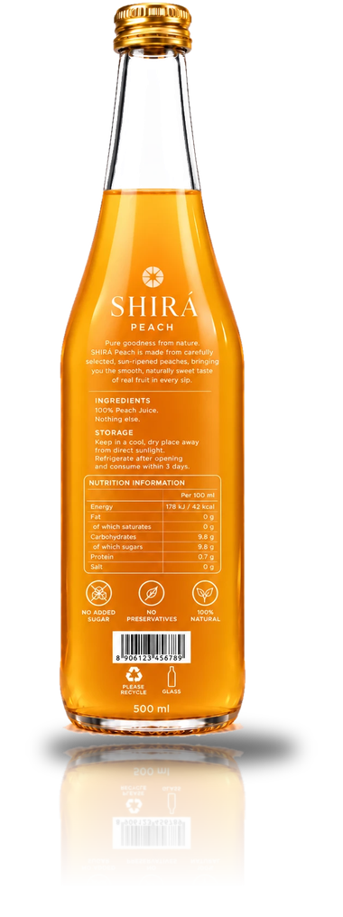
03
ORCHARD · 03 / 10
Peach
Smooth, naturally sweet taste of real peaches in every sip.
PER 100 ML
42
9.8 g
0.7 g
kcal
sugars
protein
Energy 178 kJ · Fat 0 g · Carbohydrate 9.8 g · Salt 0 g
Notes:
Peach: Smooth, naturally sweet taste of real peaches in every sip. Per 100 ml: 42 kcal (178 kJ), 9.8 g sugars, 0.7 g protein. Source: bottle label.

Slide 8

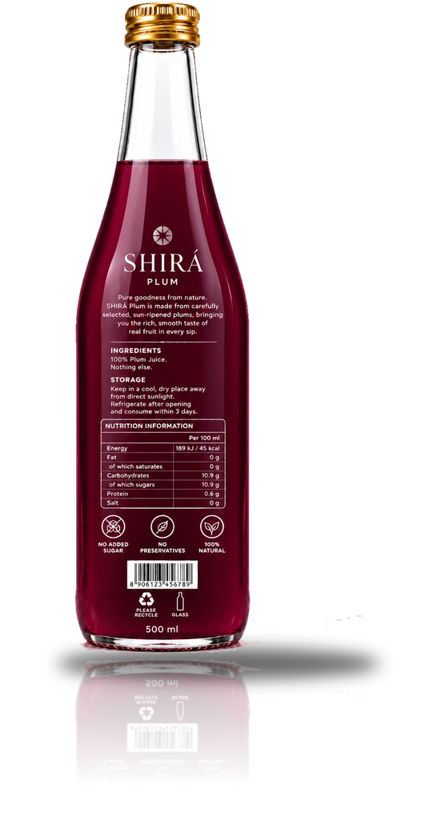
04
ORCHARD · 04 / 10
Plum
Rich, smooth taste of real plums in every sip.
PER 100 ML
45
10.9 g
0.6 g
kcal
sugars
protein
Energy 189 kJ · Fat 0 g · Carbohydrate 10.9 g · Salt 0 g
Notes:
Plum: Rich, smooth taste of real plums in every sip. Per 100 ml: 45 kcal (189 kJ), 10.9 g sugars, 0.6 g protein. Source: bottle label.

Slide 9

II
FLAVOUR FAMILY
Berries & Hips
Rich, bold and vibrantly fresh.
Blackberry · Red Currant · Rosehip
Notes:
Section: Berries & Hips. Rich, bold and vibrantly fresh.

Slide 10

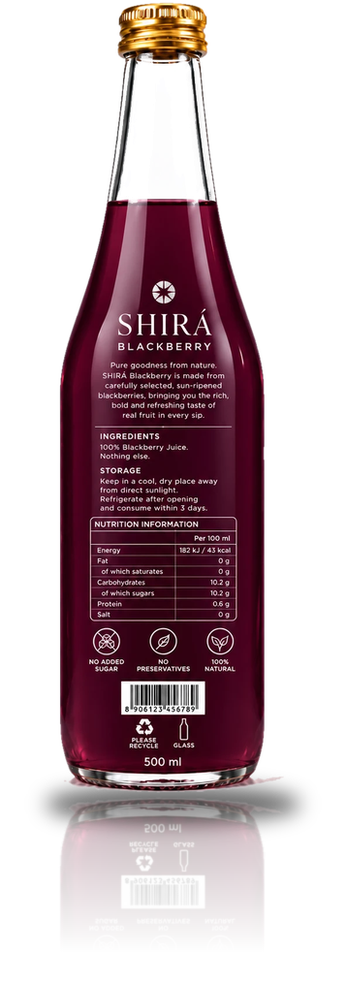
05
BERRIES & HIPS · 05 / 10
Blackberry
Rich, bold and refreshing taste of real blackberries.
PER 100 ML
43
10.2 g
0.6 g
kcal
sugars
protein
Energy 182 kJ · Fat 0 g · Carbohydrate 10.2 g · Salt 0 g
Notes:
Blackberry: Rich, bold and refreshing taste of real blackberries. Per 100 ml: 43 kcal (182 kJ), 10.2 g sugars, 0.6 g protein. Source: bottle label.

Slide 11

06
BERRIES & HIPS · 06 / 10
Red Currant
Bright, vivid red currant juice. 100% natural, not from concentrate.
Nutrition details to be confirmed
Notes:
Red Currant: Bright, vivid red currant juice. 100% natural, not from concentrate. The back label was not supplied, so nutrition values still need to be confirmed.

Slide 12

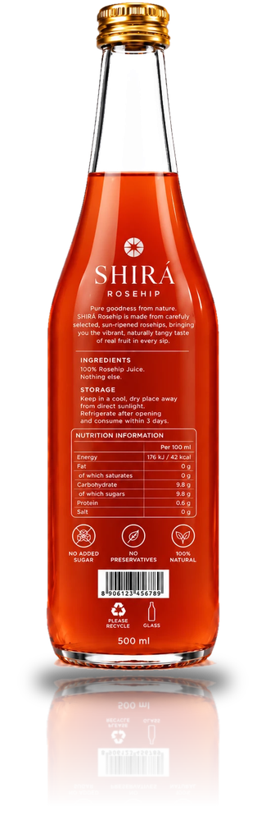
07
BERRIES & HIPS · 07 / 10
Rosehip
Vibrant, naturally tangy taste of real rosehips.
PER 100 ML
42
9.8 g
0.6 g
kcal
sugars
protein
Energy 176 kJ · Fat 0 g · Carbohydrate 9.8 g · Salt 0 g
Notes:
Rosehip: Vibrant, naturally tangy taste of real rosehips. Per 100 ml: 42 kcal (176 kJ), 9.8 g sugars, 0.6 g protein. Source: bottle label.

Slide 13

III
FLAVOUR FAMILY
Garden & Exotic
Unique, smooth and naturally rich.
Feijoa · Pumpkin · Tomato
Notes:
Section: Garden & Exotic. Unique, smooth and naturally rich.

Slide 14

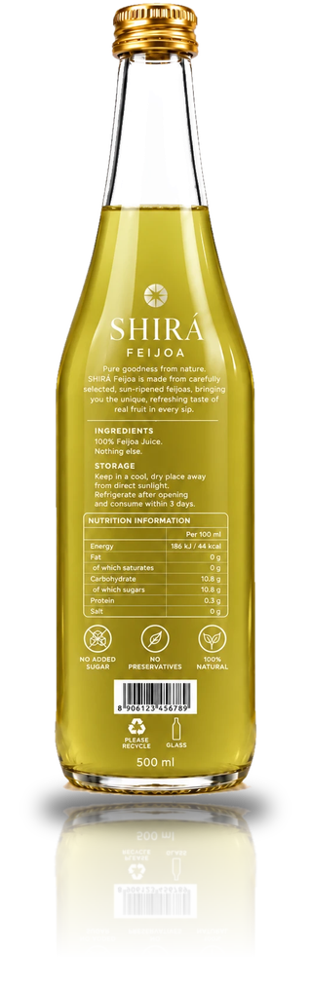
08
GARDEN & EXOTIC · 08 / 10
Feijoa
The unique, refreshing taste of real feijoa in every sip.
PER 100 ML
44
10.8 g
0.3 g
kcal
sugars
protein
Energy 186 kJ · Fat 0 g · Carbohydrate 10.8 g · Salt 0 g
Notes:
Feijoa: The unique, refreshing taste of real feijoa in every sip. Per 100 ml: 44 kcal (186 kJ), 10.8 g sugars, 0.3 g protein. Source: bottle label.

Slide 15

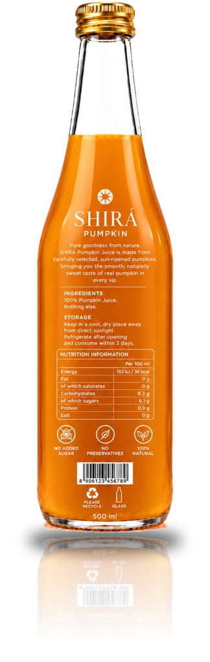
09
GARDEN & EXOTIC · 09 / 10
Pumpkin
Smooth, naturally sweet taste of real pumpkin in every sip.
PER 100 ML
36
6.1 g
0.9 g
kcal
sugars
protein
Energy 153 kJ · Fat 0 g · Carbohydrate 8.3 g · Salt 0 g
Notes:
Pumpkin: Smooth, naturally sweet taste of real pumpkin in every sip. Per 100 ml: 36 kcal (153 kJ), 6.1 g sugars, 0.9 g protein. Source: bottle label.

Slide 16

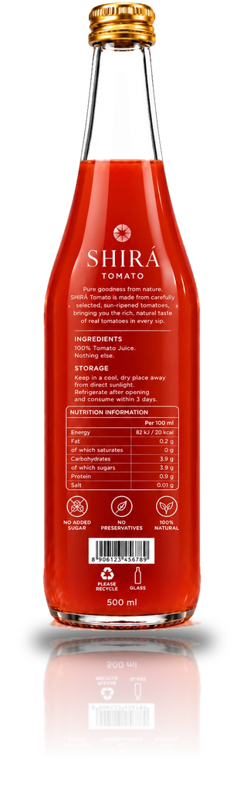
10
GARDEN & EXOTIC · 10 / 10
Tomato
Rich, natural taste of real sun-ripened tomatoes.
PER 100 ML
20
3.9 g
0.9 g
kcal
sugars
protein
Energy 82 kJ · Fat 0.2 g · Carbohydrate 3.9 g · Salt 0.01 g
Notes:
Tomato: Rich, natural taste of real sun-ripened tomatoes. Per 100 ml: 20 kcal (82 kJ), 3.9 g sugars, 0.9 g protein. Source: bottle label.

Slide 17
NUTRITION
Light by nature
Every juice stays between 36 and 45 kcal per 100 ml. Tomato is the lightest at 20 kcal.
Values from product labels. Red Currant: nutrition data to be confirmed.
Notes:
Per 100 ml values come from the back labels. Fruit juices range from 36 kcal (pumpkin) to 45 kcal (plum); tomato is 20 kcal. Red currant is excluded because its back label was not supplied.

Slide 18
THE BACK LABEL
Everything the shopper needs to know
Brand story
Nutrition table
Short note on the fruit and its taste.
1
Energy, fat, carbohydrate, sugars, protein and salt per 100 ml.
2
Ingredients
3
Claims
100% juice. Nothing else.
No added sugar · No preservatives · 100% natural.
4
Storage
Cool, dry place. Refrigerate after opening, drink within 3 days.
5
Barcode and recycling
6
Retail-ready barcode, recycle mark and glass icon.
Notes:
Anatomy of the back label, shown on Peach. All flavours share the same structure.

Slide 19
SHIRÁ
Pure goodness,
bottled.
Ten flavours. 100% juice. Nothing else.
Notes:
Closing slide. Add contact details here if needed.

