Slide 1
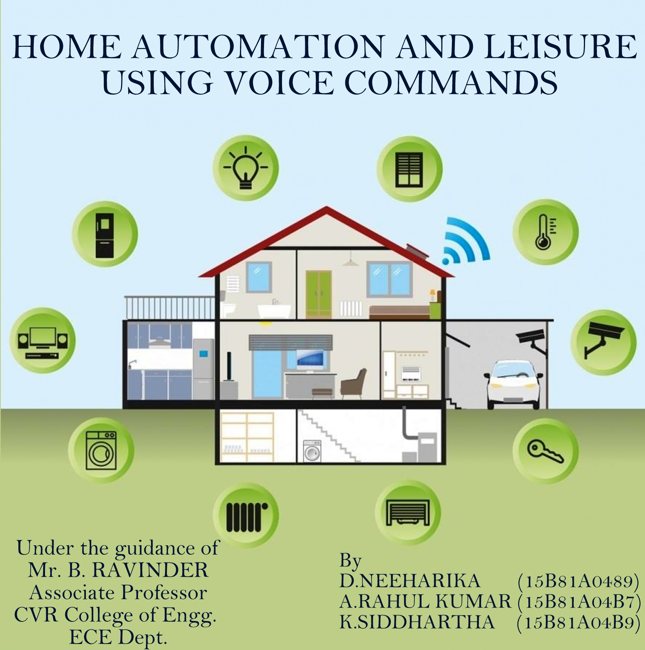

Slide 2
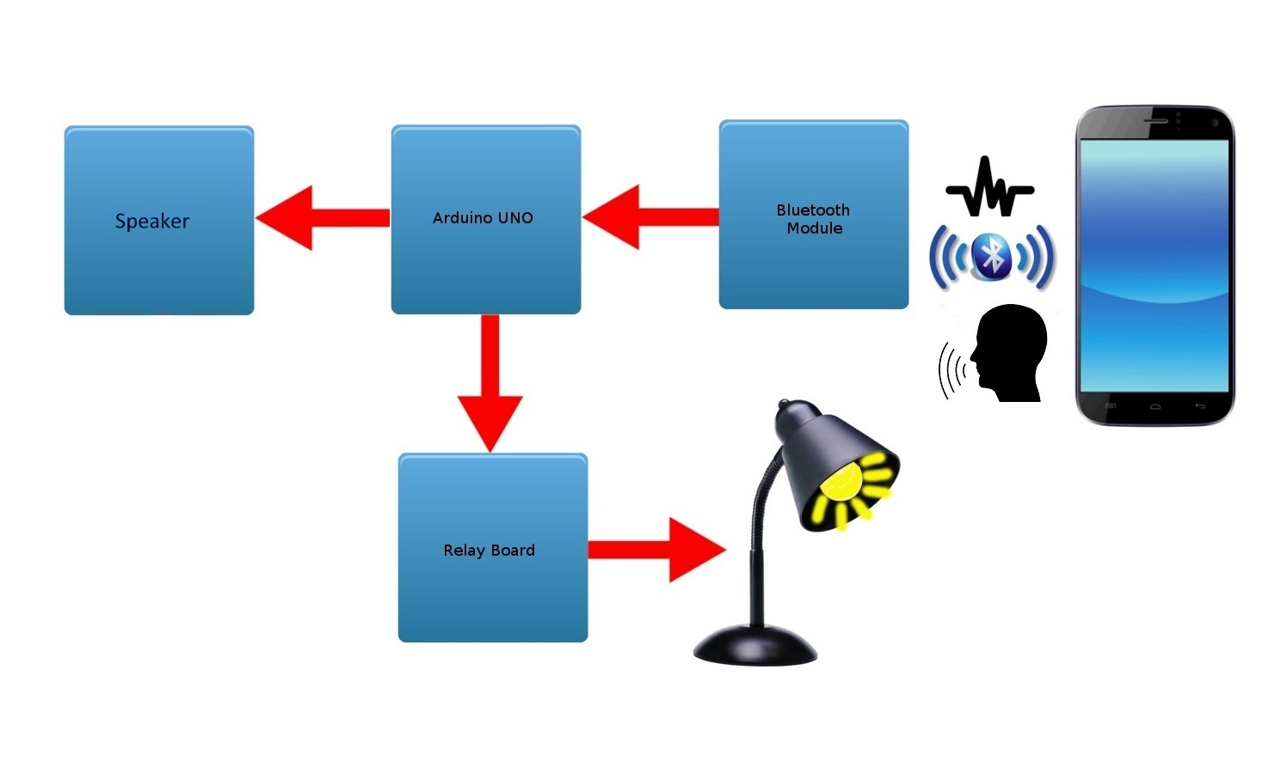
BLOCK DIAGRAM

Slide 3
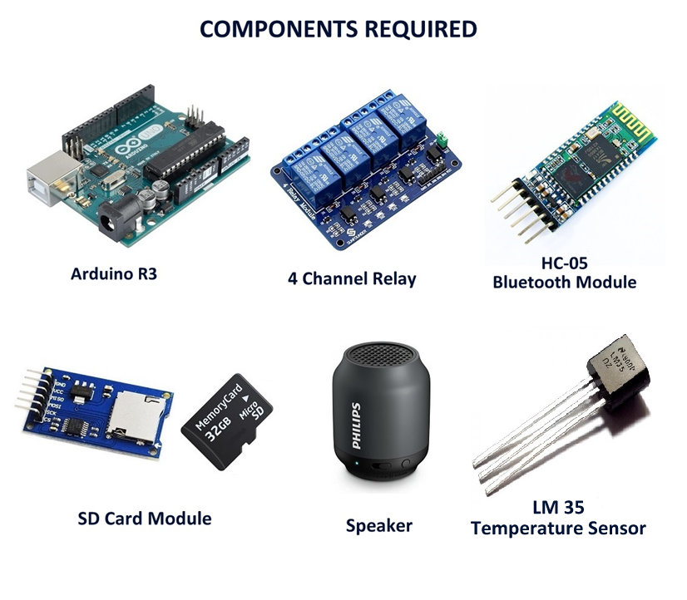

Slide 4
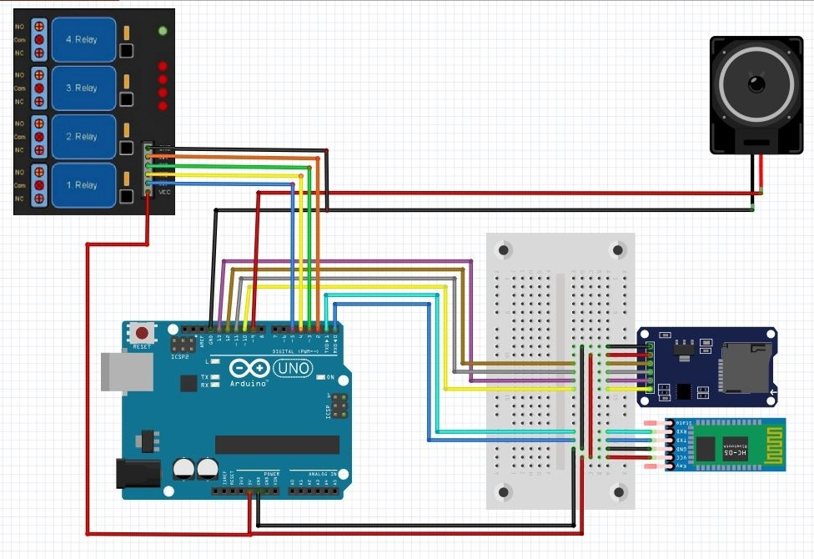
Circuit Diagram

Slide 5
WHY HOME AUTOMATION ?
Flexibility
Security
Safety
Efficiency
Simple
Interactive

Slide 6
Application
The inefficiency of operation of conventional wall switches can be overwhelmed using this smart home automation systems(without using conventional switching methods).
The loss of power can be reduced and manpower required for home automation is negligible when compared to conventional methods.
This kind of system are more useful to physically handicapped and old aged people for whom its difficult to get along without any assistance. Hence, making them more confident and independent.
This technology is not only restricted to houses but also we can use this in places where there is a risk to human life like industries and mining.

Slide 7
Advantages
Provides safety from electrical short circuits while using conventional wall switches to operate loads.
Saves a lot of time and enables us to operate from anywhere inside the house .
No need of separate remote or switch board for controlling various electrical and electronic appliances.
This technology is especially useful in home environment, where there exist hardly any infrastructure to interconnect appliances.
Easy to use and more interactive interface when compared to previous systems.

Slide 8

Software Used
Arduino (IDE) :
The open-source Arduino Software (IDE) makes it easy to write code and upload it board. It runs on Windows, Mac OS and Linux. The environment is written in Java and based on processing and other open-source software.
A program for Arduino is written in wiring language, which is similar to embedded C. It also has features like serial monitor and serial plotter which is useful in testing the code.
This software is preloaded with various libraries which can be used in interfacing various components, sensors and modules.

Slide 9
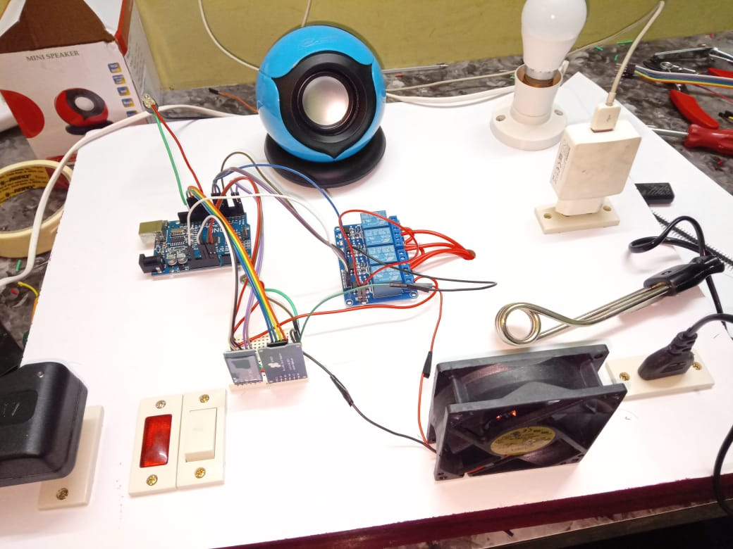
RESULT
Here, is the complete home automation system with light, fan, charger and heater which can be controlled through voice commands and acknowledgement is given through speaker.

Slide 10
CONCLUSION AND FUTURE SCOPE
In this project we have successfully implemented voice controlled home automation system controlling relays using Arduino with Bluetooth module HC-05. This project can be used for controlling ‘n’ number of input controls (i.e) by extending number of relays.
Our implemented module is more reliable and flexible in order to control any loads and the coverage area for wireless control is 10-20 meters. Hence this project can be useful for a real time voice controlled home automation. Thus Arduino based voice controlled home appliances proves to be a better remote controlled operation on home appliances using Bluetooth module HC-05.
This project can be extended for many automation applications such as industrial automation, automotive, military, healthcare, transportation and so on. Further the coverage area can also be increased by the use of GSM modules and Wi-Fi Modules.

Slide 11
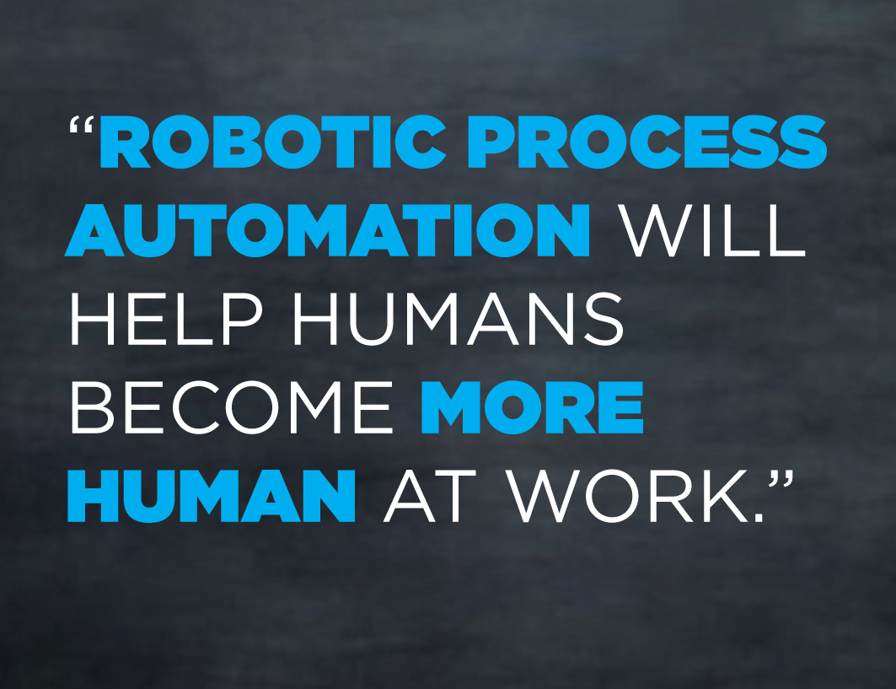

Slide 12
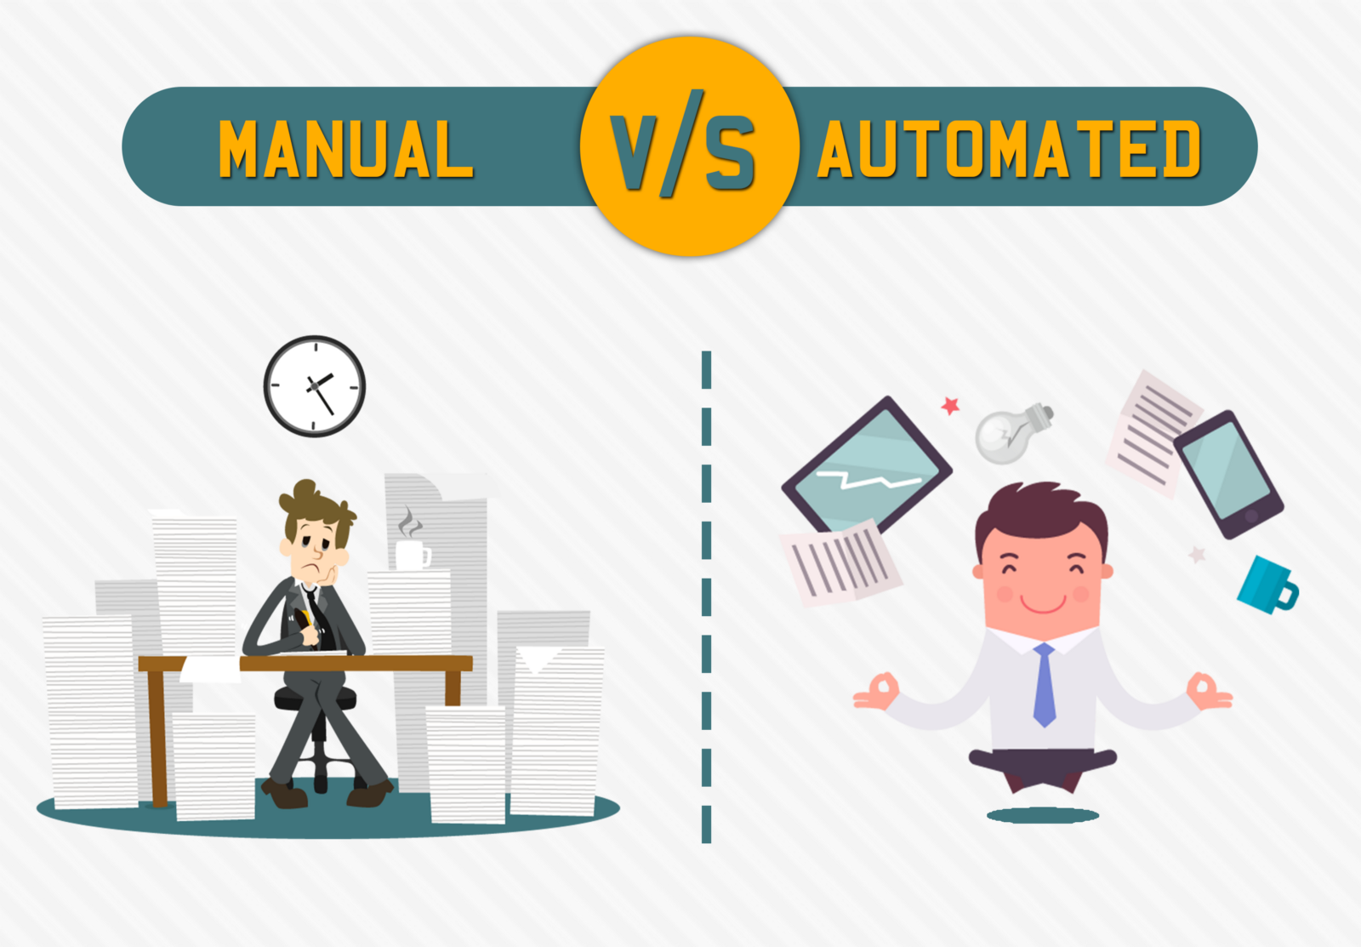

Slide 13


