Slide 1
Differential Gene Expression (DGE) in R
Kim Siegmund
kims@usc.edu

Slide 2
Learning Objectives
Describe
Describe data structures in R used for differential gene expression (DGE) analysis of bulk and of single-cell RNAseq
Apply
Apply a computational pipeline for DGE analysis
Apply
Apply dimension reduction, cluster analysis, 2-D visualization methods, and marker selection to single-cell RNAseq data

Slide 3



Open-source environment and tools for statistical computing and graphics
Notes:
Here are the tools we will use to do this:
R is the open-source environment and statistical language
Bioconductor is a project focused on software development for high-throughput genomic data. This is the type of data I will be using in this class
RStudio provides more tools for developing and sharing R software.
Together, these tools make it easy to share code and create reproducible reports. Because of this, they are widely-used in research.

Slide 4


Software version control
Open-source Software Development Platform
GitHub
Notes:
When developing code, we often have more than version saved on our computer. This is because we have our “clean version” of our finished product, but we may also want to go back and make a change and further develop the code.
We would like is a system to organize our files that allows us to share a clean version, but also still work on the code while maintaining the ability to merge any changes back into our clean version.
Git and GitHub allow us to do this.
GitHub will store your files in the cloud where they can be openly shared.
Anyone can make a copy of you code “clone it” to their local machine and use it. The code I will be using for this class will be available via GitHub for you to ‘clone’ and run on your local machine
Git is the engine that manages the files and copies. With this tool you can
freeze a copy of the code for general distribution, while continuing to work on a developmental version of the same code, and
have the ability to fold any changes you make back into the original code. All of this can be done seamlessly through Git.
Git will be the interface between Rstudio (your computer work environment) and GitHub (stores the code for class).
These tools are commonly used by software developers.

Slide 5
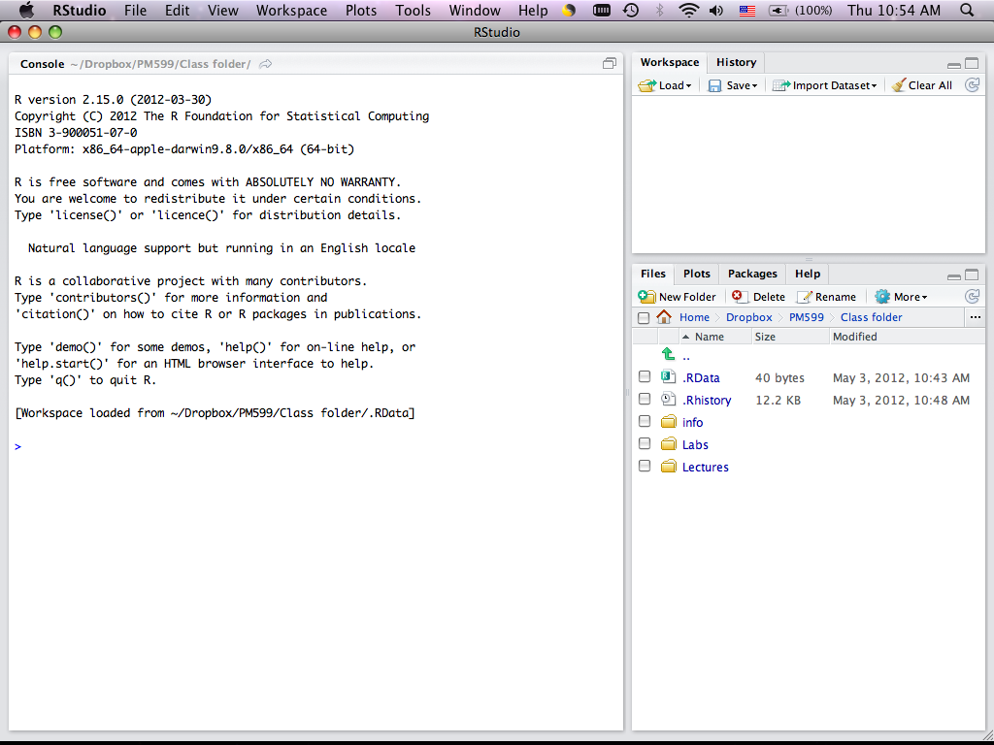
RStudio
Workspace/History
Console Window
(where code executes)
Files/Plots/
Packages/Help

Slide 6
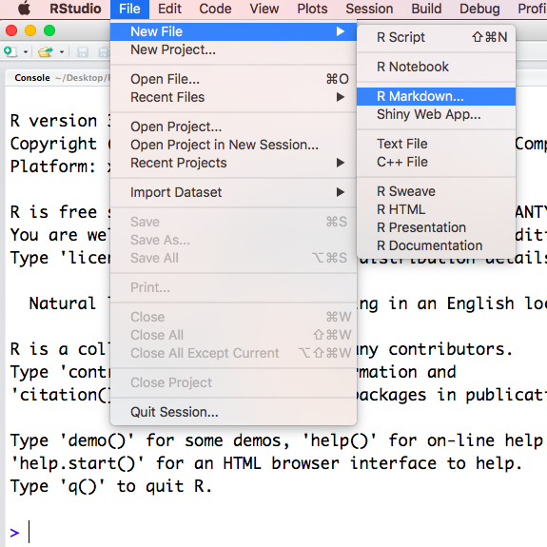
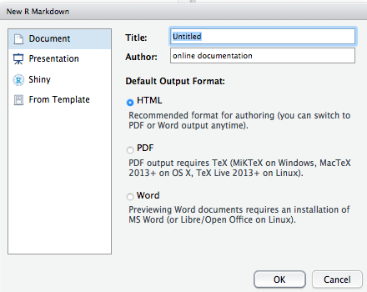
Using R Markdown

Slide 7
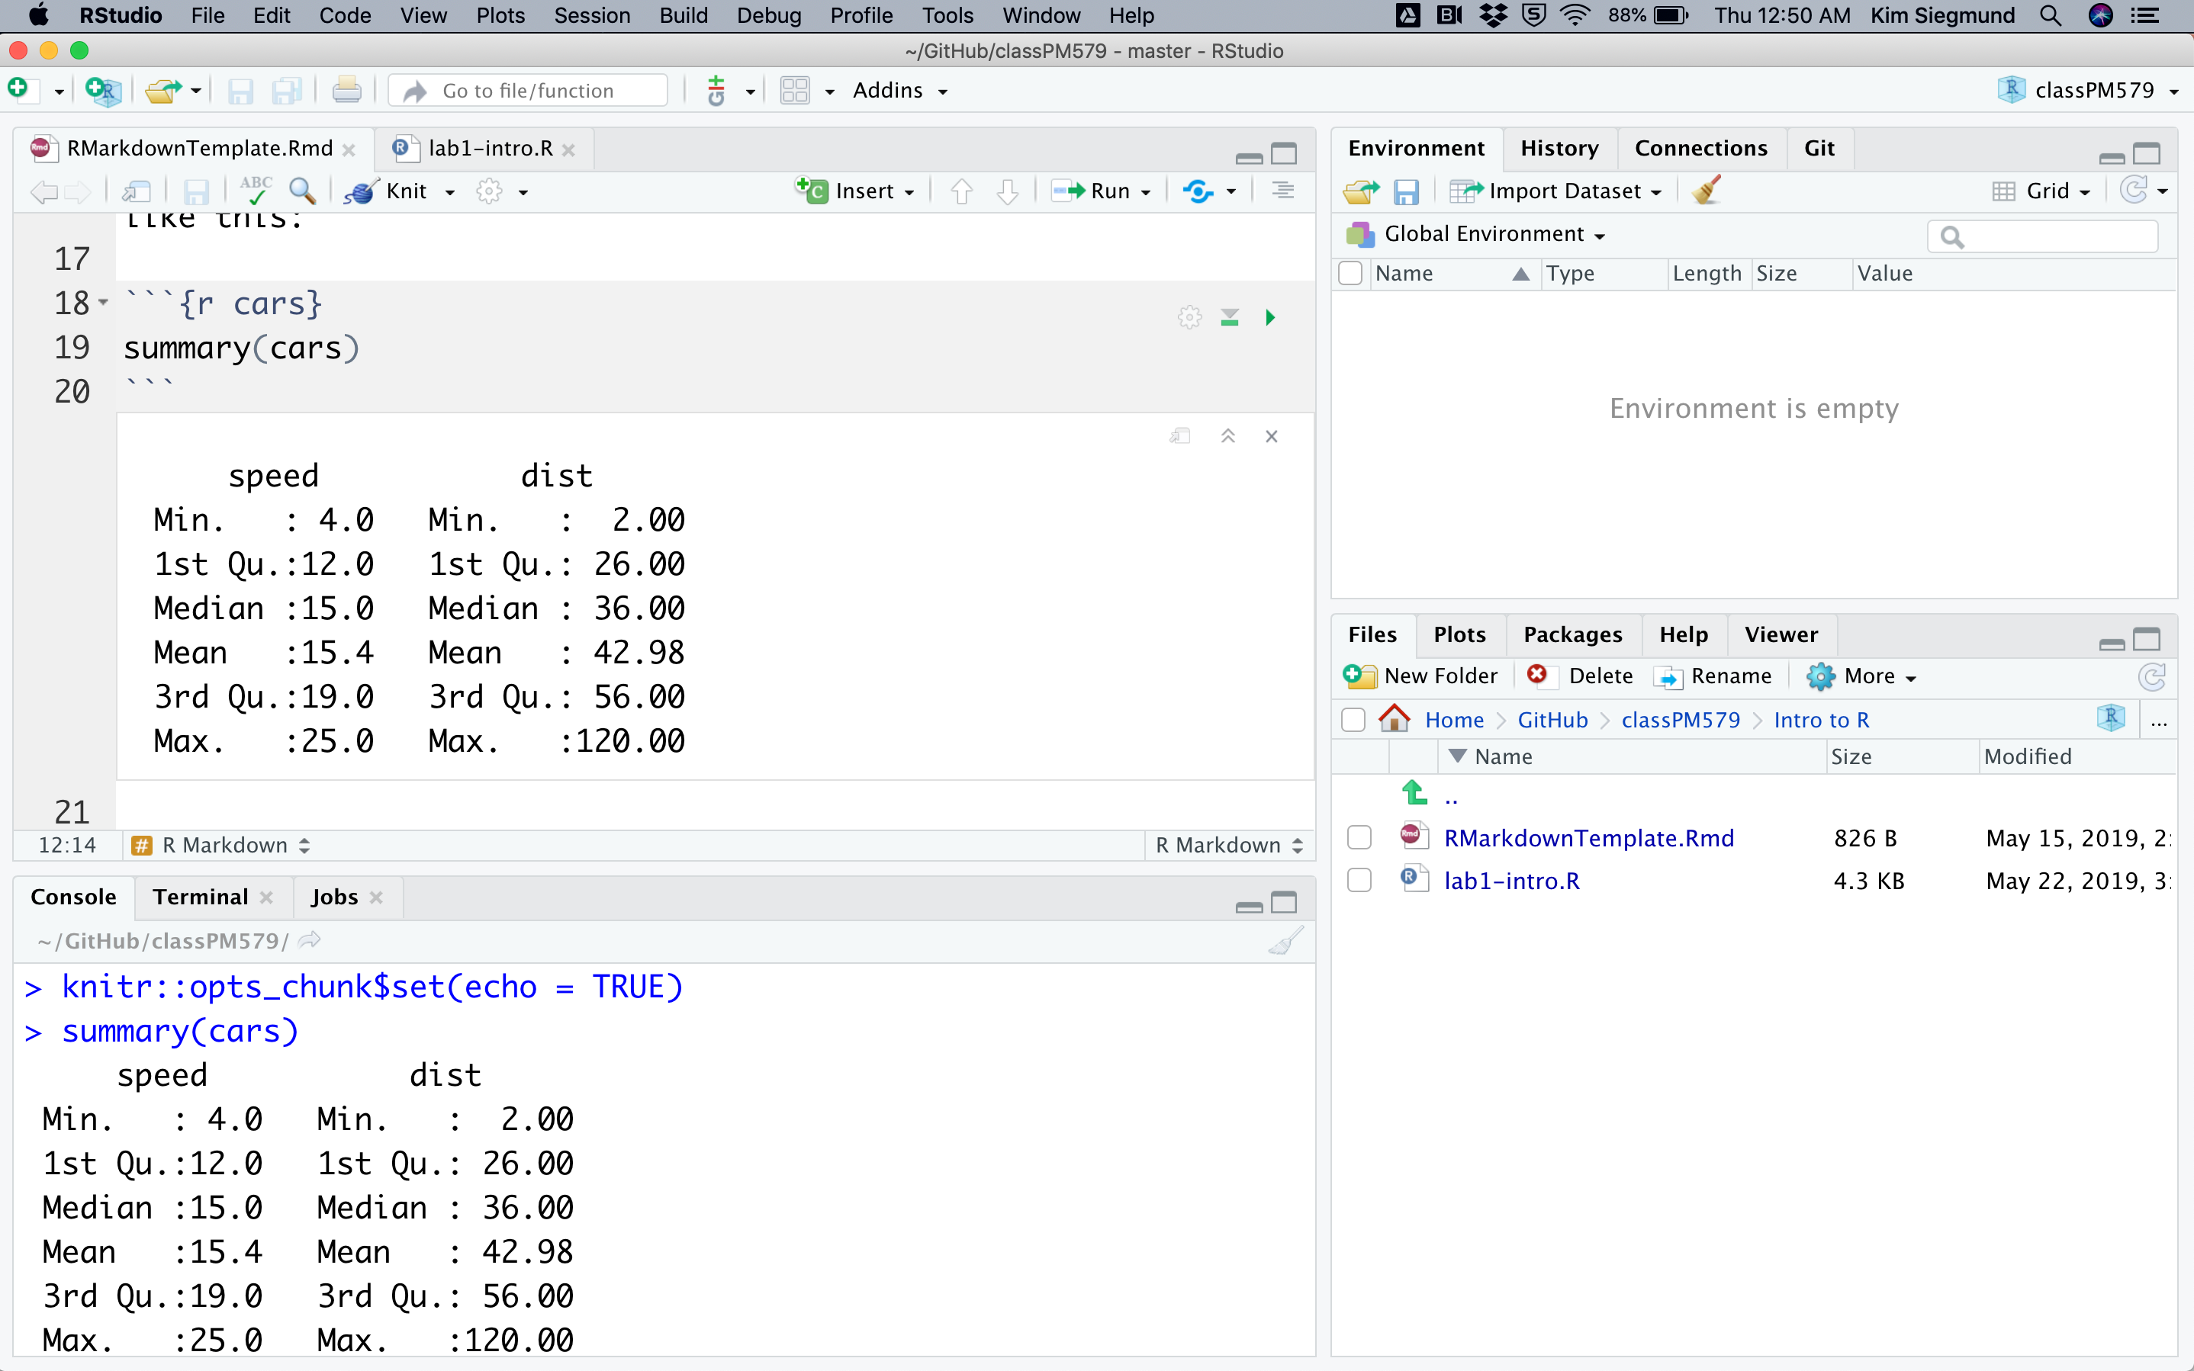
Executing R Markdown
Run all chunks above
Run
current chunk

Slide 8
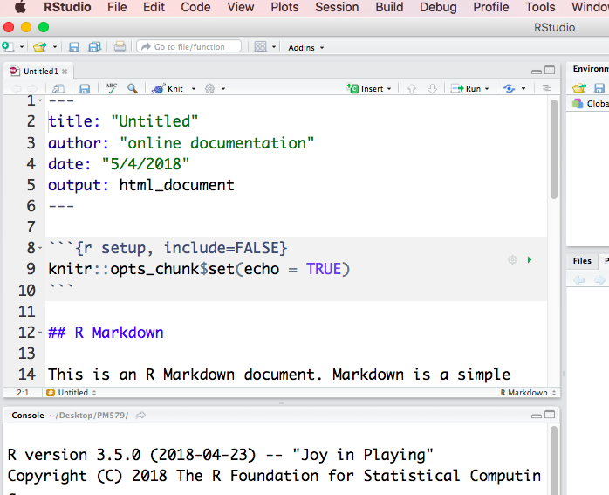
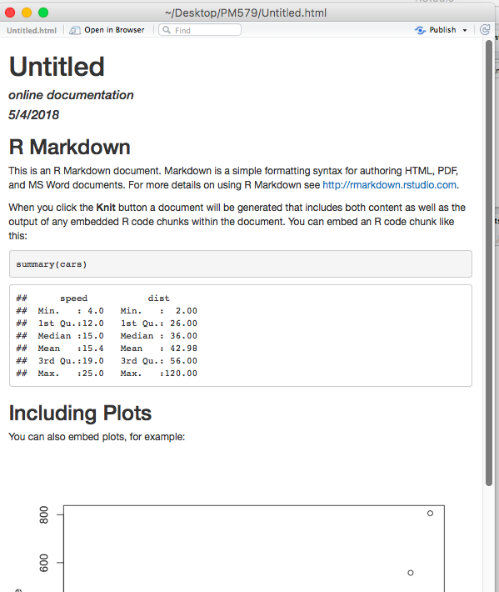
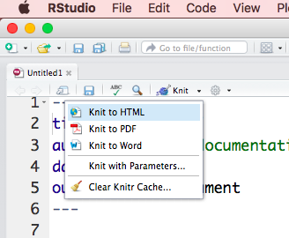
‘Knit’ R Markdown

Slide 9
Data Matrix
“Large p, small n” (p>>n)
 | n Samples
 | 1 | 2 | 3 | …
Feature 1 | Y11 | Y12 | Y13 | …
Feature 2 | Y21 | Y22 | Y23 | …
Feature 3 | Y31 | Y32 | Y33 | …
: | : | : | : | …

Slide 10
Database Organization
Sample
Quantities Measured by Counts
Sample
Genomic Features
Genomic Features
DGEList object: x
x$sample
x$counts
x$genes
Notes:
Genomic Feature definitions are under your control.
Examples of Features:
RNA-seq: Genes (from sequence annotation)/transcript/exon

Slide 11
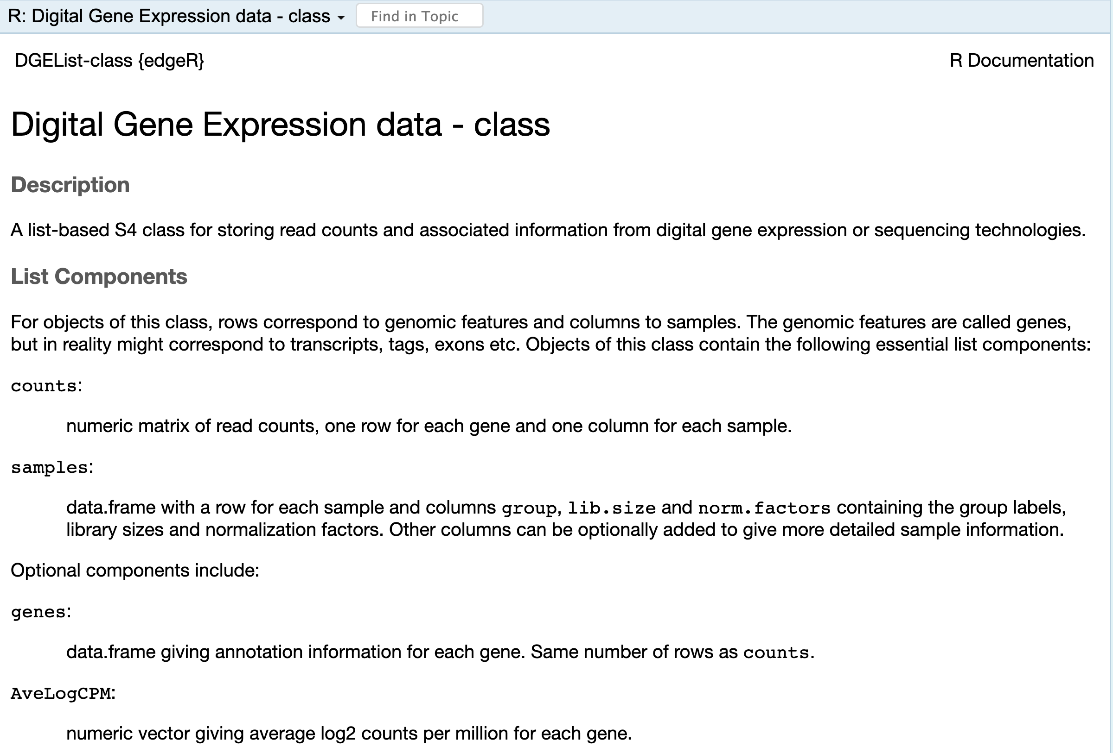
…

Slide 12
Single-Cell Sequence Data
Cell
Quantities Measured by Counts
Sparse matrix: has lots of 0s
class: dgCMatrix
label
Cell
Principal Components
TSNE
UMAP
Cell
Genomic Features
SingleCellExperiment
object: sce
counts(sce)
sce$label
reducedDim(sce, "PCA")
reducedDim(sce, ”TNSE"),…
Notes:
Multiple

Slide 13
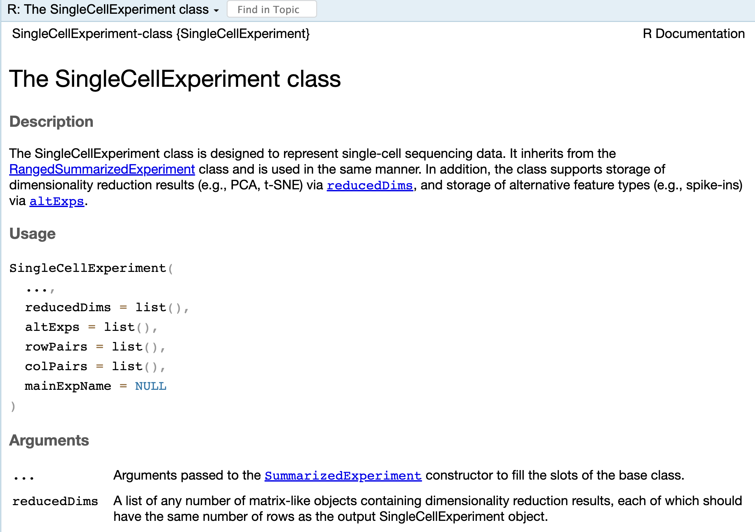

Slide 14
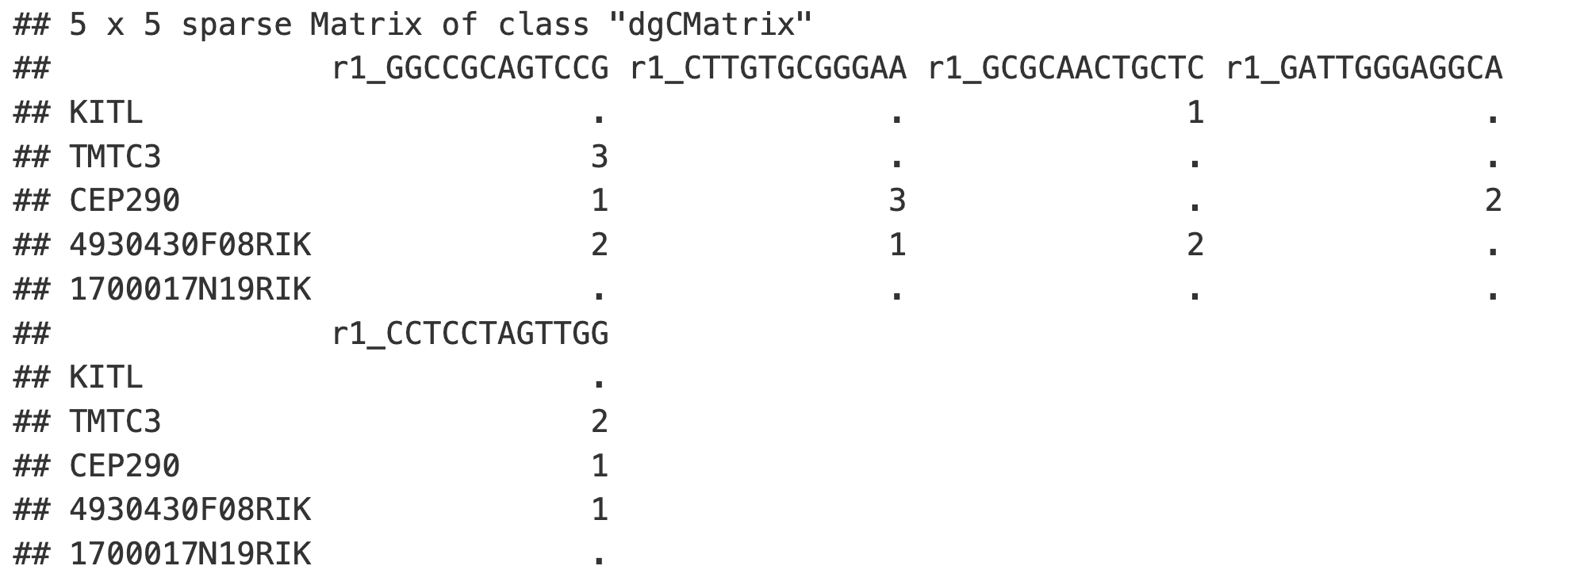
Sparse Matrix of class “dgCMatrix”
Notes:
Multiple

Slide 15
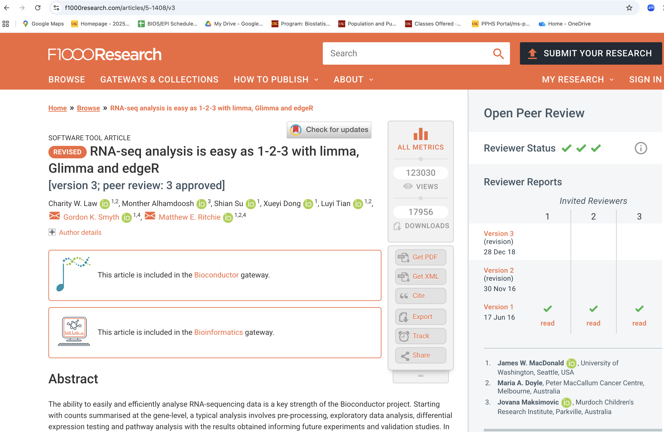
DGE Analysis Pipeline for Bulk RNA-seq

Slide 16
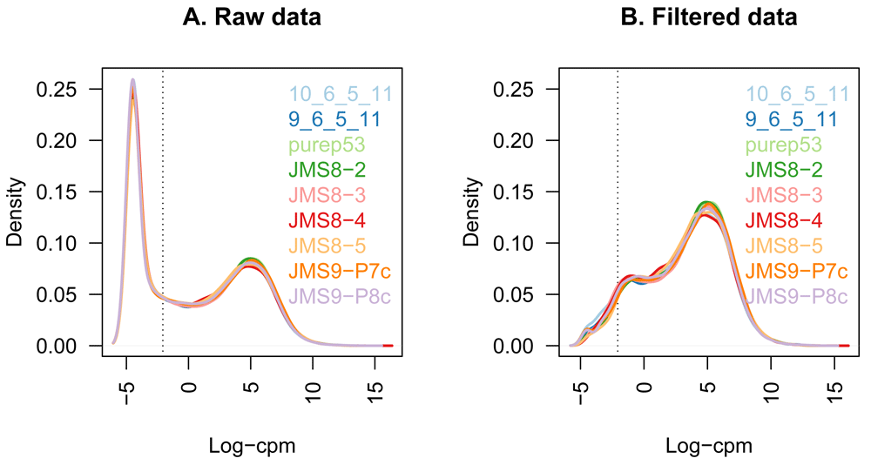

Figure 1.
Law CW, Alhamdoosh M, Su S et al. RNA-seq analysis is easy as 1-2-3 with limma, Glimma and edgeR [version 3]. F1000Research 2018, 5:1408 (doi: 10.12688/f1000research.9005.3)
Notes:
Figure 1.
The density of log-CPM values for raw pre-filtered data (A) and post-filtered data (B) are shown for each sample. Dotted vertical lines mark the log-CPM threshold (equivalent to a CPM value of about 0.2) used in the filtering step.
Law CW, Alhamdoosh M, Su S et al.. RNA-seq analysis is easy as 1-2-3 with limma, Glimma and edgeR [version 3]. F1000Research 2018, 5:1408 (doi: 10.12688/f1000research.9005.3)

Slide 17
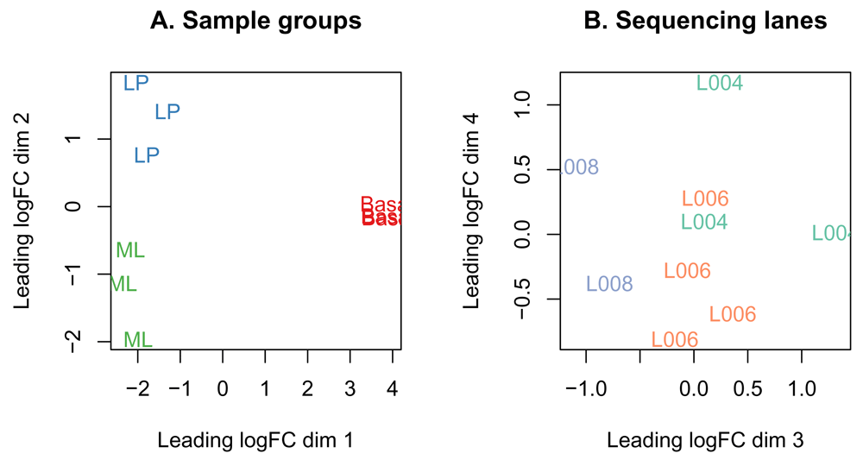
Figure 3.
Law CW, Alhamdoosh M, Su S et al. RNA-seq analysis is easy as 1-2-3 with limma, Glimma and edgeR [version 3]. F1000Research 2018, 5:1408 (doi: 10.12688/f1000research.9005.3)
Notes:
Figure 3.
MDS plots of log-CPM values over dimensions 1 and 2 with samples coloured and labeled by sample groups (A) and over dimensions 3 and 4 with samples coloured and labeled by sequencing lane (B). Distances on the plot correspond to the leading fold-change, which is the average (root-mean-square) log2-fold-change for the 500 genes most divergent between each pair of samples by default.
Law CW, Alhamdoosh M, Su S et al.. RNA-seq analysis is easy as 1-2-3 with limma, Glimma and edgeR [version 3]. F1000Research 2018, 5:1408 (doi: 10.12688/f1000research.9005.3)

Slide 18
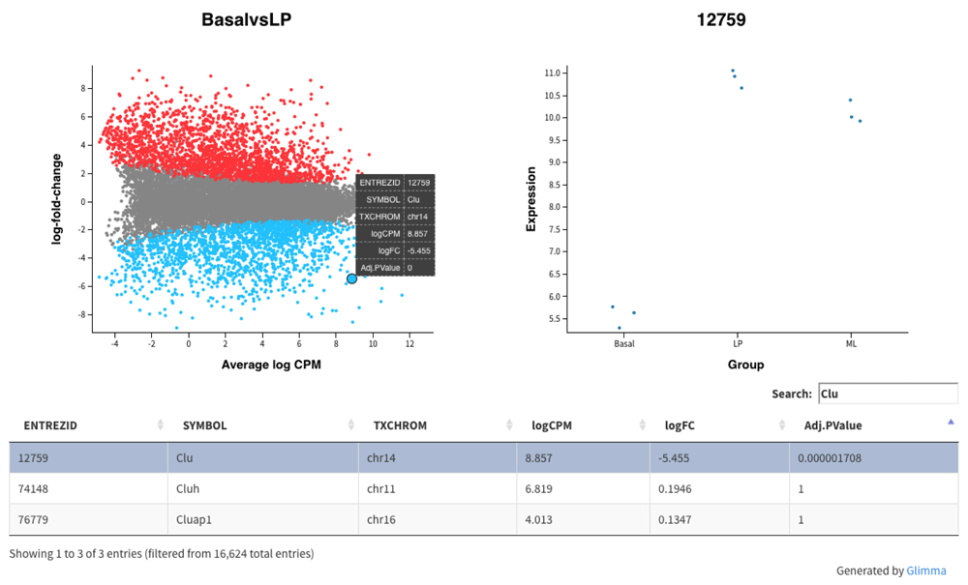
Figure 6.
Law CW, Alhamdoosh M, Su S et al. RNA-seq analysis is easy as 1-2-3 with limma, Glimma and edgeR [version 3]. F1000Research 2018, 5:1408 (doi: 10.12688/f1000research.9005.3)
Notes:
Figure 6.
Interactive mean-difference plot generated using Glimma. Summary data (log-FCs versus log-CPM values) are shown in the left panel which is linked to the individual values per sample for a selected gene in the right panel. A table of results is also displayed below these figures, along with a search bar to allow users to look up a particular gene using the annotation information available, e.g. the Gene symbol identifier Clu.
Law CW, Alhamdoosh M, Su S et al.. RNA-seq analysis is easy as 1-2-3 with limma, Glimma and edgeR [version 3]. F1000Research 2018, 5:1408 (doi: 10.12688/f1000research.9005.3)

Slide 19
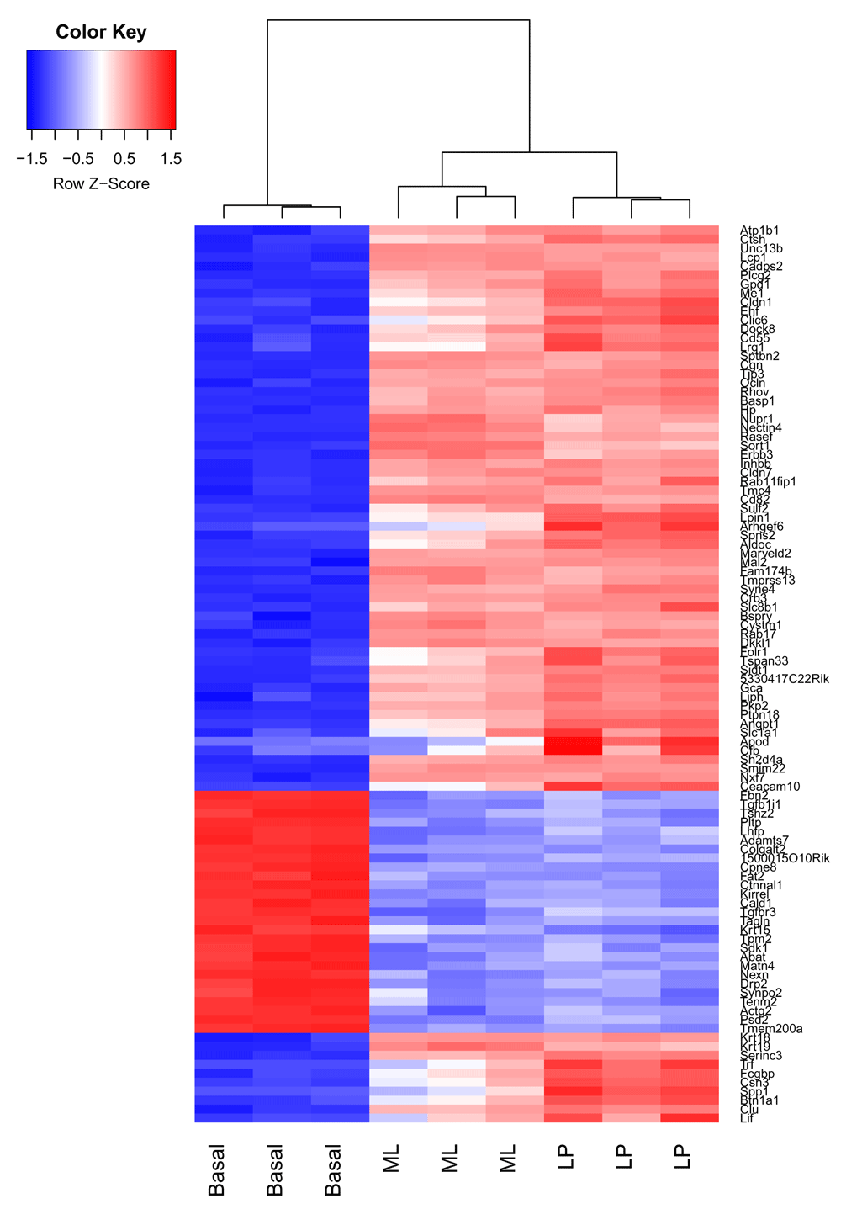
Figure 7.
Law CW, Alhamdoosh M, Su S et al. RNA-seq analysis is easy as 1-2-3 with limma, Glimma and edgeR [version 3]. F1000Research 2018, 5:1408 (doi: 10.12688/f1000research.9005.3)
Notes:
Figure 7.
Heatmap of log-CPM values for top 100 genes DE in basal versus LP. Expression across each gene (or row) have been scaled so that mean expression is zero and standard deviation is one. Samples with relatively high expression of a given gene are marked in red and samples with relatively low expression are marked in blue. Lighter shades and white represent genes with intermediate expression levels. Samples and genes have been reordered by the method of hierarchical clustering. A dendrogram is shown for the sample clustering.
Law CW, Alhamdoosh M, Su S et al.. RNA-seq analysis is easy as 1-2-3 with limma, Glimma and edgeR [version 3]. F1000Research 2018, 5:1408 (doi: 10.12688/f1000research.9005.3)

Slide 20

Computational Analysis Pipeline for scRNAseq

Slide 21
Lab code
http://github.com/ksiegmund/bioc_fgds
Need to install:
R
Rstudio: https://posit.co/downloads/
Bioconductor: https://bioconductor.org/install/

Slide 22
Bonus material
Ask Gemini for help
Check graphic color scales for color-blind friendliness
Creating a single figure from multiple ggplot figures

Slide 23
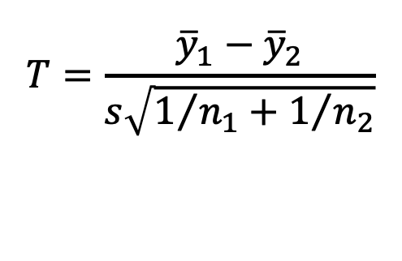
Statistics Lessons
edgeR and DESeq2 (competitor for edgeR) have high false-positive rates in large samples
Valid, and invalid filtering
  Removing lowly expressed genes
  Filtering results in volcano plots
Double-dipping: clustering sc data then testing dge
  PM579 Statistical Analysis of High-dimensional data (Summer 2026)
$$T=\frac{{\overline{y}}_{1}−{\overline{y}}_{2}}{s\sqrt{1/{n_{1}}+1/{n_{2}}}}$$

